Slide 1
THE WIND IN HER HAIR
Part 8: No secrets
Reetta Pänkäläinen

Slide 2
No secrets
I don’t see Tom anywhere so I keep walking towards the cabin. The valley seems as empty as always. No grass or trees, just a few withered bushes. I hear the dry leaves rustling in the gentle wind. There are no other sounds. No animals, no people. I think about all the stories there must be in this world and wonder why the old woman would choose to live in this one.

Slide 3
No secrets
I spot Tom sitting on a rock. He’s looking down at his feet and doesn’t see me coming at first.
- Tom! I yell and run to him. He smiles and hugs me. Then he looks at me and his eyes turn serious.
- Riley, what’s wrong?

Slide 4
No secrets
I’m not sure what to tell him. I’m still getting used to the idea of this world existing. Who am I to say what the poem means? At this point I don’t trust my own thoughts. I decide not to tell him anything yet. I need to find out more first.
- Why would the old woman want to live here? I ask hesitantly.
- What do you mean?
- Wouldn’t you rather be in Green Hill with the whales?

Slide 5
No secrets
- I always thought she liked to be alone, Tom answers.
- And how long has she been here?
- I don’t know, a few decades at least.
- Could it be centuries?
- What? No. She’s not that old.
- And are you sure she is a dweller?
- Yes, of course. I always felt like the rest of us were her children.

Slide 6
No secrets
- What is the story of Red Valley? I mean, how did you first get here, through a painting?
- No, another dweller took me here. After that I learned to picture the valley and come back. Why are you asking all these questions? I don’t like quizzes like this.
I sigh and realize I can’t keep any secrets in this situation.

Slide 7
No secrets
- I couldn’t get back to Green Hill, I even tried the song again. Then I remembered a poem about a valley with red sand.
- You found the story of Red Valley?
- No, Tom. I found her story. She’s a part of it. I don’t think she’s a dweller. She couldn’t leave even if she wanted to.
- But everyone knows she’s a dweller. All the men and women I’ve talked to in this world would say the same.

Slide 8
No secrets
- Has she ever said it herself? That she’s a dweller, I ask.
I can see him trying to remember. He rubs his temples and stays quiet for a long time.
- Tell me about the poem, he says.

Slide 9
No secrets
We sit down on a rock and I tell him everything I remember. He doesn’t say anything, just listens. He’s sitting just a few inches away from me but suddenly it feels like we are miles apart.
- Tom, are you okay?
- I can’t believe it. So this world was always meant to end?
- I don’t know any more than you do, Tom. Should we go back to the old lady and ask her for help? She said she would help us.

Slide 10
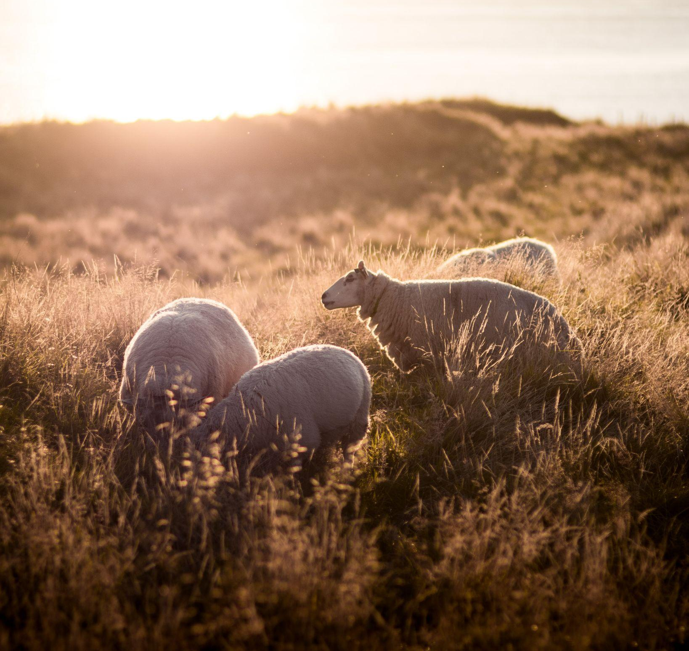
No secrets
- She said it herself, she doesn’t have a solution. No, I think we have to find someone else.
- Do you have someone in mind?
- Maybe. How do you feel about sheep?
- Sheep? It’s a story about sheep?
- I think I’ll just show you.

Slide 11
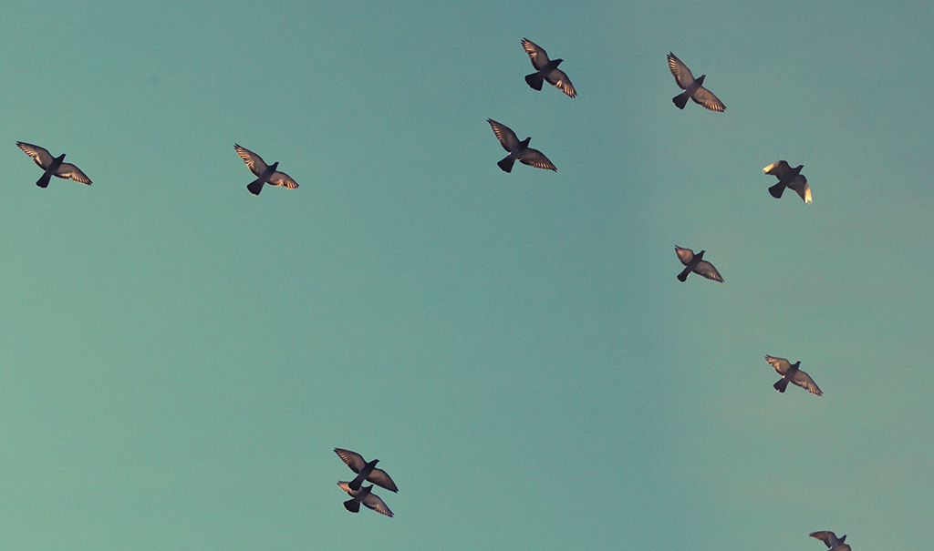
To be continued.

Slide 12
CREDITS
Special thanks to all the people who made and released these awesome resources for free:
Presentation template by SlidesCarnival
Photographs by Unsplash

Slide 13
Reetta Pänkäläinen 2023

