Slide 1
THE WIND IN HER HAIR
Part 7: The crow
Reetta Pänkäläinen

Slide 2
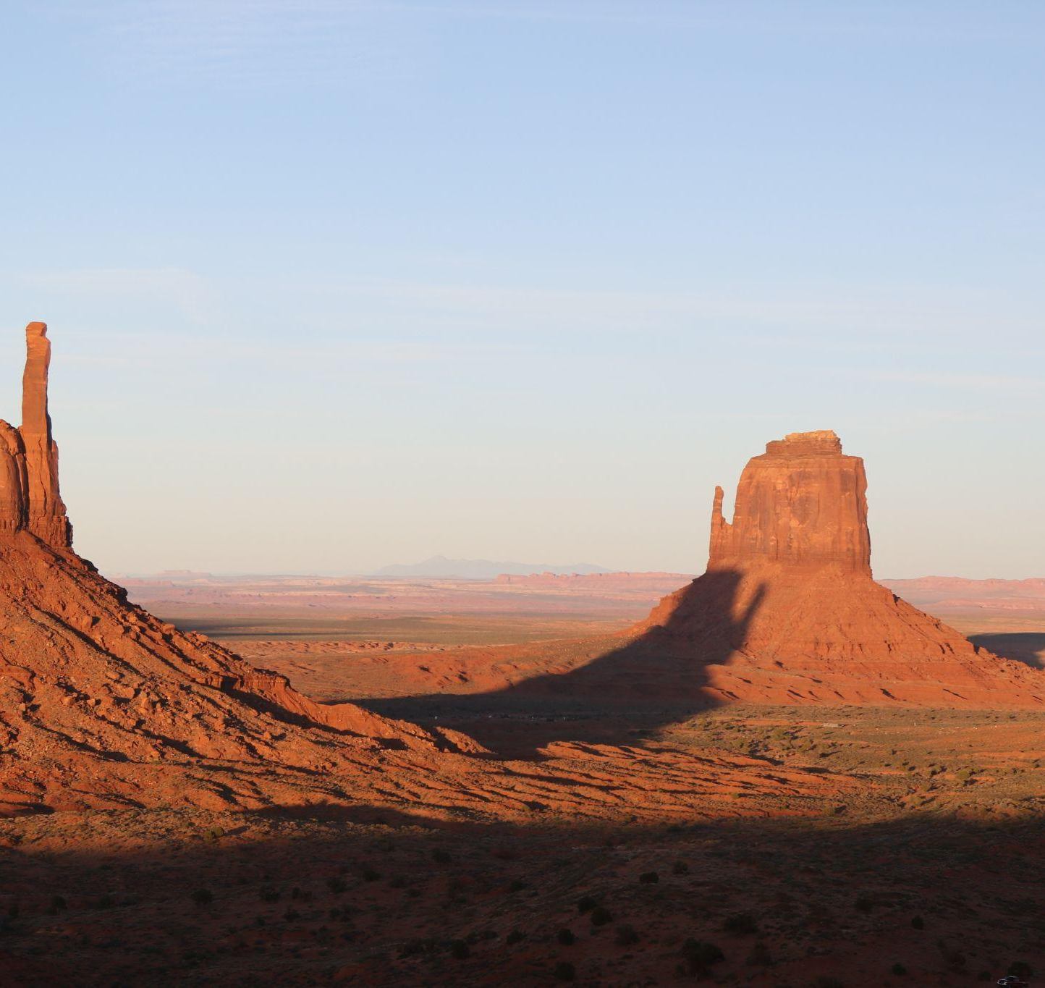
The crow
We say goodbye to the old woman and walk out the door.
- Do you have a plan? I ask.
- The plan is to find as many dwellers as possible and see what happens next, Tom answers.
- Where do you want to go?

Slide 3
The crow
Before Tom has time to answer, I can feel the wind again. A strand of hair brushes my face.
- I’m sorry, Tom. I can’t help it. I have to go.
- I know, it’s okay. If Green Hill is gone, you’ll find me here. You’ll find a way.
The wind gets stronger and stronger and I’m gone again.

Slide 4
The crow
I find myself sitting on my bed and I feel helpless. I need to get back but I have no idea how. It’s Saturday and I’m the only one home. I listen to the song that got me to Green Hill last time but nothing happens. Could Green Hill be gone already? I sit on the floor and look at the books on my shelf. Then I remember the old woman braiding her hair. I remember seeing it somewhere before.

Slide 5
The crow
I go to the bookshelf and run my finger through the backs of the books. I stop at a thin, blue book. It’s a book of poetry that I got from my grandmother when I was seven years old.

Slide 6
The crow
I pick up the book and start leafing through the pages. There are poems about birds and other animals. The poems are quite difficult to understand and I don’t even know all the words. Then I find it - a poem about an old woman with long, dark hair. She braids her hair while singing an old song. The song is about a valley made of red sand. I sit down on the bed and read the poem again and again.

Slide 7
The crow
This is it! This is the story of the old woman in Red Valley, the ticket to her cabin. I keep reading. Nothing happens at first and I get restless. I close the book and I close my eyes. I calm myself down before I find the poem again. I start reading and picture the valley in my head the same way I did as a child. Then I find a verse that makes my skin crawl.

Slide 8
The crow
The sun is high in the sky
The stars await for the night
The sand is as red as my blood
The valley, it yearns for a flood
She ties her dark hair with a string
And waits for the cape crow to sing

Slide 9
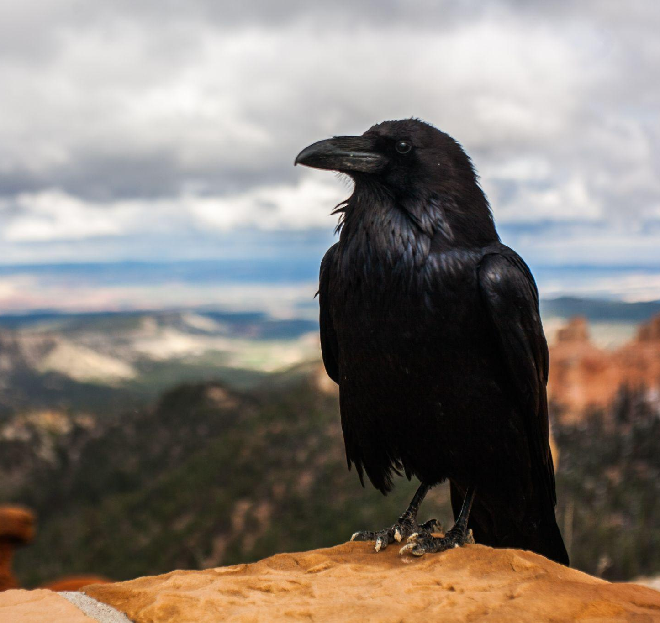
The crow
For what has a dawn has a dusk
When all that is left is a husk
And as the crow lets out a cry
She’ll know that the end
has come nigh.

Slide 10
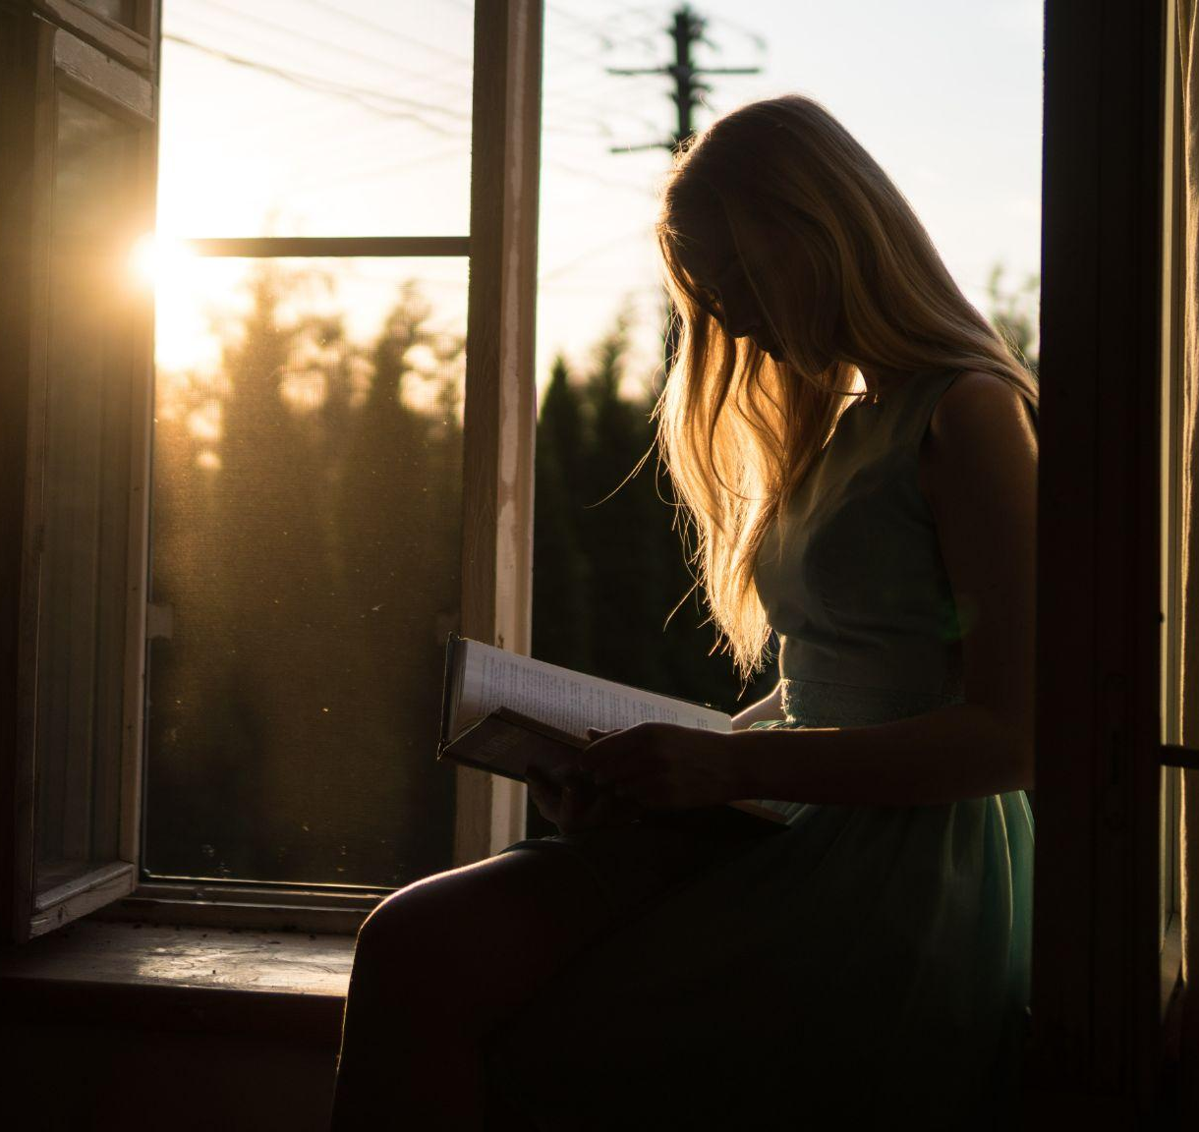
The crow
I’m back in Red Valley. I should be happy but the poem has left me feeling anxious. I start walking with only one question in my mind. A question that I have had since I finished the poem. Is this world going to end no matter what we do?

Slide 11
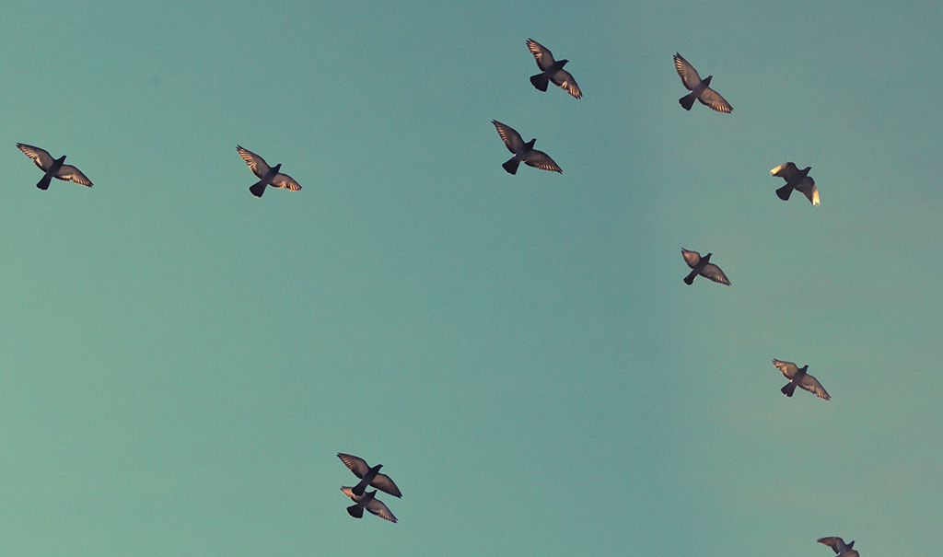
To be continued.

Slide 12
CREDITS
Special thanks to all the people who made and released these awesome resources for free:
Presentation template by SlidesCarnival
Photographs by Unsplash

Slide 13
Reetta Pänkäläinen 2023

