Slide 1
THE WIND IN HER HAIR
Part 4: The whales
Reetta Pänkäläinen

Slide 2
The whales
“Come back tomorrow.”
I have no idea how to go back the next day. I try to imagine the hill and the flock of giant birds but they escape my mind. Then I remember Tom’s words about tickets. I need a ticket to that world. The right song.

Slide 3
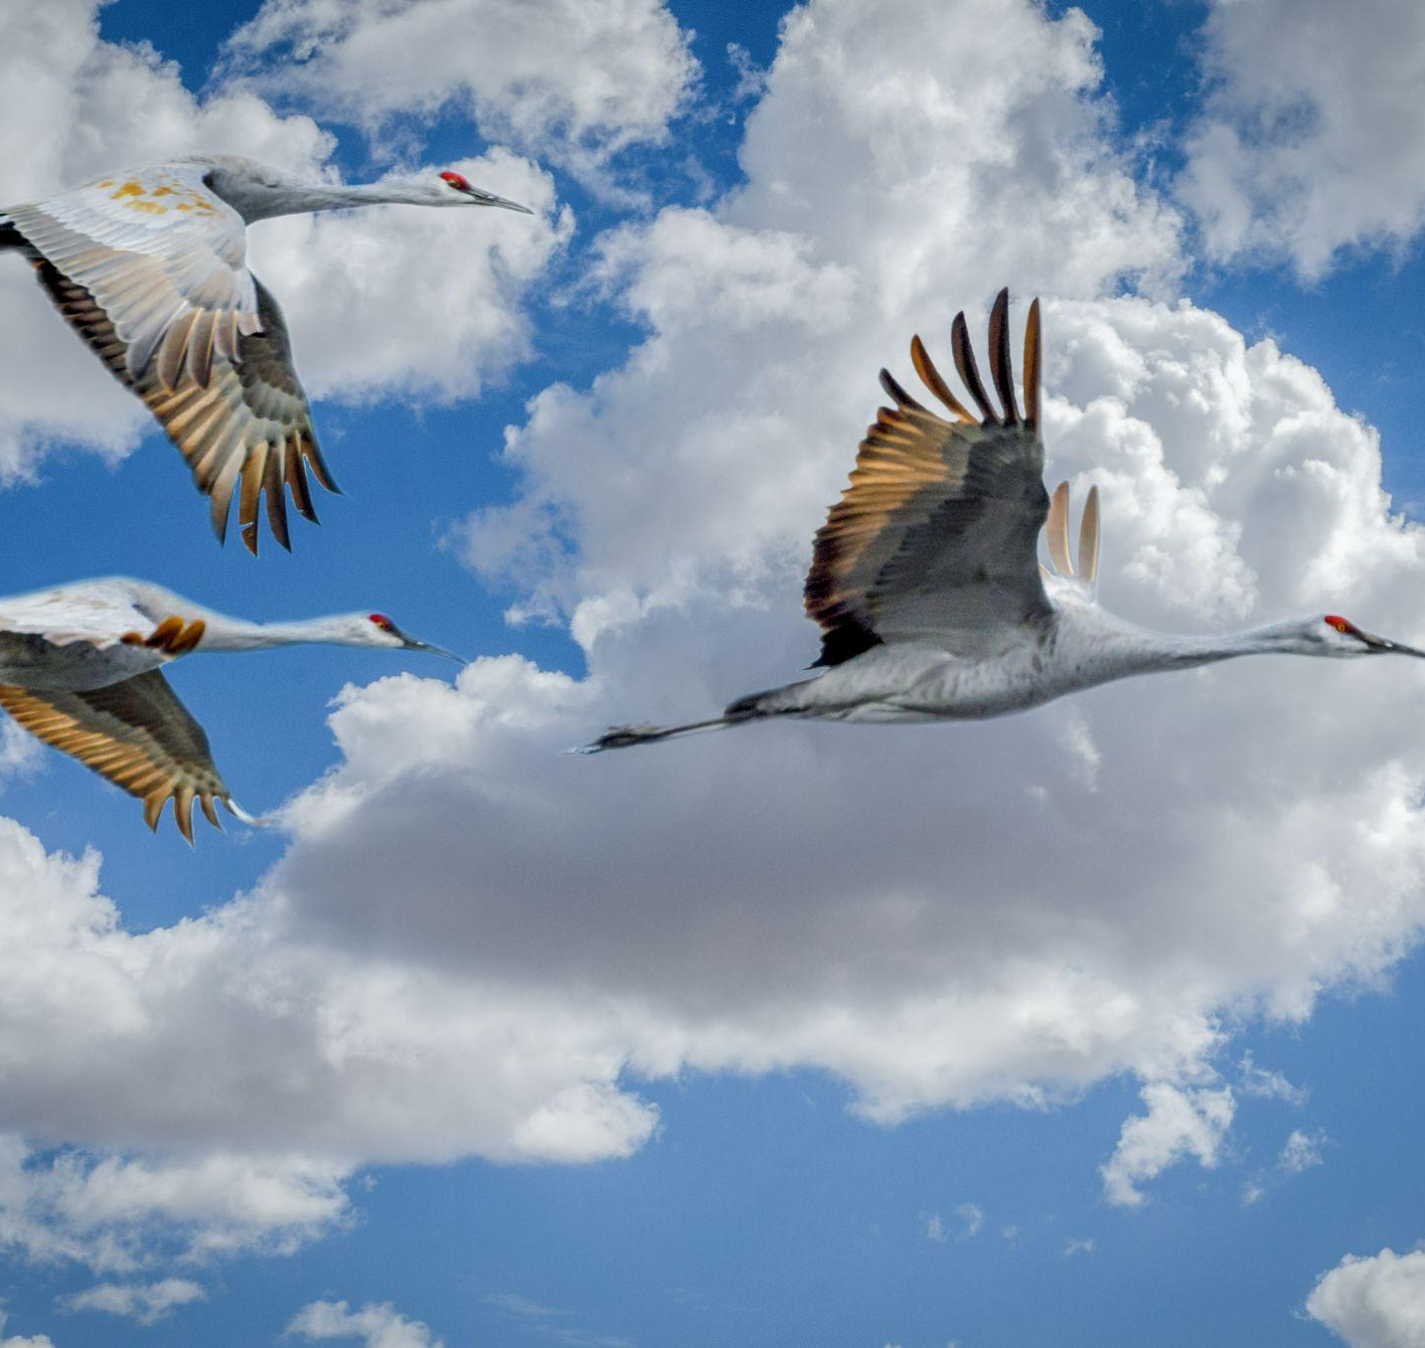
The whales
I picture the birds again. Little by little, I can hear a melody getting stronger in my head. I recognise the song and play it on my phone.
- I will never get tired of this view.
It’s Tom. Before I know it, I’m back on the hill.

Slide 4
The whales
- I knew you would know what to do. Come on, I’ll show you around. Trust me, you’ll love it, Tom says and jumps down from a big rock.
- Won’t I have to leave soon again?
- No, you won’t. Each time you’ll be able to stay a bit longer. You’ll see. Shall we go?

Slide 5
The whales
I look around and see the birds again. I can hear people talking, exactly like the first time.
- That’s weird, I say and look around.
- What is? Tom asks.
- It’s like I never left. Everything is exactly the same.
- Oh you noticed? It took me a while the first time. It is exactly the same. And it will be the same every time you visit. It’s a story. It keeps repeating itself over and over.

Slide 6
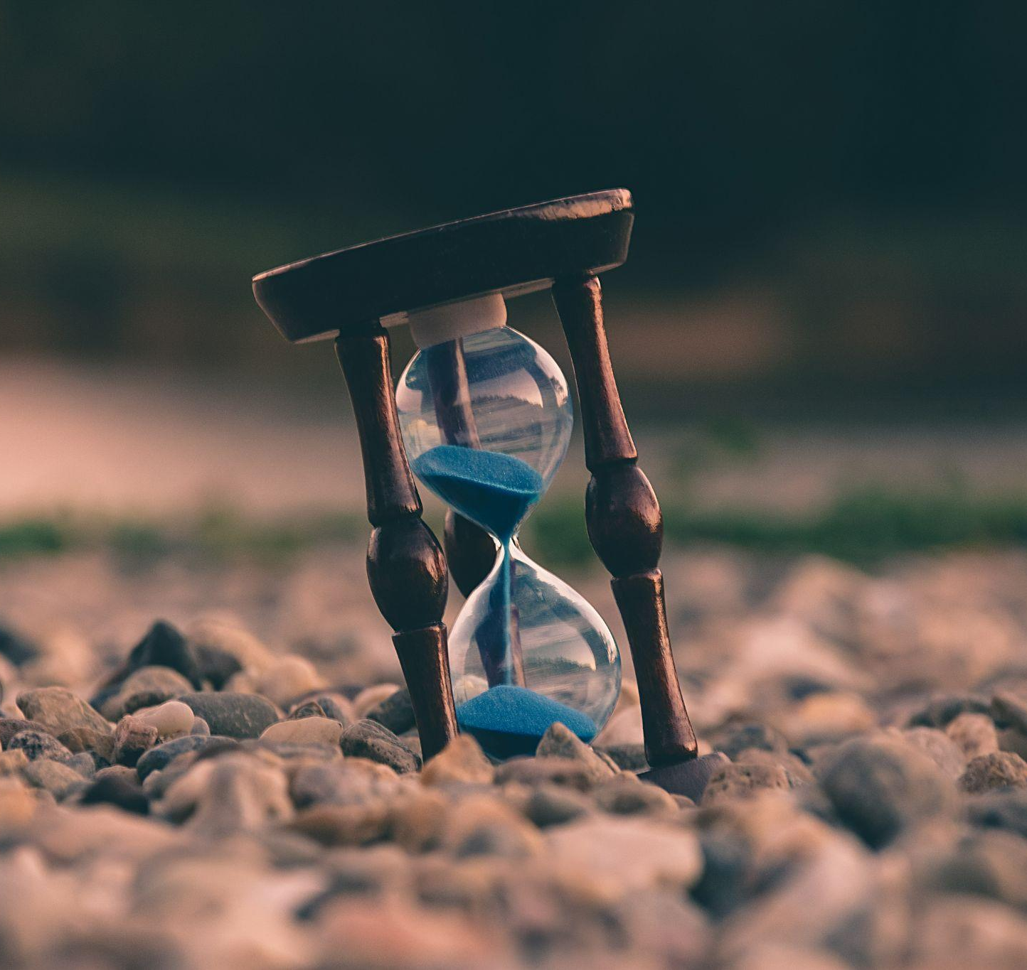
The whales
- Is it like that everywhere in this world?
- As far as I know, yes. But it won’t be weird after you get used to it.
- How long does the story last?
- Every story is different, this one lasts for about 30 minutes.

Slide 7
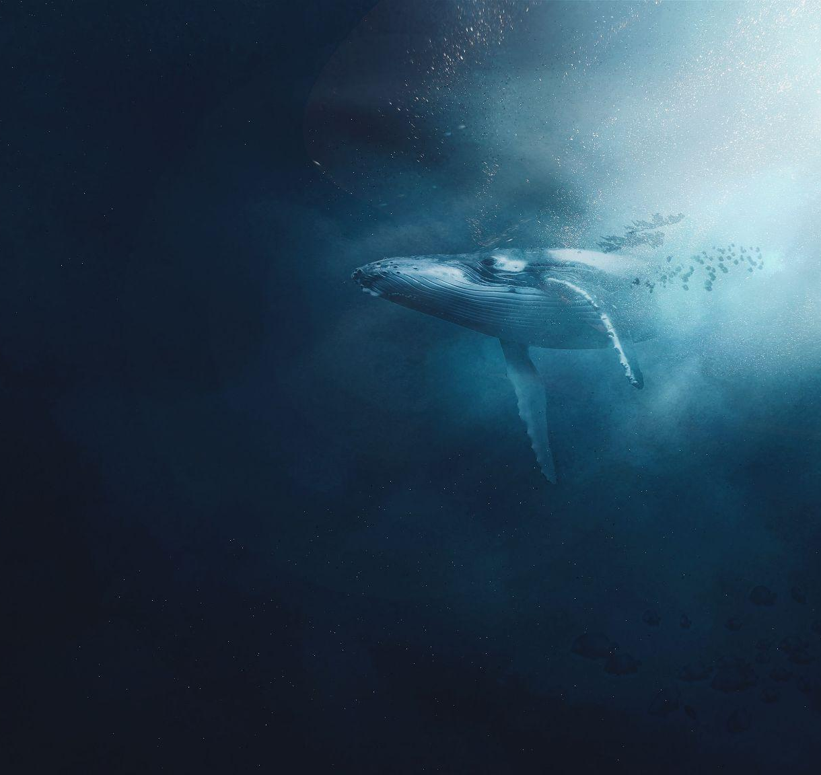
The whales
- Then what happens? Will I be forced to go back home?
- Pretty much. Or you can travel to a different story before you get thrown out. But we still have time. Look, they even have whales here. They’ll be gone soon, we have to be quick.

Slide 8
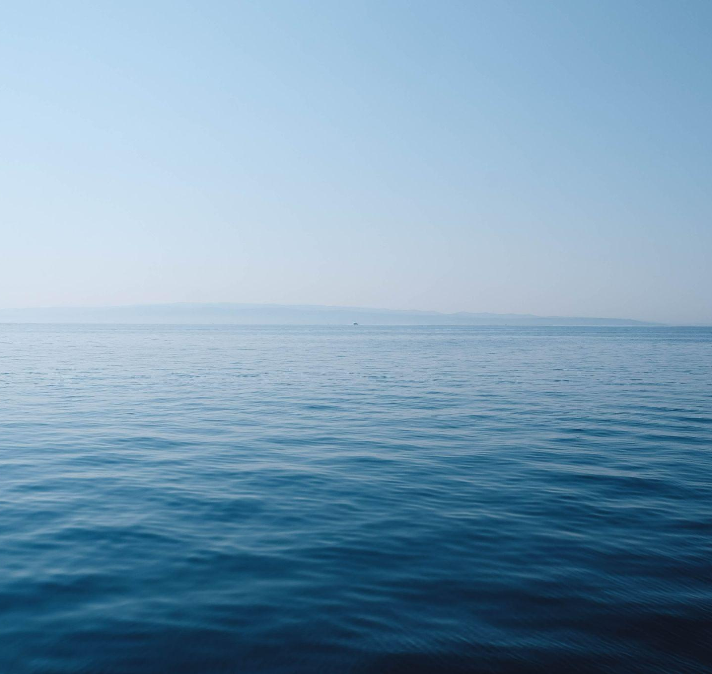
The whales
We walk down to the beach and start looking at the sea.
- Now this really is weird, Tom says after a while.
- What are you talking about?
- The whales are gone. This has never happened before.

Slide 9
The whales
Tom looks worried.
- Is that bad? Tom?
Tom stays quiet for a minute and finally grabs my hand.
- We need to go. I have another story in mind already, it’ll only take a second to go there. Follow me.
I don’t know why, but I trust him. I nod and we’re gone.

Slide 10
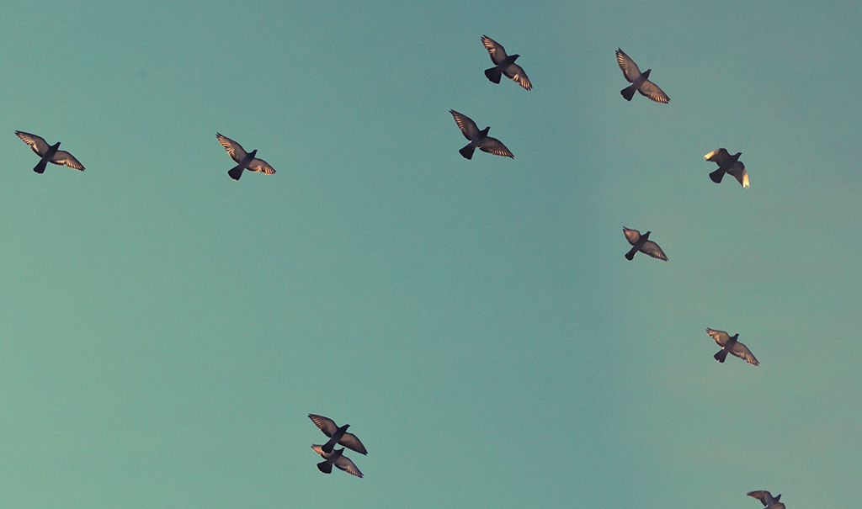
To be continued.

Slide 11
CREDITS
Special thanks to all the people who made and released these awesome resources for free:
Presentation template by SlidesCarnival
Photographs by Unsplash

Slide 12
Reetta Pänkäläinen 2023

