Slide 1
THE WIND IN HER HAIR
Part 3: Stories
Reetta Pänkäläinen

Slide 2
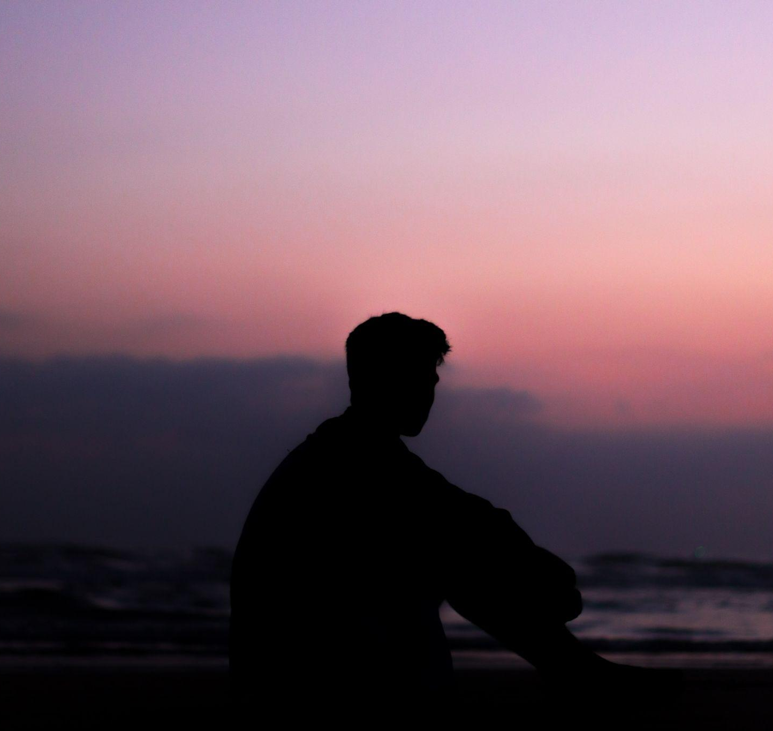
Stories
- My name’s Tom, by the way, the boy says.
- I’m Riley.
- So Riley, When did you first get here?
- Yesterday. I was in a park, there were people there.

Slide 3
Stories
- Did you stay long? Tom asks.
- No, the wind blew me away after a while. But my phone, it rang. I heard my sister’s voice. How is that possible?
- It wasn’t your phone. Or your sister. It was all part of the story.
- What story?

Slide 4
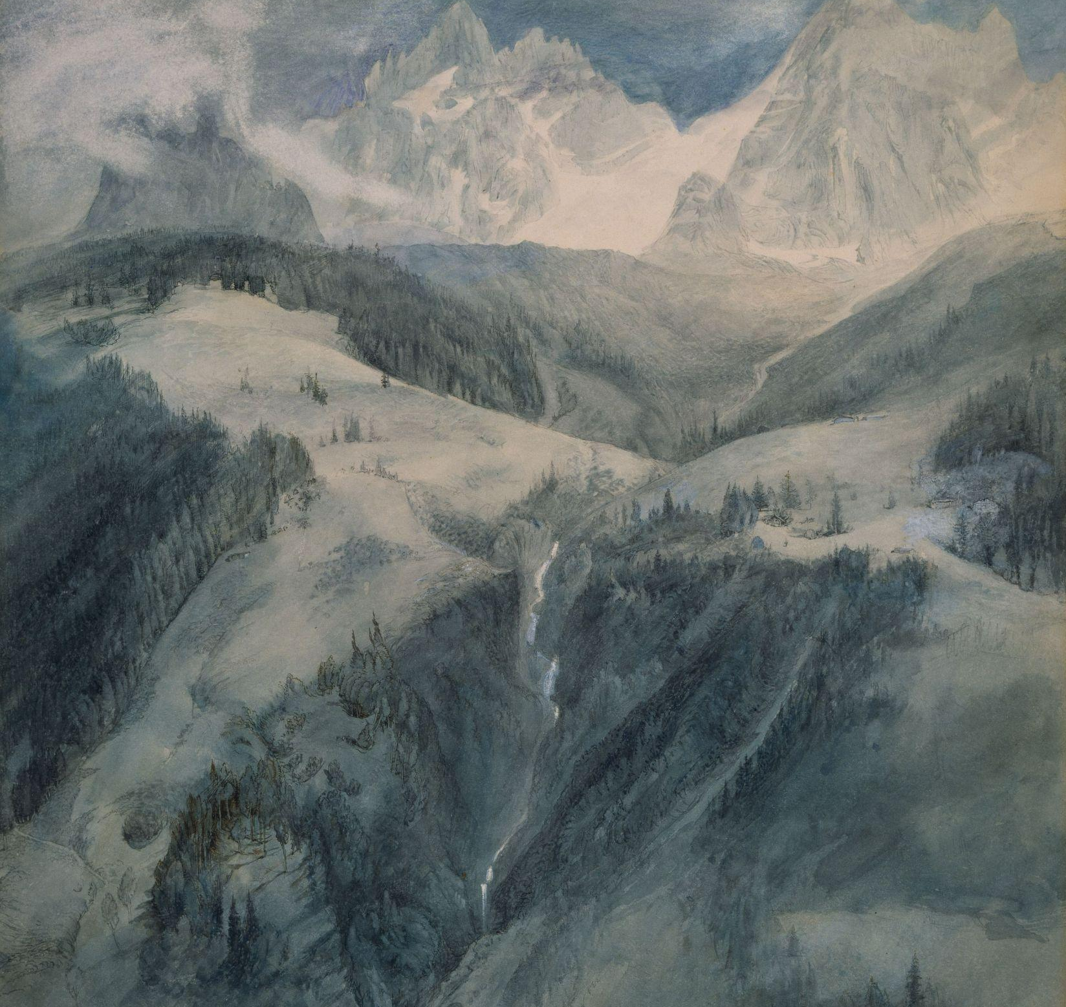
Stories
- Like I said, you’re a story dweller. This world, it’s full of stories. Millions of them. And you are able to visit them. I first came here four years ago through a painting. I looked at the colours and felt something pull me away.

Slide 5
Stories
- I don’t understand any of this. Are you saying this place isn’t real? That someone made it up?
- No, it’s real. How did you get here? I use pictures, but there are other ways as well.
- I’m not sure. I just listened to a song and found myself here.
- There we go. You heard the story in a song and it brought you here.

Slide 6
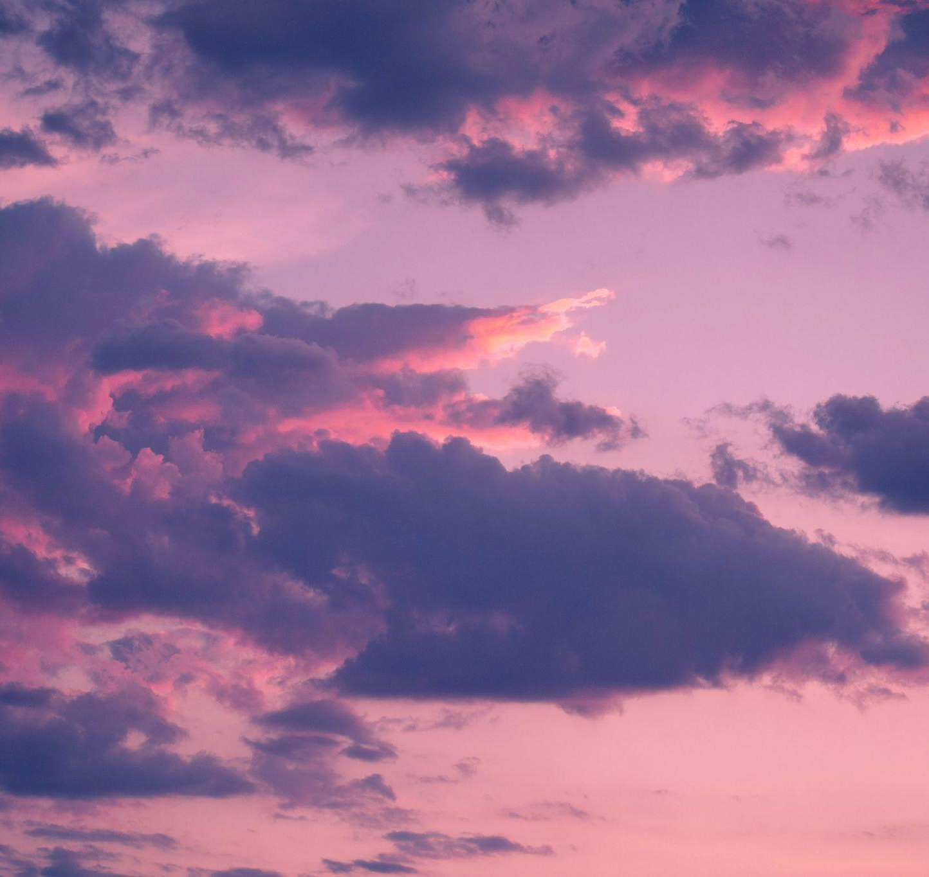
Stories
- But why did I come here? I didn’t ask for this.
- You came here because you could. That’s all I know. There is a lot we don’t know about this place.

Slide 7
Stories
- How did we get to this hill? I didn’t hear any music.
- I brought you here. I saw this place in a picture last year. It became my favourite straight away. Did you see the flock of giant birds when we got here? Amazing.
- I think I want to go home now. This is too much.

Slide 8
Stories
- Everyone feels the same way at first, trust me.
- What did I do to get here?
- When you were little, did you ever get lost in a song?
- All the time. I forgot everything else. My mum hated it. She said that I simply stopped existing. I didn’t hear anything else. Just the music.

Slide 9
Stories
- It’s that same feeling that took you here, Tom says.
- So does every song have a story in this world?
- No, this world existed before the songs. But sometimes someone comes up with just the right melody or colours or even a poem. And it’s like a ticket to this place.
- But I didn’t want to get lost in a storm, why did that happen?

Slide 10
Stories
- Because you can’t control your abilities just yet.
- And how do I get back home?
- Just do what you did last time.
- Last time? I think I just thought about home and the wind rose.
And just like that, I can feel the wind in my hair again. Tom smiles.
- Come back tomorrow. It was nice to meet you, Riley.

Slide 11
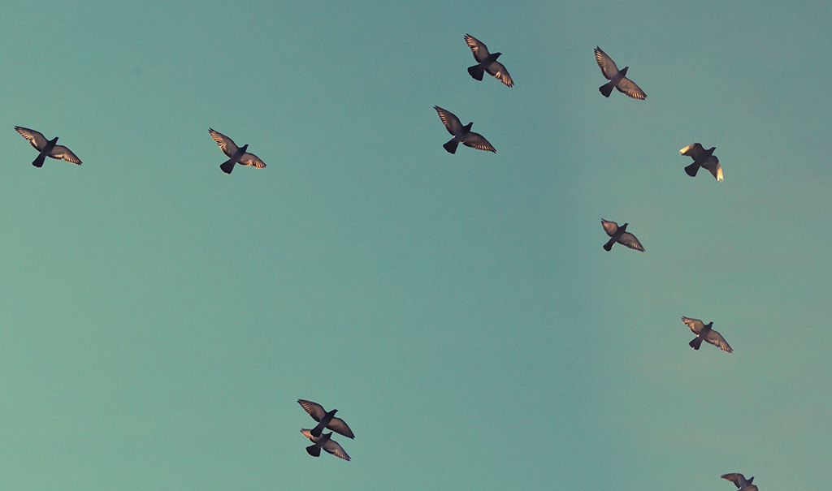
To be continued.

Slide 12
CREDITS
Special thanks to all the people who made and released these awesome resources for free:
Presentation template by SlidesCarnival
Photographs by Unsplash

Slide 13
Reetta Pänkäläinen 2023

