Slide 1
THE WIND IN HER HAIR
Part 12: The crow
Reetta Pänkäläinen

Slide 2
The crow
I look at the crow not wanting to believe what I’m seeing. Tom hasn’t noticed it, he’s too busy focusing on the dwellers as he should be. Surely, that’s all that matters right now. Anyway, would it change anything if I told Tom about the crow? Would it simply make everyone stop believing in what they were doing if they thought they couldn’t save the world? Could we make the crow fly away if we didn’t notice it? Should I stay quiet?

Slide 3
The crow
- Everyone, I’m so happy to see you all here! Tom shouts, standing on a rock in front of the crowd.
- I don’t know how much the old lady told you, but could you please raise your hand if you have seen anything strange in the stories lately?

Slide 4
The crow
A dozen hands go up at first. The rest of the dwellers raise their hands after hesitating for a bit.
- I know many of you are scared, I know I am. And many of you must be thinking what would happen if we didn’t do anything about the matter. I don’t have any answers to that, but I have an idea how to stop all of this.
There’s an excited murmur in the crowd. People seem happier.

Slide 5
The crow
- We talked to The Shepherd, Riley and I, and he said something important. The center of this world is the engine that keeps all the stories going. He told us that this engine must be dying as the worlds are starting to break. He also said that if the center didn’t get fed, this world would come to an end.
The dwellers seem anxious again and start talking to each other nervously.

Slide 6
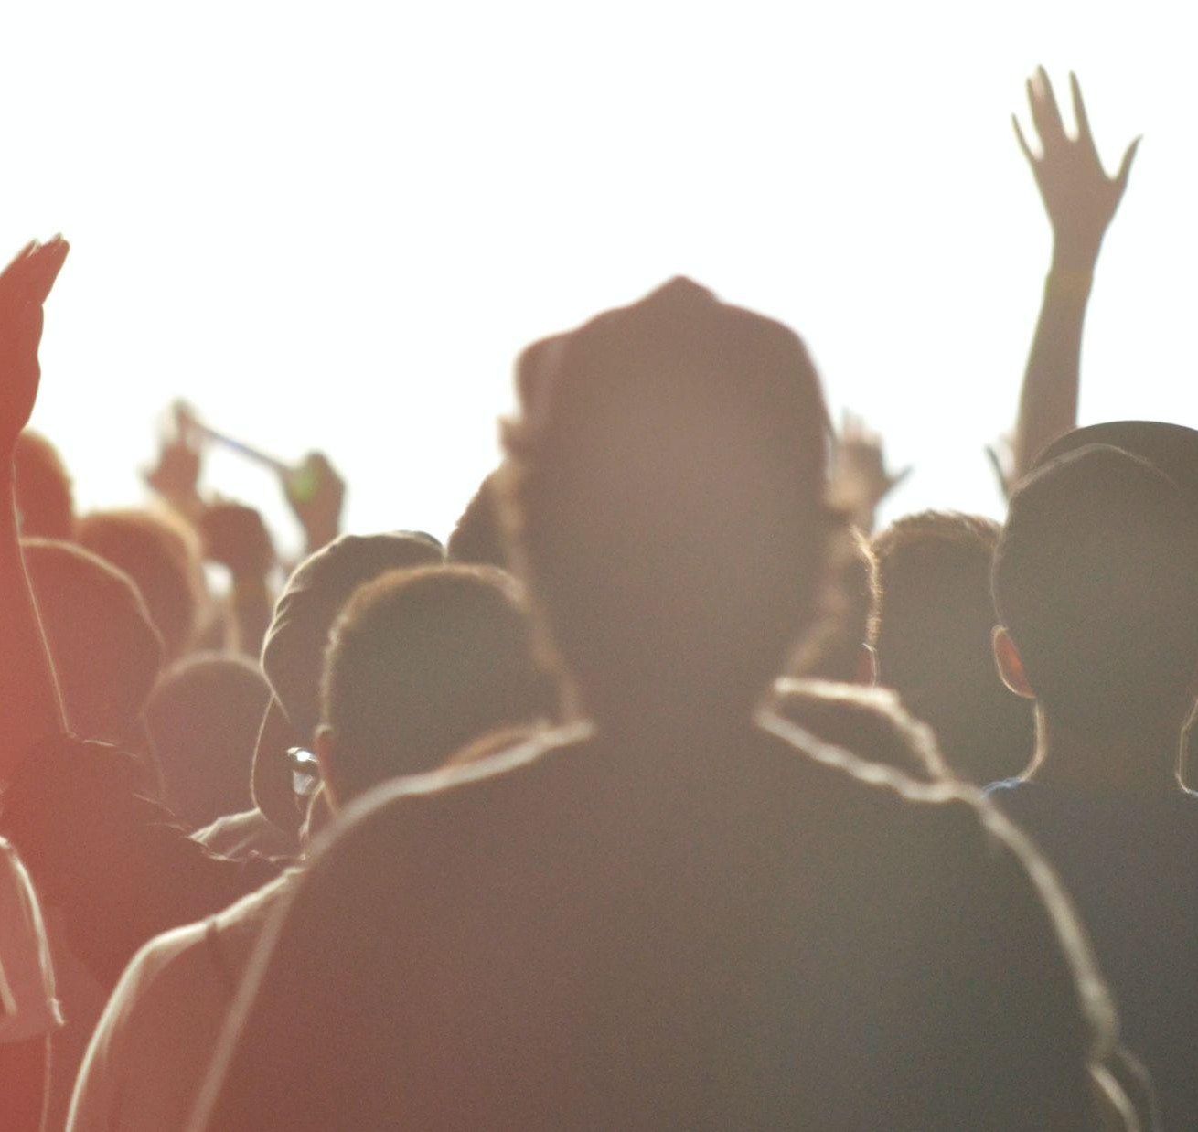
The crow
- But don’t worry, we also know what feeds the center. We must focus on the good. On love and kindness as they hold the most power in any story.
- So what should we do? asks a young woman.

Slide 7
The crow
- I want all of you to choose your favourite story. Something that makes you feel all those good things. And I want you to go visit that story in a minute. I’m hoping that if we all do this at the exact same time, it will give the center a proper boost, Tom continues.
- How do we know that it works? asks another dweller.
- To be honest, I have no idea, this has never been done before. But I really think it’s worth a shot. I wouldn’t be here telling you to do this if I didn’t think it could work.

Slide 8
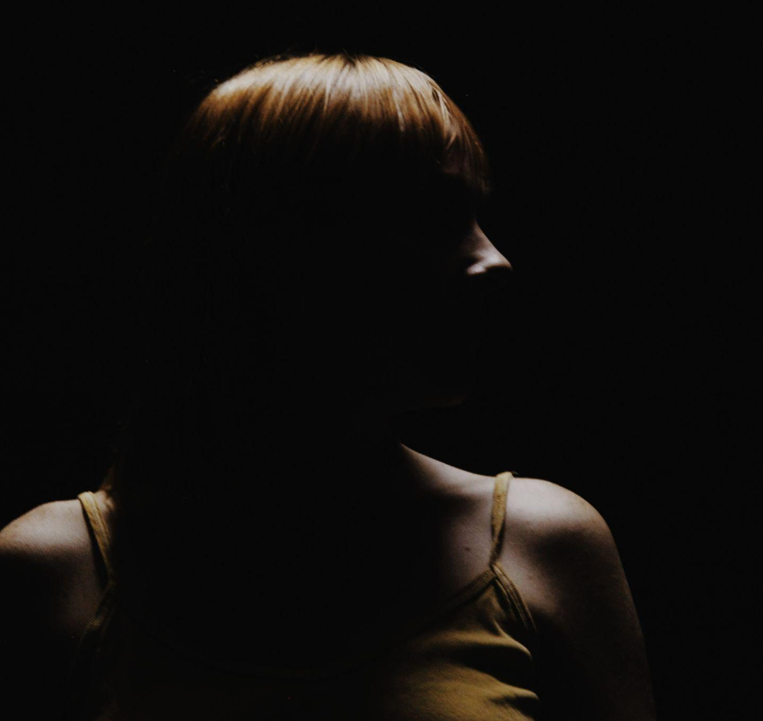
The crow
I wish I could be as confident as Tom. Although, a part of me thinks he is not confident at all but is so scared about losing this world that he’s ready to pretend in front of the other dwellers. I feel a darkness coming, an emptiness that will eat this world in one bite.

Slide 9
The crow
- Now go, everybody, do the best you can and return safely. I’ll meet you here before the day is done, Tom ends his speech and turns to look at me. He can tell something is wrong.
- What is it, Riley?
- I’m sorry, Tom. I’m just worried. I’m sure they’ll do a good job.
- I’m sure they will, too. Where do you want to go?
- I’ll go to the first story I ever visited. I’m just hoping the wind doesn’t take me back home in the middle of everything.

Slide 10
The crow
- If it does, you just need to go back. And anyway, you seem to be doing really well, Tom says.
- I don’t know what I would do if I lost this place before I even got to know it properly, I say.
- Let’s hope you never have to find that out.

Slide 11
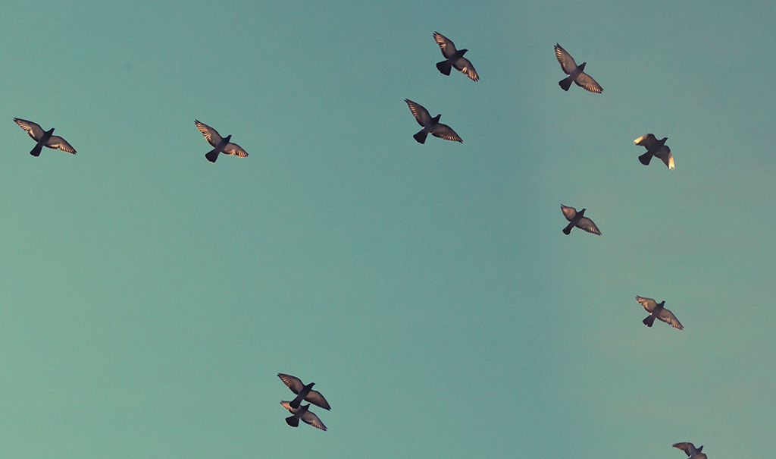
To be continued.

Slide 12
CREDITS
Special thanks to all the people who made and released these awesome resources for free:
Presentation template by SlidesCarnival
Photographs by Unsplash

Slide 13
Reetta Pänkäläinen 2023

