Slide 1
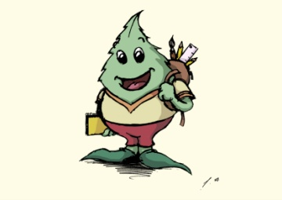
I.C.T. IN ALAMEDA DE LA SAGRA OUR SCHOOL
18 CLASSROOMS (6 INFANT EDUCATION AND 12 PRIMARY EDUCATION)
380 STUDENTS
27 TEACHERS
17% OF STUDENTS ARE FOREIGNERS (11 nationalities and 41 pupils from Morocco)
MEDIUM-LOW SOCIO-CULTURAL LEVEL
HIGH RATE OF UNEMPLOYMENT AMONG FAMILIES (above all in women)
FAMILIES WITH BIG ECONOMIC PROBLEMS DUE TO CRISIS.
SOCIAL CANTEEN FOR THE 54 PUPILS (13%) SUPPORTED BY AN N.G.O.

Slide 2
I.C.T. IN ALAMEDA DE LA SAGRA RESOURCES
27 STAFF LAPTOPS
INTERACTIVE BOARDS IN ALL CLASSROOMS
NETBOOKS FOR PUPILS: individual netbooks for 6th graders and a mobile cabinet with 25 netbooks in 5th grade classroom.
COMPUTERS ROOM
WIFI AT CENTER LEVEL
COMPUTER CORNER WITH ONE DEVICE IN INFANT EDUCATION CLASSROOMS
SCHOOL RADIOSTATION

Slide 3
I.C.T. IN ALAMEDA DE LA SAGRA ORGANISATION
I.C.T. TEAM
Four teachers are responsable for this work (computers room, school radiostation, digital boards, netbooks...)
Manager team support.
I.C.T. PLAN
A general framework for the period 2010-2015
Guidelines for investment, training, agreements at center level...
Need for a new plan.
New lines of action are planned and specified every school years
Evaluated by families and teachers
ICT skills defined in different levels of difficulty.
ICT competences integrated in the teachers programming documents and in the daily work with pupils.

Slide 4
I.C.T. IN ALAMEDA DE LA SAGRA PROBLEMS
Money for investments and for renewing equipments
Staff laptops outdated
Lack of technical support
Different levels of performance and training in our staff
ICT coordination in our staff
No ICT general framework at community level.
BYOD movement is not possible here (by now) due to economic problems and cultural background.

Slide 5
ICT
ALTHIA
DIGITAL BOARDS
SCHOOOL RADIO
SCHOOL WEBSITE
TRAINING AND INNOVATION
MANAGEMENT SOFTWARE
ESCUELA 2.0

Slide 6
ALTHIA
COMPUTERS RENEWED
DIGITAL SKILLS DEFINED
LESSONS FOR EVERY GRADE
AGREED TIMETABLE
MAINTENANCE
SMALL INVESTMENT AND BIG OUTCOME

Slide 7
SCHOOL 2.0 - ESCUELA 2.0
Teachers training and sharing protocols
Family training: guidelines, technical and personal support, resources...
Students training: guidelines, software, USB stick....
EDUCATIVE RESOURCES
SOFTWARE AND ITS EDUCATIVE USE
Projects: Virtuaula, teachers blogs, Scratch, Movie-maker, Minecraft ...

Slide 8
DIGITAL BOARDS
Teachers training
Maintenance
Didactic Programmes are shared
Digital Resource Storage online.

Slide 9
WEBSITE
INFORMATION OF THE SCHOOL LIFE AND ORGANISATION
EDUCATIVE RESOURCES FOR FAMILIES
BUILDING OUR IDENTITY
AWARDS AT NATIONAL LEVEL

Slide 10
SCHOOL RADIOSTATION
FREE ASSISTANCE TO WORK DIFFERENT COMPETENCES
AGREED TIMETABLE: DURING THE SCHOOL YEAR ALL THE LEVELS BROADCAST AT LEAST ONE FRIDAY FOR THE WHOLE VILLAGE
MAINTENANCE

Slide 11
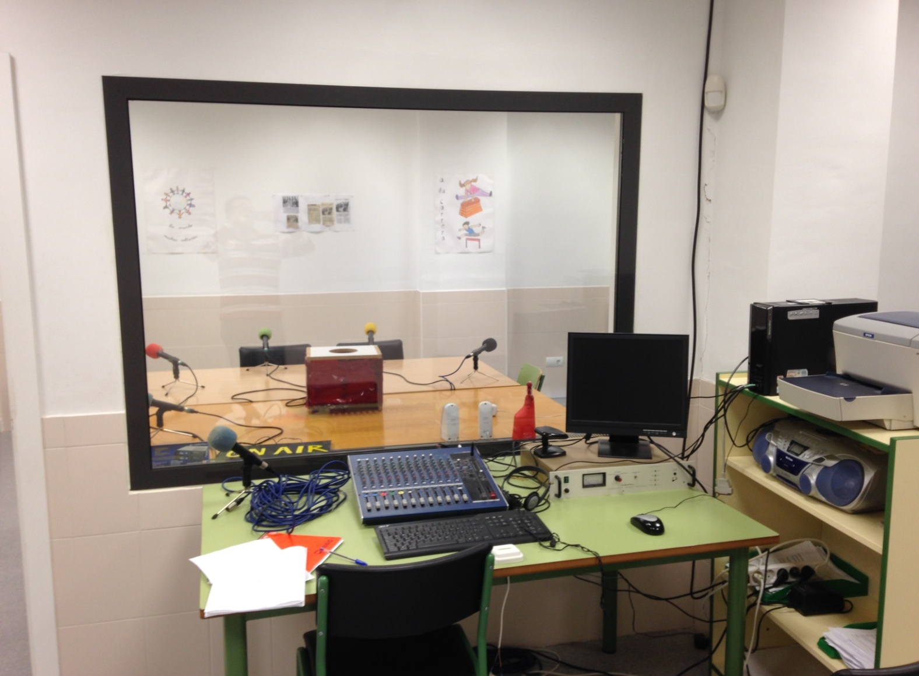
SCHOOL RADIOSTATION

Slide 12
MANAGEMENT SOFTWARE
PAPÁS 2.0 – FAMILY COMMUNICATION PLATFORM
DELPHOS-CENTRE AND PUPILS MANAGEMENT PROGRAM
GECE- ECONOMIC MANAGEMENT PROGRAM
ABIES-LIBRARY MANAGEMENT PROGRAM

Slide 13
TRAINING-INNOVATION
DIGITAL MAGAZINE
SCRATCH AND ICT IN ARTS AND CRAFTS SUBJECT
ICT AND ECO-SCHOOLS
INNOVATION PROJECTS
TEACHERS TRAINING AT THE BEGINNING OF THE SCHOOL YEAR
ICT COLLABORATIVE WORK GROUPS
ICT RESEARCH

Slide 14
FAMILIES AND ICT
Training in Papas 2.0 program.
Training in security and safety rules.
“ICT Family School” next year.

Slide 15
Benefits

