Slide 1


Mia Andersson
Careers Service
Malmö University
Careers service
at malmö university

Slide 2
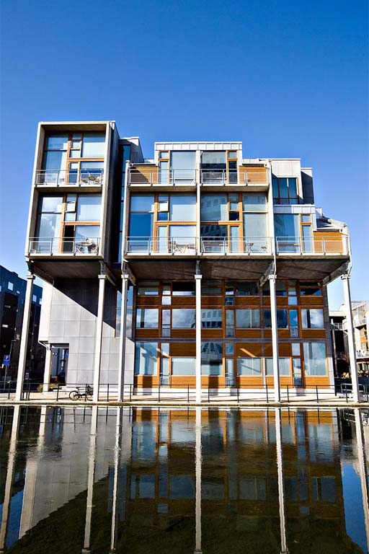

PRECONDITIONS
Malmö university
Sweden

Slide 3
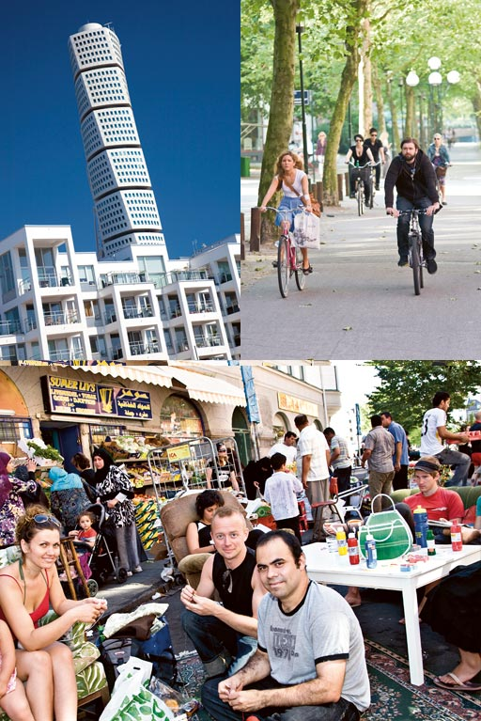
MALMÖ –
THE CITY
The third largest city in Sweden with a population of 300 000
Multicultural with 170 nationalities
Previous an industrial city – now a metropolis of knowledge and entrepreneurship
Connected to Denmark and Copenhagen by the Öresund bridge
MALMÖ UNIVERSITY
Sweden

Slide 4
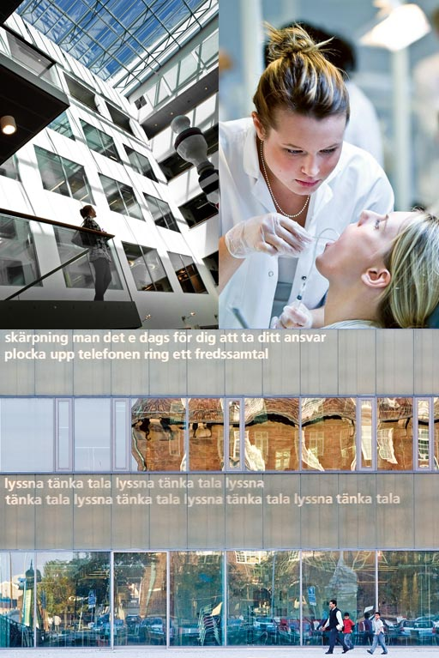
THIS IS MALMÖ UNIVERSITY
Founded in 1998
25 000 students
1 400 staff
Five interdisciplinary faculties
Faculty of Culture and Society
Faculty of Health and Society
Faculty of Odontology
Faculty of Education and Society
Faculty of Technology and Society
Turnover 125 million €
Located in the Öresund region which has a population of 3.5 million people
Malmö University
Sweden

Slide 5
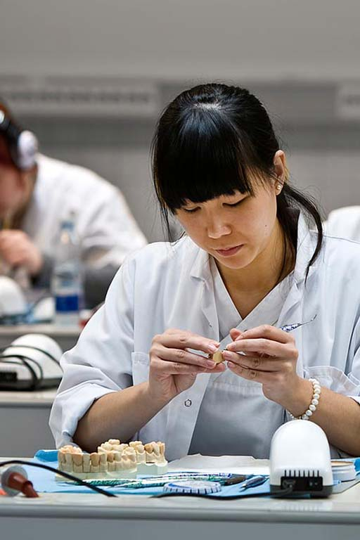

STUDENTS
25 000 students
2/3 of our students are female
1/3 have a non-Swedish background
Are often from a non-academic home
Average age of 25 years
Are employed in their field of study after graduation (92% at 2008)
Malmö university offers professional career training in an international classroom.
Malmö university
Sweden

Slide 6
General/professional qualification
COURSES AND STUDY PROGRAMMES OFFERED
New unestablished programmes
A lot of courses and programmes
conducted in English, on both
Bachelor’s and Master’s level
Malmö University
Sweden

Slide 7

STILL A YOUNG UNIVERSITY!
Malmö university
Sweden

Slide 8
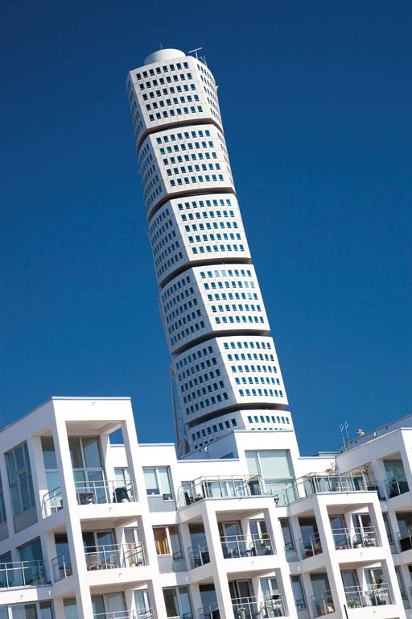
CAREERS SERVICE AT MALMÖ UNIVERSITY
Malmö university
Sweden

Slide 9

Organisation of Careers Advisers
at Schools/Faculties:
Faculty of Culture and Society
1,3 Careers Advisers
Faculty of Health and Society
2,0 Careers Advisers
Faculty of Odontology
1,0 Careers Adviser
Faculty of Education and Society
3,0 Careers Advisers
Faculty of Technology and Society
0,5 Careers Adviser

Slide 10
Careers Advisers at School/Faculty
What are my options after studying a certain subject/programme?
Course/programme details?
I want to take a time-out from my studies...
I am a student at a different university and would like to transfer to Malmö University... or vice-versa.
Exams, course literature, and/or course plan within a specific programme or course.

Slide 11
Additionally…
Centralised Careers Service at Malmö University
6,8 Careers Advisers

Slide 12

Three target groups/aims
Prospective students (IN)
2. Students; with a focus on academic support (THROUGH)
3. Students; with a focus on careers advising (OUT)

Slide 13
Careers Service
IN question:
What should I do with my life?
THROUGH question:
I do not know if this is the right education for me anymore?
OUT question:
What could I work with after graduation?

Slide 14
Changing working conditions
Globalisation
Business cycles
Labour market
The importance of networking
International/national
Established/unestablished labour markets
Notes:
Dagens pass
Om ett år träffas vi igen, I en kurs som heter “Att arbeta som designer”. Vi vill gärna, I god tid, presentera denna kurs och dess innehåll samt ge tankar och reflektioner över hur ni kan förbereda er för denna kurs.
Ht 09 nu vt11 kursen Att arbeta som designer
-------------------------------------------------------------------------- -------------------------------------------------------------sommaren 2012
Genom att presentar kursens innehåll presentar vi också vår verksamhet och vad/hur vi faktiskt arbetar med studenter.
-Vi möter studenter enskilt/grupp
Vi möter studenter i undervisning
“Vad blir jag av det här”
Vi möter även presumtiva studenter, vanligaste frågan:
“Vet inte vad jag ska bli”
Så, först tänker vi ge en bakgrundsbeskrivning till varför vi valt att arbeta som vi gör (som ligger till grund för kursen)
Genom att titta historiskt bakåt, kan man också klarare se de förändringar som skett i historien men också förstå de utamningar vi står inför dagligdags.

Slide 15
APPROACH
Holistic view
Life long/wide learning
Activating
Including
Notes:
Dagens pass
Om ett år träffas vi igen, I en kurs som heter “Att arbeta som designer”. Vi vill gärna, I god tid, presentera denna kurs och dess innehåll samt ge tankar och reflektioner över hur ni kan förbereda er för denna kurs.
Ht 09 nu vt11 kursen Att arbeta som designer
-------------------------------------------------------------------------- -------------------------------------------------------------sommaren 2012
Genom att presentar kursens innehåll presentar vi också vår verksamhet och vad/hur vi faktiskt arbetar med studenter.
-Vi möter studenter enskilt/grupp
Vi möter studenter i undervisning
“Vad blir jag av det här”
Vi möter även presumtiva studenter, vanligaste frågan:
“Vet inte vad jag ska bli”
Så, först tänker vi ge en bakgrundsbeskrivning till varför vi valt att arbeta som vi gör (som ligger till grund för kursen)
Genom att titta historiskt bakåt, kan man också klarare se de förändringar som skett i historien men också förstå de utamningar vi står inför dagligdags.

Slide 16
Including approach
More student influence
Closer cooperation with faculties
We reach people that normally wouldn’t find us
Preventive work

Slide 17
Cooperation
Careers center/Malmö city
(A day at the university)
Networking with careers advisers HE/USS/Adult edu
Education fairs
Coop with Folk High Schools
Project Nordic Countries (men/HE)
Recognition of prior learning (guidance, development etc)
Employers (companies, oganizaions, public sector)
Drivhuset/The Greenhouse
Alumni network
Student Union
Labour market groups at Mah
Teachers, careers advisers and other co-workers at Mah
IN
THROUGH
OUT
Activities
INFORMATION SERVICE; phone hours, e-mail, drop-in, social media
CAREERS GUIDANCE; 60% pre students, 40% students
Study techniques and study
stress (coop with Student Health Services)
Group activities/events:
-Open to all students, like CV-writing (Eng/Swe)
Programme focused (Eng/Swe)
Individual:
-Job coaching (Eng/Swe)
”Ask a student”
”Shadow a student”

Slide 18
Career Event - example
Student aims::
Make students aware of different pathways after leaving University (broaden perspectives)
Increase their understanding of the qualifications requried within the fields of work
Start building a professional network
Practice the ability to communicate skills
Approach
PROGRAM
Program
Morning
Education in:
Networking /information interviewing
or
Communicating Skills
LUNCH
Afternoon
Information and panel disussion on terms like employability and skills/qualifications.
Mingel and networking students/guests.Opportunity for students to ask specific questions and to be able to practice the skills taught
from the morning sessions.
The Career Event is created in co-operation with :
Teacher responsible for the programme
Careers Adviser at the Faculty
Careers Adviser at Careers Service
Values for the companies/organisations
Discover new educational programmes in the recruiting process
Marketing towards students through Mahs information channels
Collaboration with the University
External guests have been invited after talking to both teachers /Careers Advisers at Faculties and students
The Careers Service are responsible to invite guests to the Careers Event.
Values for the education/Malmö University
Supporting the students’ contacts with the labour market
Awareness and marketing of programmes at Mah to employers
Networking
Feedback on employabilitiy factor from the employers
The Ambition is always to find a mix of alumnies, entreprenuers and women/men.

Slide 19
Karriärportfolio
Students reflecting and documenting what they learn during their studies, and how this knowledge can be useful
Training programme for all Careers advisers at Malmö University
2-3 times/semester competence developing seminars/study visits
Cases and ”Theory Boost” for Careers Service-advisers
About 3 times/semester case discussion. Spring 2013: Theory Boost

Slide 20
THANK YOU!
Mia Andersson
Mia.andersson@mah.se
Malmö University
Sweden

Slide 21
Extra bilder om utbildningar på engelska…

Slide 22

EDUCATION IN ENGLISH
Bachelor's programmes
English studies
European studies
Human Rights
International Migration and Ethnic Relations
International Relations
Peace and Conflict studies
MALMÖ uNIVERSITY
Sweden

Slide 23

EDUCATION IN ENGLISH
Master's Programmes –
1 or 2 years
Biomedical Methods and Technology
Communication for Development
Computer Science
Global Political Studies
Interaction Design
International Migration and Ethnic Relations
Leadership for Sustainability
Public Health
Sustainable Urban Management
The Øresund Master Programme of European Studies
MALMÖ UNIVERSITY
Sweden

