Slide 1
Solution Focused Communication
Workshop
VALA-conference
Höllviken
13-10-23
Björn Lindahl

Slide 2
Björn Lindahl
  11 years as a counsellor.
  2 years as teacher at the CGC education at Malmö university.
  42 years old
  3 children
  7 cats
  1 wife
  Love football, hate early mornings

Slide 3
The workshop today
Introduction about the solution-focused dialogue. Very Basic!
Finish with a little dialogue-exercise in S.F.

Slide 4
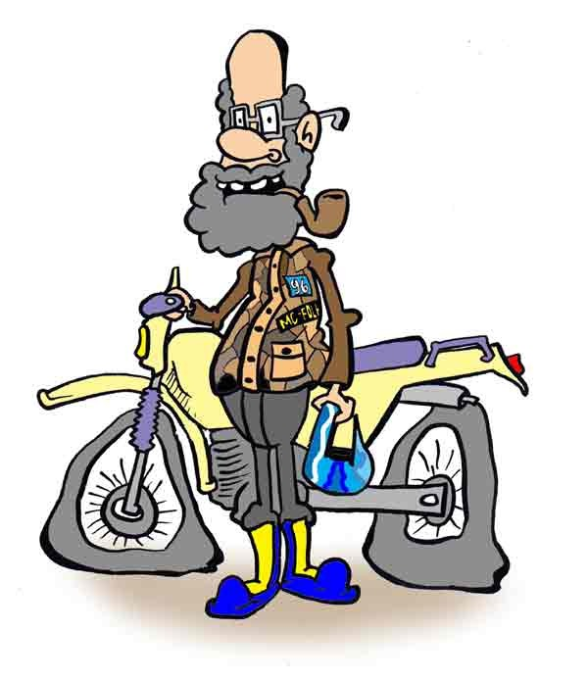
The only thing worth talking about is where we are going……

Slide 5
Solution Focus – what is that?
is a type of talking therapy based upon social constructionist philosophy. It focuses on what clients want to achieve through therapy rather than on historical problem(s) that made them seek help. The approach focuses on the past only in order to activate conversations about resources and past successes. The therapist/counselor uses respectful curiosity to invite the client to envision their preferred future.

Slide 6
http://www.youtube.com/watch?feature=player_embedded&v=JX2FnFUqLMo

Slide 7
The base of the solution-focused dialogue
Two acticities;
  Formulate goals that relates to clients frame of reference
  Develop solutions that builds on exceptions

Slide 8
1. Describe the problem
  In S.F we don´t waste much time on this phase, because it´s not useful when we´re looking for solutions.
  We are not interested in what causes the problem(s), and we dont pay any attention to details about the problem(s)
  We listen to clients problems with respect but already in this phase we start to think about how we can start to talk about solutions.

Slide 9
2. Develop well-formulated goals.
    Here it is important that the helper, together with the clients, explore what will be different when the problem is solved.
    In this phase you can clearly separate solution-focused method from the problem-focused method. If you are problem-focused you start to value the problem instead of looking forward.

Slide 10
3. Look after exceptions
    We ask our clients about moments in the passed when the problems don´t appears, or when the are less serious.
    To support this, questions are asked about the client’s story, strengths and resources; and especially, about any exceptions to client-perceived problems.

Slide 11
4. Finish the dialogue whith feedback
    Feedback is formulated according to the information about goals and exceptions, the clients are giving us during the dialogue.
    It´s important in this phase that we give our clients compliments

Slide 12
5. Evaluate clients succes
Together with our client we work with scales to explore where the client stands in the relation between the problem and the goal.
0 10
Problem Goal

Slide 13
PLUS - modellen
2
lösning
1
undantag
plattform
3
4
Steg/skala

Slide 14
Exercise
Explore Benefits and differencies
Person A describes something that he or she wants to achieve or change in life
Person B asks;
Assume that you succeed, what would be better for you? What more would be better?
What would be different in your life? What more would be better?
What is the first thing/step you have to do/take right now to make this change?
Person B summarizes the conversation.
Turn places.

