Slide 1
Populism
The Rise of Populism in Europe

Slide 2
Definition of ”Populism”*
Populism (LAT. populus, "people")
”A political philosophy supporting the rights and power of the people in their struggle against the privileged elite”
”Political movements or political parties which reflect a major disillusionment with conventional political parties and which have, or present themselves as having, the objective of returning political power to the mass of the people”
In general, ideology or political movement that mobilizes the population (often, but not always, the lower classes) against an institution or government, usually in the defense of the underdog or the wronged. (Treated unfairly or unjustly)
* Dictionary, Encyclopedia, Wikipedia.

Slide 3
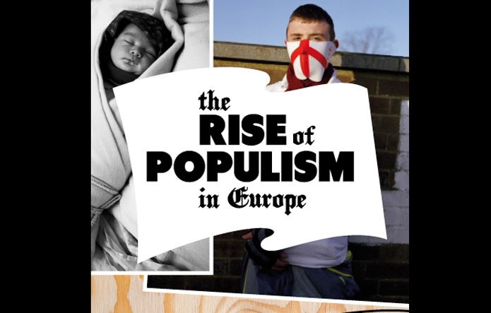
Characteristic of populism
Relates to policy with simplified solutions to difficult political problems
Thin ideology which provides for two homogeneous, antagonistic groups; a us-against-them-thinking
The people against the elite
Swedes (or other nationalities) against immigrants
Country against country
Populists will always claim that they and they alone represent the people and their true interests.

Slide 4
Characteristic of populism
Populism across Europe and the United States takes different forms depending on nationally specific factors such as political history, system and culture, but there are similarities.
Populism in Europe relies heavily on xenophobia, nationalism, and racism.

Slide 5
In several European countries, including Finland, Hungary, Latvia, Lithuania, Norway, and Switzerland, right-wing parties have taken the reins of government. And even where right-wing populists haven’t gained power, groups such as Britain’s UKIP, the French Front National, and Germany’s Alternative für Deutschland are enjoying record popularity.
The rise of populism across Europe & USA.
The populists are coming!
In many European countries, so-called “populist” political parties are on the rise, disrupting the established political order and upstaging mainstream parties.

Slide 6
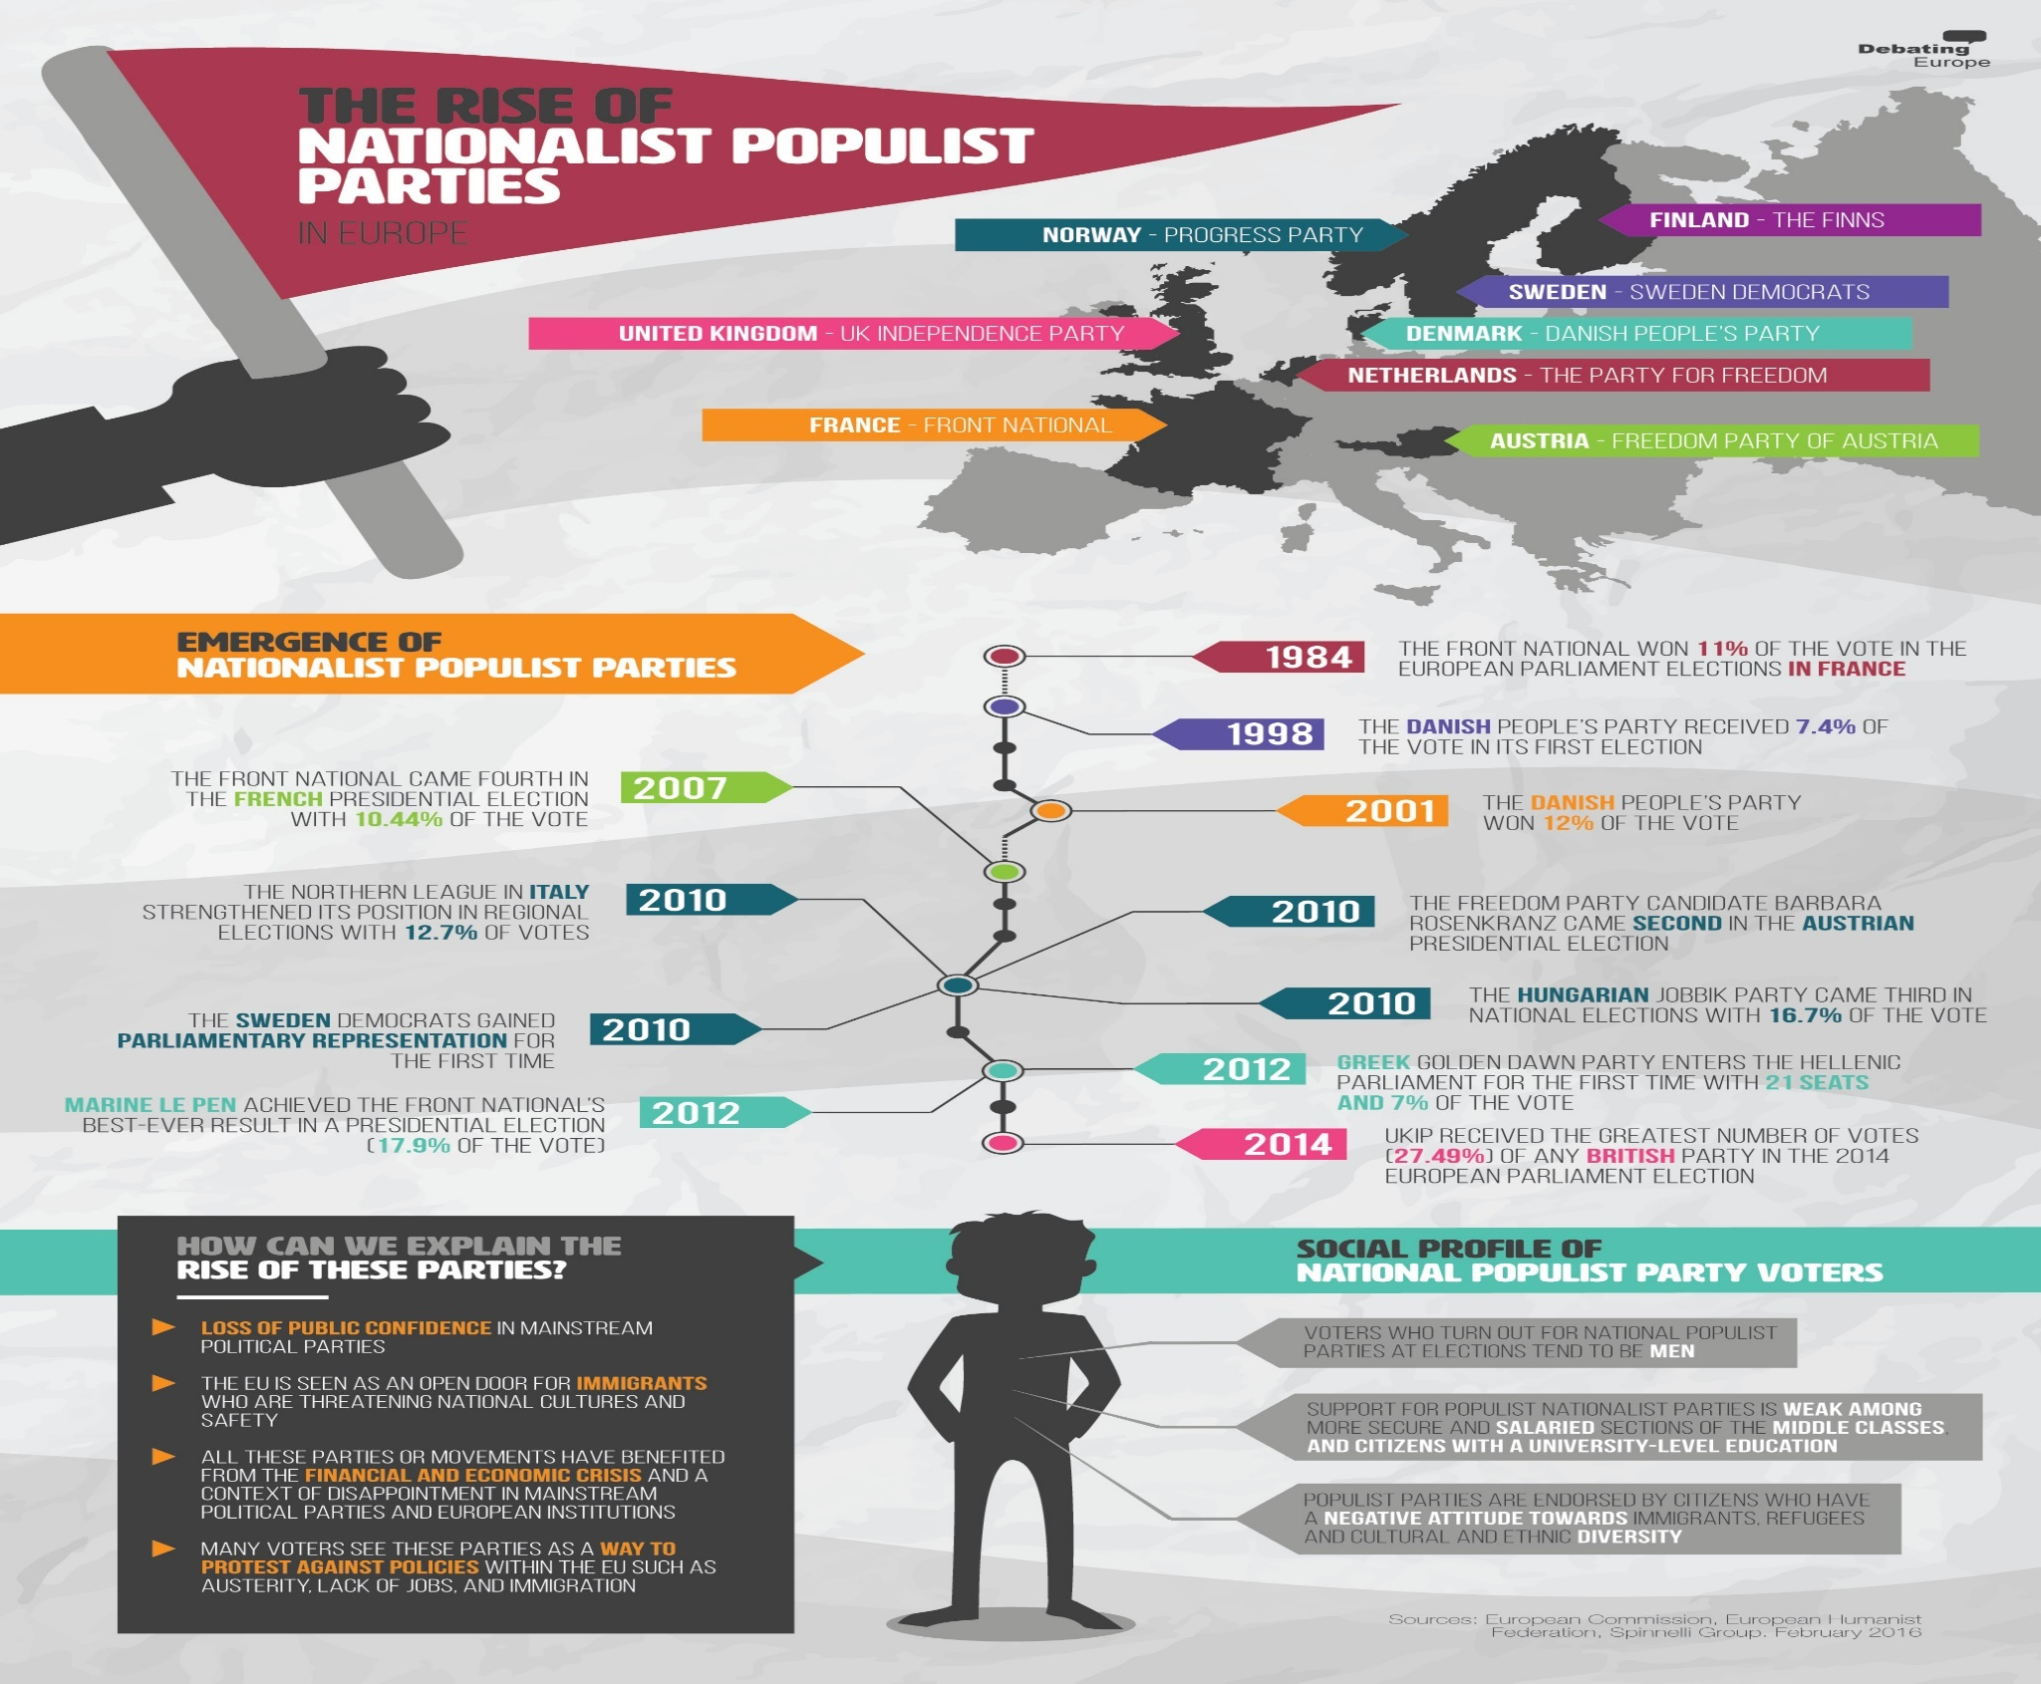
Emergence of Nationalist Populist Parties

Slide 7
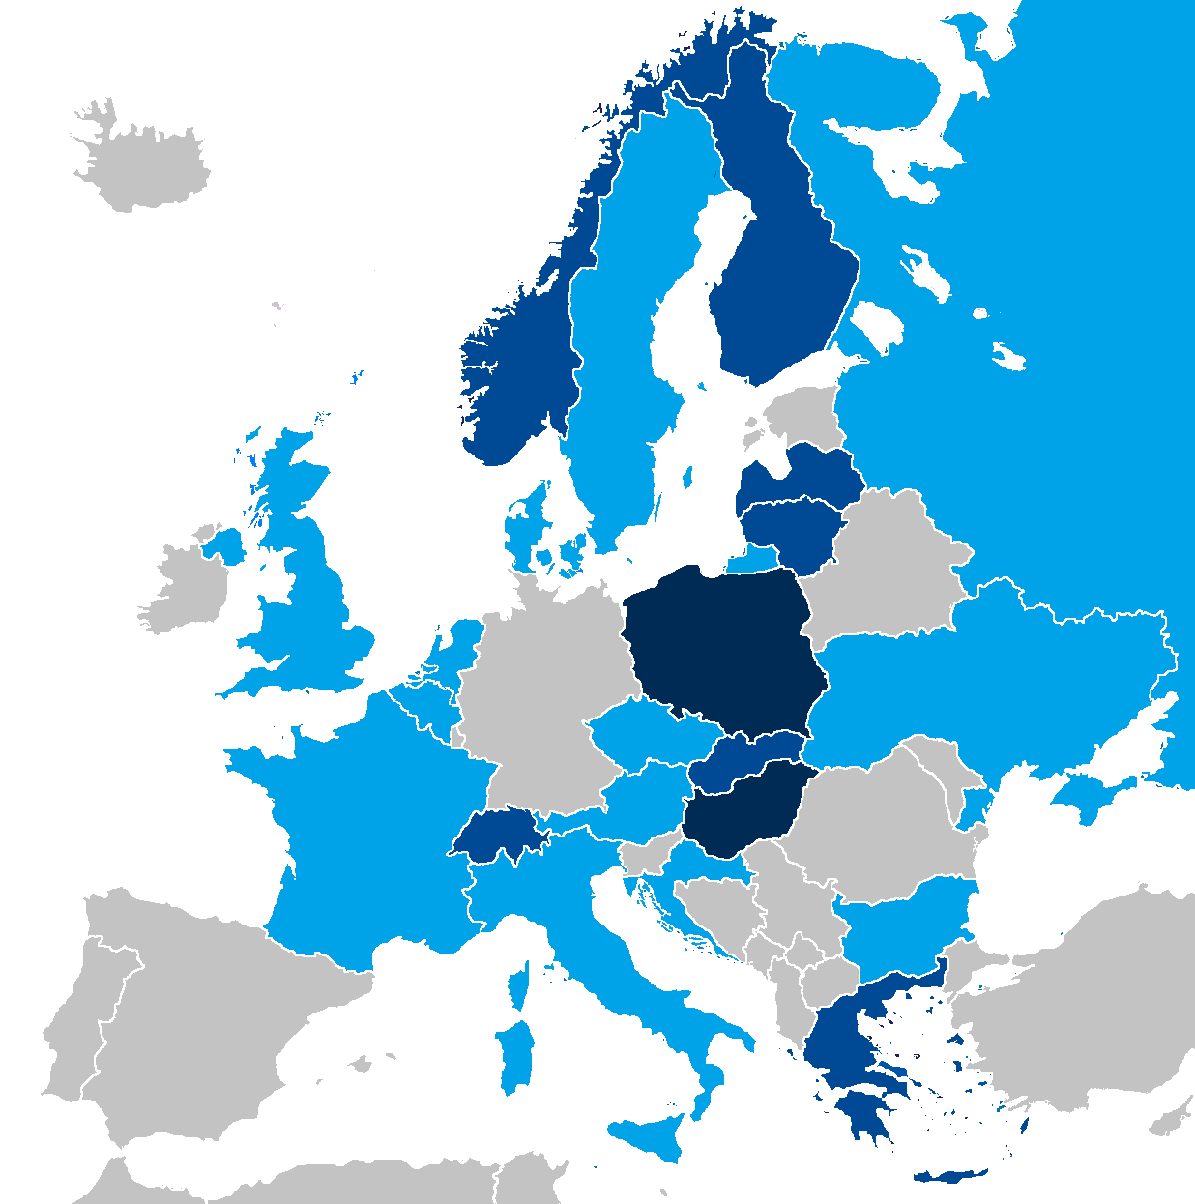
Trump, Brexit & more…
HSBC's* chief European economist, Simon Wells, said in a note sent to clients on Wednesday: "There is a risk that the Trump victory could boost the popularity of anti-immigration and populist parties across Europe.
The recent EU barometer shows that immigration and terrorism are now the two biggest threats among the population, which has contributed to the rise of populist parties across the EU.“
European national parliaments with representatives from right-wing populist parties in 2016. In dark blue, those in government.
*HSBC :One of the largest banking and financial services institutions in the world

Slide 8
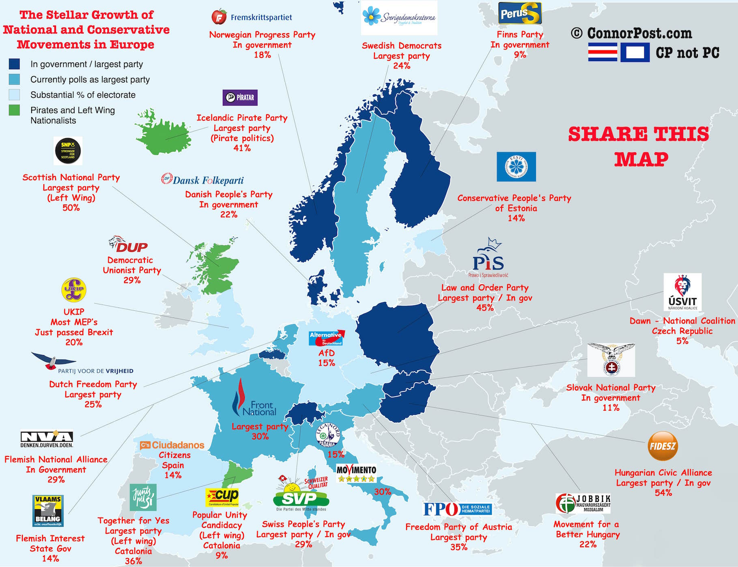

Slide 9
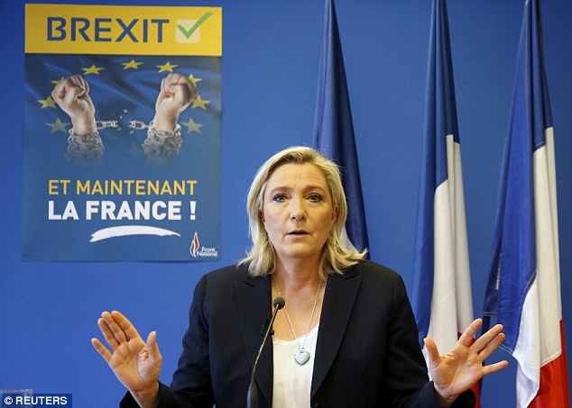
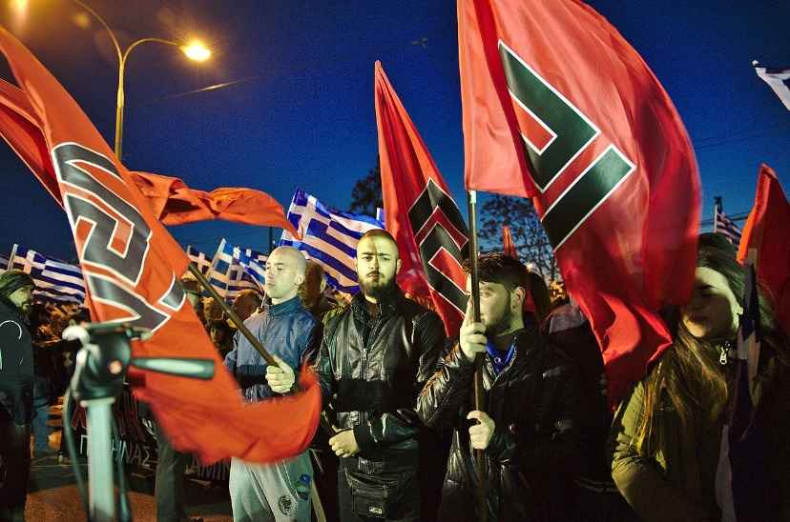
Trump, Brexit & more…
Populism is now the most important force in global politics and is likely to hit Europe next
Donald Trump's surprise victory in the US presidential election has consolidated the global antiestablishment mood sparked by Britain's summer vote to leave the European Union, according to financial and political analysts.
The rise of upstart political parties across Europe is threatening to tear apart the continent’s political systems
Golden Dawn members hold flags with the meander symbol at rally in Athens, March 2015

Slide 10
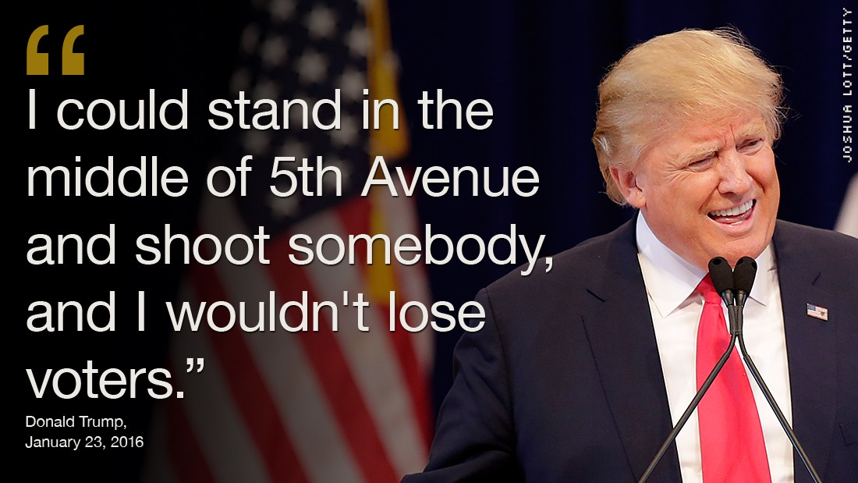
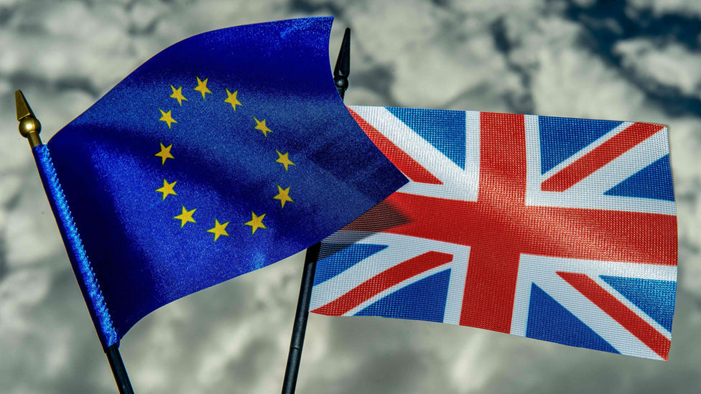
Trump, Brexit & more…
What does Brexit mean?
It is a word that has become used as a shorthand way of saying the UK leaving the EU - merging the words Britain and exit to get Brexit, in a same way as a possible Greek exit from the euro was dubbed Grexit in the past.
Both the Brexit campaign and Trump's presidential bid were built upon protectionist ideas, promising to turn the clock back on global trade and create blue-collar jobs by revitalizing dull and rusty manufacturing industries.

Slide 11
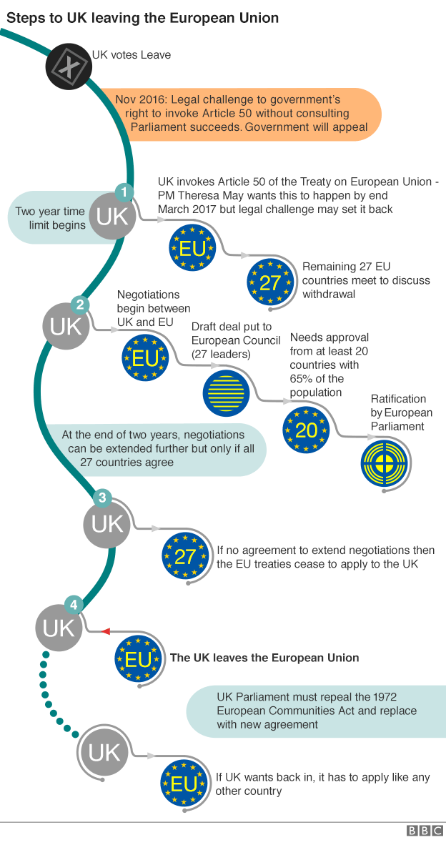
Trump, Brexit & more…
Why is Britain leaving the European Union?
A referendum - a vote in which everyone (or nearly everyone) of voting age can take part - was held on Thursday 23 June, to decide whether the UK should leave or remain in the European Union. Leave won by 52% to 48%. The referendum turnout was 71.8%, with more than 30 million people voting.
What was the breakdown across the UK?
England voted strongly for Brexit, by 53.4% to 46.6%, as did Wales, with Leave getting 52.5% of the vote and Remain 47.5%. Scotland and Northern Ireland both backed staying in the EU. Scotland backed Remain by 62% to 38%, while 55.8% in Northern Ireland voted Remain and 44.2% Leave.

Slide 12
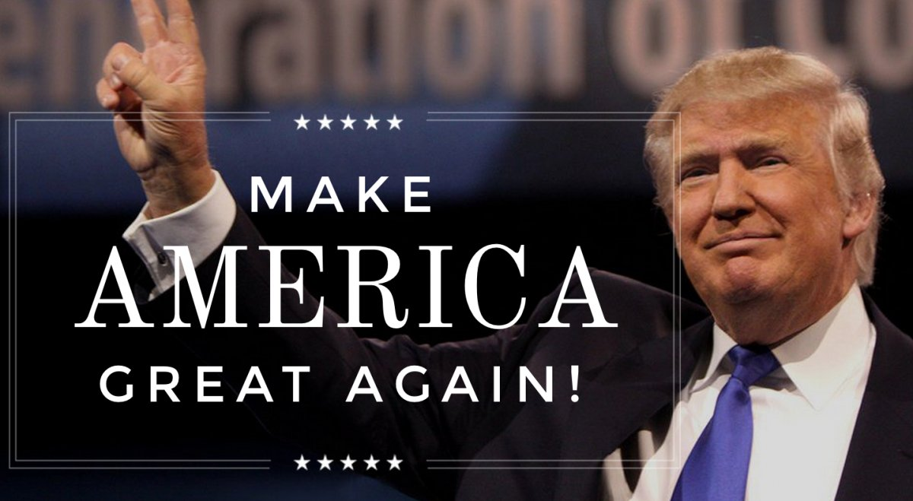
Why Populist Parties Are Booming Across Europe & USA?
“The era of the two-party system is over,” says Pablo Iglesias, the head of the Spain’s young leftist group Podemos (We Can), one of two new parties that together won over a third of the vote in the nation’s December elections.
That may be true. But why? And what’s next?

Slide 13
Social Profile of Nationals Populist Party Voters
Mike van Dulken, the head of research at Accendo Markets, says:
"The probability of a Le Pen win in France next year really can't be discounted as the rise of populist politics begins to deliver for the masses. Any minute now we could be living in a very different world."

Slide 14
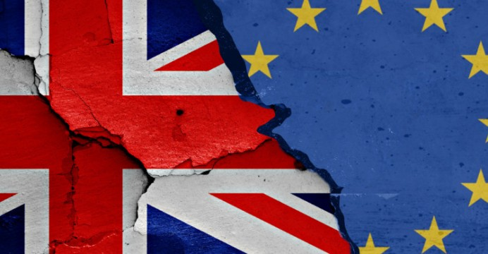
Populist parties on the right and the left are on the rise across Europe*
While supporters hope that populist parties' policies will bring about greater equality and growth for all, their rise creates major political and economic uncertainty for Europe.
HSBC's Wells says they could "not only put at risk trade relationships and immigration policy, but could threaten the very existence of the EU
* HSBC : One of the largest banking and financial services institutions in the world

Slide 15
Several potential flash points are on the horizon:
December 4: Italy holds a crucial constitutional referendum, seen by many as a proxy vote on Prime Minister Matteo Renzi's leadership term.
December 4: Austria will repeat its presidential election, which was almost won by Norbert Hofer, a man nicknamed "Austria's Donald Trump" in May.
March 15, 2017: Parliamentary elections in the Netherlands, where the nationalist, right-wing Party for Freedom is gaining ground.
April-June 2017: French presidential and parliamentary election, which could see big gains for Marine Le Pen and her right-wing, anti-immigration party National Front.
September 2017: German parliamentary elections.

Slide 16
Populism-takes-over-the-world
The populist wave that carried Donald Trump to victory didn't start in the United States, and it won't end there

Slide 17
Questions
Donald Trump, Silvio Berlusconi, Marine Le Pen, Hugo Chávez, Pablo Iglesias….populists are on the rise across the globe.
But what exactly is populism?
Should everyone who criticizes Wall Street or Washington be called a populist?
What precisely is the difference between right-wing and left-wing populism?
Does populism bring government closer to the people or is it a threat to democracy?
Who are "the people" anyway and who can speak in their name?
Have the terrorist attacks in Brussels and Paris fueled the rise of Europe’s so-called populist radical right parties. You know, Trumpism?
Is Europe becoming Trump country?
It is populism the tool that turns a democracy into authoritarianism?

Slide 18
The End

Slide 19
Extra material ☺

Slide 20
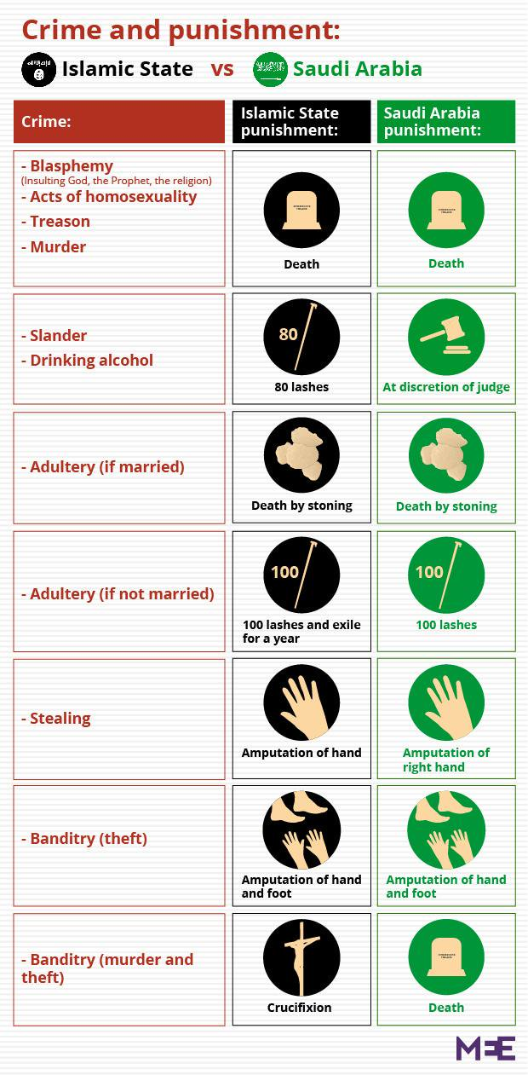
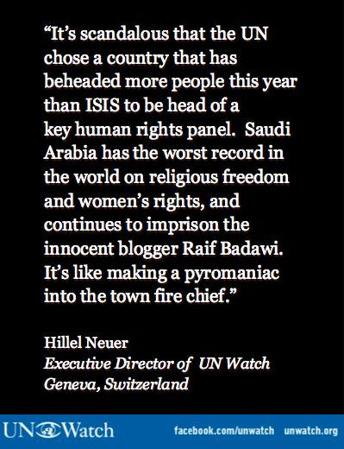
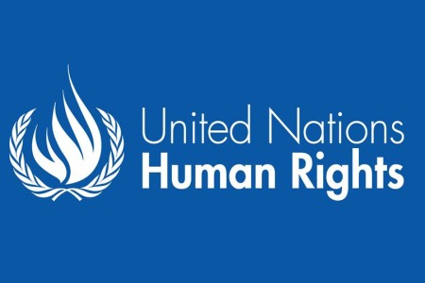
How did Saudi Arabia just get re-elected to the Human Rights Council, the United Nations' premier human rights body?

