Slide 1
Lauseenvastikkeet
New Insights
Module 7 Grammar

Slide 2
Lauseenvastikkeet
Going home I came across an interesting specimen.
The films shown here are all old classics.
Lauseenvastikkeet ovat kirjoitetussa englannin kielessä varsin tavallisia, ja jokaisen on hyvä ymmärtää niitä teksteissä.
Usein ne on järkevintä suomentaa sivulauseina, ei vastikkeina.
Näissä dioissa esitellään vastikkeiden muodostuksen perustapaukset ja tarkemmin relatiivilauseiden vastikkeet, koska ne ovat englannissa erityisen yleisiä.
More advanced -dioissa esitellään muodostusta tarkemmin.

Slide 3
Read and translate the sentences.
When coming across a bear in the woods, what should you do?
The man giving the lecture was my former teacher.
If followed carefully, the instructions will be of great help.
I live in a house built almost a hundred years ago.

Slide 4
Read and translate the sentences.
When coming across a bear in the woods, what should you do?
The man giving the lecture was my former teacher.
If followed carefully, the instructions will be of great help.
I live in a house built almost a hundred years ago.
Jos törmäät karhuun metsässä, mitä sinun pitäisi tehdä?
Mies, joka piti luentoa, oli vanha opettajani.
Jos näitä ohjeita noudatetaan huolellisesti, niistä on paljon apua.
Asun talossa, joka rakennettiin melkein sata vuotta sitten.

Slide 5
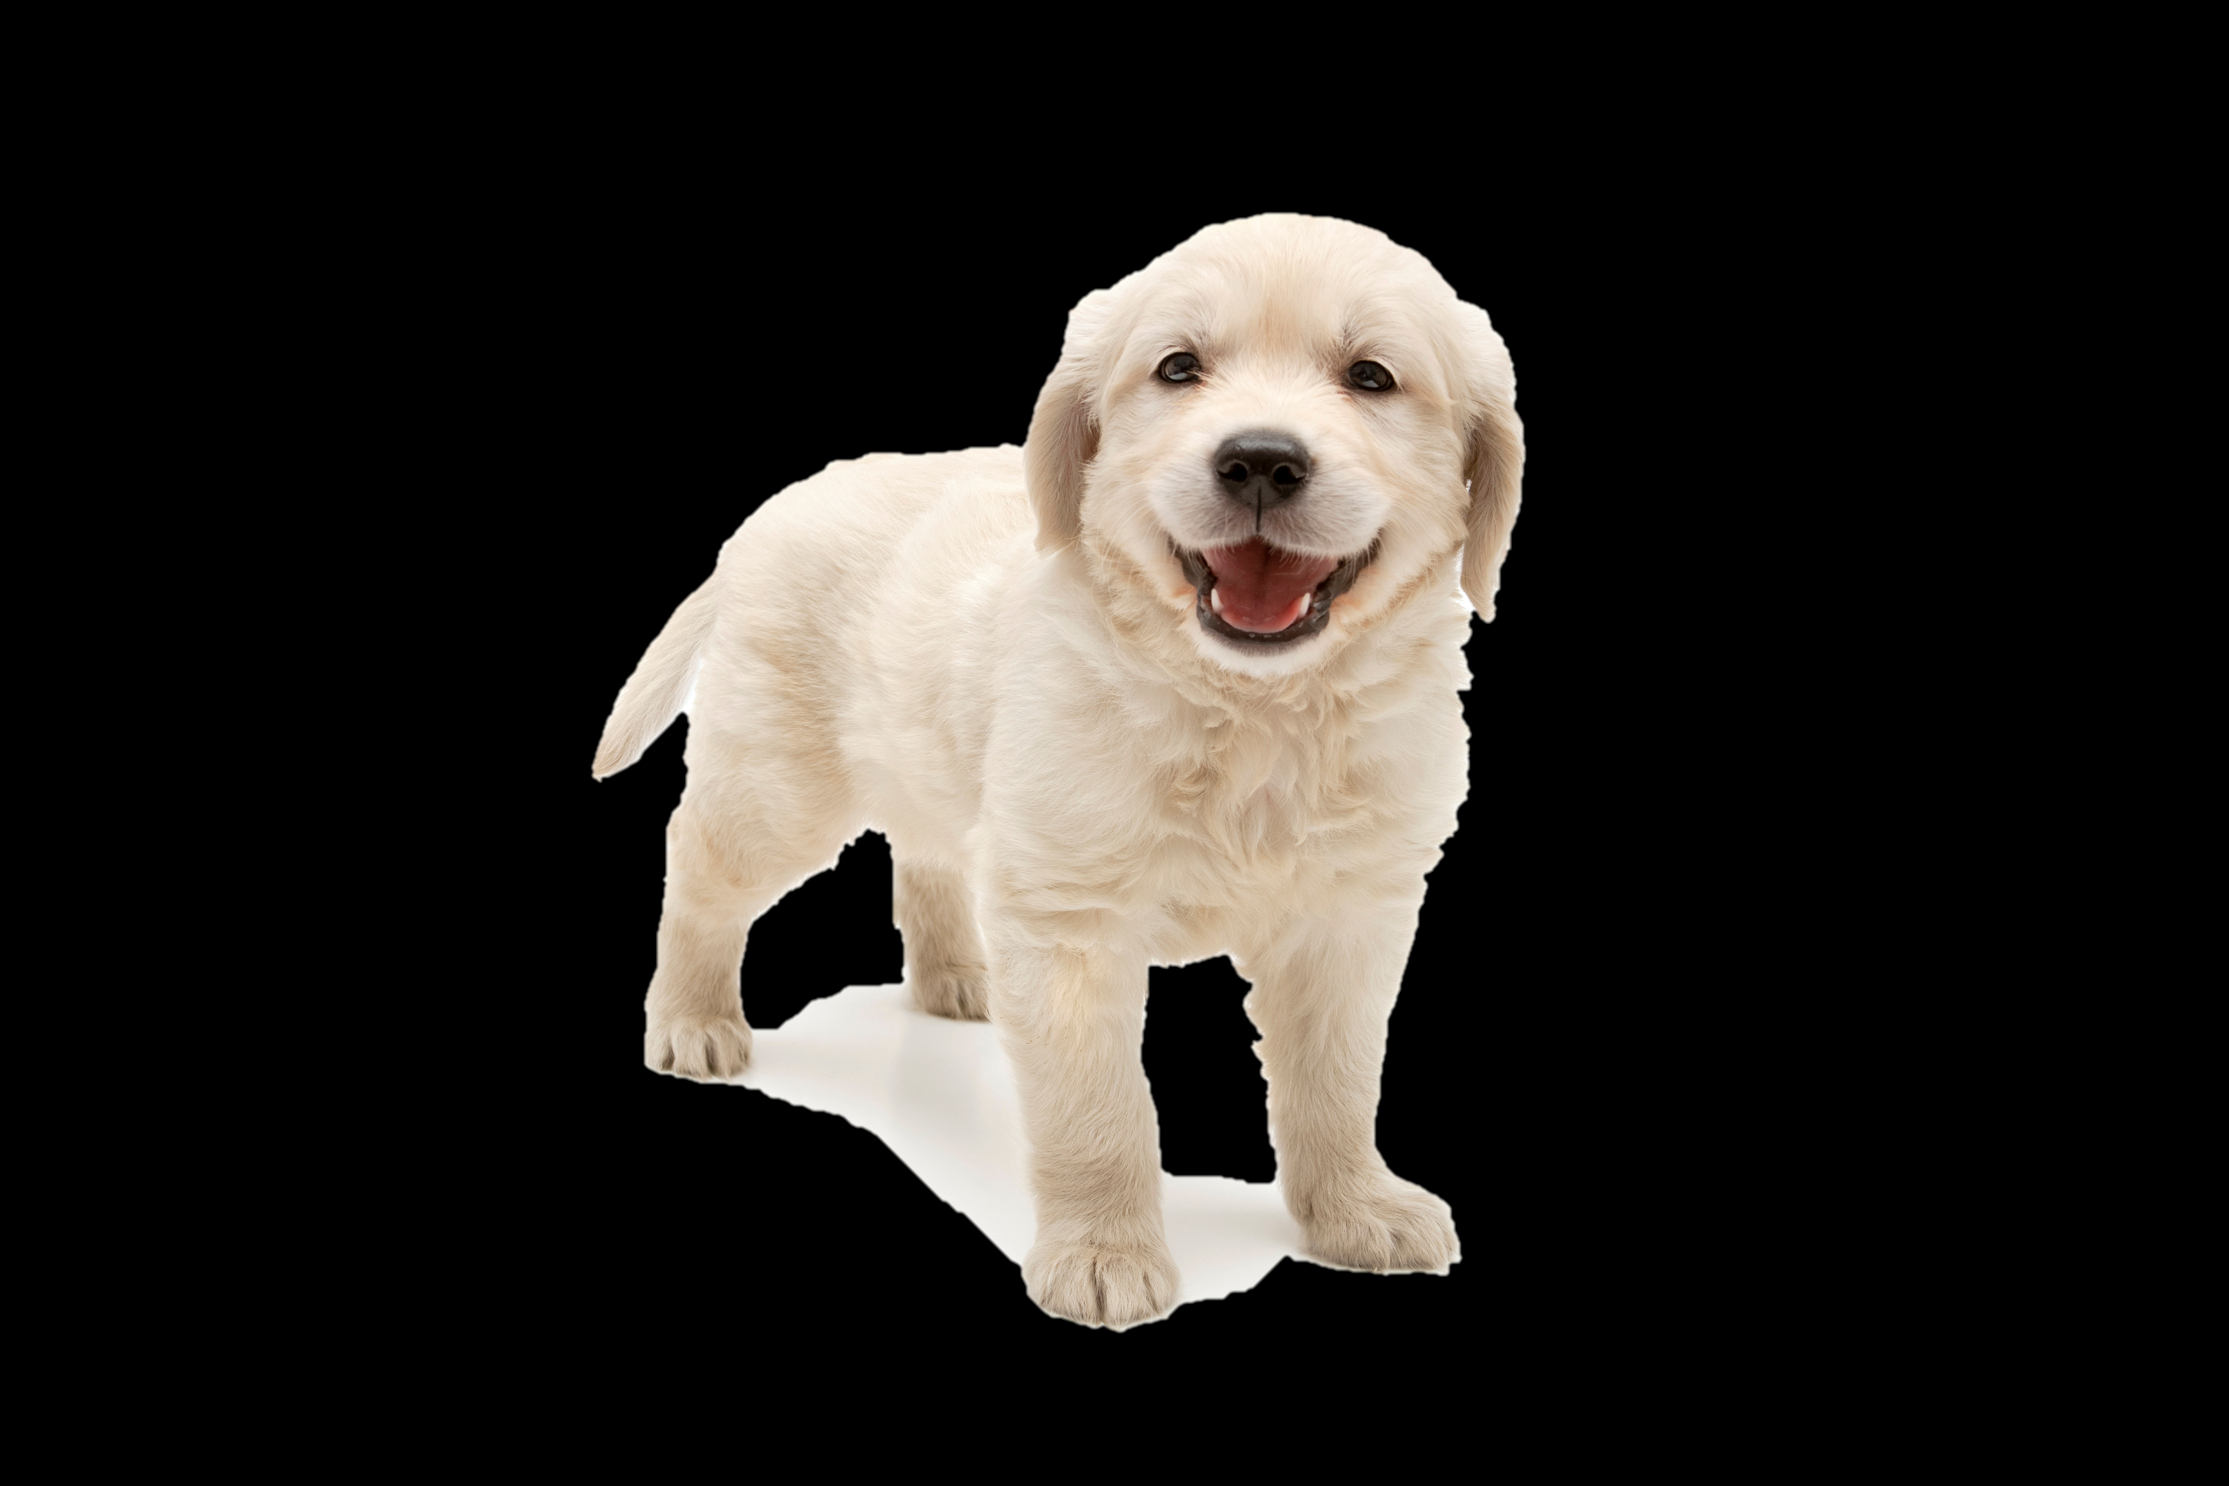
Aktiivilause
As she saw the puppy, Mary knew she had to have it.
Seeing the puppy Mary knew she had to have it.
Aktiivimuotoinen verbi → ing-muoto
Subjekti (sama kuin päälauseessa) → pois
Konjunktio → pois (yleensä)
iStock.com/101cats

Slide 6
Passiivilause
If it is taken regularly, the medicine will be effective.
(If) taken regularly, the medicine will be effective.
Passiivimuotoinen verbi → jää 3. muoto
Be-verbin osuus → pois
Subjekti (sama kuin päälauseessa) → pois
Konjunktio → pois (yleensä)

Slide 7
Prepositiorakenteet
When/After he had washed up, he was all set to go.
After washing up he was all set to go.
Just as she was seen by the police, she vanished into the house.
On being seen by the police, she vanished into the house.
Aikaa ilmaiseva lauseenvastike muodostetaan usein prepositiolla.
Tavallisimmat prepositiot: after, before, since ja on (juuri kun)
Aktiivilause: prepositio + ing-muoto (after doing)
Passiivilause: prepositio + being + 3. muoto (after being done)

Slide 8
Practise. Use shortened sentences.
Katsoessaan elokuvia äiti usein nukahtaa.
(When) watching films, mum often falls asleep.
2. Tämän tietäen en ollut huolissani, kun tulin kotiin.
Knowing this I wasn’t worried when I came home.
3. Jos minulle annettaisiin toinen mahdollisuus, en toimisi samoin.
(If) given another chance, I wouldn’t act the same way.
4. Kun äitiä pilkataan, hän suuttuu.
(When) made fun of / mocked, mother will get angry.

Slide 9
Practise. Make shortened sentences with prepositions.
5. Ennen saapumistaan New Yorkiin Matt oli innostunut.
Before arriving in New York, Matt was excited.
6. Kuultuaan onnettomuudesta hän oli hermostunut.
After hearing about the accident, he was nervous.
7. Kun hänelle oli kerrottu suunnitelmasta, hän ei ollut uskonut sitä.
On being told about the plan, he hadn’t believed it.
8. Tultuaan nähdyksi terroristien seurassa hän olisi epäilty.
After being seen with the terrorists, he would be a suspect.

Slide 10
Relatiivilauseiden vastikkeet
Aktiivimuotoinen relatiivilause
The man who sold the painting seemed trustworthy.
The man selling the painting seemed trustworthy.
Verbi korvataan ing-muodolla.
Relatiivipronomini (lauseen subjekti) pois.
Eli muodostetaan samaan tapaan kuin yleensäkin aktiivissa olevat lauseenvastikkeet.

Slide 11
Relatiivilauseiden vastikkeet
2. Passivimuotoinen relatiivilause
The gift which had been given to her by her uncle was unique.
The gift given to her by her uncle was unique.
Verbistä jää jäljelle vain 3. muoto.
Be-verbin osuus pois.
Relatiivipronomini (lauseen subjekti) pois.
Muodostetaan samaan tapaan kuin muutkin passiivivastikkeet.

Slide 12
Relatiivilauseiden vastikkeet
3. Infinitiivirakenne
The best thing that you can do is to try again.
The best thing to do is to try again.
Relatiivilauseen voi korvata infinitiivillä (esim. to do).
Korrelaatissa on superlatiivi, järjestysluku, next, last, only.

Slide 13
Relatiivilauseiden vastikkeet
4. Prepositiorakenne
New York is a city that has a lot to offer to tourists.
New York is a city with a lot to offer to tourists.
She was a teacher who had time for her students.
She was a teacher with time for her students.
Relatiivilauseen voi joskus korvata prepositiorakenteella.
Prepositioita: with, without, in

Slide 14
Practise. Turn relative clauses into
shortened sentences.
The man who gave the warning was a police officer.
The man giving the warning was a police officer.
2. It was about the animal that lived in the trees.
It was about the animal living in the trees.
3. But why should we care about an animal which is seen so rarely?
But why should we care about an animal seen so rarely?
4. Our neighbour, who had been told to be quiet, was angry.
Our neighbour, told to be quiet, was angry.

Slide 15
Practise. Turn relative clauses into
shortened sentences.
5. Why am I always the last who hears the truth?
Why am I always the last to hear (/hearing) the truth?
6. The first item which tempted me was a scarf.
The first item to tempt (/tempting) me was a scarf.
7. Tom Hanks is an actor who has a lot of famous roles.
Tom Hanks is an actor with a lot of famous roles.
8. But the man who wore a blue suit was not him.
But the man in (/wearing) a blue suit was not him.

