Slide 1
Indefiniittipronominit – Kooste
New Insights
Module 4 Grammar

Slide 2
Every, some, any ja no
Everything happens for a reason.
Everybody knows what happened but not everyone wants to talk about it.
Is there something wrong?
Nothing surprises me, anything might happen next.
Anybody might be behind this.
-thing-loppuisia indefiniittipronomineja käytetään asioista.
Ihmisistä käytetään joko -body- tai -one-loppuisia pronomineja.

Slide 3
Every, some, any ja no
Nobody knows everything.
Nothing ever happens around here.
Someone has left their coat on the chair.
Does anyone remember misplacing theirs?
Kaikki every-, some-, any- ja no-alkuiset pronominit ovat yksiköllisiä.
Niiden kanssa verbi on yksikössä.
Vaikka nämä pronominit ovat yksiköllisiä, niihin viitataan monikollisella pronominilla.

Slide 4
Every, some, any ja no
Nobody saw anybody leave the building.
Hardly anyone ever enters.
Why don't we pay any attention anymore?
Not everyone remembers their friends' birthdays.
Lauseessa voi olla vain yksi kieltomuoto.
Kieltomuoto not tulee yleensä ennen every-sanoja.

Slide 5
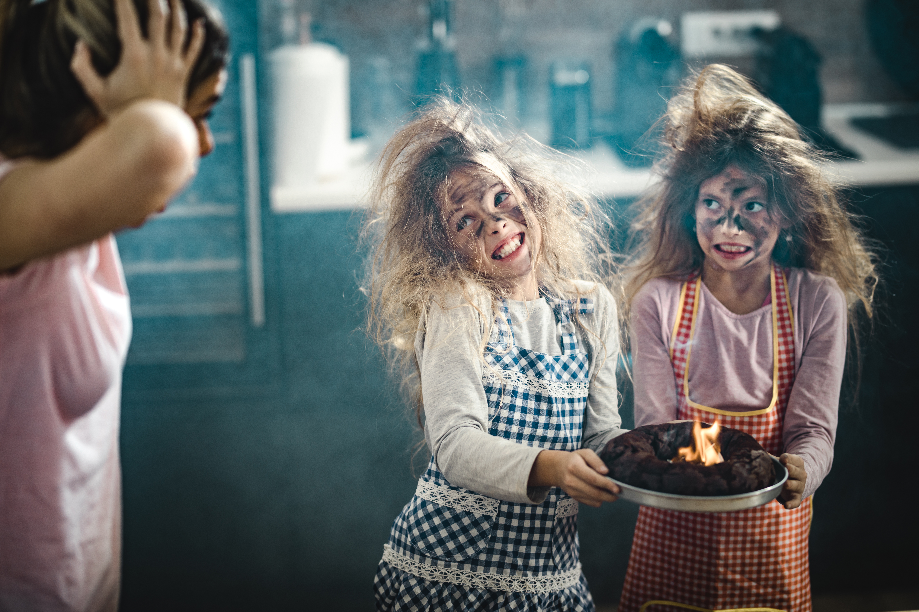
Every, some, any ja no
No chocolate was added to the batter.
Nobody liked the burnt cake.
Kielteistä lausetta ei voi aloittaa any-alkuisella pronominilla, vaan silloin käytetään no-alkuisia pronomineja.
Getty Images / skynesher

Slide 6
Every, some, any ja no
Any student here could give a speech on any topic.
No speakers volunteered though.
Do you remember every word that I say?
There must be some reasons behind their actions.
Substantiivin edellä käytetään indefiniittipronominista adjektiivista (lyhyttä) muotoa.

Slide 7
Every, some, any ja no
Every one of the participants tried their best.
One of the athletes smiled broadly.
Some of the prize money was given to charity.
Would any of us been able to do the same?
None of the money was wasted.
Of-rakenteen kanssa tarvitaan indefiniittipronominista omaa muotoa.

Slide 8
Another, other, others, the other
Would you like another slice of pizza?
Did you taste the other pizza, too?
Others hadn't noticed the kitten, but we saw it in the tree.
When we arrived, the others were already ready to move on.
another (joukosta, jää vielä muitakin)
the other (kahdesta)
others (toiset ihmiset, myös: other people)
the others (tietyt)

Slide 9

Another, other, others, the other
The doctor and the patient looked at each other / one another.
They didn't understand each other's / one another's thoughts.
each other / one another = toisiaan, toinen toisiaan
each other's / one another's = omistusmuoto
Getty Images / Charday Penn

Slide 10
Another, other, others, the other
People's tastes differ: one prefers golf, another tennis.
One match was worth watching, the other a waste of time.
Some dislike ice-hockey, others soccer.
There were quite a few supporters at the local match. Some left early, the others stayed despite the downpour.
yksi/toinen - toinen (one - another)
toinen - (se) toinen (one - the other)
toiset - toiset (some - others)
toiset - (ne) toiset (some - the others)

Slide 11
All, whole
All (of) the sausages and all (of) the juice vanished from the fridge.
All that I had time for was to help with cleaning up.
We all love to sleep late / All of us love to sleep late.
Have you loved chocolate all your life / your whole life?
all (of) = kaikki
all that = kaikki mitä
we all / all of us (all persoonapronominien kanssa)
all your life / your whole life = koko

Slide 12
Both, each
Both films interest me.
Do both of the books on the table belong to you?
We need to add both milk and honey to the mix.
Each of you wants to leave early.
The teachers each keep their bikes in the yard.
both = molemmat
both – and = sekä – että
each = kumpikin, joka ikinen

Slide 13
Either, neither
Can't we go either way?
Sure, choose either.
Neither of the paths goes in the right direction.
We can either wait or go right away.
I neither studied nor worked last summer.
either = jompikumpi, kumpi tahansa
neither = ei kumpikaan
either – or = joko – tai
neither – nor = ei – eikä

