Slide 1
Indefiniittipronominit:
Every, some, any ja no
New Insights
Module 4 Grammar

Slide 2
Express in Finnish.
Has everybody cast their vote now?
Not everyone was looking forward to the elections.
Everything isn't the same as before.
Every / each candidate makes good promises.
Does every one of them convince you?
Each of us wants a new government.
All of us agree.

Slide 3
Every
Has everybody cast their vote now?
Not everyone was looking forward to the elections.
Everything is the same as before.
Ihmisistä käytetään joko -body- tai -one-loppuisia pronomineja. Niillä ei ole merkityseroa.
Asioista käytetään -thing-loppuisia pronomineja.
Verbeistä käytetään yksikkömuotoa.
Huomaa monikollisen pronominin käyttö (they, them, their, theirs).
Kieltomuoto not tulee yleensä ennen every-sanoja.

Slide 4
Every
Every / each candidate makes good promises.
Does every one of them convince you?
Each of us wants a new government.
All of us agree.
Every/each ovat yksiköllisen substantiivin edellä.
Of-rakenteen edellä every ja one kirjoitetaan erikseen.
All-sanan jälkeen verbi on monikkomuodossa.

Slide 5
Express in Finnish.
Somebody has tampered with my bike.
Has someone taken it with them?
There's something fishy about this.
The tyres need some air.
Some people don't know anything!
Did you say something?
You won't help me? Some friend you are!
One of you will give me a hand.
Are some of you too busy for this?
Some of the soup went to waste.

Slide 6
Some
Somebody has tampered with my bike.
Has someone taken it with them?
There's something fishy about this.
Ihmisistä käytetään joko -body- tai -one-loppuisia pronomineja. Niillä ei ole merkityseroa.
Verbeistä käytetään yksikkömuotoa.
Huomaa monikollisen pronominin käyttö (they, them, their, theirs).
Asioista käytetään -thing-loppuisia pronomineja.

Slide 7
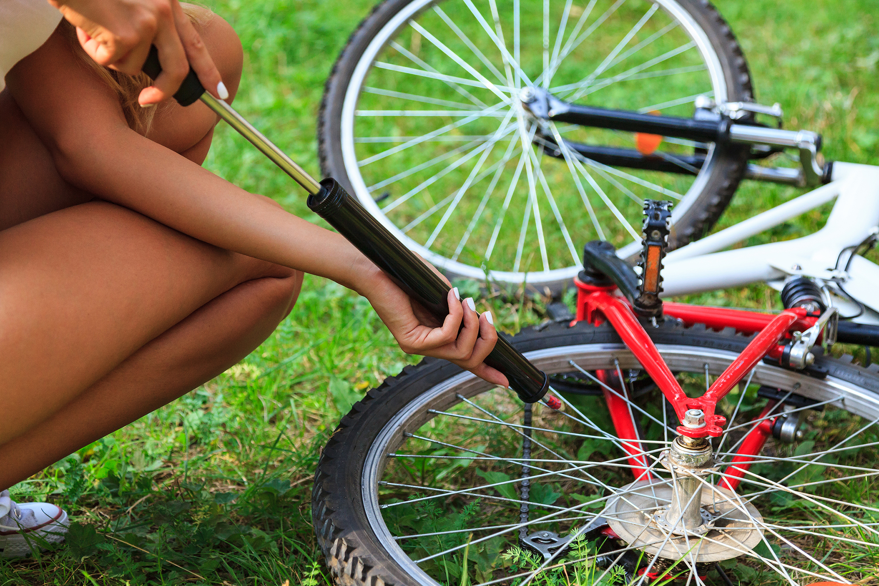
Some
The tyres need some air.
Some people don't know anything!
Some + ainesana = jonkin verran, hieman
Some + monikko = jotkut, joitakin
iStockcom / Nobilior

Slide 8
Some
Did you say something?
You won't help me? Some friend you are!
Jos kysymyslauseessa on some, odotetaan myönteistä vastausta.
Some + ihmistä tarkoittava sana yksikössä on painokas, sävyltään halveksivakin ilmaus.

Slide 9
Some
One of you will give me a hand.
Are some of you too busy for this?
Some of the soup went to waste.
Of-rakenteessa one on yksikkö, some monikko.
Of-rakenteessa some + ainesana = osa.

Slide 10
Express in Finnish.
Did anybody volunteer for the job?
We didn't see anyone raise their hand.
There was hardly anything to do.
Do I have any choice?
Choose any country you are interested in.
Any of us can work with any of the topics you might pick.

Slide 11
Any
Did anybody volunteer for the job?
We didn't see anyone raise their hand.
There was hardly anything to do.
Any-pronomineja käytetään useimmiten kielto- ja kysymyslauseissa (kukaan, mitään).
Anybody/anyone ihmiset; anything asiat.
Lauseessa voi olla vain yksi kieltomuoto.
Hardly, scarcely, rarely, seldom ja without ovat kielteisiä sanoja.
Any-sanoilla ei voi aloittaa kielteistä lausetta (kts. no).

Slide 12
Any
Do I have any choice?
Anything you are interested in is fine.
Any of us can work with any of the topics you might pick.
Substantiivin edelle tulee pelkkä any.
Myönteisissä lauseissa any-pronomini ilmaisee kuka tahansa tai mitä tahansa.

Slide 13
Express in Finnish.
Nobody is taking this seriously.
No one has realized it will affect them, too.
That's why nothing has been done yet.
No speakers have been booked.
I believe no time can be lost either.
None of the organizers have given this any thought.
None of the money has been lost yet.

Slide 14
No
Nobody is taking this seriously.
No one has realized it will affect them, too.
That's why nothing has been done yet.
Nobody/no one ihmiset; nothing asiat.
Verbeistä käytetään yksikkömuotoa.
Huomaa monikollisen pronominin käyttö (they, them, their, theirs).
Kielteistä lausetta ei voi aloittaa any-alkuisella pronominilla, vaan silloin käytetään no-alkuisia pronomineja.

Slide 15
No
No speakers have been booked.
I believe no time can be lost either.
None of the organizers have given this any thought.
None of the money has been lost yet.
Sanaa no käytetään yksiköllisten ja monikollisten substantiiven edellä.
Of-rakenteessa käytetään sanaa none.
Se voi olla yksikkö tai monikko.

Slide 16
Practise.
1. Onko jokainen jo kuullut jotakin uudesta kauppakeskuksesta?
Has everybody / everyone already heard something about the new shopping mall?
2. Kukaan ei ole kuullut kaikkea.
Nobody / no one has heard everything / all.
3. Joku meistä voisi auttaa heitä kaikkia.
One of us could help all of them / every one of them / each of them.
4. Mitä tahansa voisi tapahtua joillekin meistä.
Anything might happen to some of us.

Slide 17
Practise.
5. Kukaan meistä ei mennyt avajaisiin.
None of us went to the opening.
6. Osaako kukaan selittää päätöstään?
Can anyone / anybody explain their decision?
7. Kaikki eivät ole kiinnostuneita shoppailusta.
Not everybody / everyone is interested in shopping.
8. Shoppailu on kaikkea muuta kuin tylsää.
Shopping is anything but boring.

