Slide 1
Yleis- vai kestomuoto – More advanced
New Insights
Module 1 Grammar

Slide 2
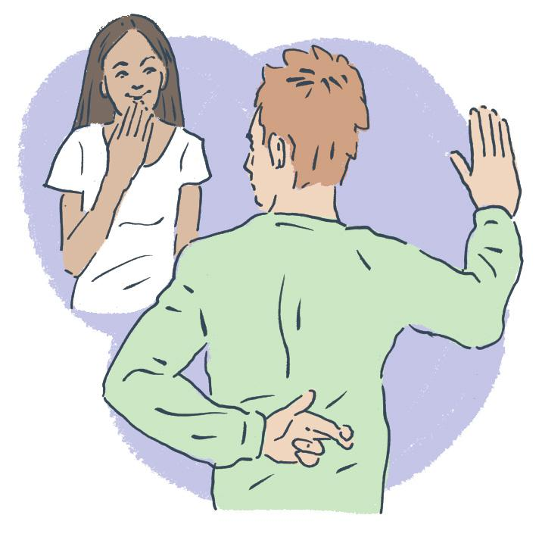
What differences in meaning do the simple and continuous forms have?
Mike usually tells the truth.
Mike isn’t telling the truth now.
Mike told a big lie to Julia.
Mike was telling lies all the time but Julia didn’t notice it.
Why hasn’t Mike told Julia the truth?
Mike has been telling so many lies that Julia is fed up.

Slide 3
Yleis- ja kestomuodon käytön eroista
Usein sekä yleis- että kestomuoto on mahdollinen, mutta niiden välillä voi tulla merkityseroja.
Mike usually tells the truth. (tapa)
Mike isn’t telling the truth now. (tällä hetkellä)
Mike told a big lie to Julia. (tapahtui)
Mike was telling lies all the time but Julia didn’t notice it. (jatkui)
Why hasn’t Mike told Julia the truth? (on tapahtunut)
Mike has been telling so many lies that Julia is fed up. (jatkuu)

Slide 4
Yleis- ja kestopreesensin käytön eroista
We go to the gym every Thursday.
toistuva tekeminen, tapa
We are going there now.
tekeminen on käynnissä parhaillaan
We don’t often meet.
toteamus, tapa
We are meeting tomorrow.
sovittu tapaaminen

Slide 5
Yleis- ja kestopreesensin käytön eroista
The sun rises from the east.
yleinen tosiasia
The sun is rising.
tapahtuu parhaillaan
The lesson doesn’t start until 8.15 am.
aikataulu
The lesson isn’t starting yet.
tapahtuu tällä hetkellä

Slide 6
Yleis- ja kestopreesensin käytön eroista
They come from Sweden.
pysyvä olotila, ovat kotoisin
They are coming from Sweden.
matkustavat tällä hetkellä
Sue can smell something burning in the kitchen.
aistihavainto
She is always smelling things even though nothing is wrong.
aistiharha

Slide 7
Yleis- ja kestopreesensin käytön eroista
Do you lose your temper easily?
tapa, taipumus
Are you always losing your temper?
ärsyttävä ja huono tapa
(mukana yleensä always)

Slide 8
Yleis- ja kestoimperfektin käytön eroista
We walked and then we sat down on the bench.
perättäiset tapahtumat
We were walking the park when a thunderstorm broke out.
taustakuvaus ja yksittäinen tapahtuma
We wondered if tomorrow would work.
pohdimme
We were wondering if tomorrow would work.
kohtelias tiedustelu

Slide 9
Yleis- ja kestoperfektin käytön eroista
I have painted my room blue.
päättynyt tekeminen, nyt huone on sininen
I have been painting my room blue.
maalaaminen on kesken
I have meant every word.
toteamus
I’ve been meaning to have a word with you.
aikomus

Slide 10
Yleis- ja kestoperfektin käytön eroista
I have run all my life.
harrastus, pysyvä asia
I have been running and am still out of breath.
juuri päättynyt tekeminen,
yhteys nykyhetkeen
I have never felt this great!
uusi tunne
I have been feeling better by and by.
asteittainen muutos

Slide 11
Yleis- ja kestopluskvamperfektin käytön eroista
The castle had stood on the hill for hundreds of years.
pysyvä olotila
I had been standing for hours and felt tired.
väliaikainen olotila

Slide 12
How do the two alternatives differ?
1. When I got home, Tom a) was cooking b) cooked dinner.
a) Tom had already started cooking
b) Tom started when I got there
2. Mia a) was washing b) washed the car while I was reading the newspaper.
a) two simultaneous, unfinished actions
b) Mia finished washing the car while I continued reading
3. They a) visited b) were visiting the Met yesterday.
a) a typical visit, narration
b) emphasizes the duration

Slide 13
How do the two alternatives differ?
4. Kate a) is participating b) participates in the race.
a) at the moment or an agreement
b) a statement
5. Jack a) always complains b) is always complaining about how little he earns.
a) a habit
b) an annoying habit
6. I a) was working b) worked in the basement when you arrived.
a) background action, you arrive in the middle of it
b) working hadn't taken long yet

Slide 14
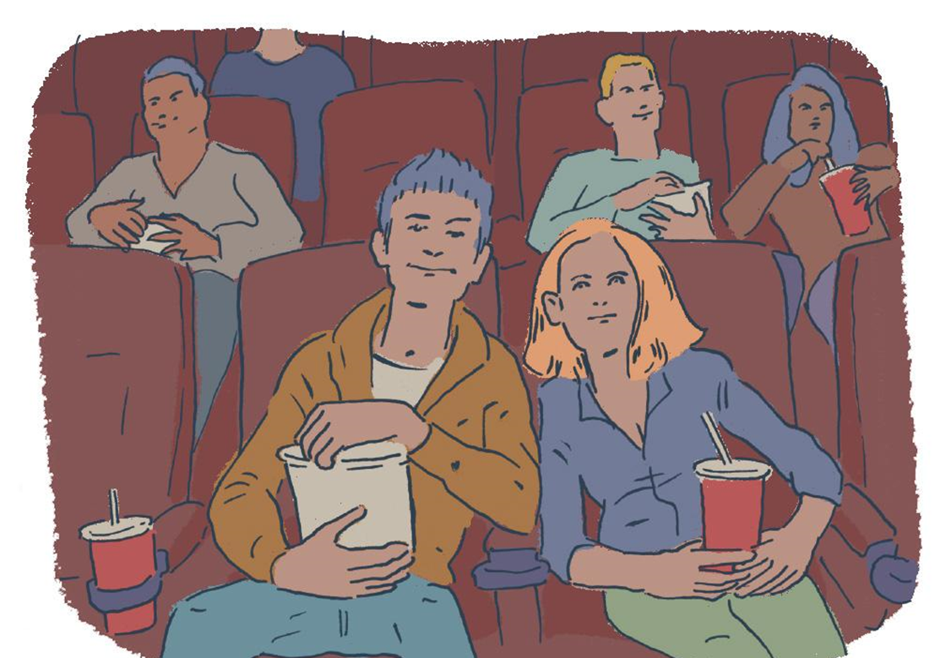
What has happened and what have the people been doing? Use as many of the following verbs as possible: believe, drink, doubt, eat, exist, imagine, know, leave, look, love, hate, have, own, pay, prefer, realize, remember, suppose, taste, understand, watch, want, wish.

