Slide 1
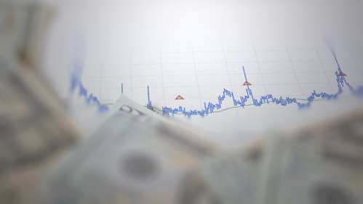
Investing

Slide 2
What is investing?
Putting money into assets which can make profit
You can invest to different type of assets like stocks, mutual funds and bonds

Slide 3
Why to invest?
By investing you can make additional income
By saving money you can't make profit
By investing money allows you to financial flexibility in the future
The earlier you start to invest the easier it is and there is bigger chance to get larger ammount of money

Slide 4
What are good investments
Every investments have risks
Good investments are the one that increases its value overtime and is reliable
For example good investments for beginners could be fund indexes like s&p500
S&p500 is a fund index that invests in Nasdaqs top 50 biggest companies so it's pretty safe and it has a good profit marginal

Slide 5
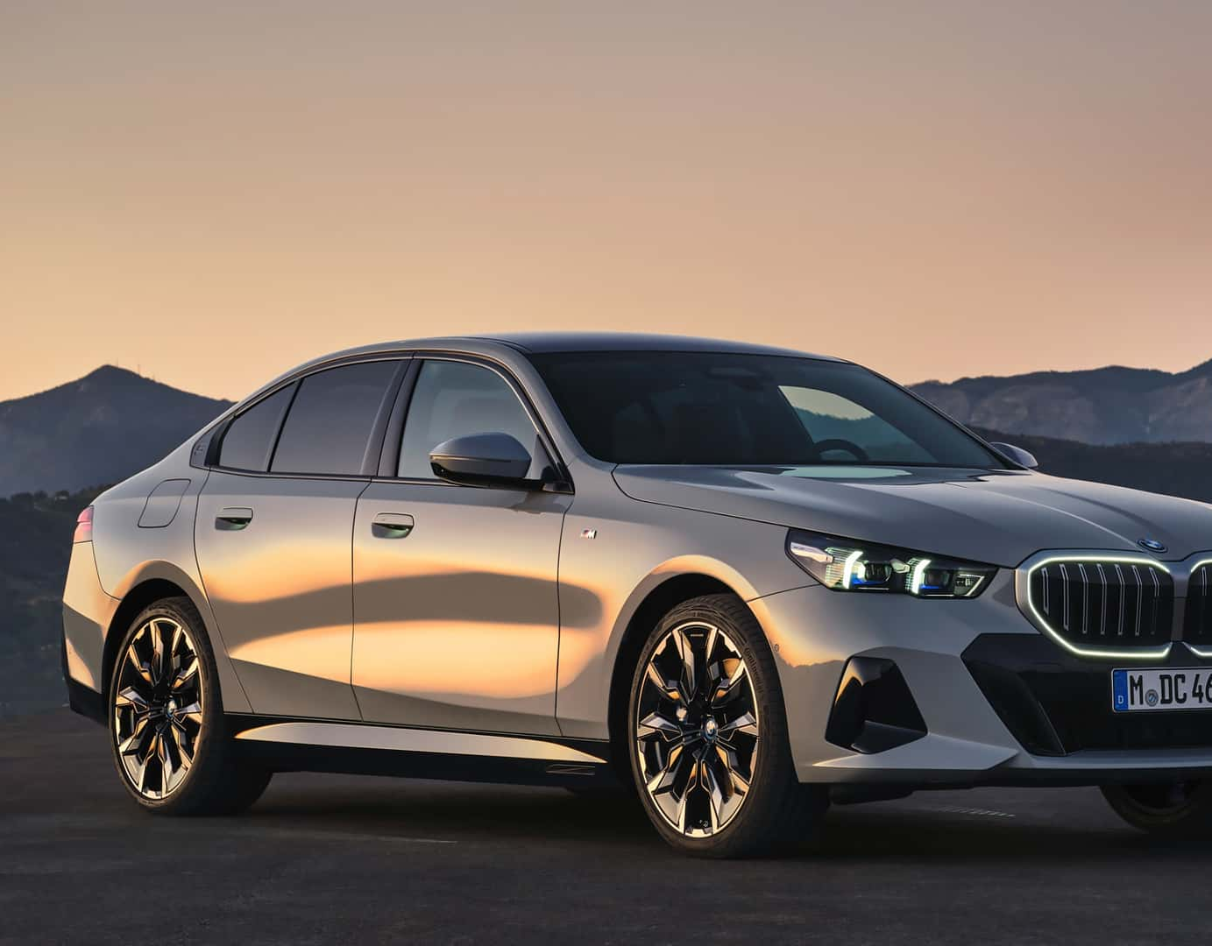
What are bad investments
Investment is usually considered bad when it's risk and return does not meet. Meaning that the risk is higher than the possible profit could be
Bad investments in case of profit are also things like gambling, expensive cars and clothes and generally just things that dosen't keep their value in long run
Bad investments can also be things that slowers your progression or makes you less capable person things like alcohol and drugs

Slide 6
Why should you invest instead of saving money?
By investing you can make profit
By saving money you can't make profit
When saving money the value decreases because of inflation
Investing can help you protect the value of money as the cost of living rises

Slide 7
How to start investing
Even tho many thinks that investing is hard and that it takes a lot of time its actually pretty effortless and easy.
You can study investing on internet for example or get investment help from the bank
You dont have to have big capital to start
Starting early and temporal dispersion are the major factors

Slide 8
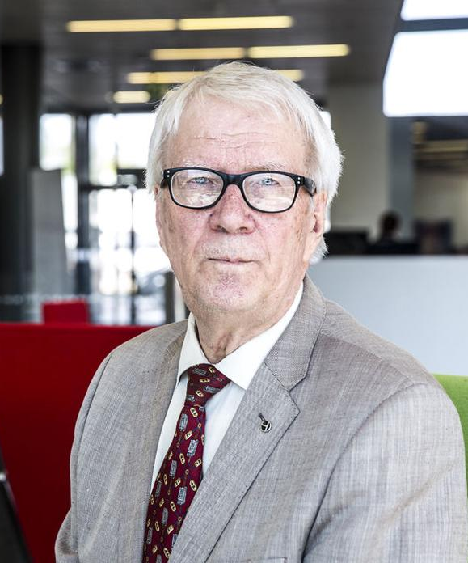
Erkki Sinkko
Born in 1936 (85 years old)
He started to invest in 1970
He invested in to stocks
He started investing with 13 000€
After 40 years the value of stocks were over 5,5 mil.€
In his opinion long-term investment is better option that gambling

Slide 9
Sources
https://fi.wikipedia.org/wiki/Erkki_Sinkko#:~:text=Erkki%20Sinkko%20(s.,ja%20taloustiedon%20opettajana%20Perni%C3%B6n%20lukiossa
https://www.investopedia.com/terms/i/investing.asp
https://www.bankrate.com/investing/best-investments/

