Slide 1

Making a cake
Mimosa & Thyra

Slide 2
Planing and the process
- First it was hard to decide something we wanted to do and after we had on decided to make a cake it was easy to decide what we wanted it to look like and what flavour would it be
- Editing was quite hard because it was something new
- Making this power point was hard sometimes because of tecnical difficulties
- We leard about how hard making icing can be and how diffucult decorating a cake can be , we learnd how to edit and translate resepies into english

Slide 3
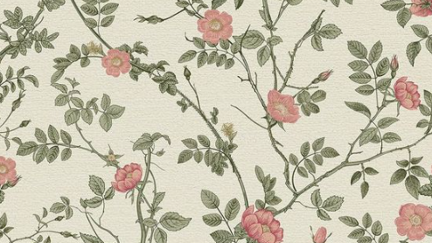
Cake history
The first recorded cakes were made in ancient Egypt by adding together flour, water and honey. Later the Greeks added to the resepy eggs, butter and something to make the batter rise. The Romans added yeast to make the batter richer, airier and softer.
By the middle ages cakes had become a very popular dessert in Europe, different in every area. In England fruitcakes were very popular.
The meaning of cakes have changed alot, at first they were offerings to gods but now they’re just for celebrations like weddings, birthdays and confermations.

Slide 4

Ingrediant list
How we made the cake:
First we mesaured the dry ingrediants and mixed them together
Then we mixed the butter and sugar
We added the eggs one by one
And we added the milk and the dry in small parts untill it was all mixed
Last we added a lot of sprinkels
Butter cream:
200g butter
200g powdered sugar
1 tbs vanilla sugar
Food coloring
Cake:
4 ¼ dl flour
2 tsp baking powder
½ tsp salt
200g room tempture butter
3 ½ dl sugar
4 eggs
1 tsp vanilla extract
1 ¼ room tempeture milk
Filling:
- Strawberies
Rasbarries
Whipcream
How we made butter cream:
We added room temputure butter to a bowl mixed it
We added the sugar and vanilla sugar then we mixed it untill it was fluffy

Slide 5
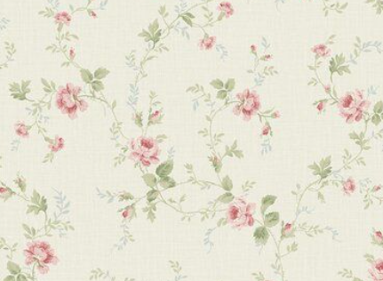
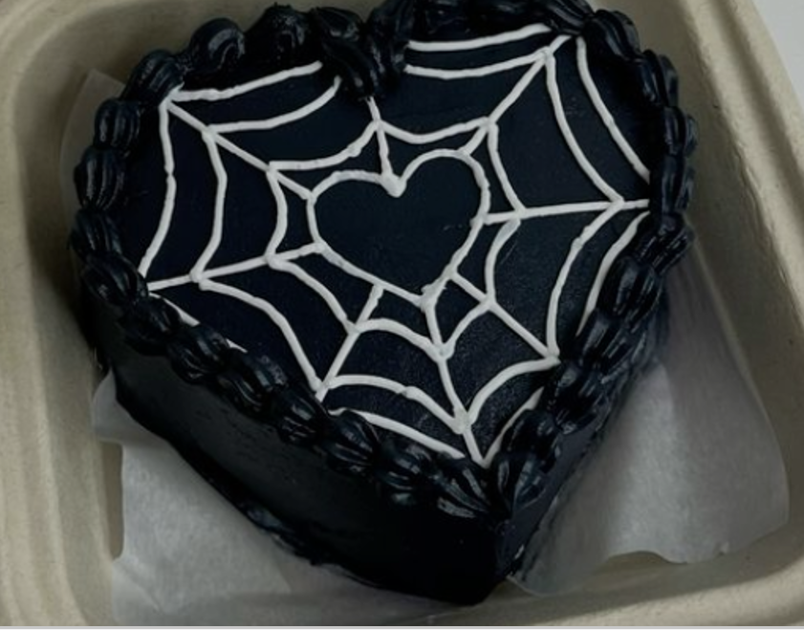
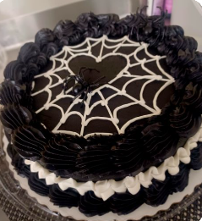
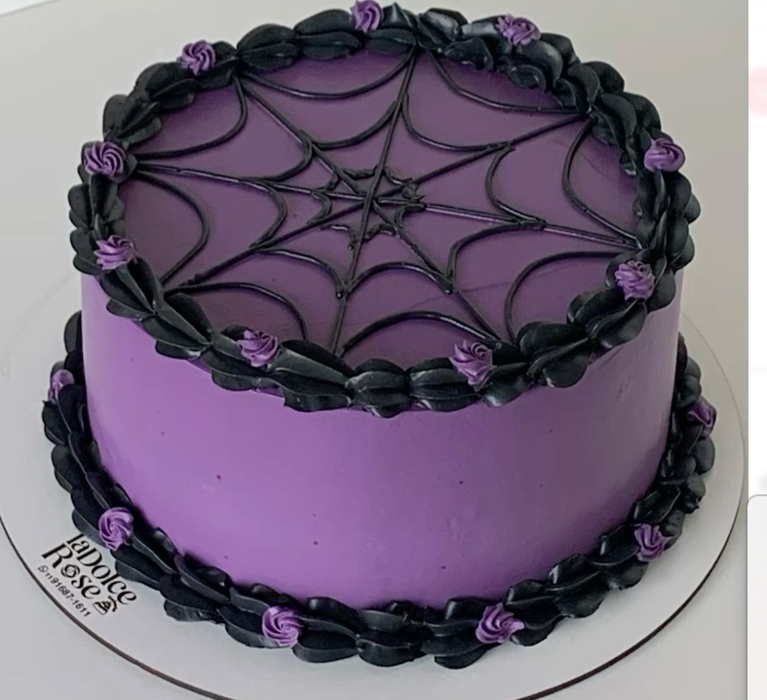
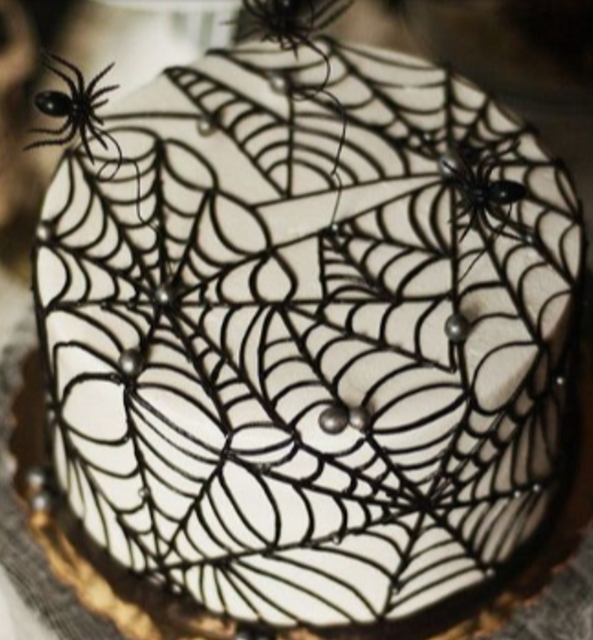
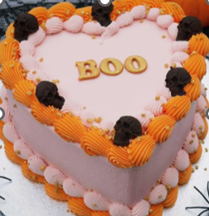
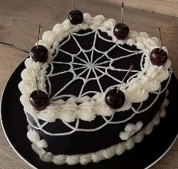
Insperation photos

Slide 6
Resoucres & resepies
https://jackandbeyond.com/blogs/cake-resources/what-was-the-first-ever-cake-like
https://www.neljakerrosta.fi/reseptit/neljan-kerroksen-vanilja-kakkupohja/
https://www.k-ruoka.fi/reseptit/voikreemi

