Slide 1
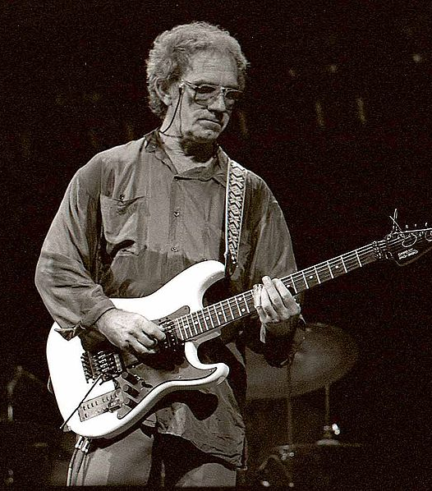
J. J. Cale

Slide 2
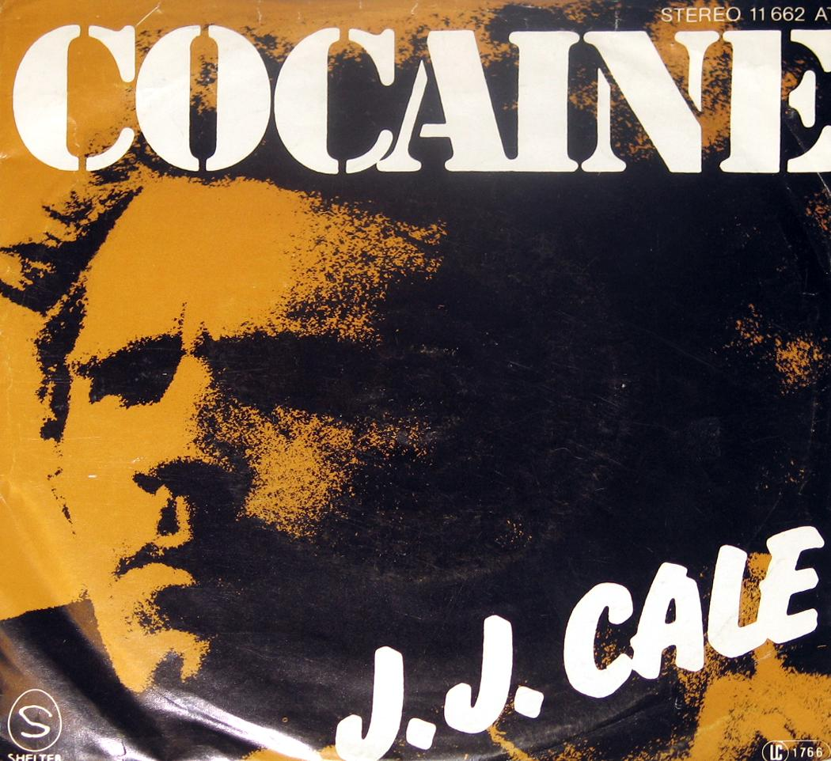
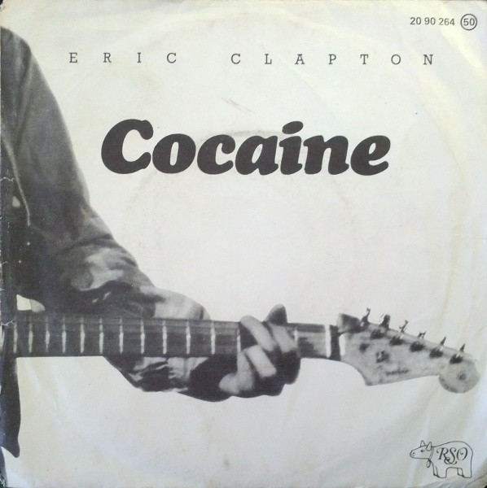
John Weldon "J. J." Cale (1938–2013)
American guitarist, singer and songwriter
Big influence on many artists
Eric Clapton, Mark Knopfler, Lynyrd Skynyrd, Tom Petty
"One of the most important artists in the history of rock" -Clapton
Many songs have been covered by other musicians
"Cocaine", "Call Me The Breeze"
Avoided fame and fortune

Slide 3
Life
Grew up in Tulsa, Oklahoma
One of the creators of the Tulsa Sound
Worked as a studio engineer and played in bands
Eric Clapton covered Cale's single "After Midnight" in 1970 and it became a success
Cale released his first album "Naturally" in 1972
Became a recluse in 1980 and lived in a trailer without a phone
Spent the 80's "mowing the lawn and listening to Van Halen and rap."
Married Christine Lakeland in 1995
Died of a heart attack in July 2013 at the age of 74

Slide 4
Producer, sound engineer and a mixer
Learned to play the guitar and studied sound engineering while living with his parents
Built his own recording studio
Was drafted into the military after graduation and took technical training in the Air Force and learned about electronics there
Often produced his own songs and acted as the sound engineer
Came up with a unique sound
Vocals buried in the mix

Slide 5
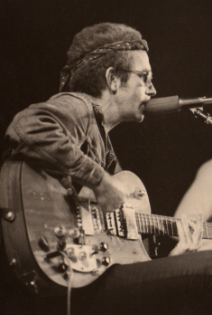
Music
"Tulsa Sound"
Laid-back
Mix of rock, blues, country and jazz
Quiet and whispery vocals
Precise but relaxed guitar playing
Mixed and produced his own music
Own unique sound

Slide 6
Songs

Slide 7
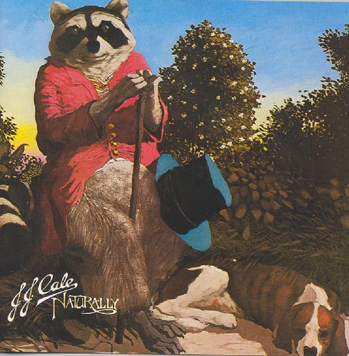
After Midnight
First released in 1966 and covered by Eric Clapton in 1970
Great bassline
Rhythmic piano gives the song a rock n' roll feel
Whispery and relaxing vocals
Simple but beautiful and clean guitar solo
Cales first album Naturally (1972)

Slide 8
Lights Down Low
First released in 2019
Has a nice relaxed country feel
Fun lyrics
Guitar creates a strong rhythm
You can hear the guitar and the strings
Intertwining guitar parts

Slide 9
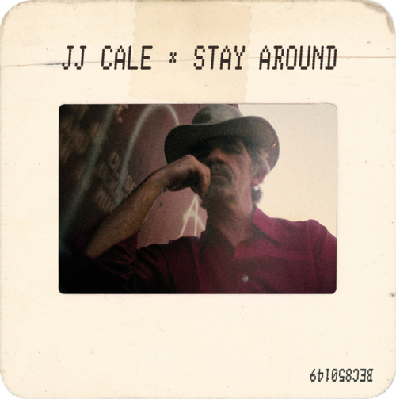
Stay Around
First released in 2019
Beautiful guitar playing
Relaxing groove and whispery vocals
Good lyrics
Mix of low, faint vocals and clear, bright guitar creates great contrast

Slide 10
Sources:
https://www.jjcale.com/biography
https://en.wikipedia.org/wiki/J._J._Cale
https://www.allmusic.com/artist/jj-cale-mn0000119651/biography
http://www.blues-finland.com/articles/jj_cale_uusinta_2016.html
Pictures:
https://fi.m.wikipedia.org/wiki/Tiedosto:J.J._CALE.jpg
https://www.flickr.com/photos/digimeister/25243343951
https://www.discogs.com/Eric-Clapton-Cocaine-Lay-Down-Sally/release/3998601
https://pixabay.com/fi/photos/%C3%A4%C3%A4ni-%C3%A4%C3%A4nitys-sound-studio-mikseri-1652404/
https://commons.wikimedia.org/wiki/File:J_J_Cale_Munich_75.jpg
https://www.flickr.com/photos/oddsock/73307238

