Slide 1
How does exercise affect different body systems?
Pinja Järvi

Slide 2
My choice of topic
The different stages of work
The easy parts and the difficulties
Things I learned

Slide 3
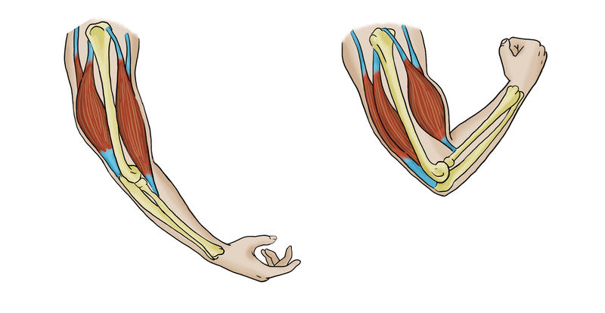
Positive effects:
Your mood improves (endorphins and serotonin)
Your stress levels reduces
You can sleep better
Relieves the symptoms of mental healt disorders
Exercise preventions of many diseases:
Heart and blood circulation diseases
Type 2 diabetes
Musculoskeletal system diseases
Some cancers

Slide 4
Too much exercise causes:
Overtraining
Insomnia (cortisol)
Powerlessness and pain
No results
Bad mood and frustration

Slide 5
My own results and observations

Slide 6
Better sleep
Easier to concentrate
Less stress
Sometimes little overworked
Didn’t get bored
Healtier feeling

Slide 7
Sources:
https://www.ukkinstituutti.fi/tietoa_terveysliikunnasta/liikunnan_vaikutukset
https://www.sharecare.com/health/types-exercise/how-does-exercise-affect-body
https://www.youtube.com/watch?v=Yla4f8OKbSE
https://www.youtube.com/watch?v=2MoGxae-zyo
https://www.smartmoves.fi/liikkuminen/liikunnan-hyodyt/

