Slide 1
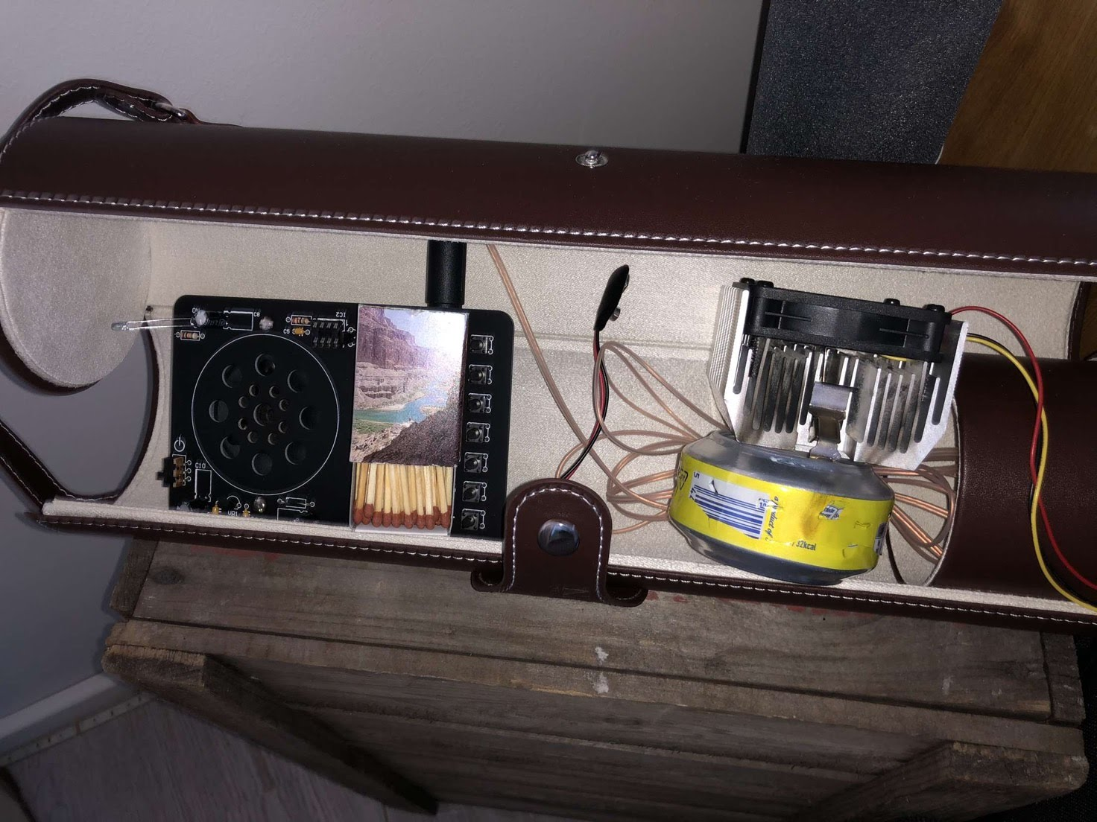
Emergency radio
Otto & Teemu

Slide 2
Our choice of topic
At first we had no idea what to do with our project. Then Otto suggested that we design an invention that could help people
After some thinking, we came to the conclusion that we wanted to build a radio that operates on wind power

Slide 3
Our stages of work

Slide 4
Our projects easy and difficult parts
The easy ones
The difficult ones
Making the operating manual for it
The idea of what we wanted to make
Making this PowerPoint
Making the model and getting it to work like how Otto wanted it to work

Slide 5
What did we learn?

Slide 6
