Slide 1
conspiracy theories about avril lavigne

Slide 2
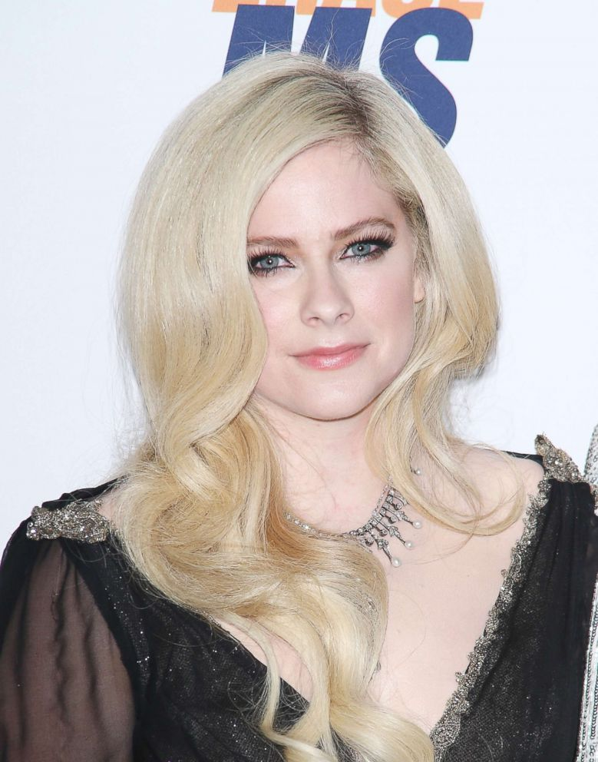
Avril Lavigne
a Canadian singer, songwriter, and actress
By the age of 15 she had appeared on stage
pop punk music
One of the most important Canadian female artist of all time

Slide 3
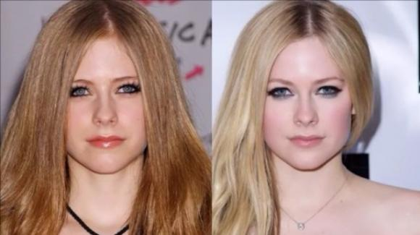
Suicide and replacement
2003 Suicide
record company
to avoid losing profits
Lookalike Melissa Vandella (actress)

Slide 4
5 YEAR Break
LYME DISEASE
open letter to her fans posted on her website
song 'Head Above Water’ 2019
SUBSTITUTION

Slide 5
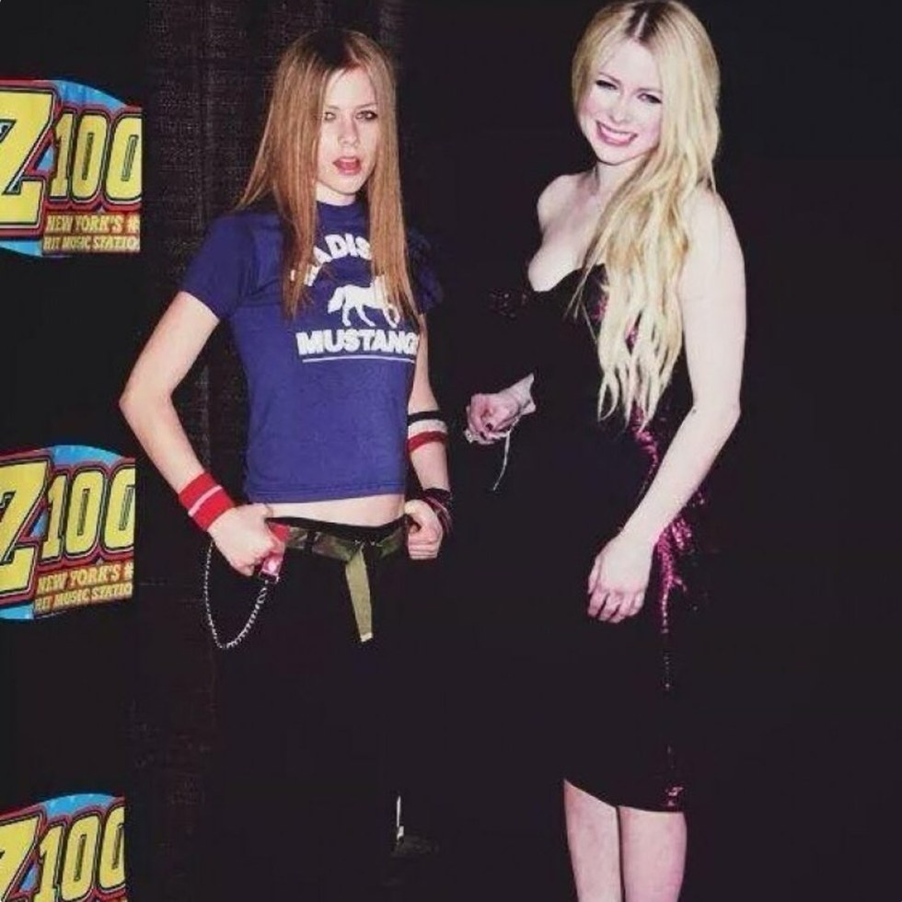
Proves
STYLE: Punk -> more feminine and sensual
VOICE: Deeper / lower
SONG sleeped away 2004 she talks about her death
INTERVIEW question about his death -> Avril nervous, hesitation

Slide 6
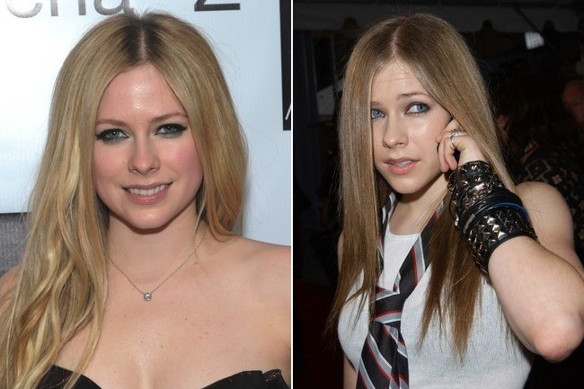
physical differences
Moles disappeared
different nose
new Avril 3 cm taller
corners of their eyes

Slide 7
WEB SITES
https://en.wikipedia.org/wiki/Avril_Lavigne
https://www.theguardian.com/lifeandstyle/shortcuts/2017/may/15/avril-lavigne-melissa-cloning-conspiracy-theories
https://www.independent.co.uk/arts-entertainment/music/news/avril-lavigne-dead-melissa-conspiracy-theory-lookalike-doppelganger-a8615421.html
https://www.eonline.com/news/982957/avril-lavigne-finally-responds-to-viral-conspiracy-theory-that-she-died-years-ago

