Slide 1
Creative Writing
By Sofia

Slide 2
WHY DID I CHOSE THIS TOPIC?
"I have always loved writing and i thought that creative writing was the right option for me"
"No one forgets the truth ; they just get better at lying"
Richard Yates: The Revolutionary road (1961)
"Nothing is so painful to the human mind as a great and sudden change"
Mary Shelley: Frankenstein (1818)

Slide 3

Stages of work
Difficulties with the project and how I solved them?

Slide 4
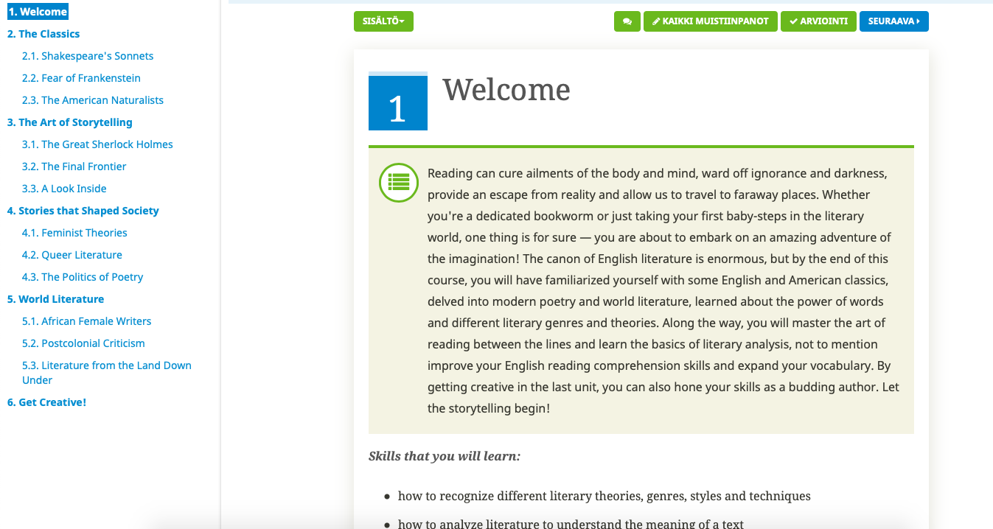
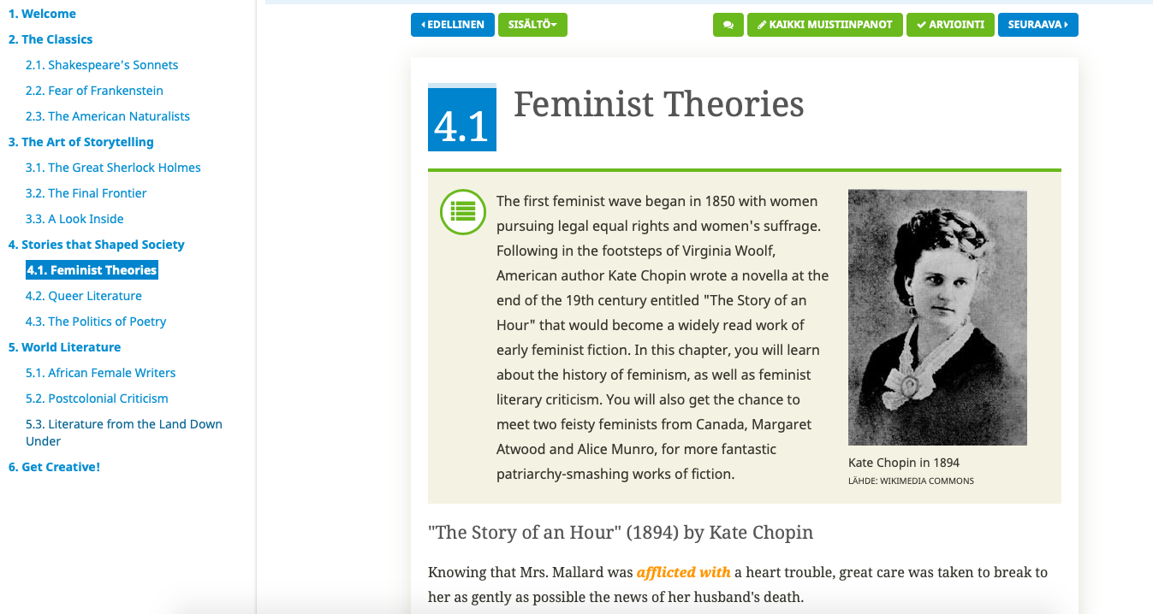
English literature and creative writing

Slide 5
What I learned from this project?

Slide 6
Few of my texts
Days went by, one after another. She waited, she waited so long that after a time had went by she didn't remember anymore who she was. She was just a breath of missing, breath of sorrow and a faded figure against the window. a Figure that was waiting for something that isn’t never coming back.
Time, time is a strange thing. When you are waiting something to happen time goes truly slow, but when you are having the time of your life time just slips between your fingers. Time is life.
I broke myself so you can be whole.

