Slide 1
A book presentation
Twilight by Stephanie Meyer

Slide 2
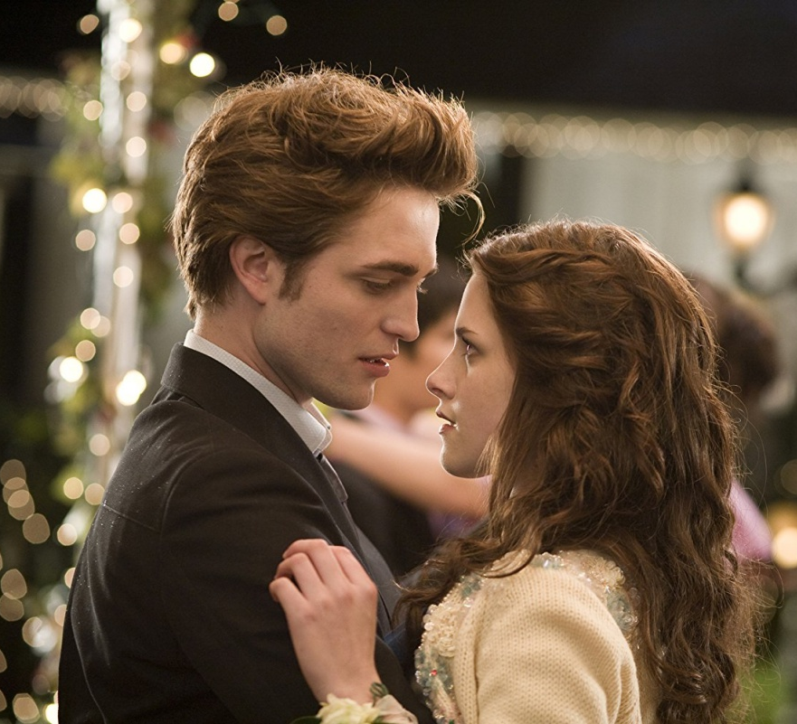
What happens in the book?

Slide 3
How the book was different from the movie?

Slide 4
Some words I learned
A parka - pitkä hupullinen takki s.3
A canopy – latvusto s.7
On the periphery – not within reach s.58
Dwindling - vähenevä/hupeneva s. 126

Slide 5
Why I chose this topic for my project?

Slide 6
Reading experience

