Slide 1
EN course 7
Mia-Riikka Heinonen

Slide 2
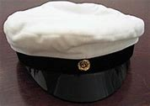
EN 7
The themes and targets of the course:
Increasing your vocabulary in the areas of nature and the environment
Revising key areas of grammar to improve your written and spoken English
Meet the requirements of the matriculation excamination

Slide 3
EN 7
The course comprises of:
book work
e-based learning (Sanoma Pro + other sources) Key: LTEE
A short project
2 essays / writing assignments
2 long listening comprehensions, several shorter ones
Thursdays > revision> preparing for the Big Test !!!

Slide 4
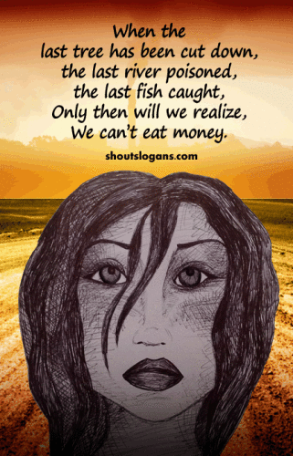
EN 7
Mottos for the course:
Blood, Toil, Tears and Sweat (Churchill)
Keep your eyes on the prize!
Modern technology Owes ecology An apology. ~Alan M. Eddison

Slide 5

En 7
Common rules for attending the course:
Everyone works! I’ll do my share , you’ll do yours! And it’s all done for your sake.
No phones allowed in the class! If we need them, I’ll tell you.
Evaluation is based 50 % on the work you do and 50 % on the test result.
The maximum number of absences in this course is 4.

