Slide 1
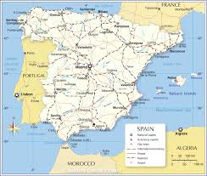
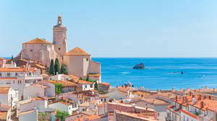
Erasmus trip to Spain

Slide 2
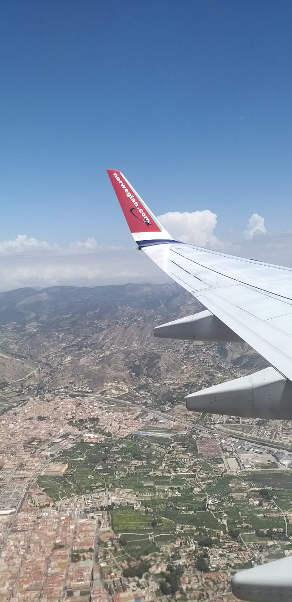
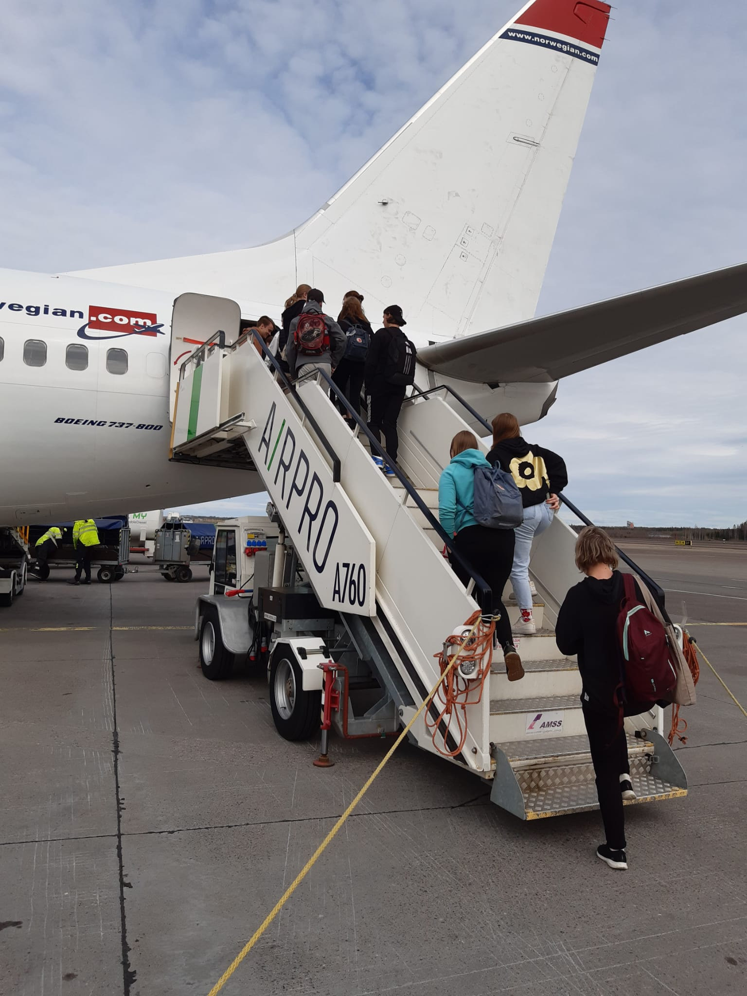
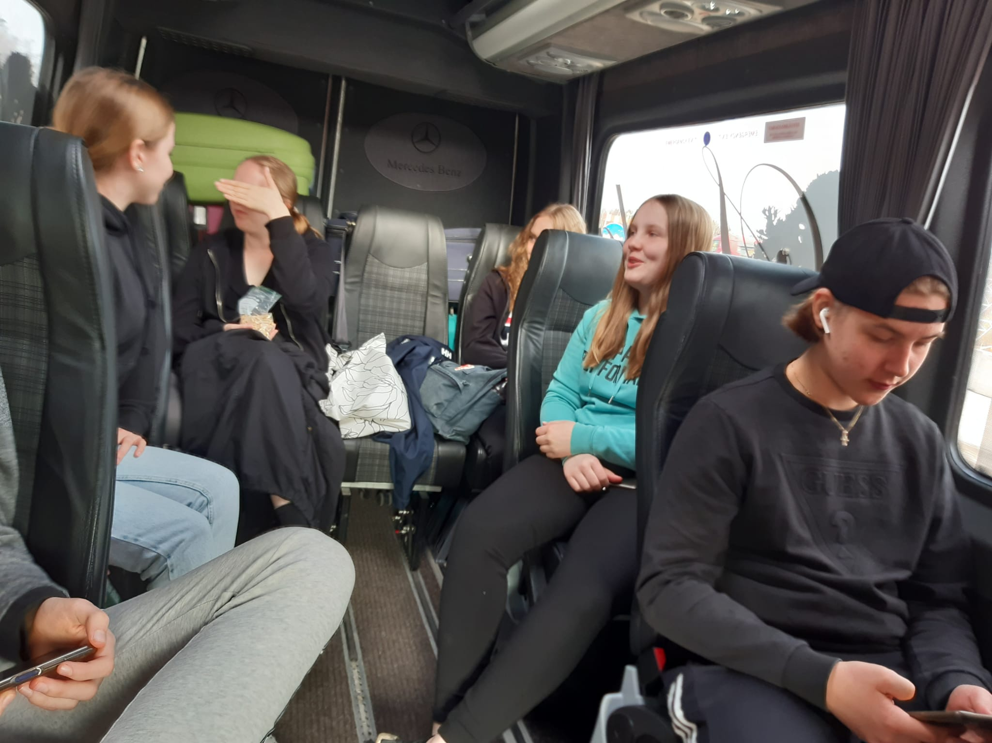
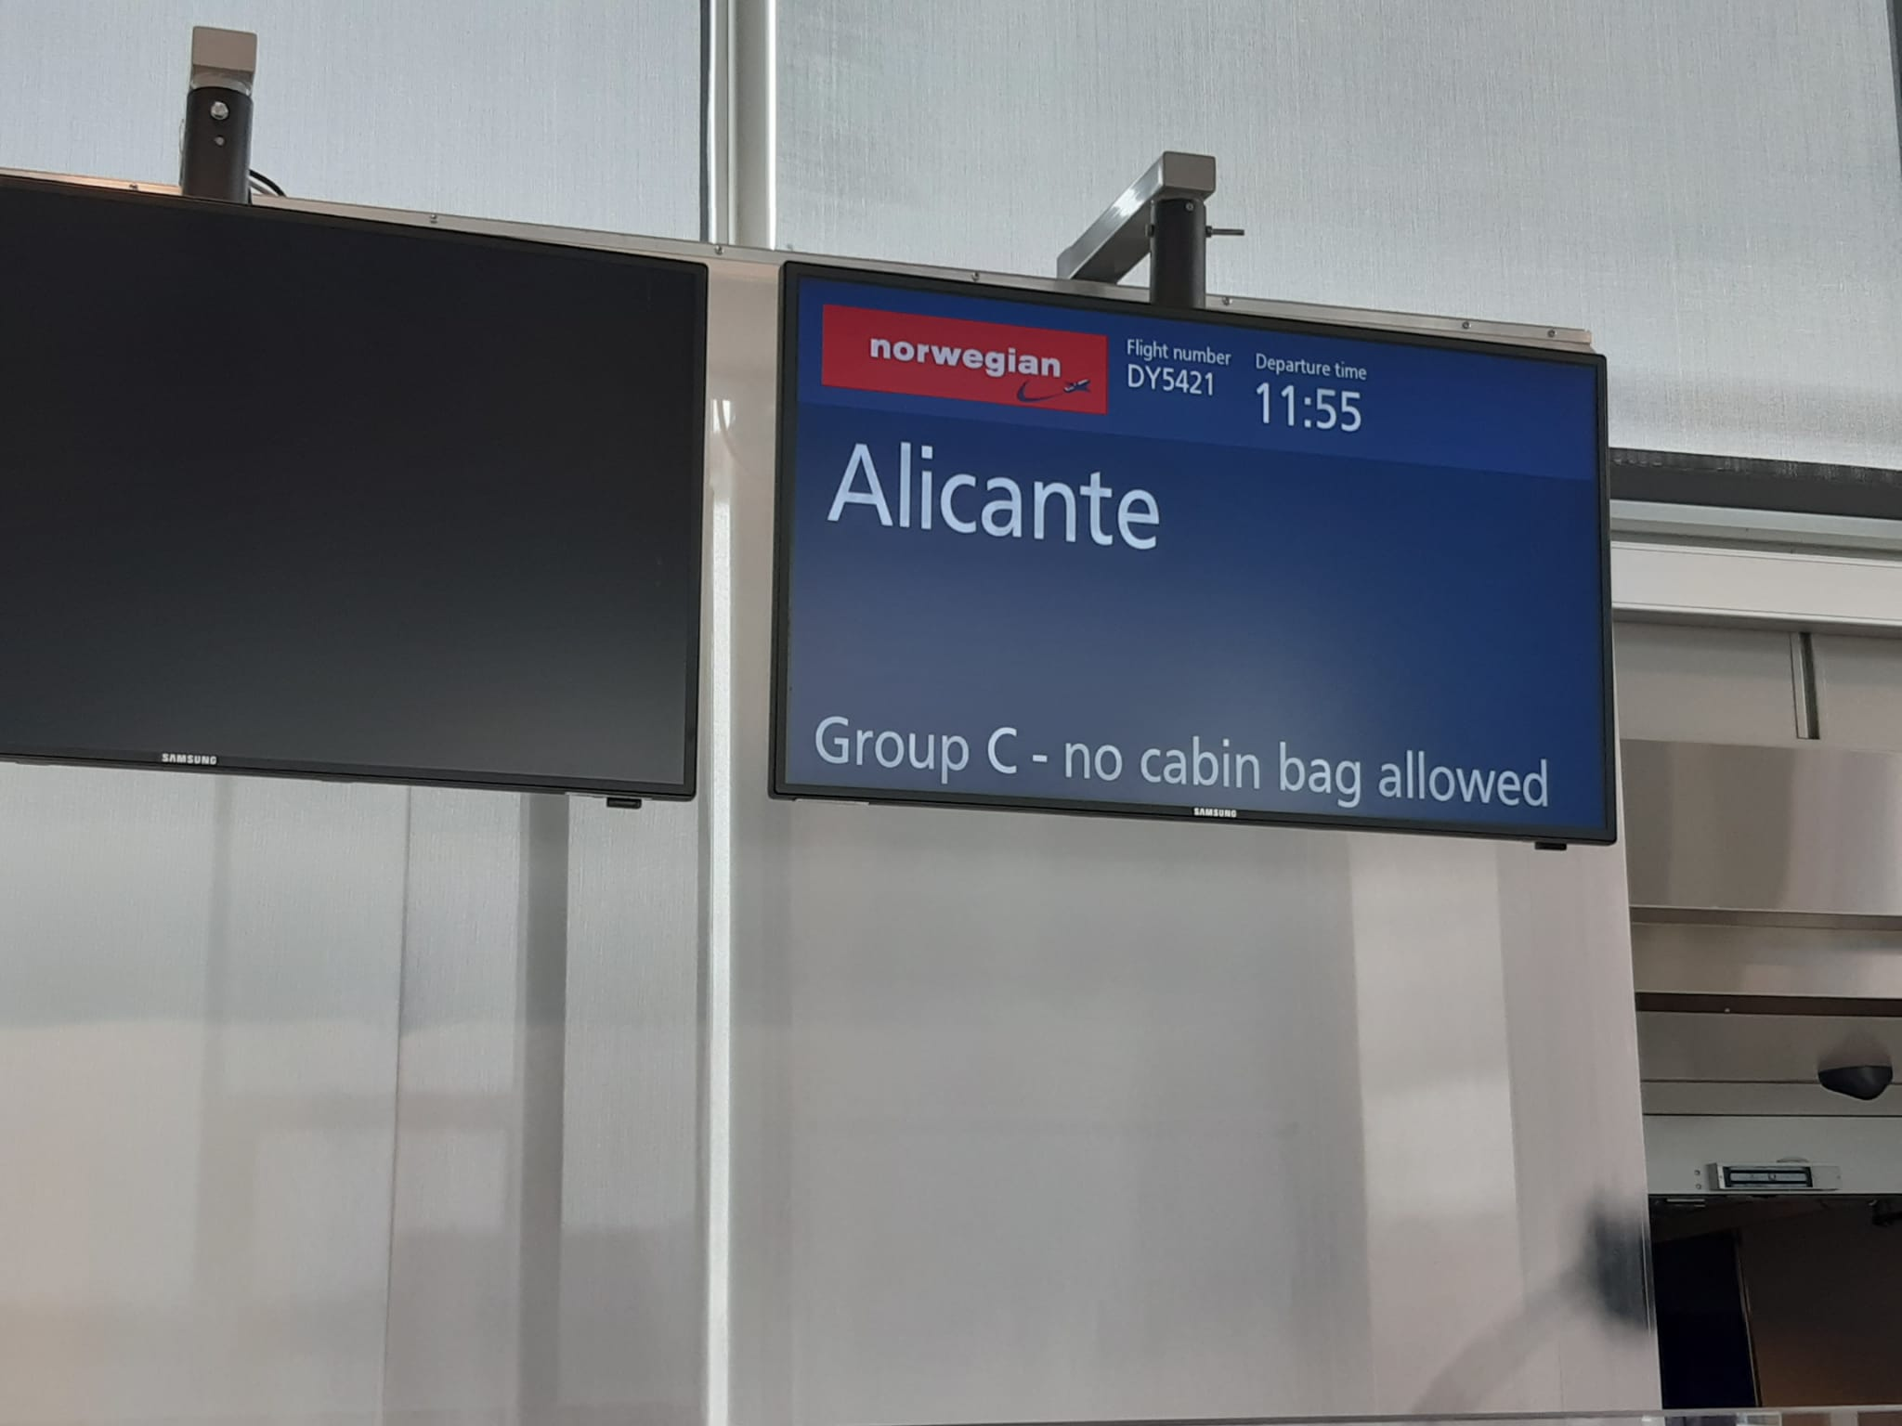
Monday
First we went to Hj.Nortamo school at 6:45am. Leaving to the Helsinki/Vantaa airport with a taxi. Then we flew to Alicante and from there we went to Murcia with a bus. We spent the rest of the day in Murcia together and after that we went to our hosts homes in Torre-Pacheco.

Slide 3
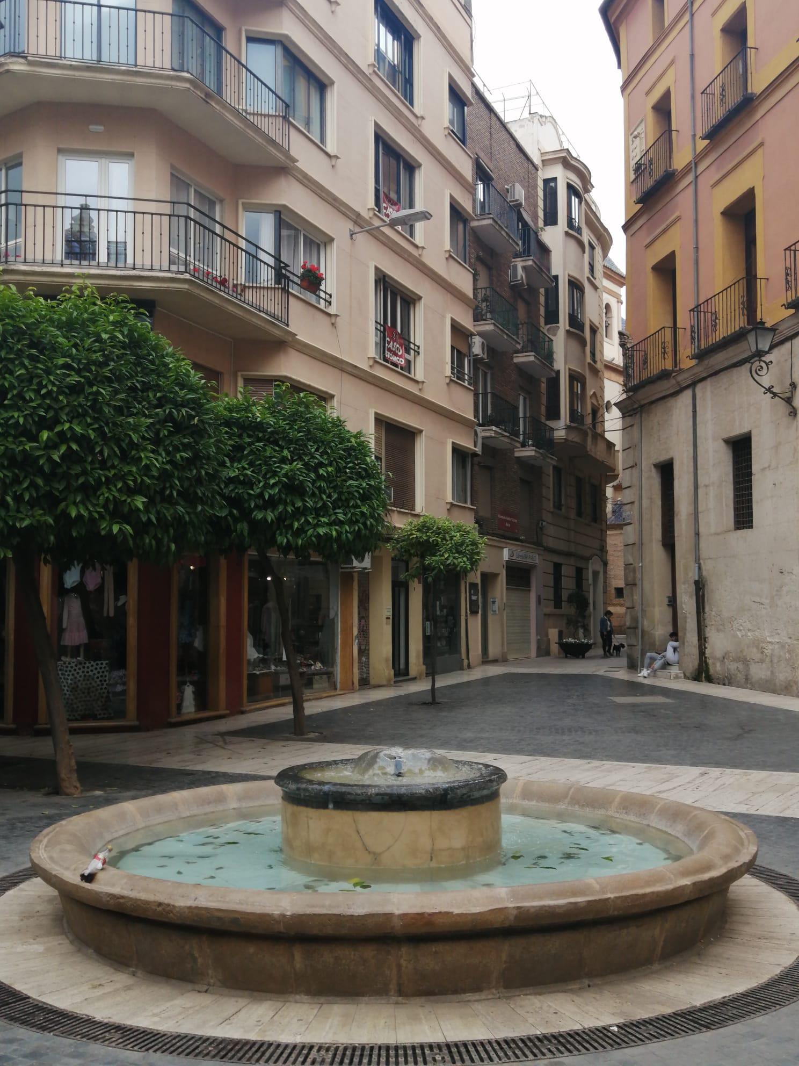
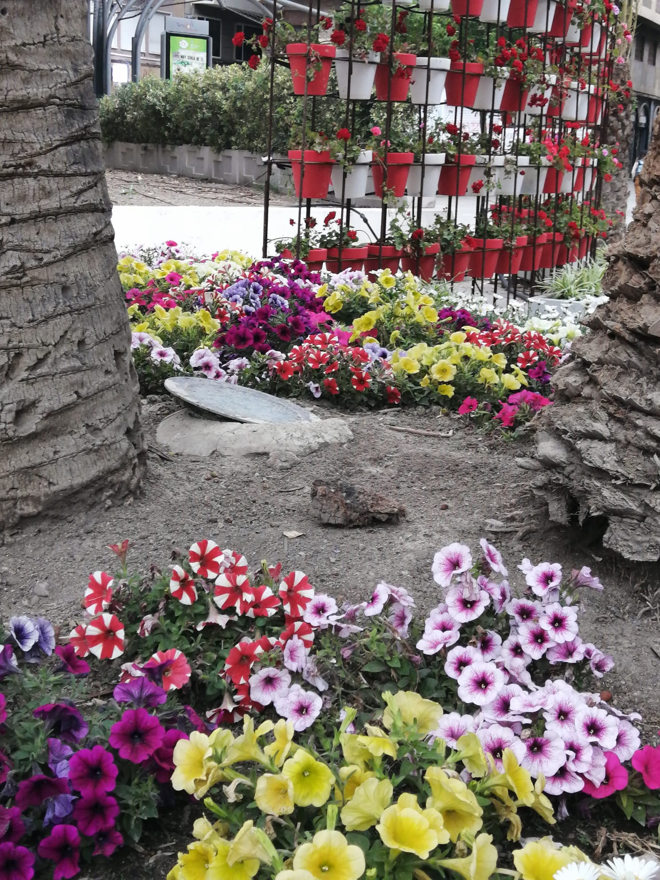
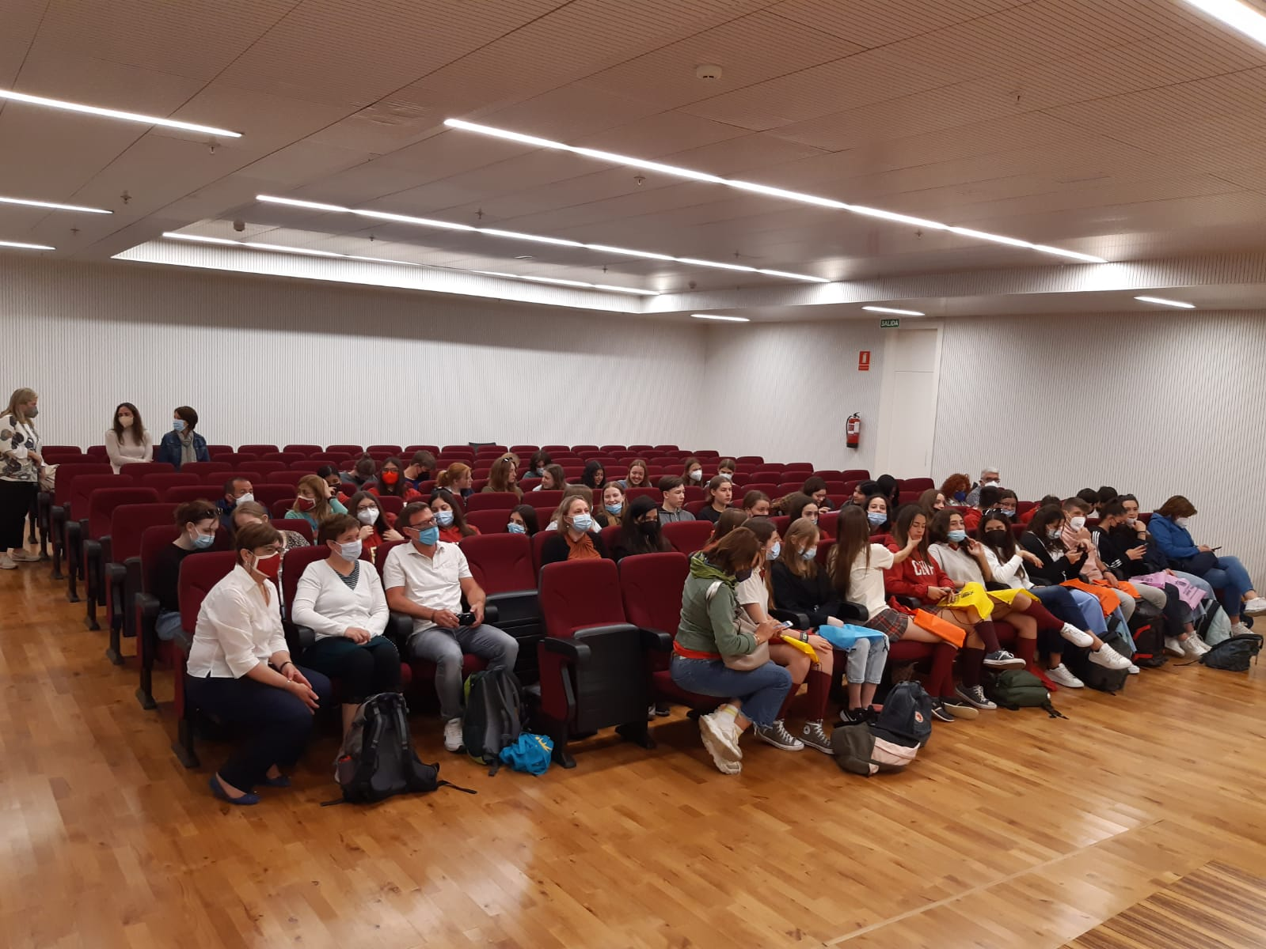
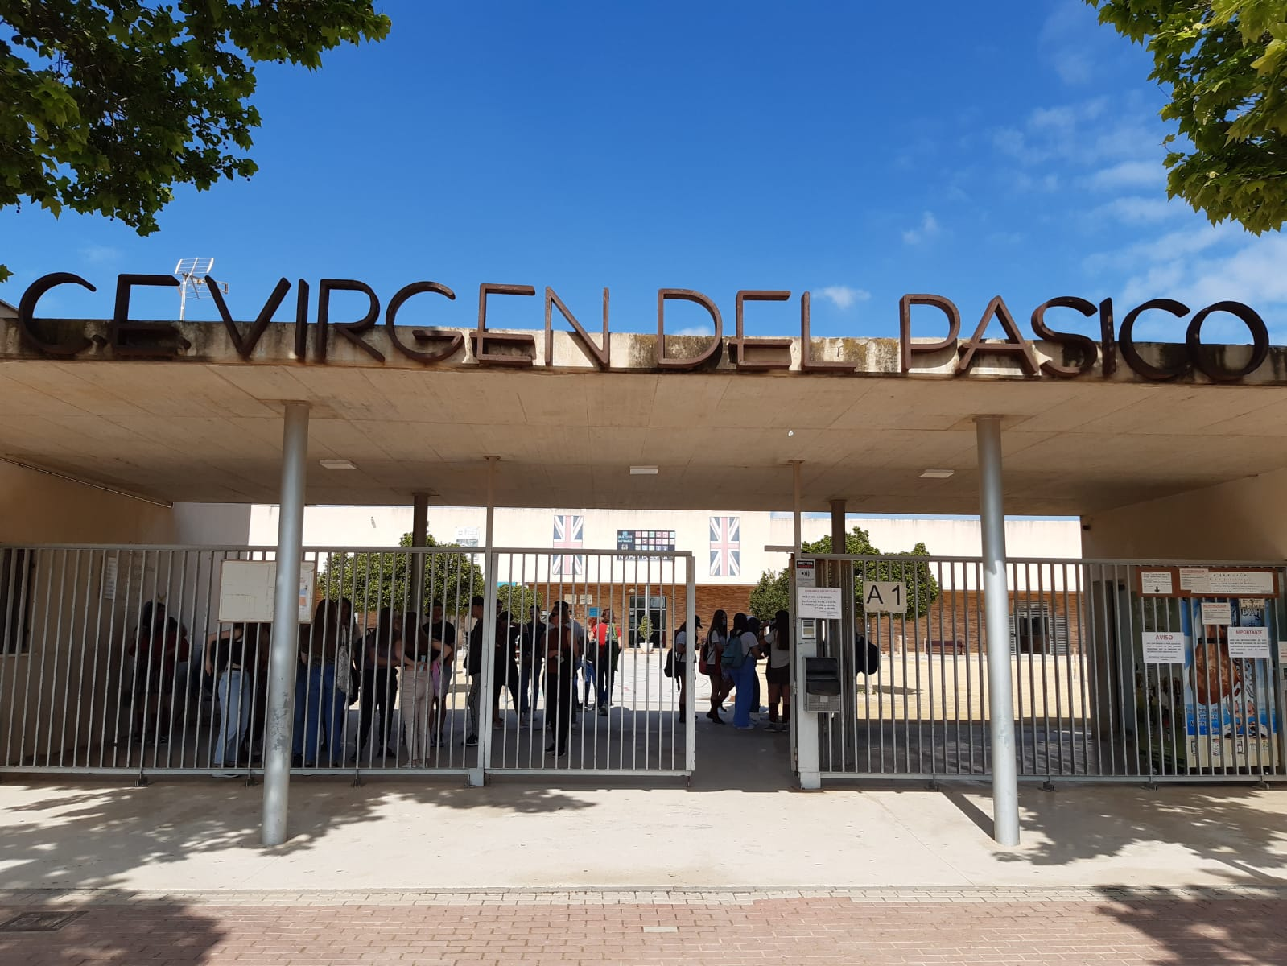
Tuesday
First in the morning we went to the town hall. Then we visited a church. Then we we went to the school and the students showed us the school. At the school we got to know the other people that are in the project.

Slide 4
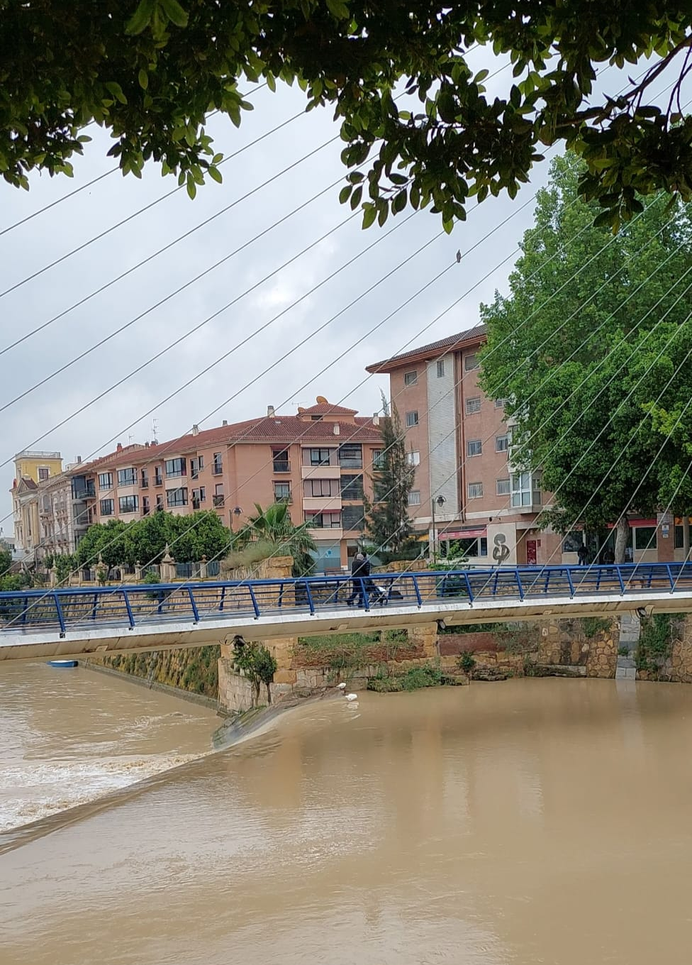
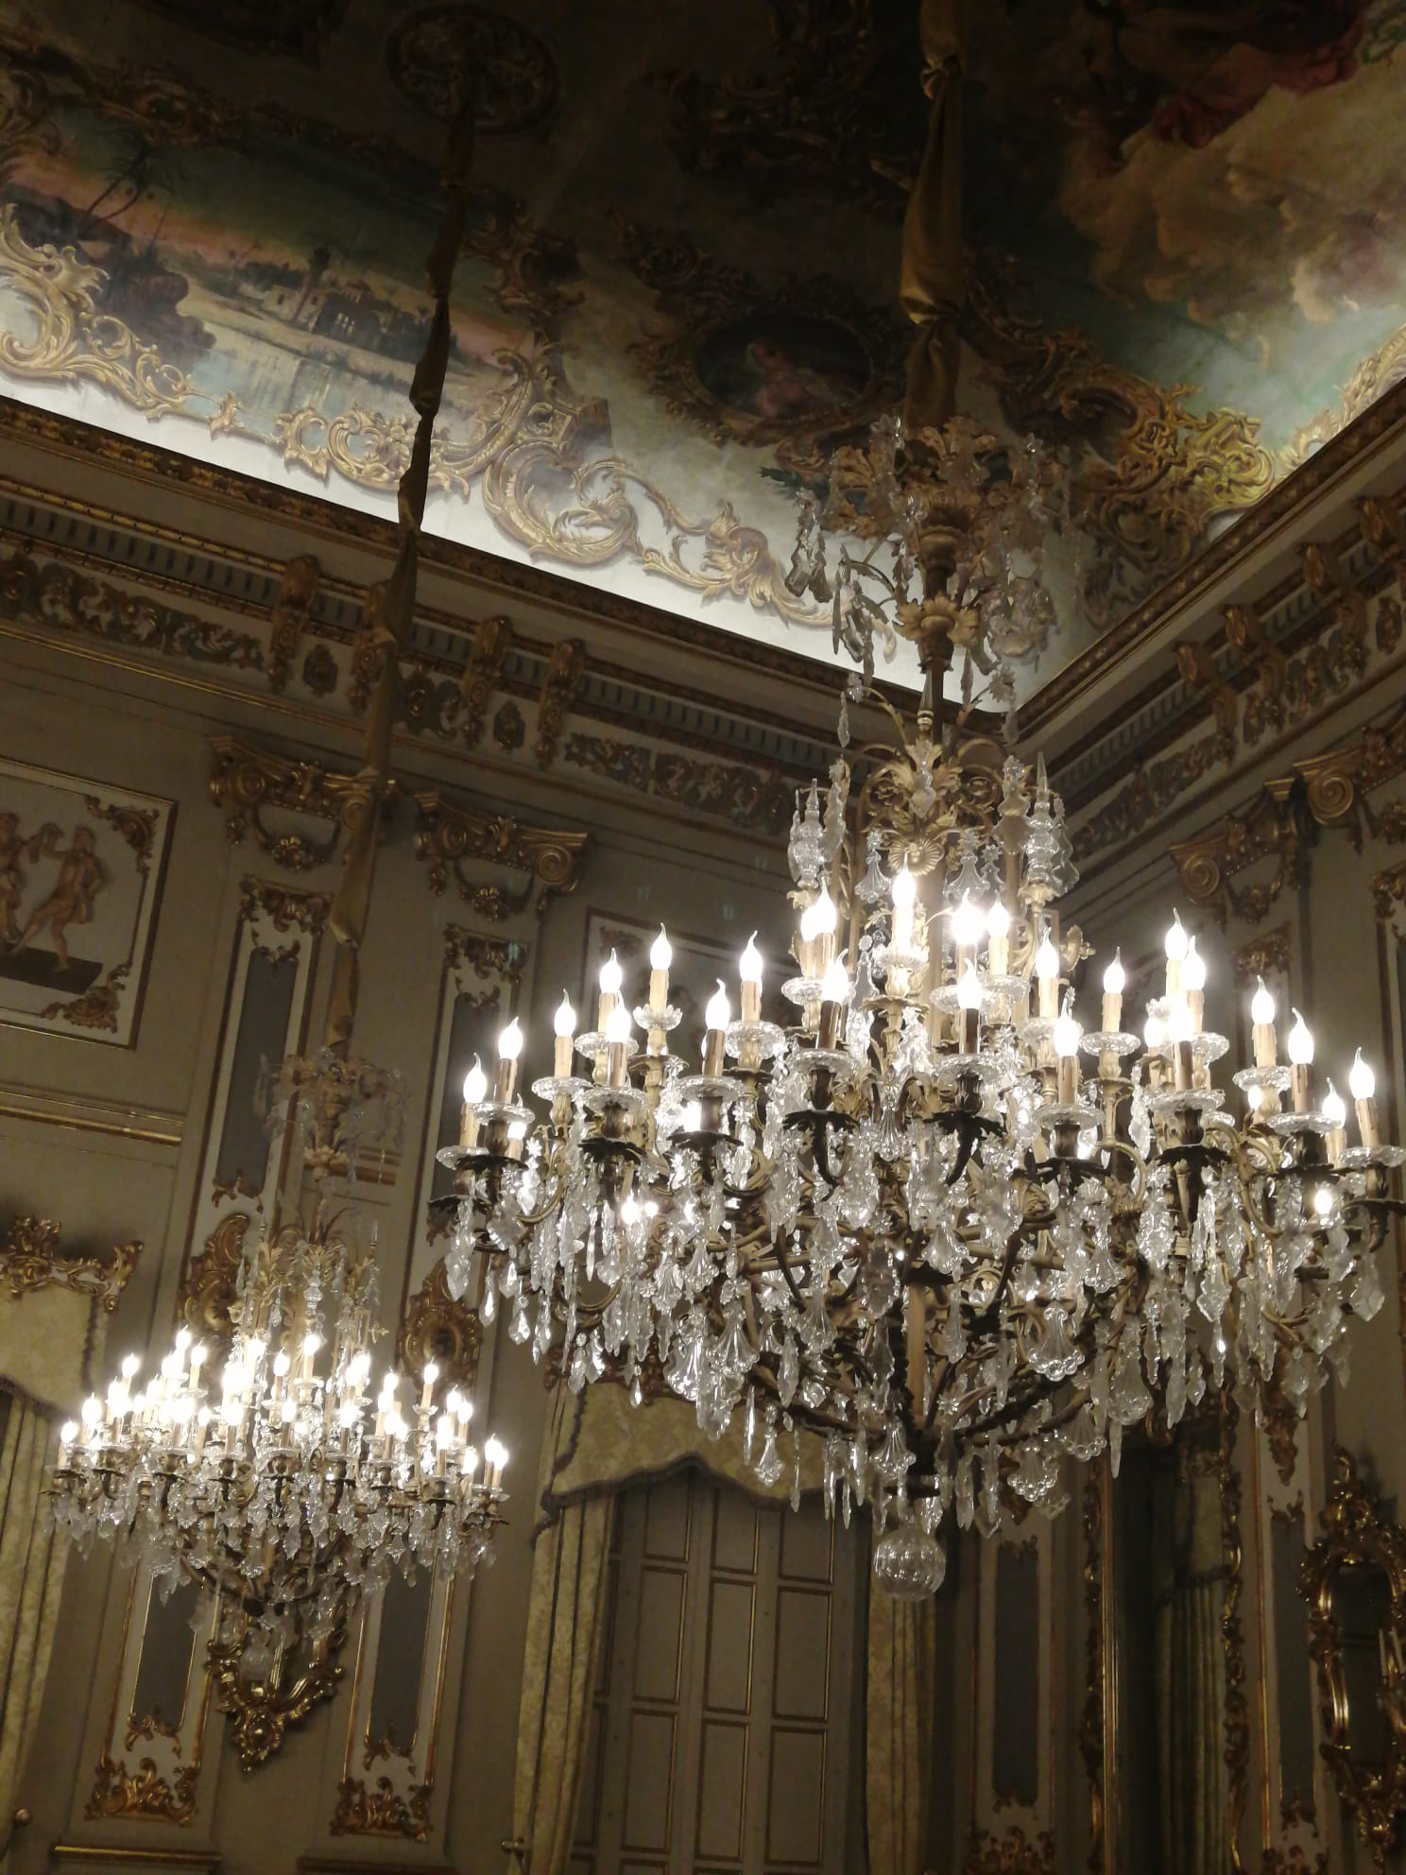
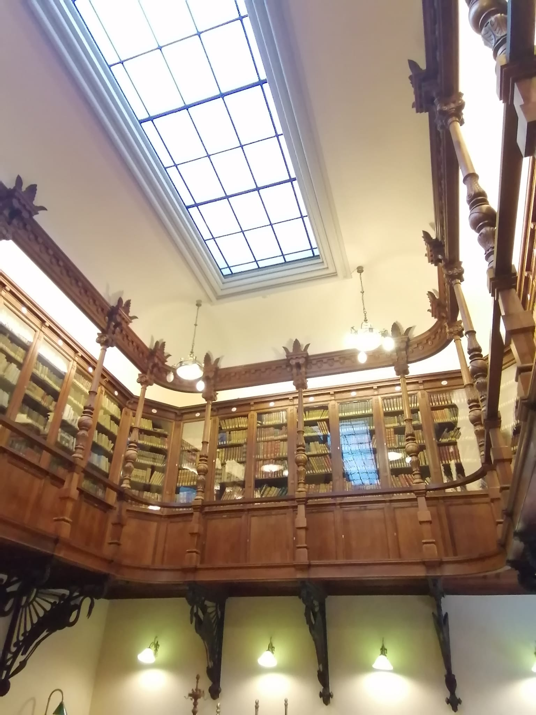
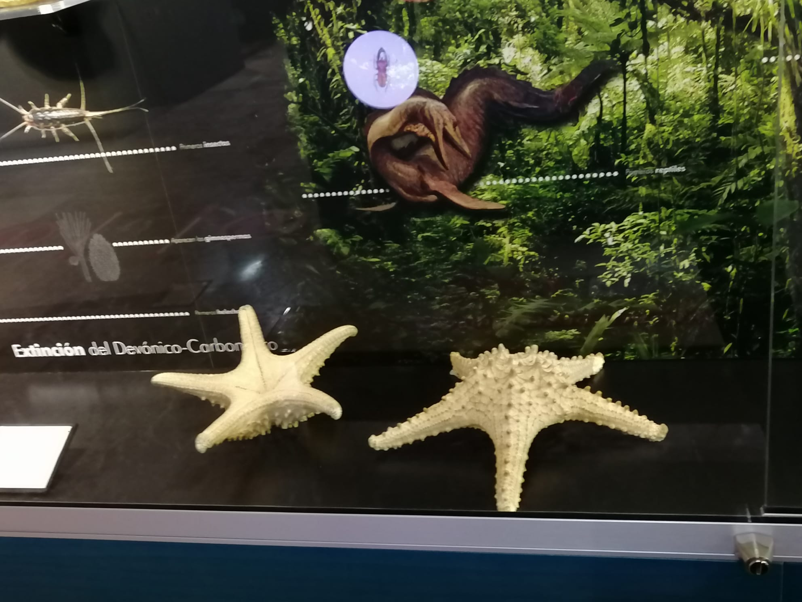
Wednesday
It was a rainy day. First we went to school and from there by bus to Murcia. In Murcia we went to sea museum and we had a tour there after that we ate at burger king and then we went to shopping and another museum

Slide 5
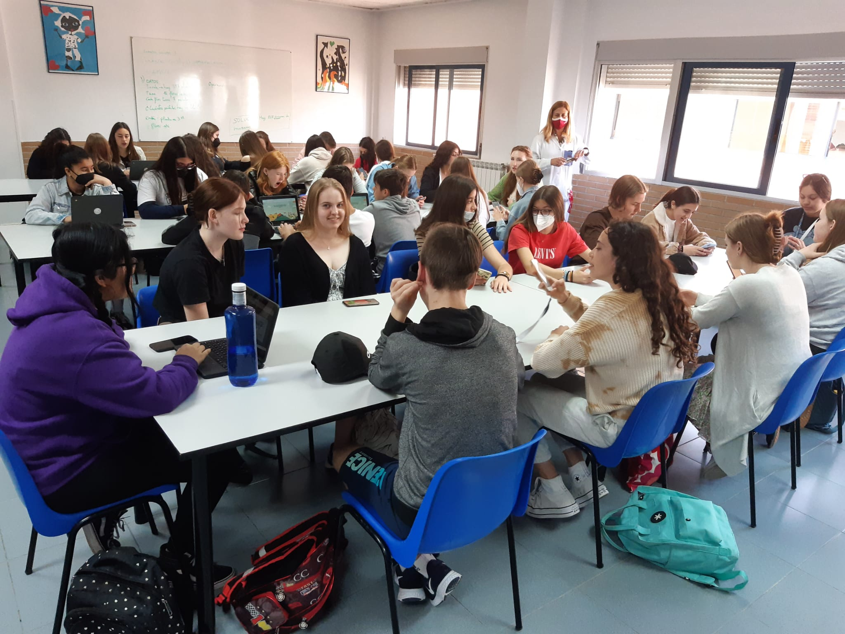
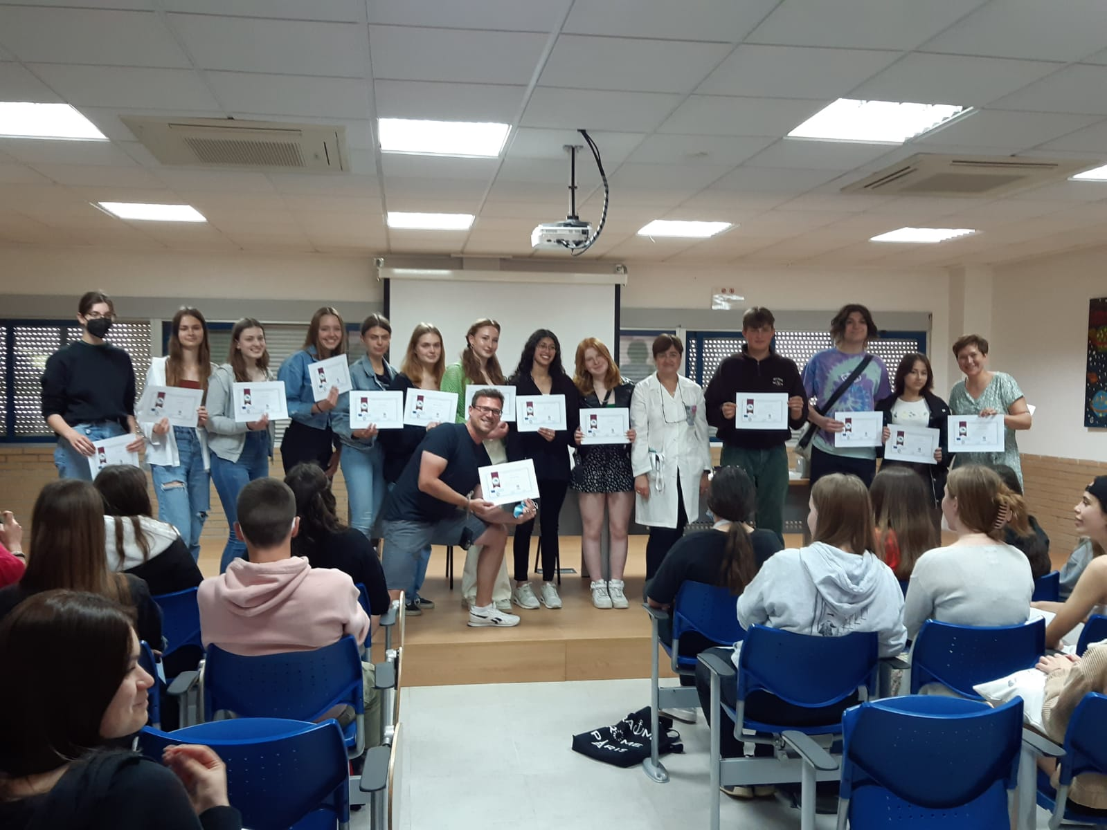
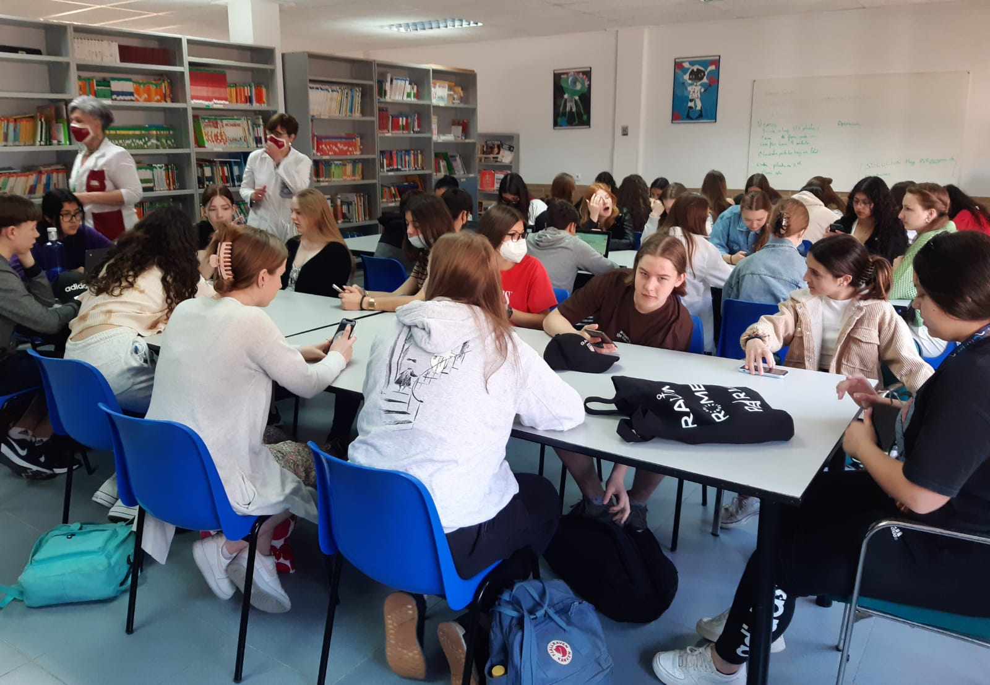
Thursday
On thursday we were mostly at school. There we checked our water footprints and did other erasmus exercices. At the end of the day we got our certificates that we have visited the school. When everyone got their certificates we went with our hosts.

Slide 6
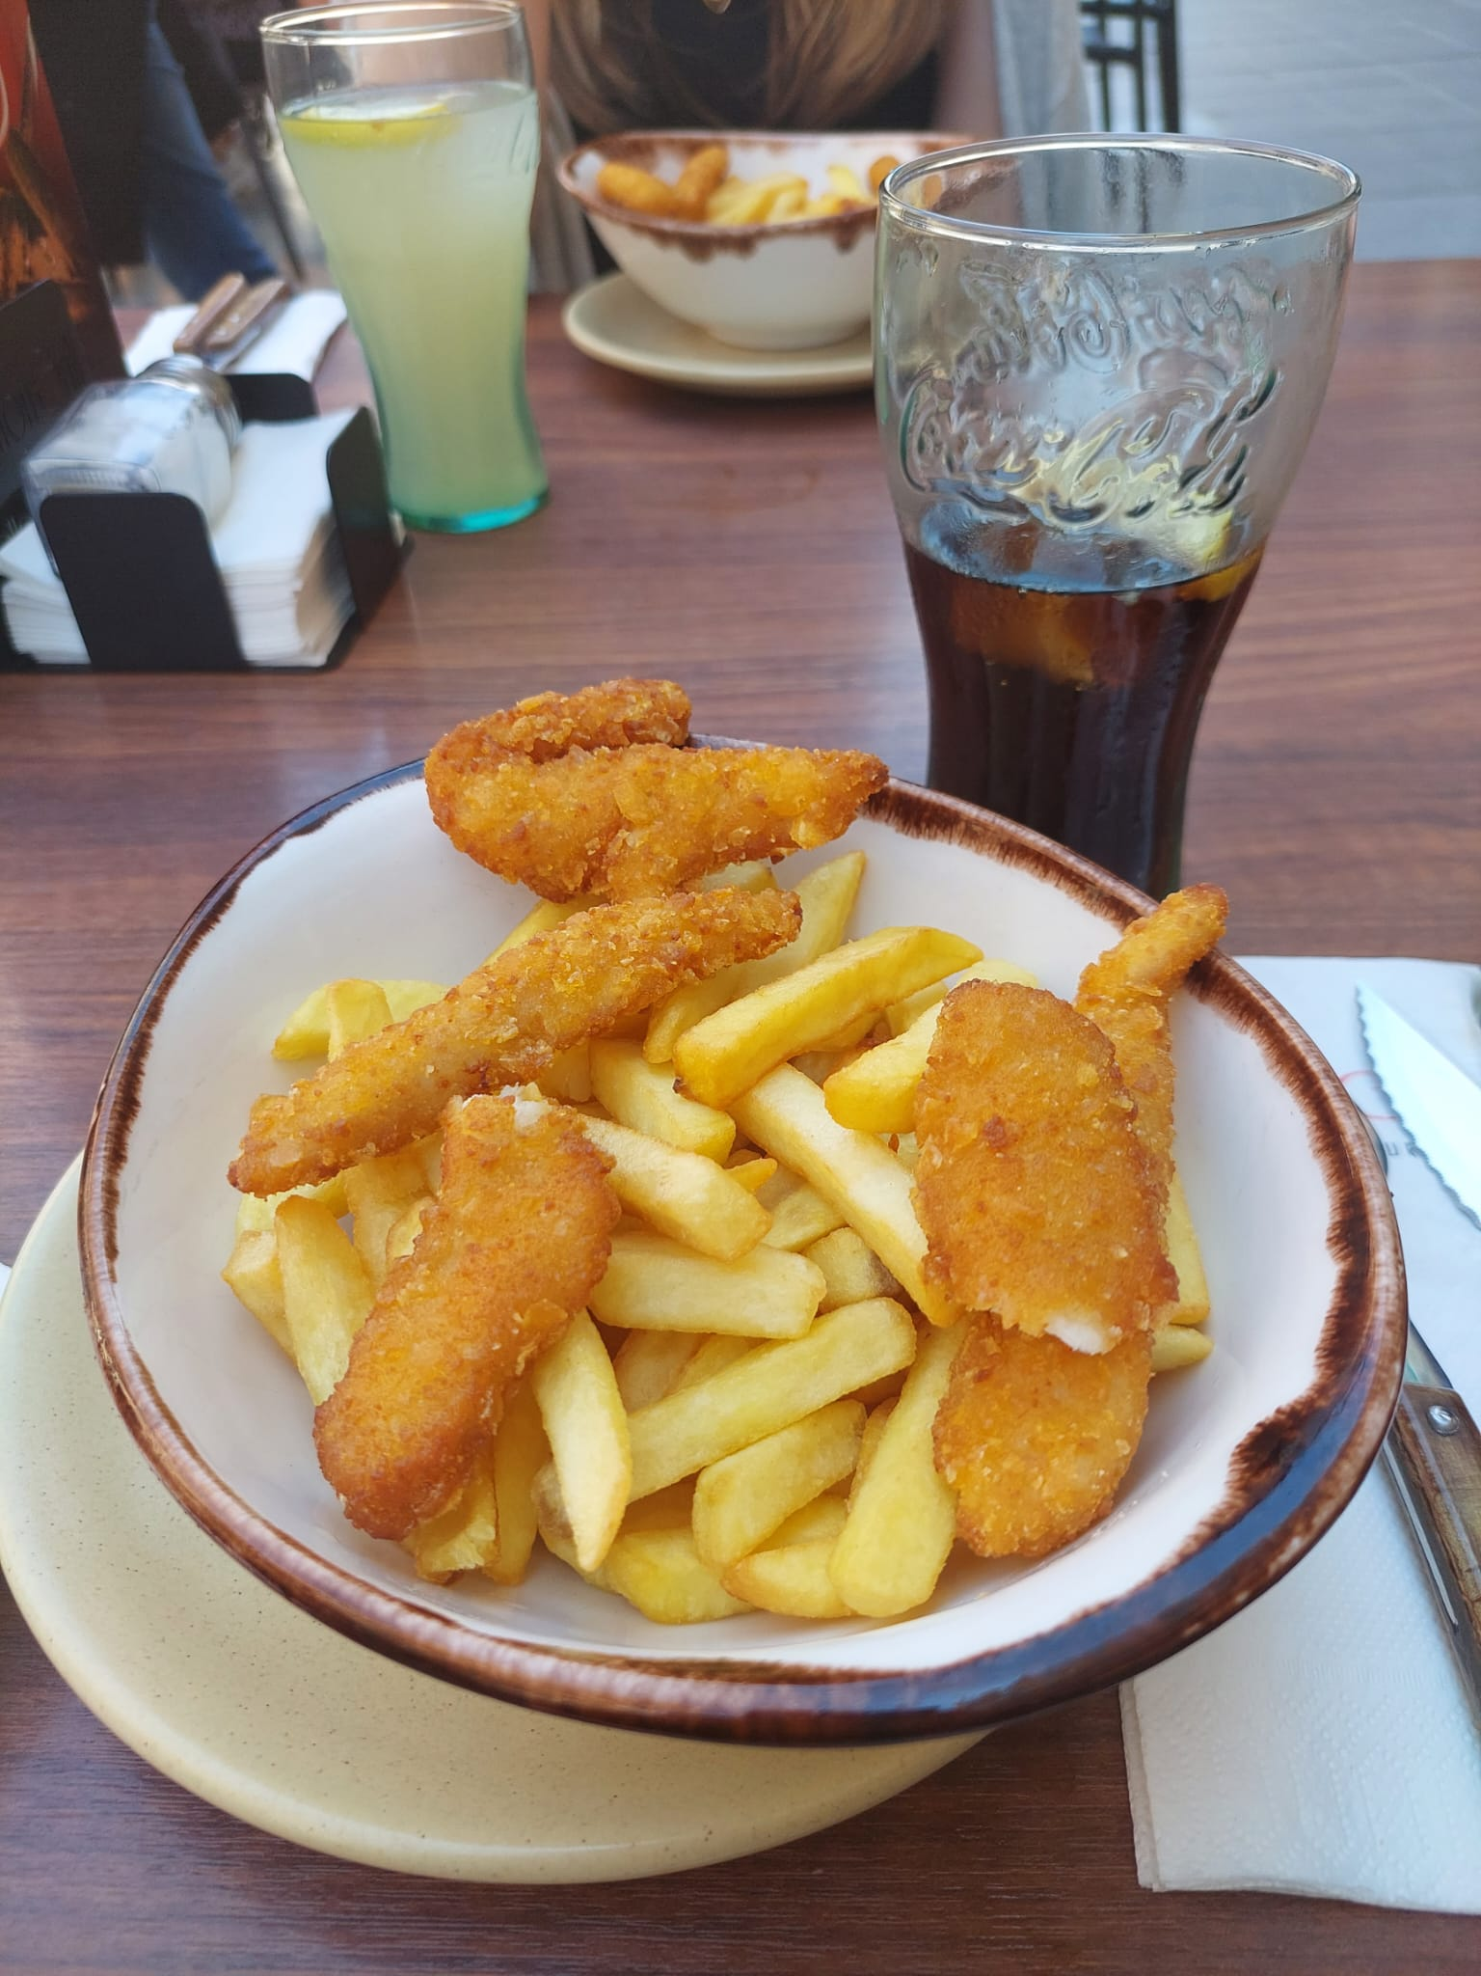
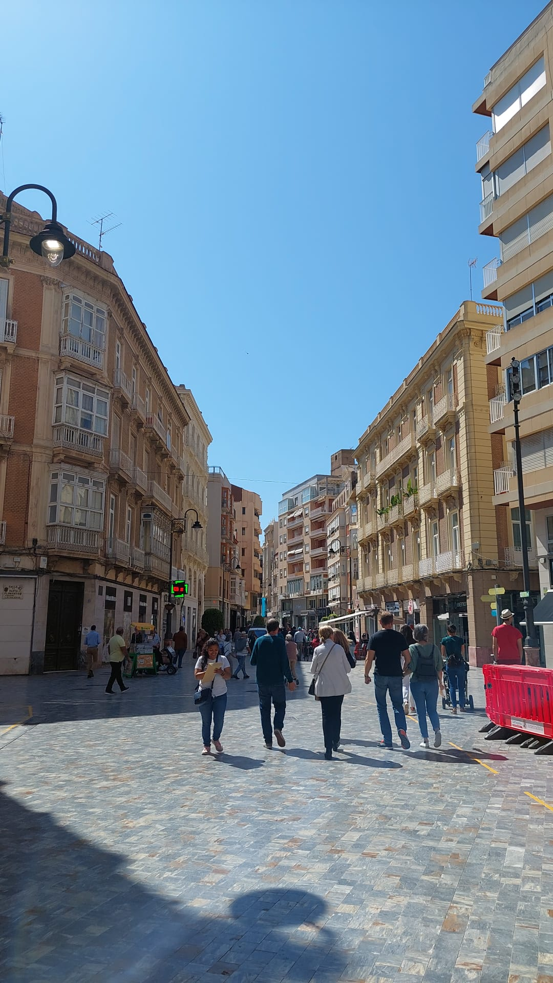
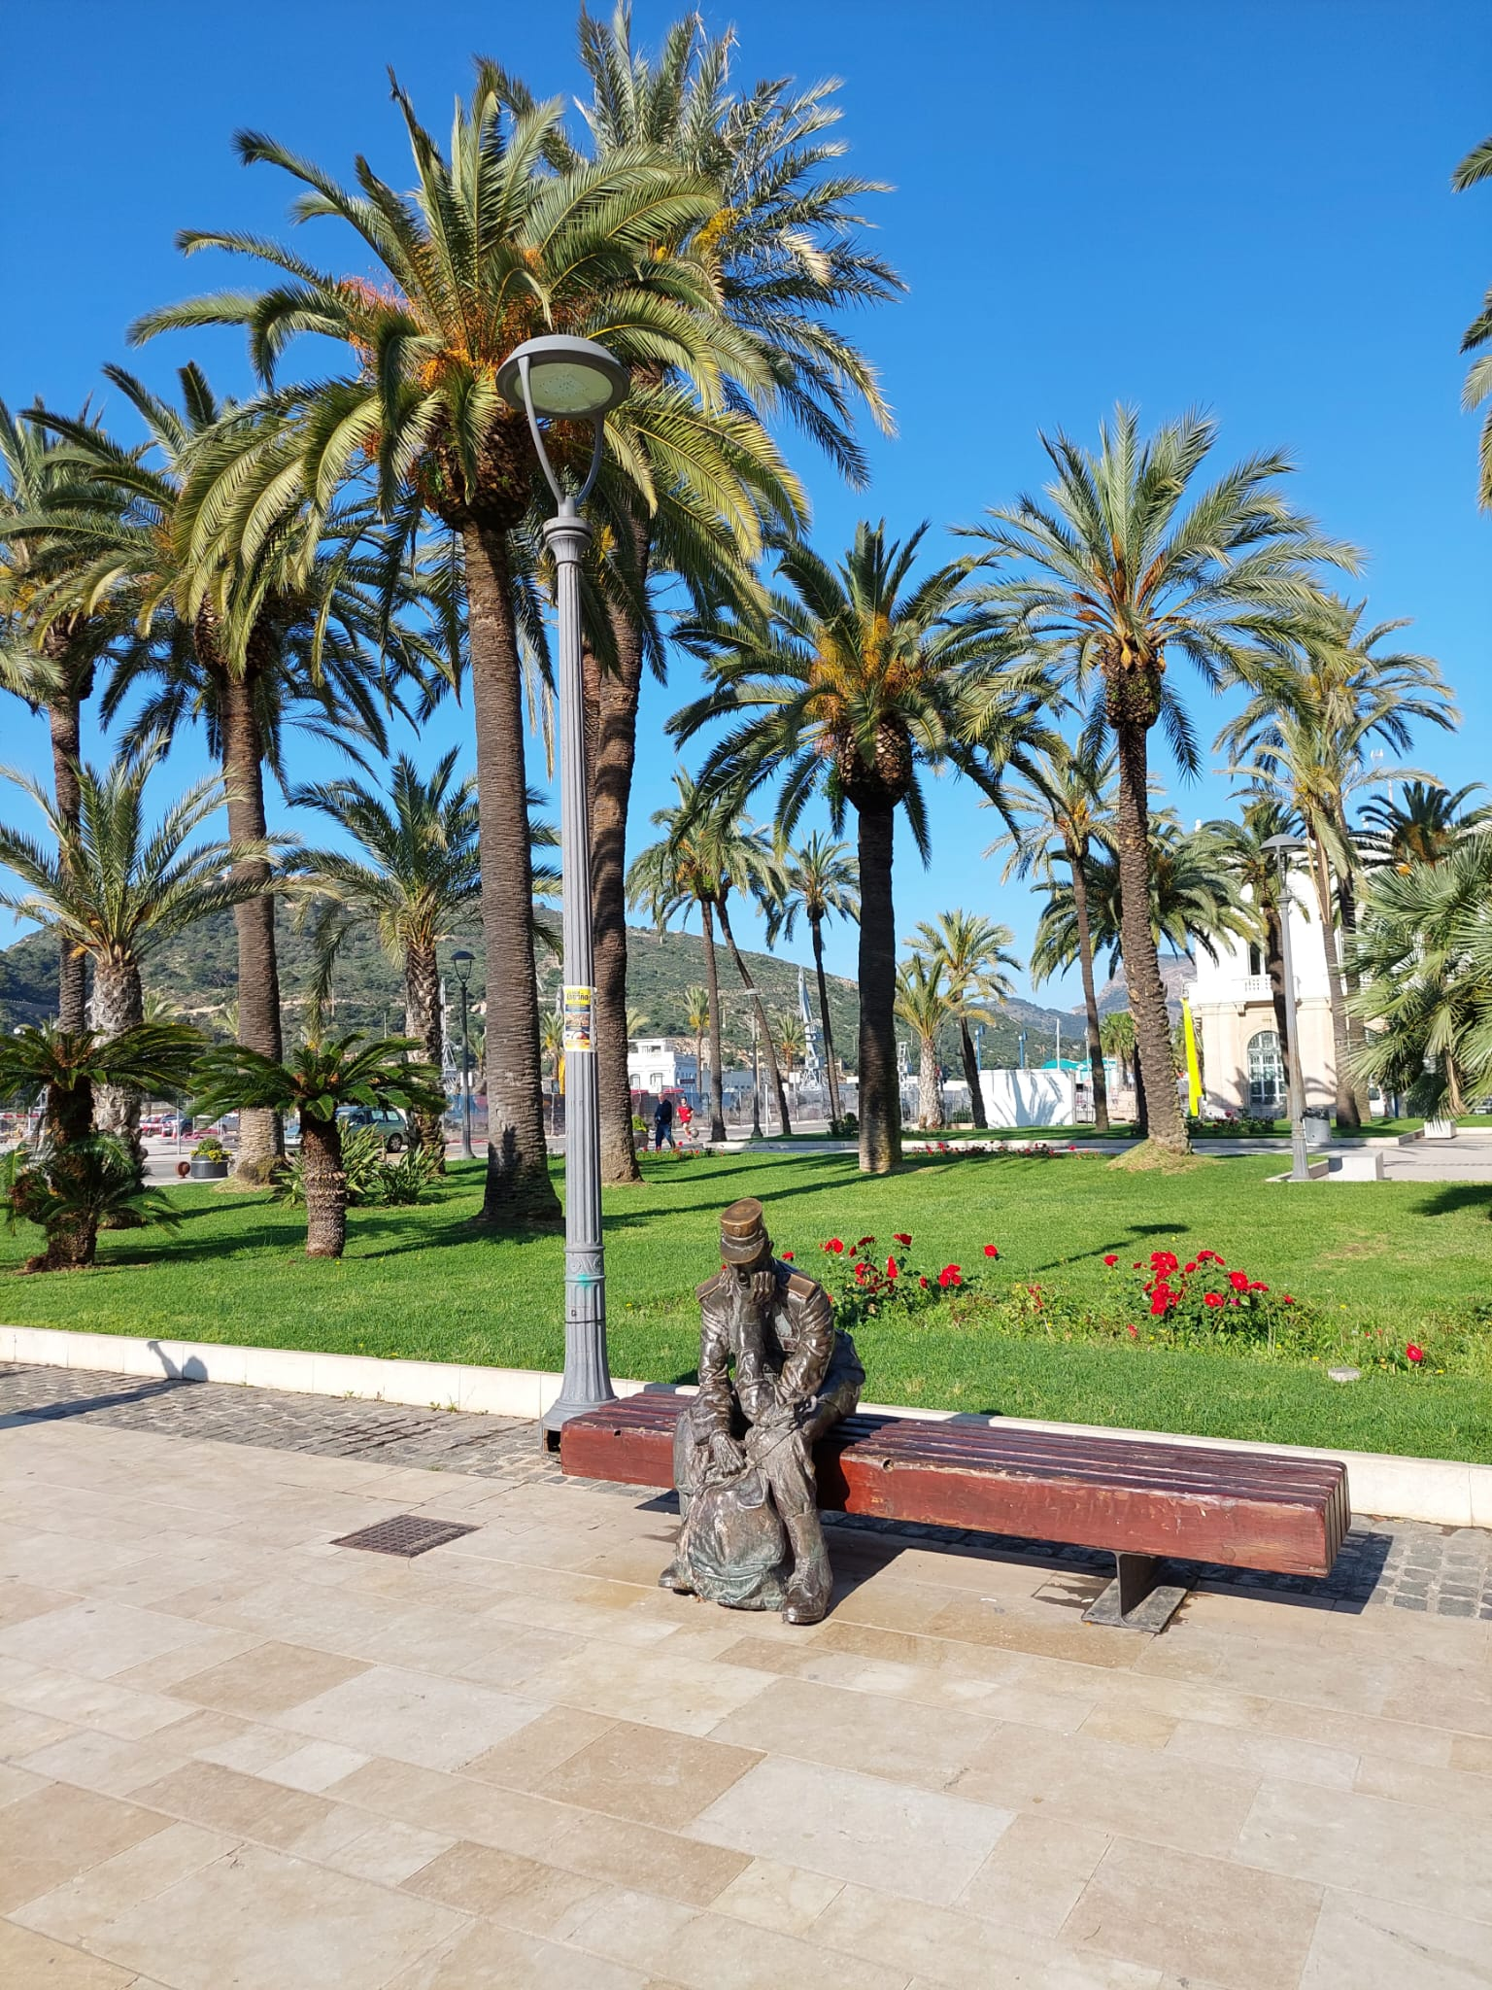
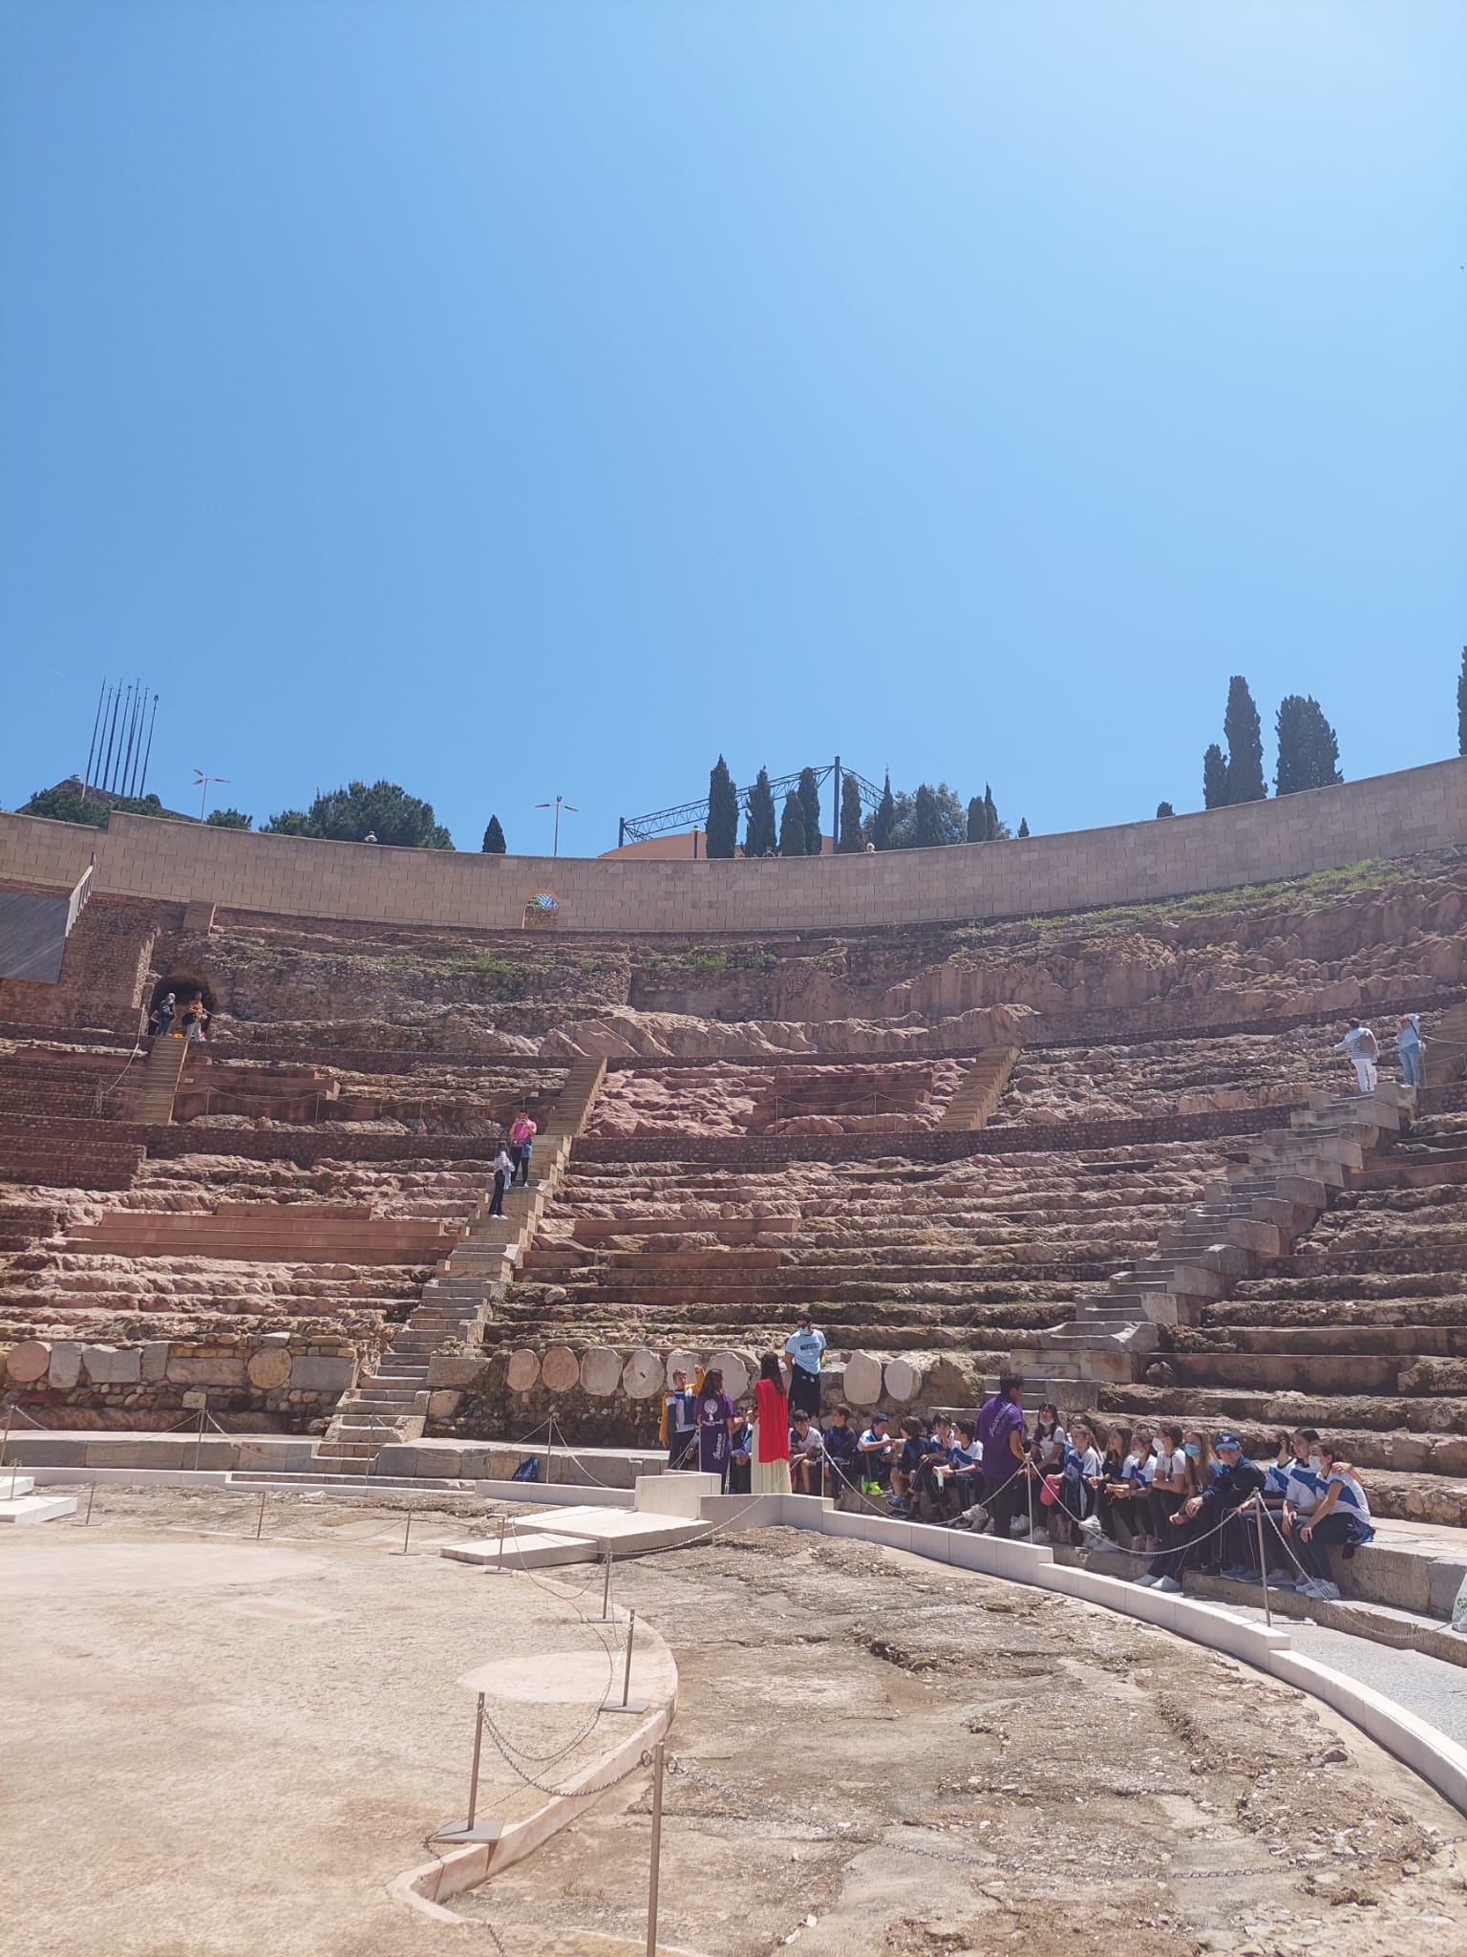
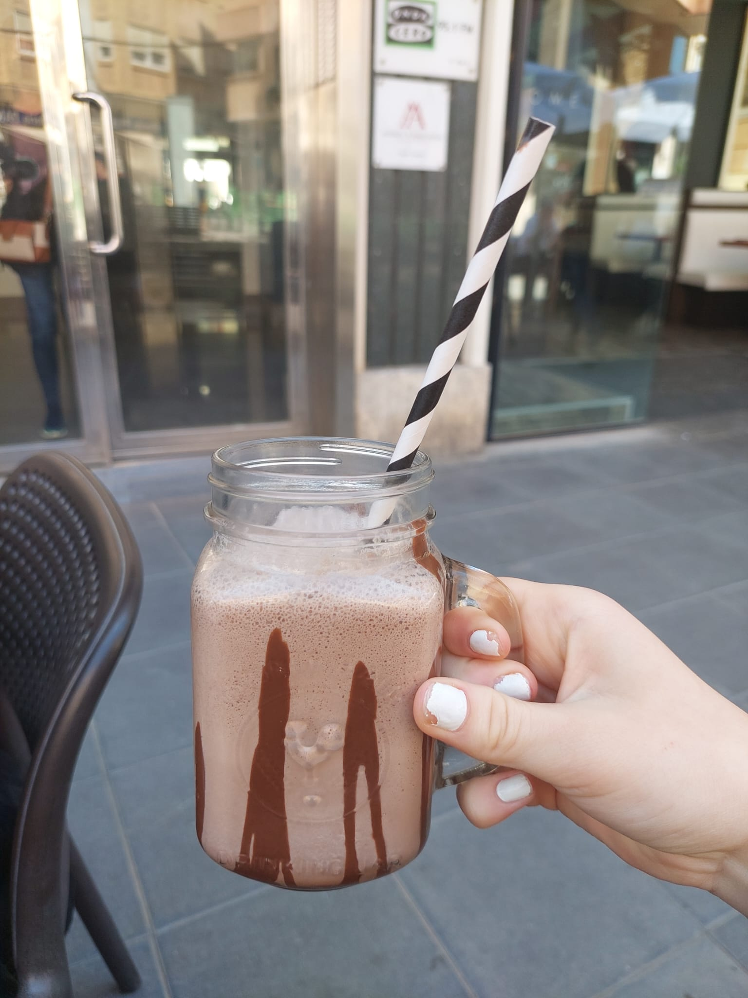
Friday
At 8.30 we met at school and 8.45 we left to Cartagena by bus. First we visited the Cartagena Harbour. We had a guided tour there and and we watched a presentation video about Cartagena. 13.00 we visited Roman theatre. Then we had free time in the city and we visited different shops.

Slide 7
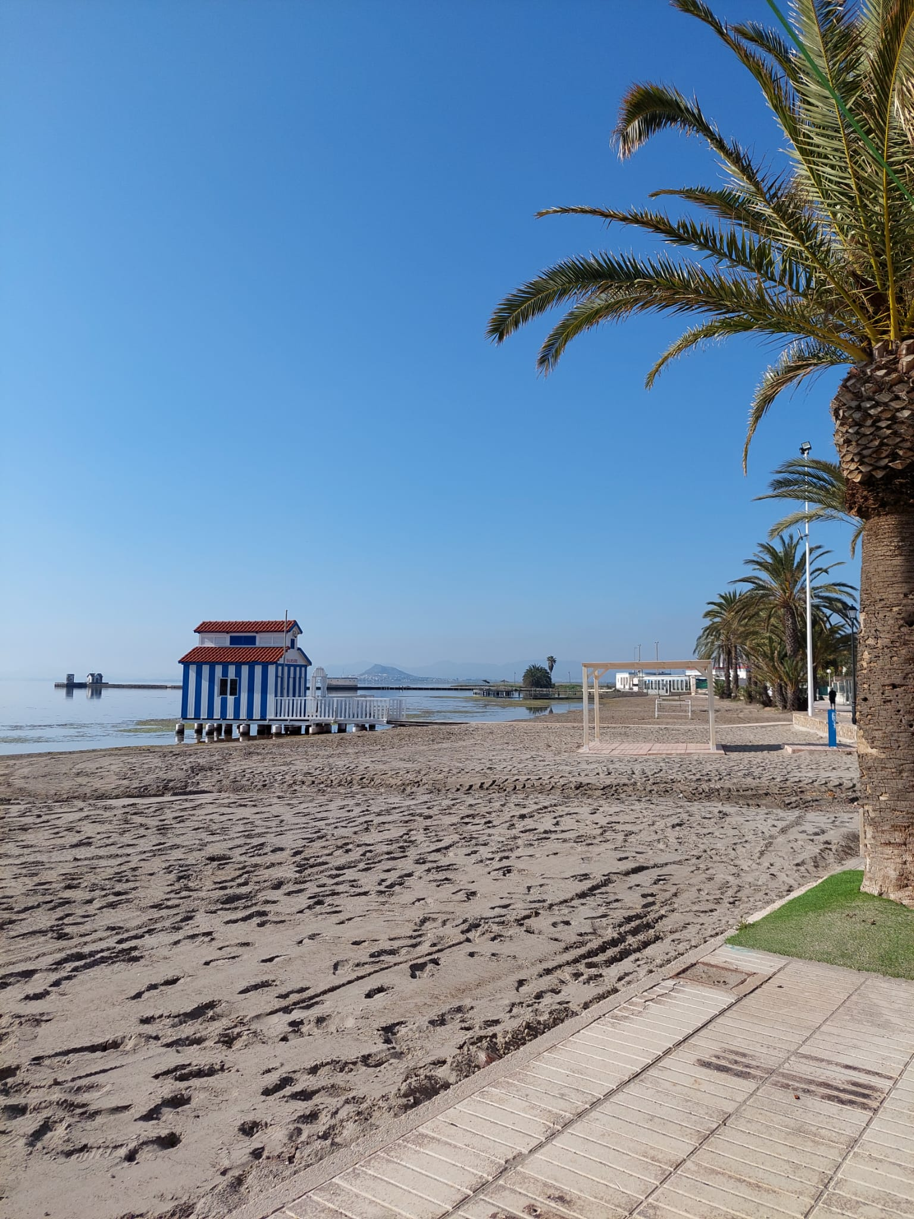
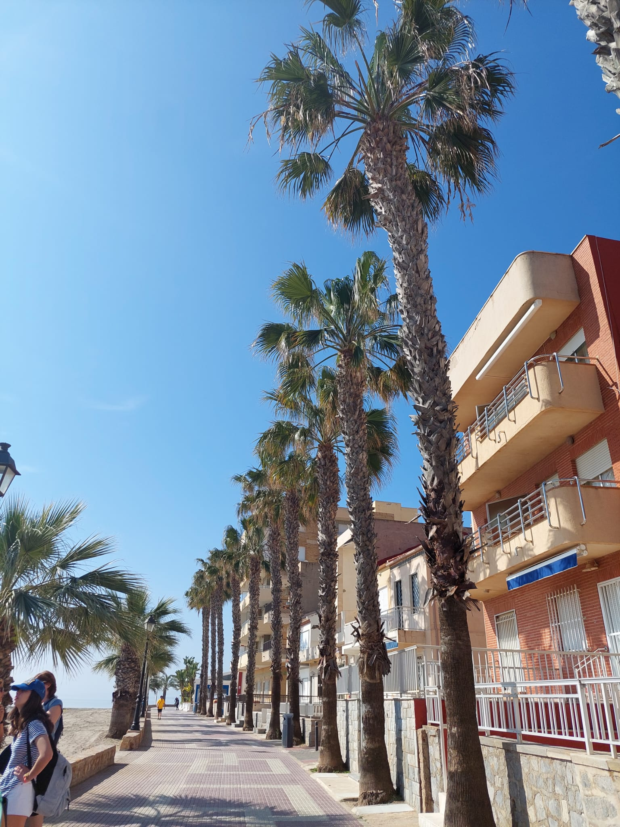
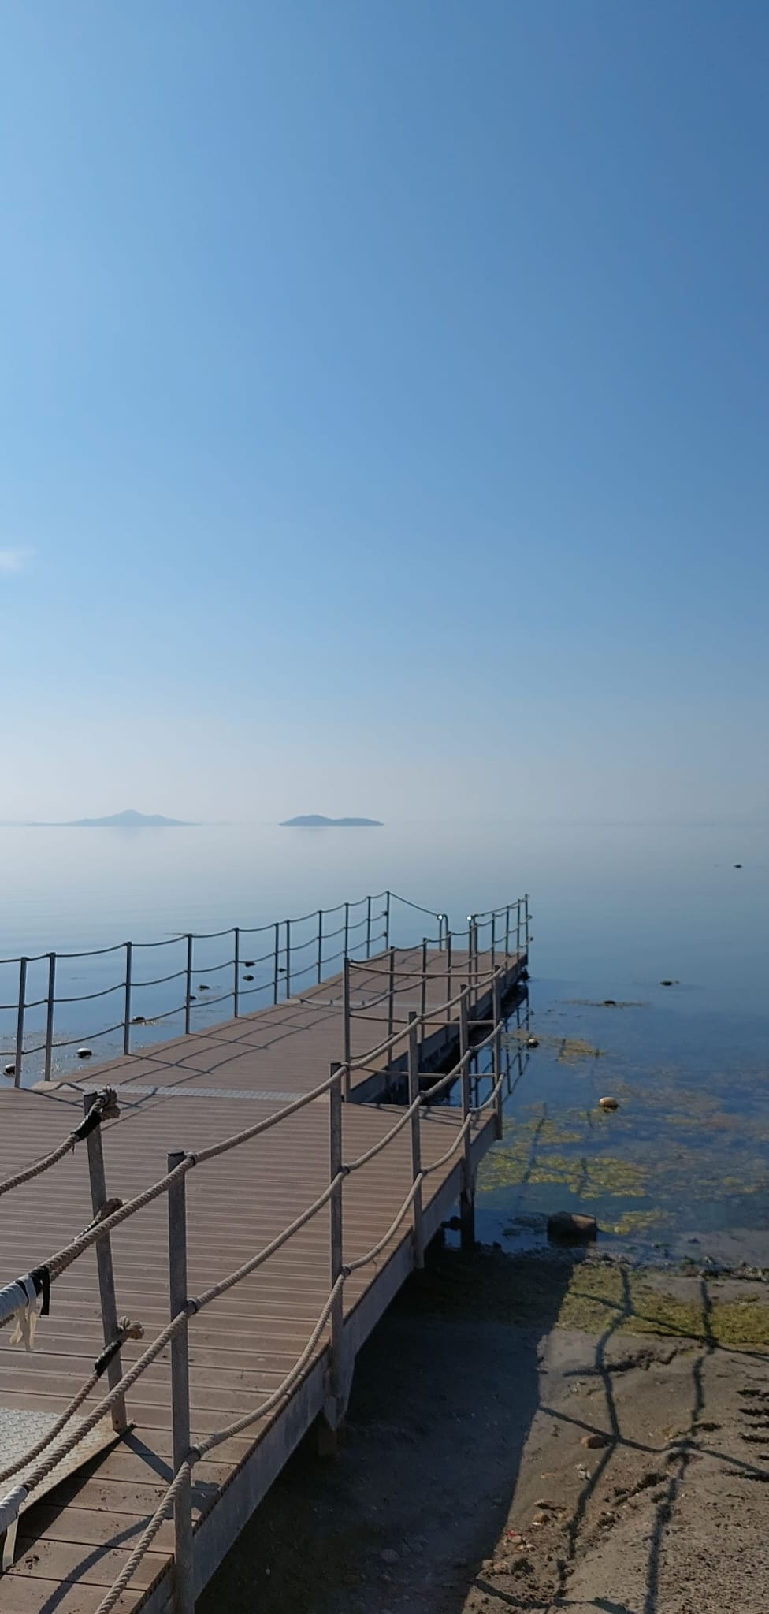
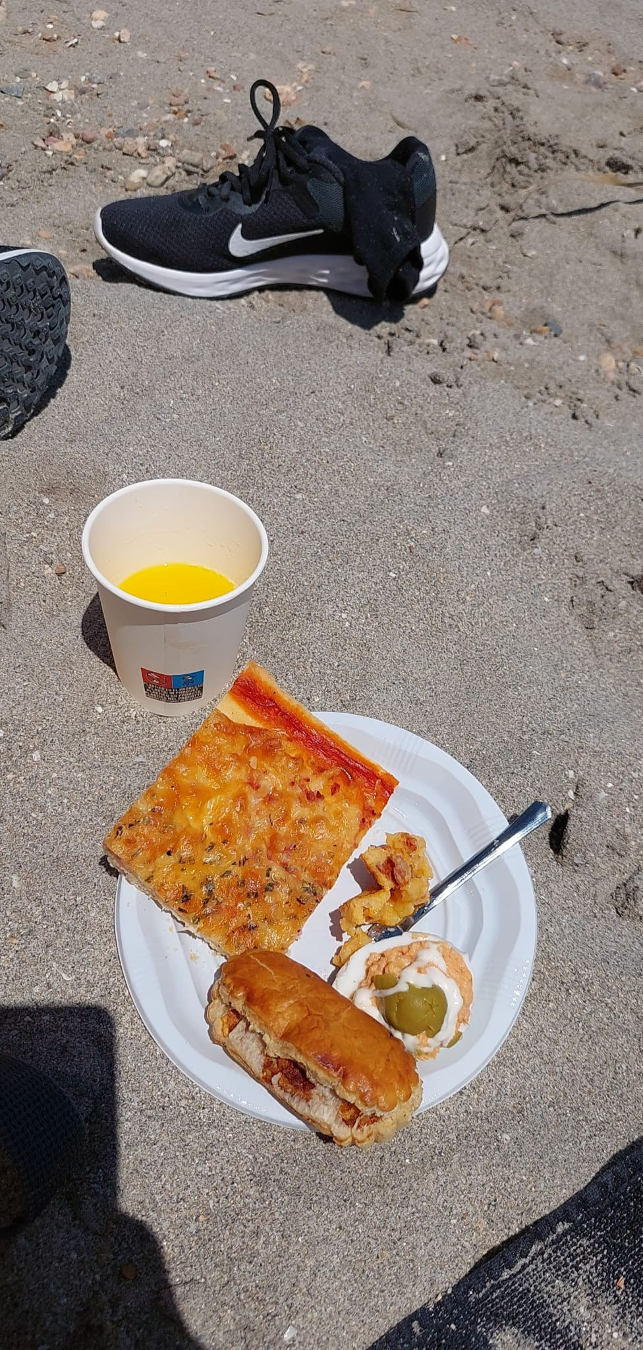
Saturday
We went to see the Air Base at Los Alcazares at 9:15am. After the tour was finished at 11am we went to see the “Mar Menor” which was a boat trip close to the area. When the boat trip which took 2 hours was finished we hanged out on the beach for many hours and our hosts parents had made us all kinds of spanish foods. Then after all off that we went with our hosts to their homes.

Slide 8
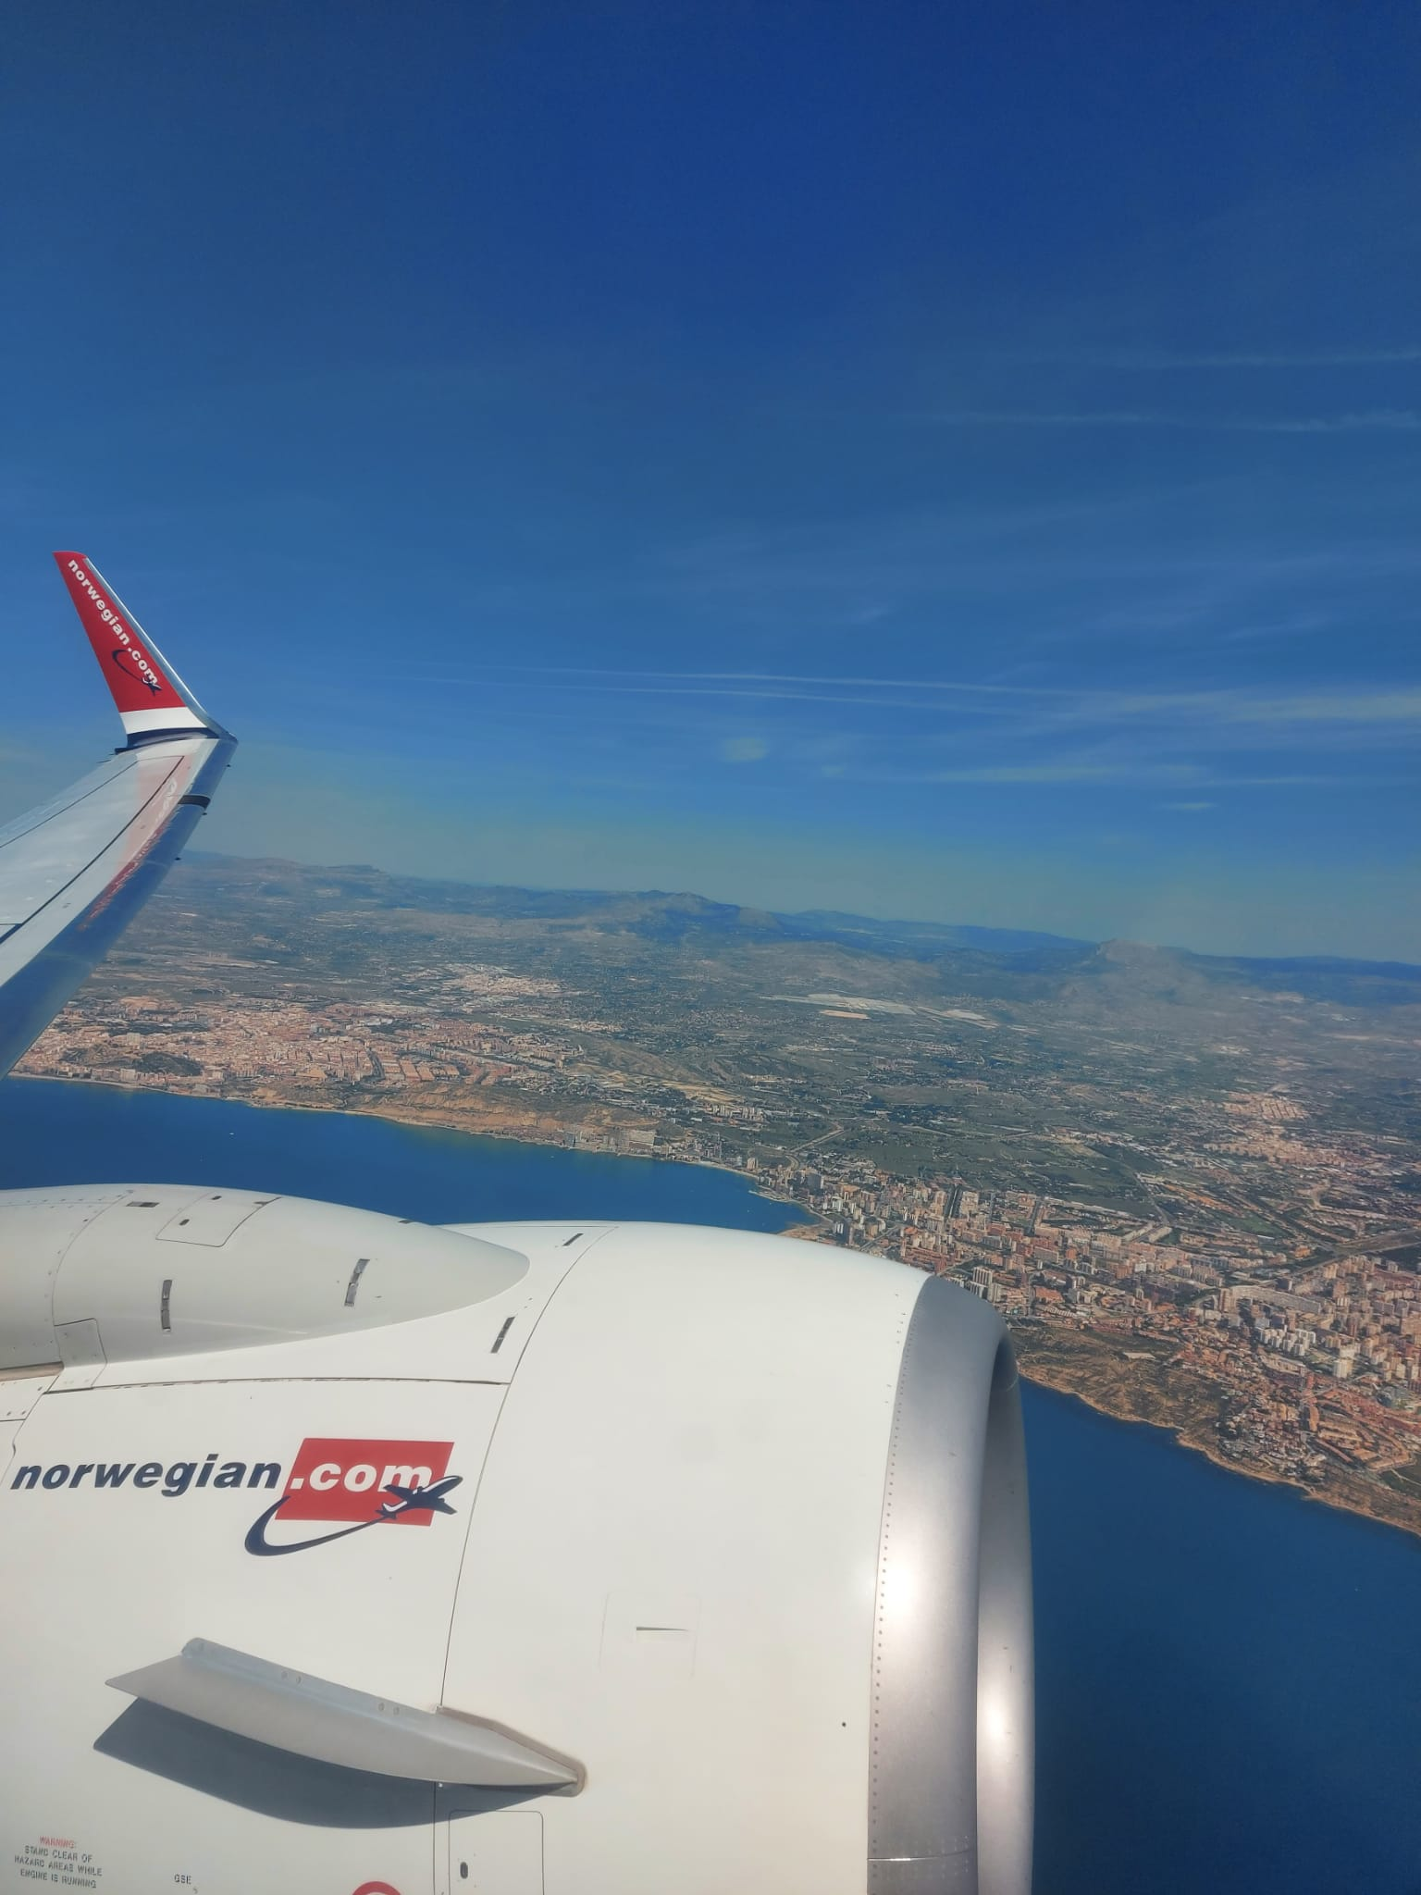
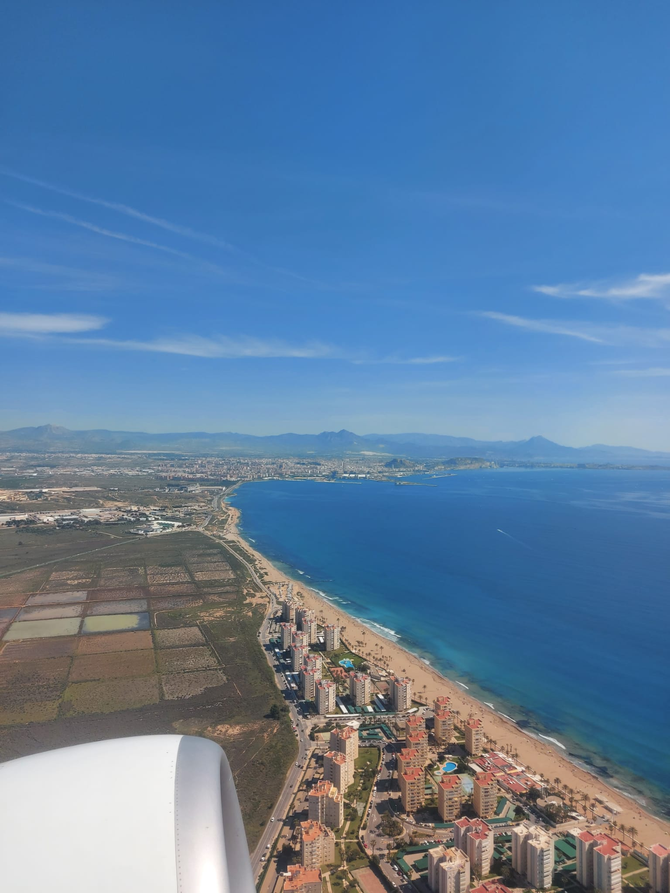
Sunday
At 6:45 am we went to the hotel to leave to Alicante airport with a taxi. Before that we said our goodbyes to everyone there before leaving. Then we flew back to Helsinki/Vantaa airport and took a taxi back to Hj. nortamo school and from there everyone went back home.

