Slide 1
KEEP CALM
AND
DO MORE THAN SURVIVE
MADE BY:
RÄNTÄ (Hugo Roni Joona Minttu and Iván)

Slide 2
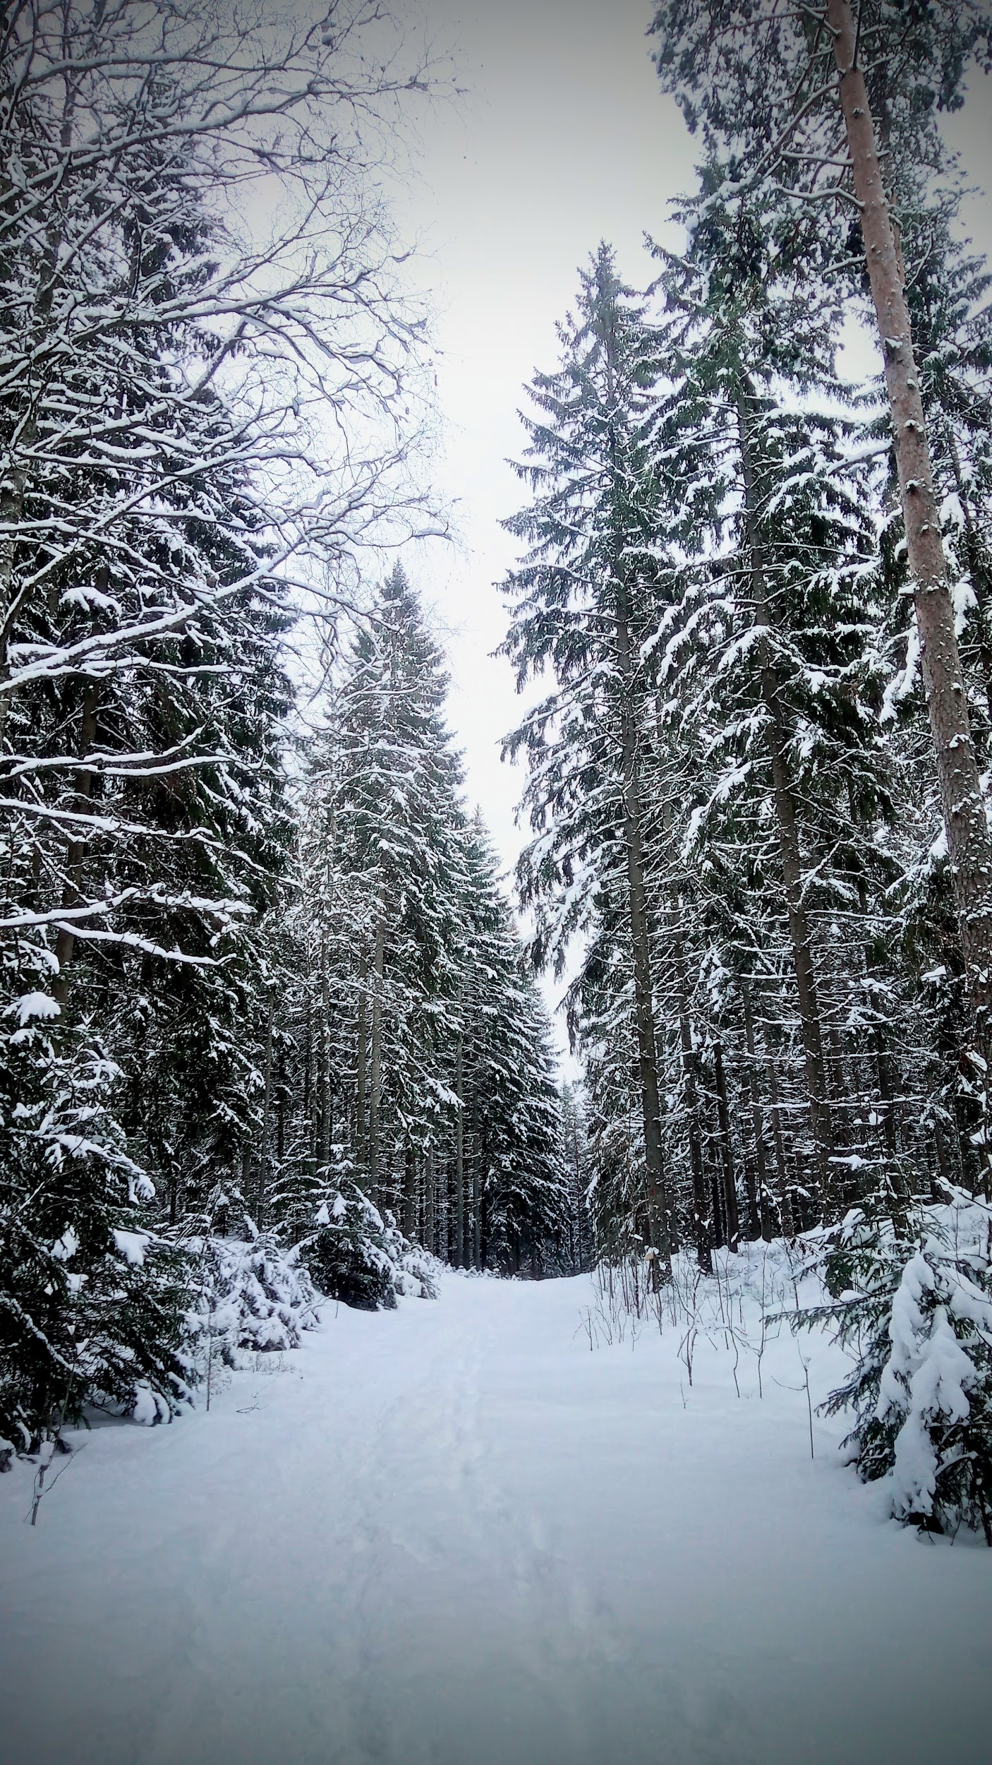
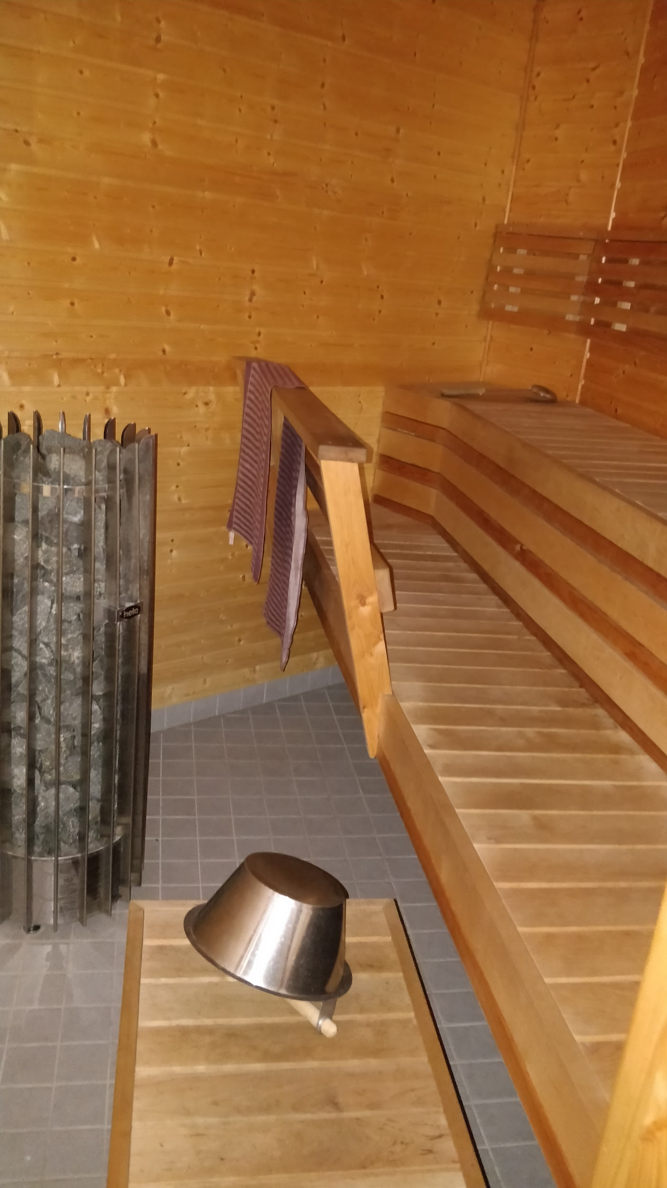
How to deal with stress
Going to sauna helped us to be more relaxed, and to be more peaceful with other people. To be in the nature for about 20 min a day could help you if you are stressed. If you would like to not be stressed (witch most people don’t want to be) the nature is a very good way to escape the stressy life and also to just relax stop for a few minutes and think of what you ,see ,feel ,hear and taste.
actual picture from the woods

Slide 3
Metacognitive Strategies
We used different kind of Metacognitive Strategies to achieve our goals. One who we used was to work in a group because we can use our different experiences and we become wiser and stronger together.
We used the metacognitive strategy SMART (explained in the next slide) when we were supposed to make this for example

Slide 4
SMART
S= specific (kinda obvious)
M= measurable ( When do you know that you have achieved your goal?)
A= achievable ( is it possible that you can or want to achieve it?)
R= Relevant (What does it mean for you?)
T=Timley (how long time will it take for you to reach your goal)

Slide 5
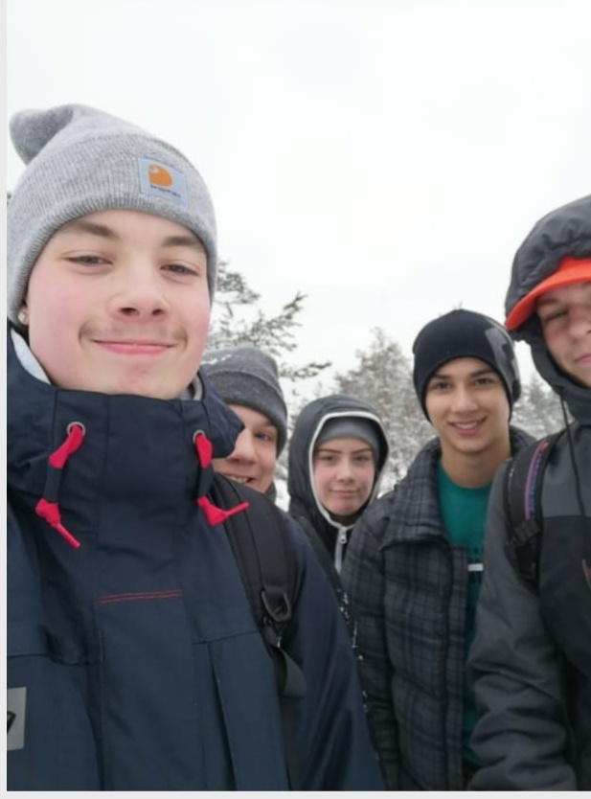
How to become a responsible adult
This project has been about us succeeding in life and a good way of doing that is by be a responsible adult so you make life better for everybody their for yourself, because studies show that you get happier if you give a gift than buying one to yourself.
At the the third day ( tuesday ) we learnt about everyman's right but also our responsobeleties. By that we became a little bit more like responsible adult. On wednesday we went to the recycling site and learnt were the trash goes and hopefully everybody realised that we can not used this planet as we do. “The house is on fire”

Slide 6
Sleep nutrition and sport
A way to have a good life is by having a full working body
A person who is between 12years old and 16 years old need nine to eight hours of sleep per night other wise the person will be tired and lose focuse and will gain weigth. They alson need at least 1 hour of active sport which could be dance, hecer footing, or any kind of other sport. The amount of food you eat and how much of every thing (like how much of your portion is meat and how much is salad) depend on what kind of body you have or what you do in your spare time. But you should never (more like rarely) eat fast food because it is to much sugar which is fast energy who gives you much and intensive energy for a brief moment of time to later dip and go downunder your orginall amount of energy. So fast food actualy ends up taking energy instead of giving you it.
We learnt this on the wednesday

Slide 7
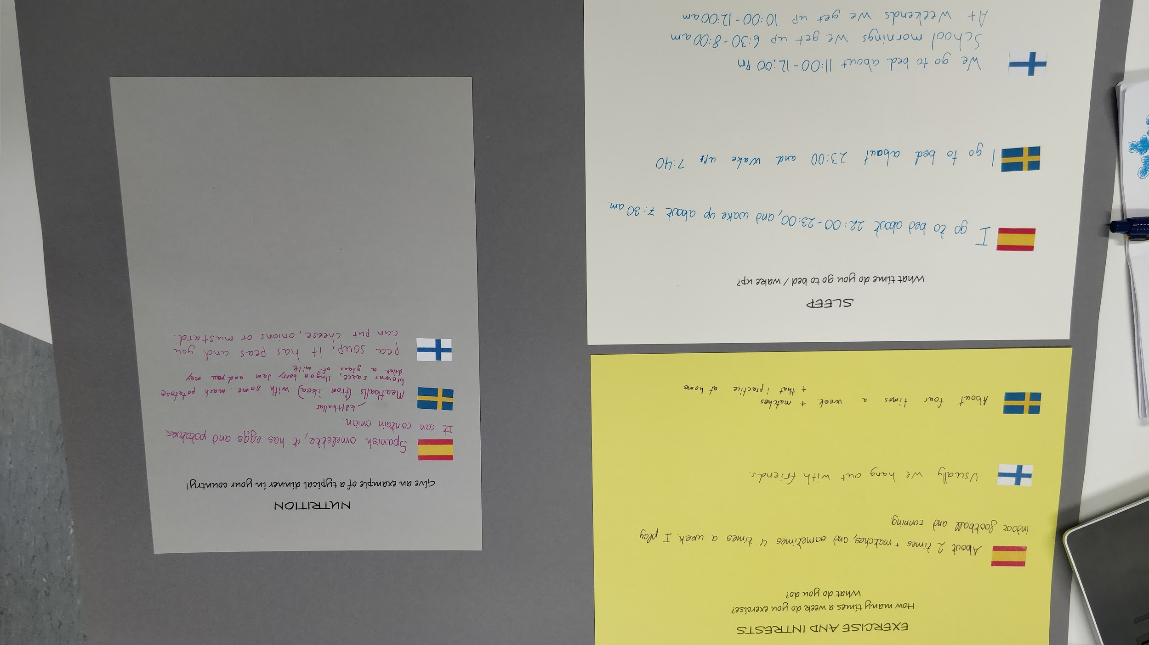
How to succeed in life
Follow everyman's rights and responsibilities, such us taking care of the environment, be a good example for young people, etc.

Slide 8
Recycling
https://youtu.be/RpjXKbc7J4I
https://youtu.be/rxgjfHNUzEg
https://youtu.be/-xW6XTb48cU

