Slide 1
Keep calm and move on
How to
-deal with stress
-become a more responsible adult
-succeed in life

Slide 2
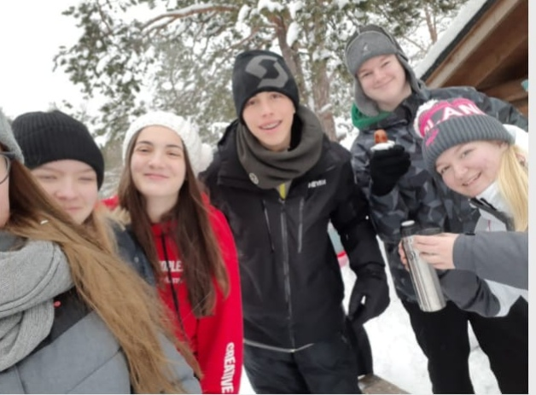
Dealing with stress.
Stress is something everyone experiences. Here are a few ways to make your life stress-free.
Sauna and ice swimming relax your body
Being mindful of the environment can put your mind at ease
Silently hiking in nature is good for your body and your mind, because your mind gets a break from thinking about daily problems
You need to eat well, sleep enough and exercise in order to take care of your body and mind.
Being open minded and trying out new things will prevent you from becoming too stressed.

Slide 3
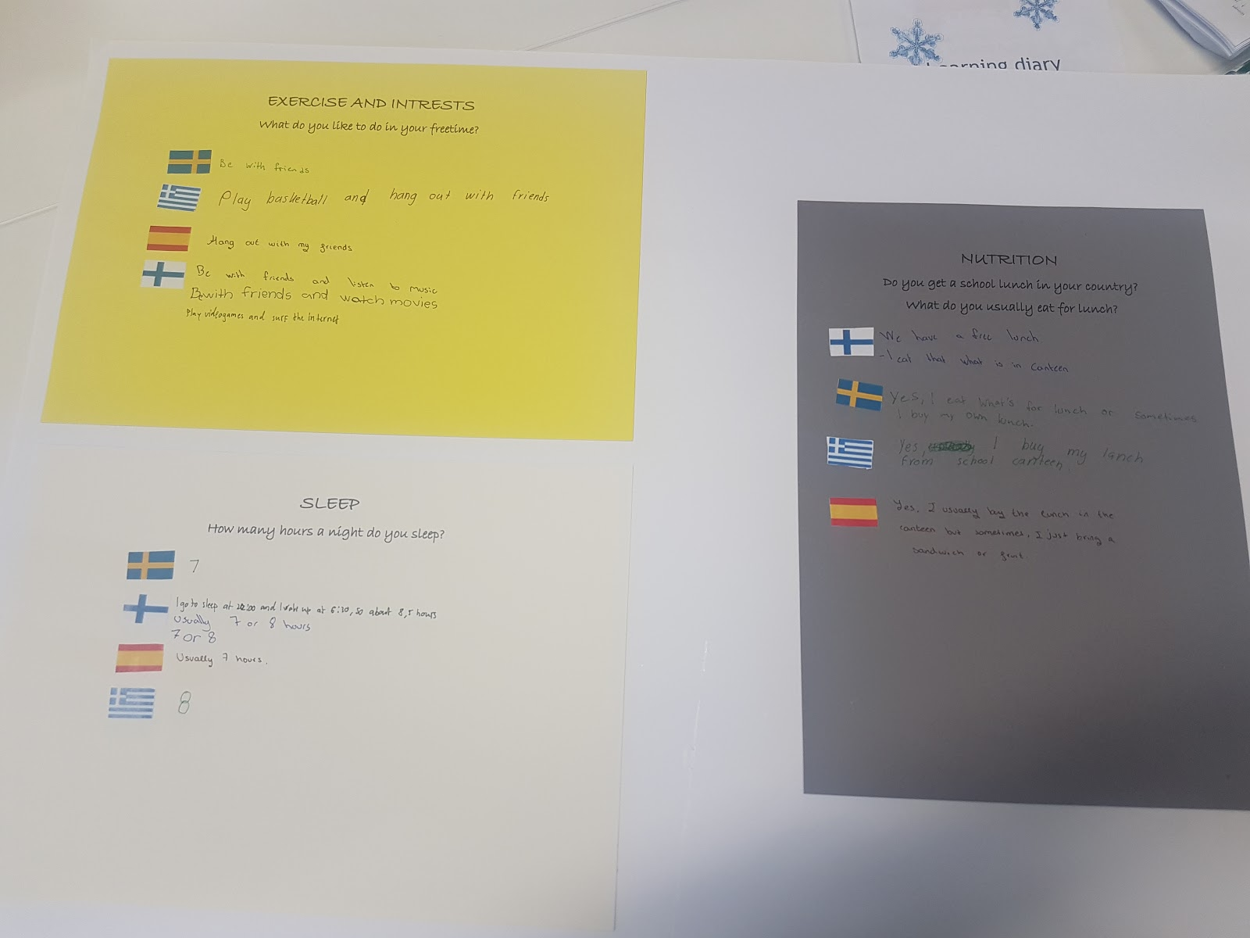

Slide 4
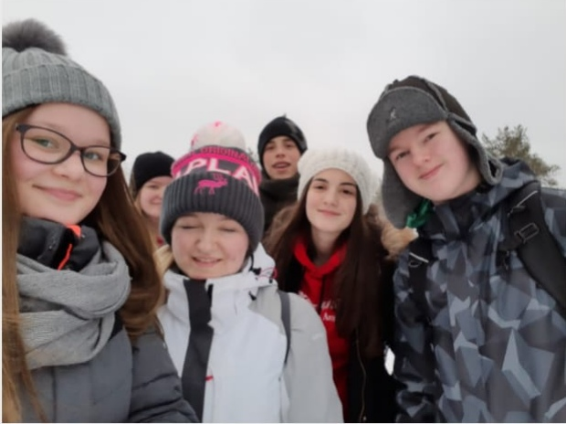
Becoming a more responsible adult
Everyone becomes an adult at some point, and with adulthood come certain responsibilities. It’s important to learn how to transform into a responsible adult.
You need to learn to take other people into account and to learn how to work with different kinds of people.
You need to learn how to handle your money.
You need to be aware of the environment and do your part in taking care of it.
you must be persistent and never give up, no matter how hard you fail. Taking responsibility for your mistakes is very important.
You need to know how to do things safely. Take care of your health.

Slide 5
Recycling
Recycling is one of the most basic responsibilities, and it’s something even younger people can do.
You need to learn how to correctly recycle waste, because certain types of waste can harm the environment, if not dealt with properly.
For example : You need to cover the cathode and anode of a battery.

Slide 6
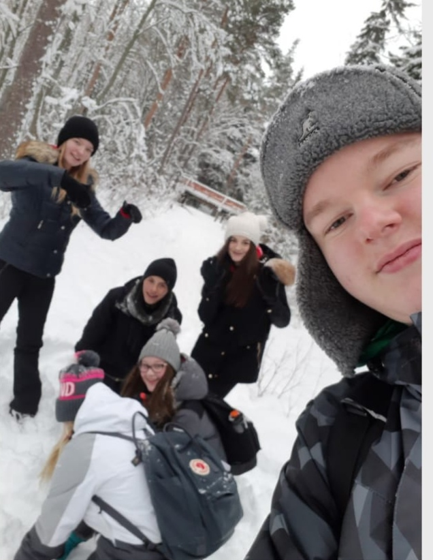
Succeeding in life
No matter what you’re trying to accomplish in your life, there are a few pieces of universal advice that will help you reach your goal.
Planning (SMART) clearly define what your goal is, think about what are the requirements for reaching it, think about if your goal is reasonable, think about how much reaching this goal actually matters to you, figure out how long it will take for you to reach your goal and prepare accordingly.
Using metacognitive learning strategies is the most efficient way to learn how to overcome any obstacles in life.
Never give up and always keep in mind that you can improve. You need to have a positive mindset, because it’s the only way to guarantee that you won’t give up.

Slide 7
Our learning diary
Here is a list of the learning strategies we used during this project
Learning from mistakes Writing post-it notes Tests Elaborating to prior knowledge Self-evaluating Debating Working as a group Brainstorming Skimming Playing learning games Note taking Learning by hearing, seeing and doing Peer teaching and learning Asking eachother questions
Our shared experience
Sunday
We went silent walking and doing some Seppo exercises, ice-swimming and we went to the sauna.
Monday
On the second day we worked in school on posters about the importance of sleep, nutrition and sports. After that we went skating to the ice-stadium nearby.
Tuesday
We started the day by hiking to Ryssänkallio from Lähdepelto and doing some Seppo exercises on the way there. We ate some food there and hiked back to Lähdepelto afterwards. We spent the rest of the day participating in various snow related activities such as skiing and sledding.
Wednesday
This day’s goal was learning about recycling. We went to the Hevossuo waste management site. We were in the bus and one of the workers gave us a tour of the site. Back in school we learned about recycling, and did some exercises about it. We recorded videos of ourselves sorting rubbish and returning bottles and cans to the bottle bank for some money. After we were done with that, we started working on this presentation.
Thursday
Because we are not psychics, we can’t see the future and thus can only write about the first part of this day. We started out with a media breakfast, where we read some newspapers while eating and drinking. The rest of the first part of this day was spent on finishing this presentation.

