Slide 1
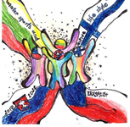
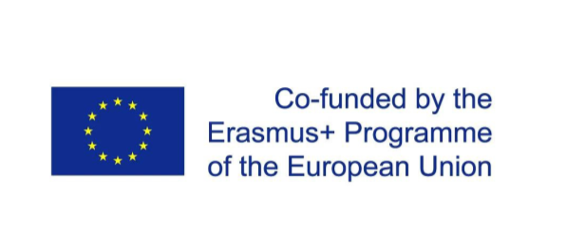
Winter sports and active lifestyle

Slide 2
Finland
Presentation for Erasmus+ meeting at Raahe 5.9-9.9.2022

Slide 3
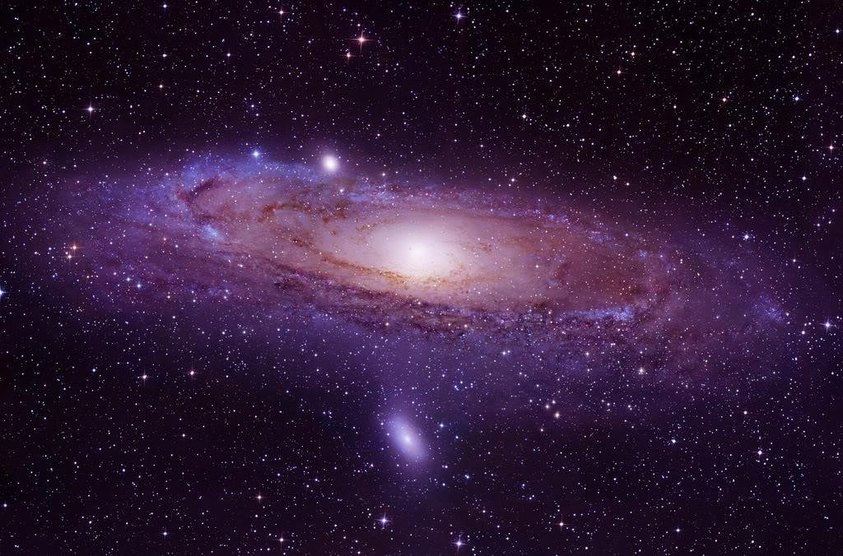
In our Universe…

Slide 4
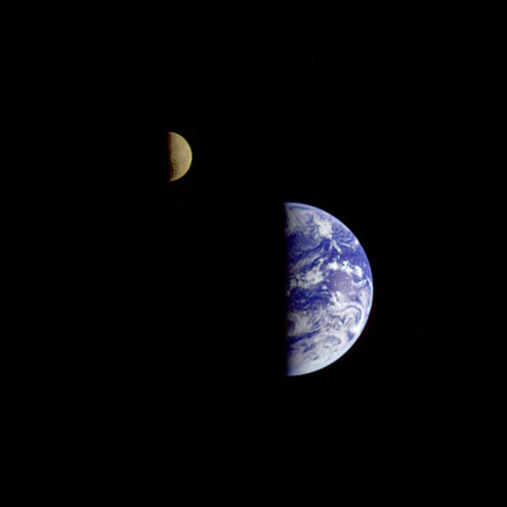
In a small solar system…

Slide 5
blue planet…

Slide 6
At continent of Europe…

Slide 7
sijaitsee
Suomi,
Is located country: Finland

Slide 8
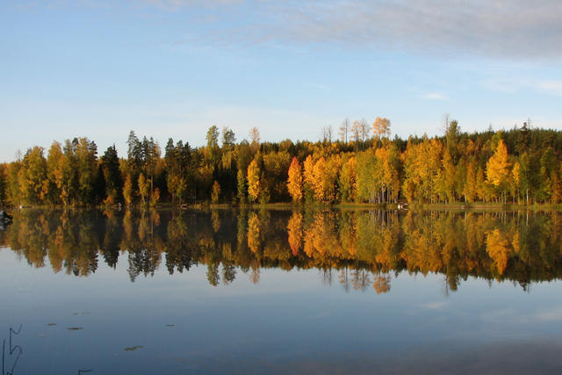
Finland is often called as land of thousands of lakes

Slide 9
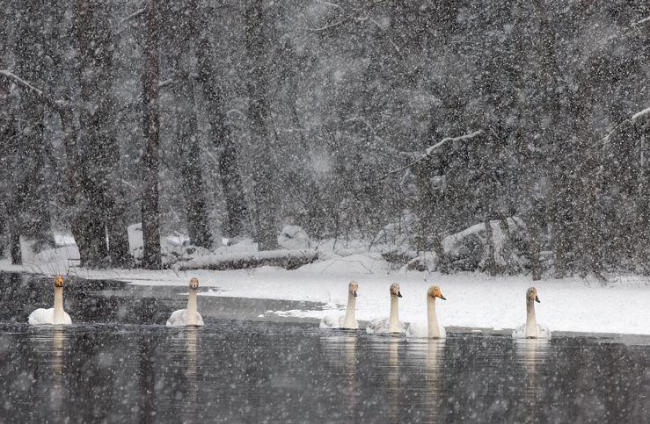
Actually there is 57 000 lakes that are larger than a hectare (10 000 m²)

Slide 10
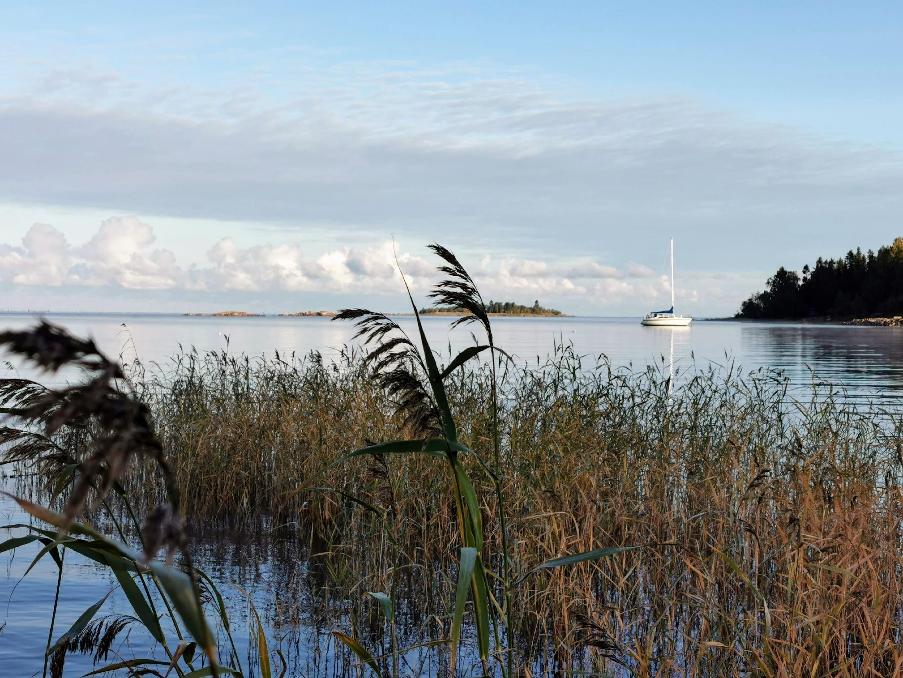
There is also beautiful coast and sea

Slide 11
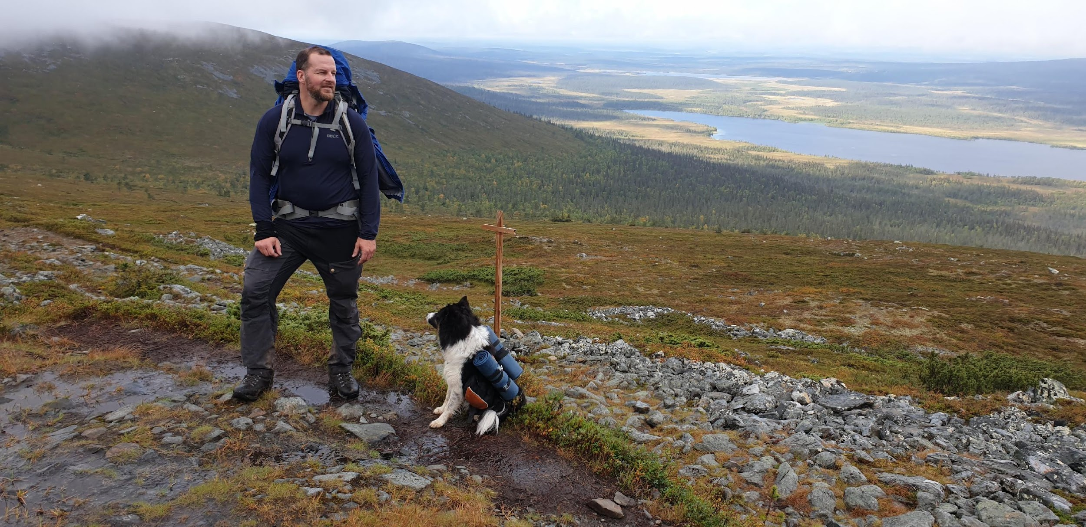
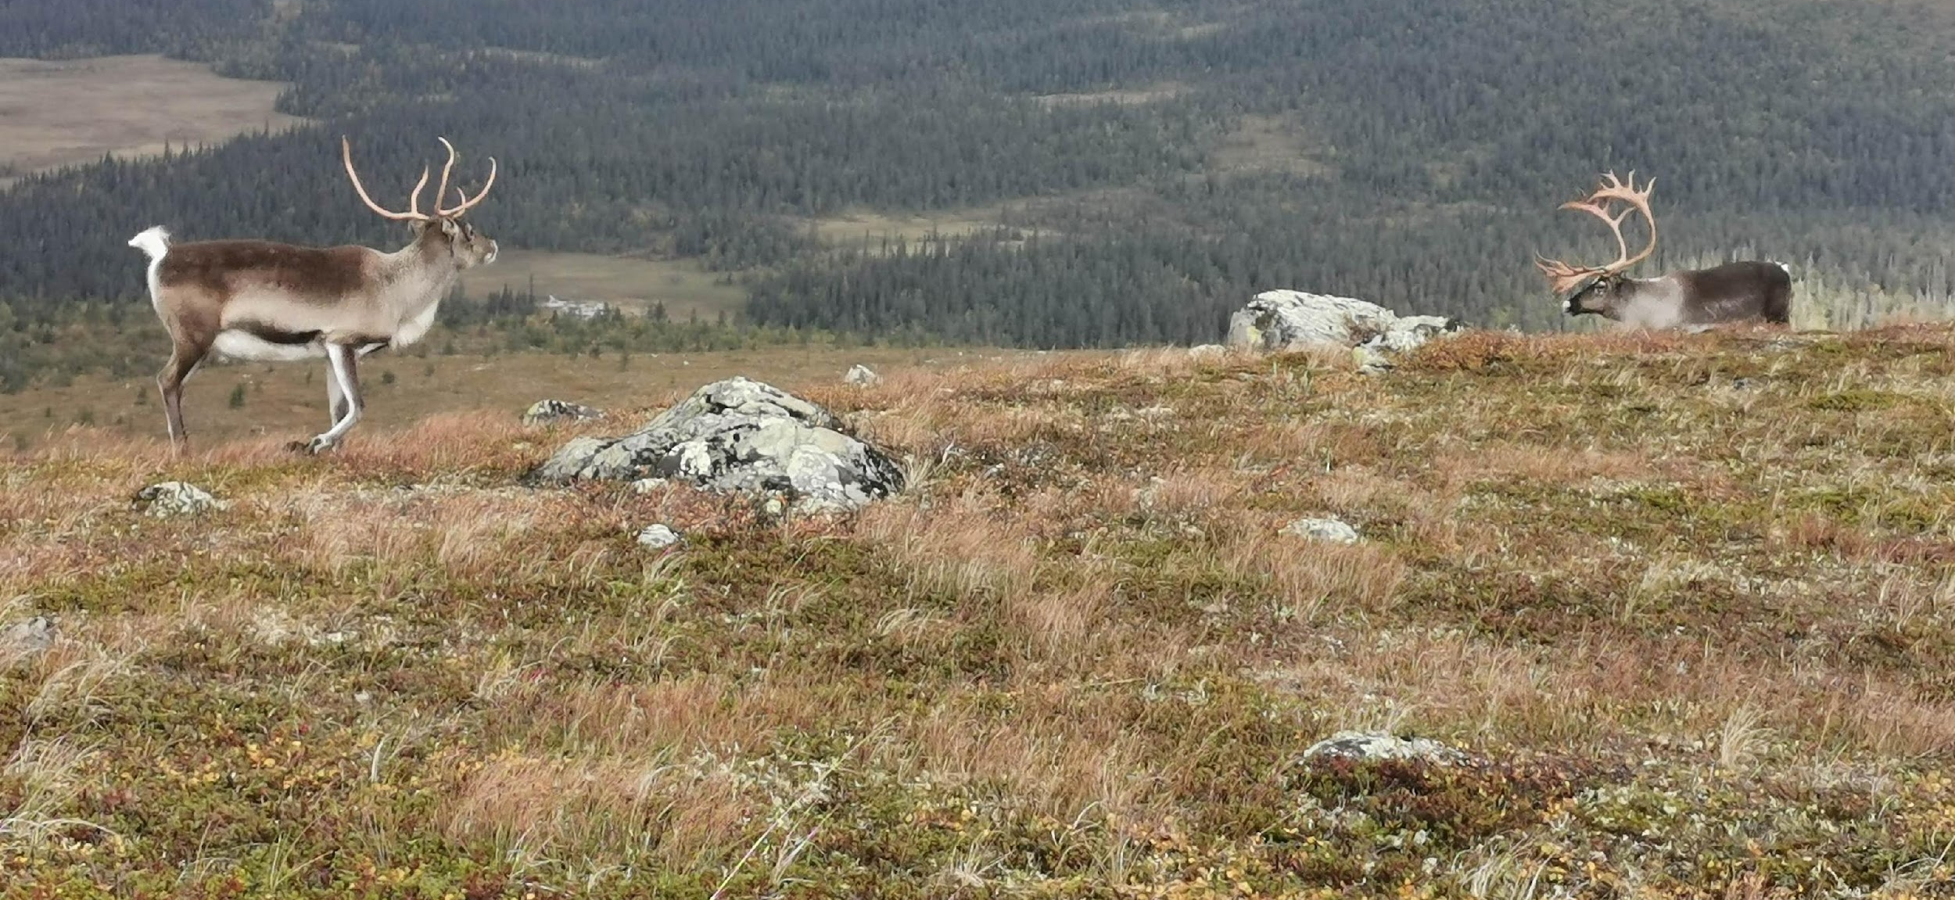
And arctic hills of Lapland with reindeers wandering freely around.

Slide 12
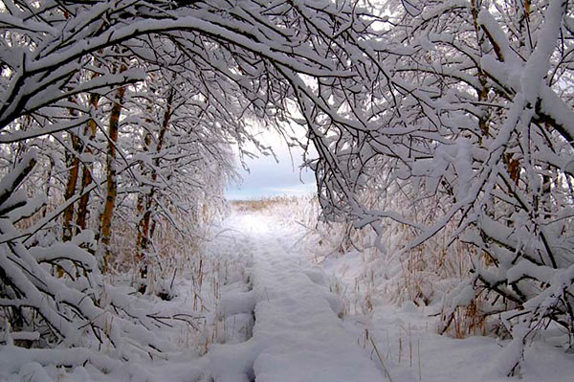
Winter lasts from November to April – so normally there is a lot of time for winter sports

Slide 13
And to watch Northern lights

Slide 14
HISTORY
(very) short version history of Finland

Slide 15
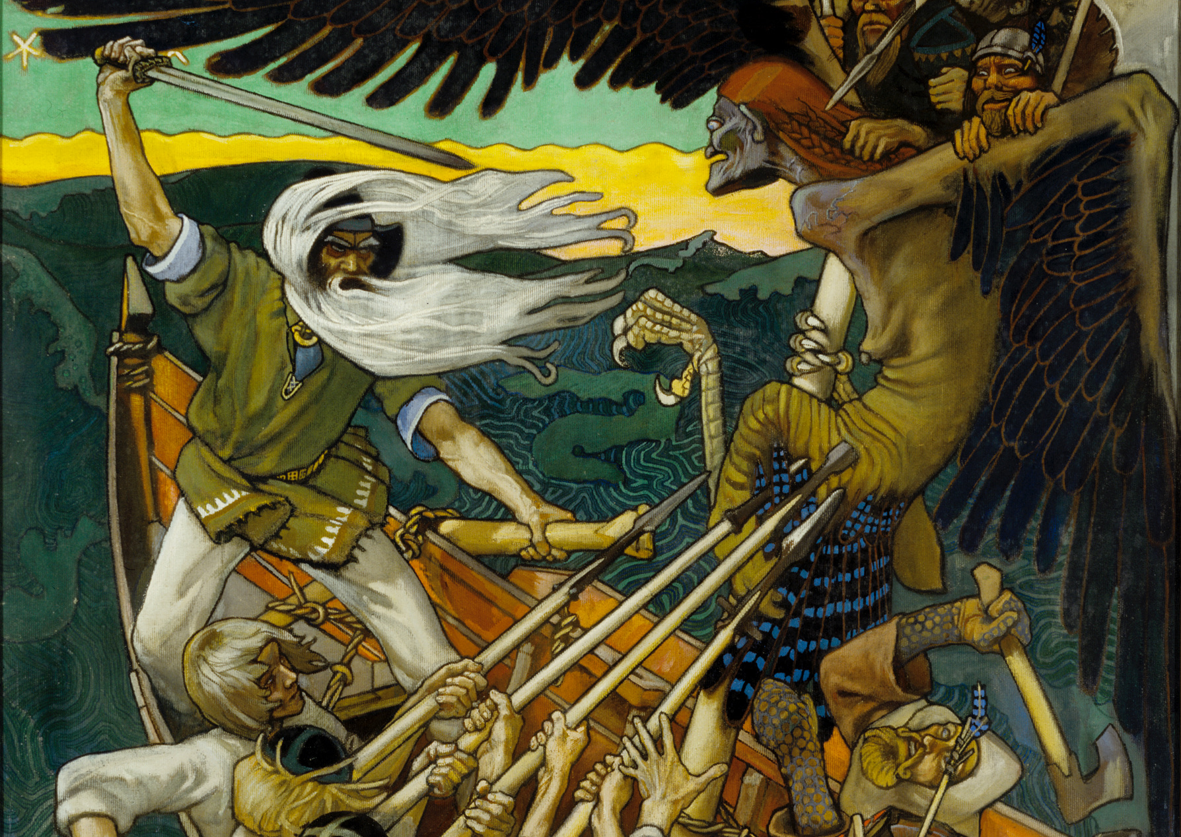
According to our national myth ”Kalevala”, world was created out of an egg mother of the egg was duck type bird called ”Sotka”.
Kalevala was founded at 19th century, when nationalism started to evoke in Finland.

Slide 16
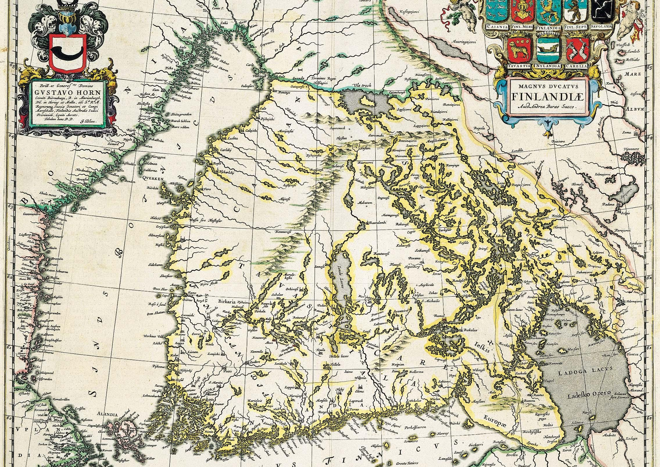
Finland has been “border country” between Sweden and Russia.
Sweden governed Finland until year 1809.
Russia governed Finland until year 1917.

Slide 17
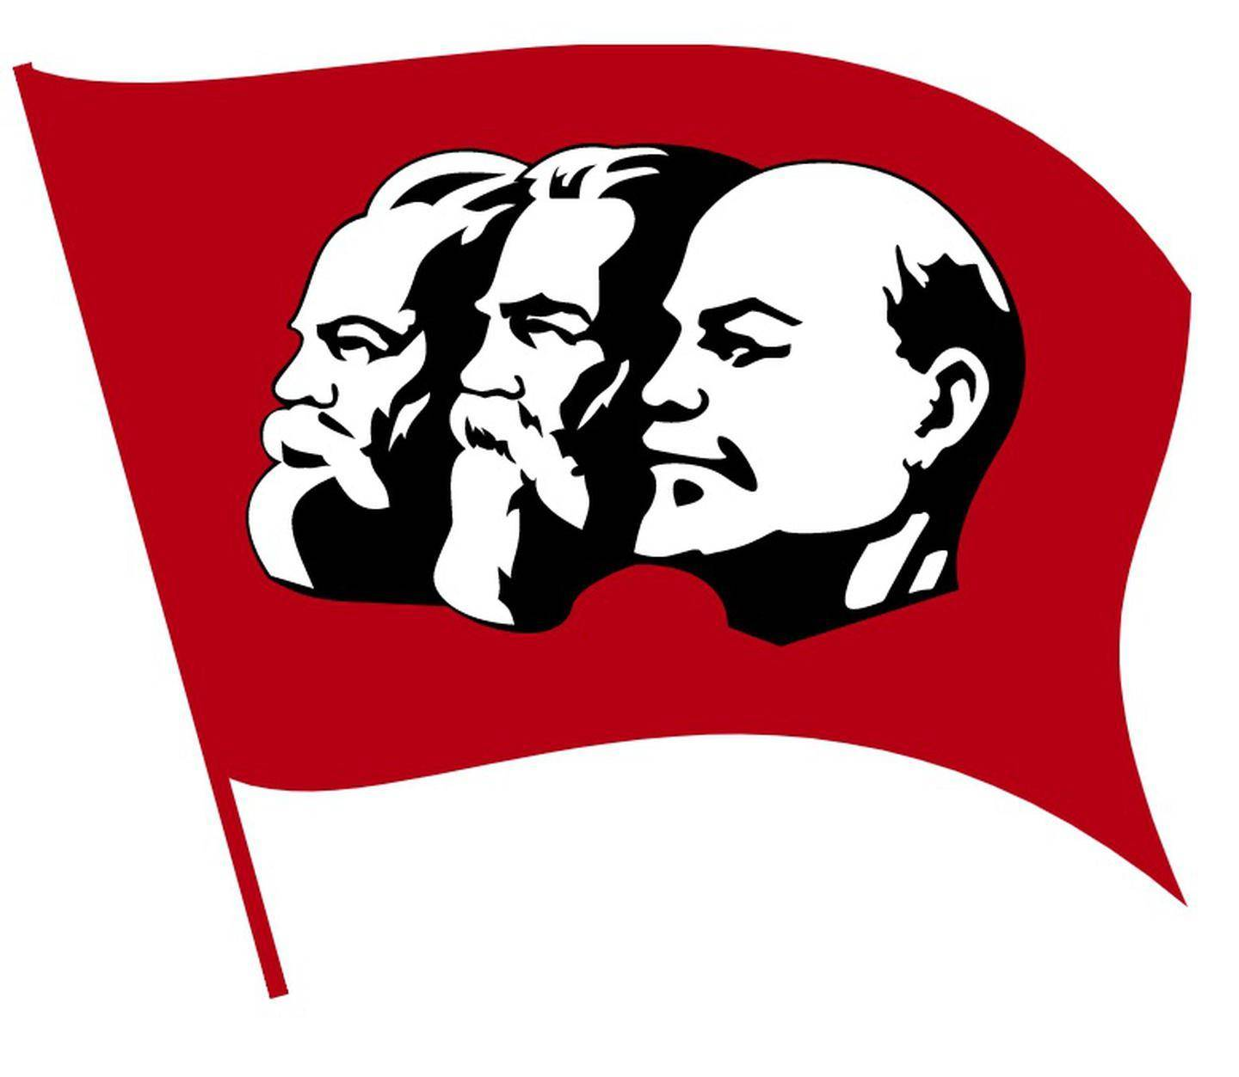
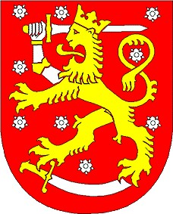
During the First World War and because of communist´s revolution at Russia, Finland got independence in year 1917
Lion and red color in Finland’s coat of arms reminds of Swedish kings.

Slide 18
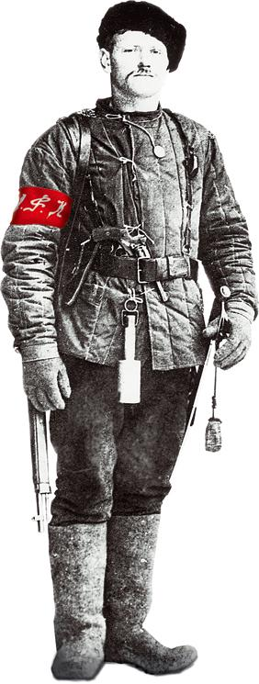
Communist revolution happened also in Finland. It caused a civil war 1918 between communist “red” and bourgeois “white” armies.

Slide 19
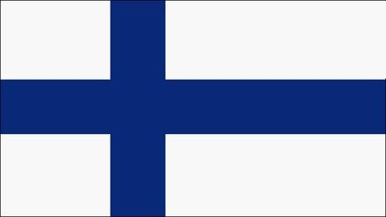
“White” army won and republic of Finland was founded. Our head of the state was now called president – not king or Tšar.
The blue-white flag reminds of christianity, blue color reminds of lakes and sky, but red color wasn´t wanted to flag. So white it is.

Slide 20
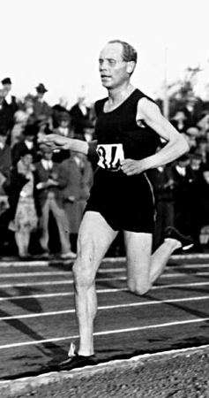
Young nation industrialized and specialized on wood products.
Finnish people were very proud of its athletes: Paavo Nurmi won 5 gold medals at Pariisi Olympics 1924.

Slide 21
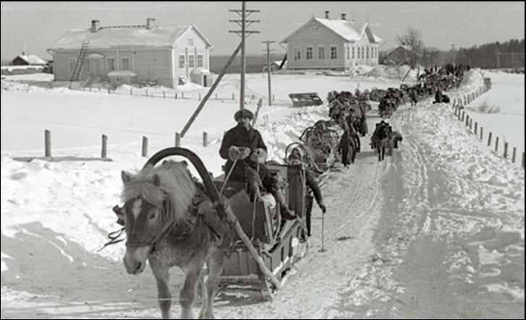
In Second World War (1939-45) Finland fought twice against the Soviet Union and lost eastern parts of its country

Slide 22
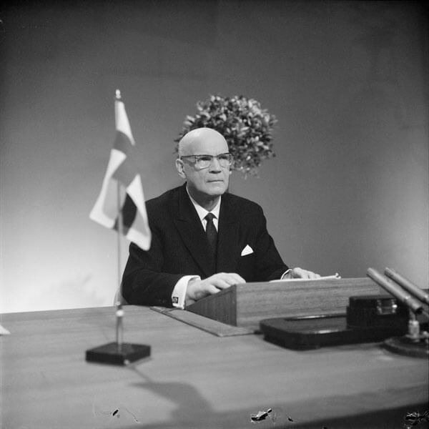
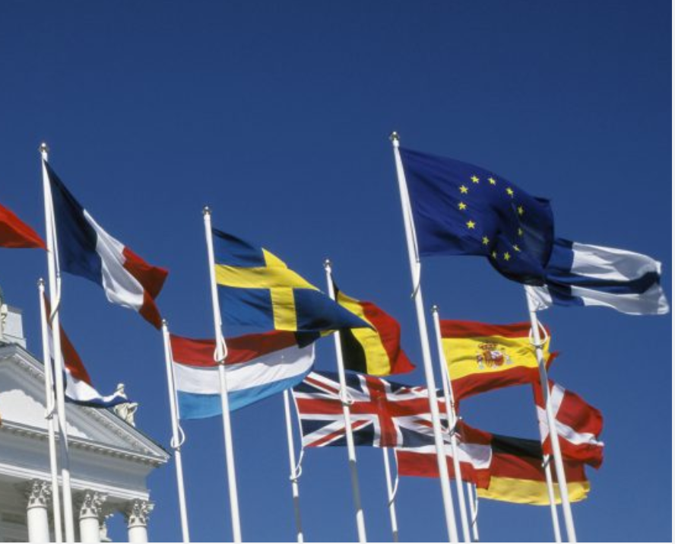
During the cold war era Finland tried to have good relationships with Soviet Union.
Soon after Soviet Union collapsed Finland joined EU in year 1995.

Slide 23
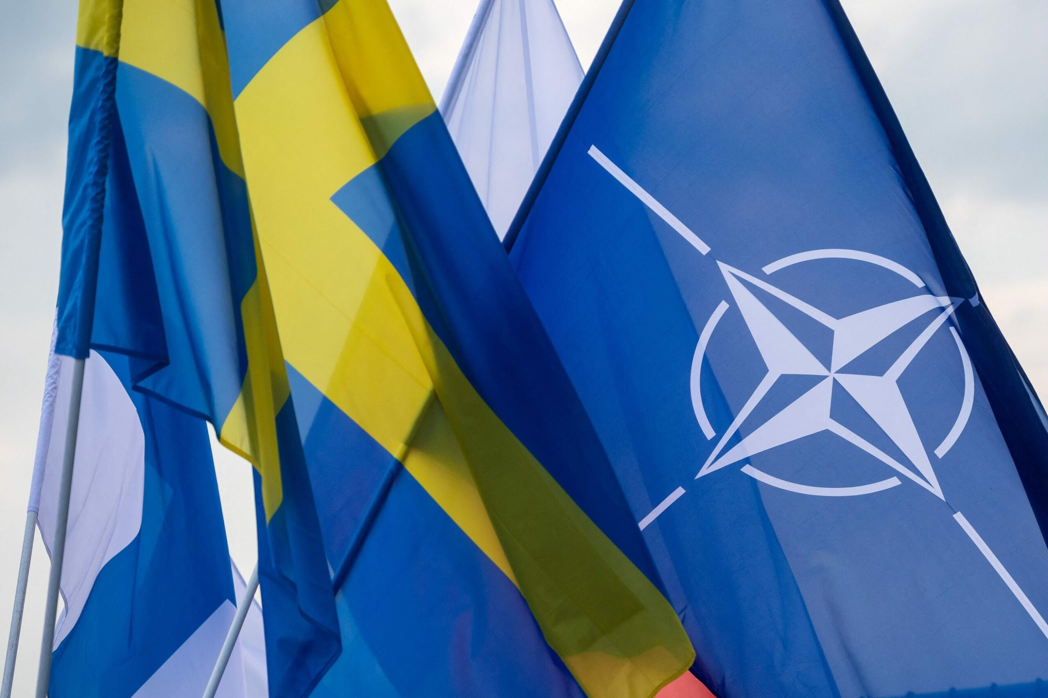
In 2022 Finland is choosing western co-operation.
After Russia attacked Ukraine, Finland delivered application for NATO-membership together with Sweden.

Slide 24
Few words about
FAUNA AND FLORA
in Finland

Slide 25
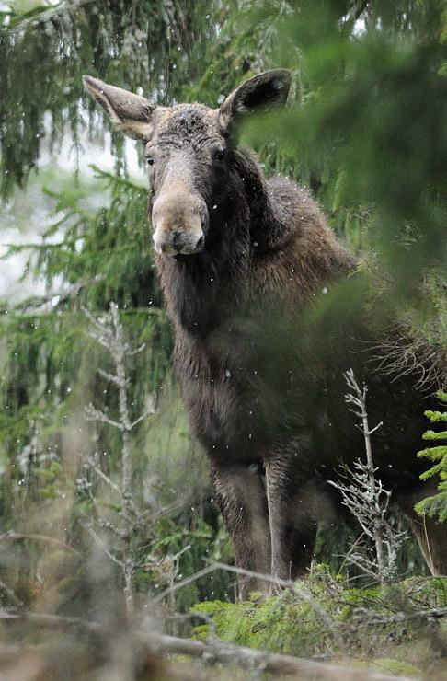
Moose. ”Hirvi”. Largest animal in Finland and quite common in forests. Over 2 meters high and can weight 800 kilos. Huge. (lat. Alces Alces)

Slide 26
Swan. “Joutsen”. National bird of Finland, (lat. Cygnus cygnus)

Slide 27
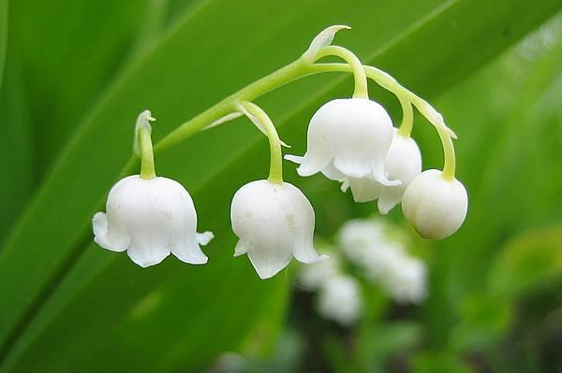
Lily-of-the-valley. “Kielo”. National flower of Finland. (lat. Convallaria majalis)

Slide 28
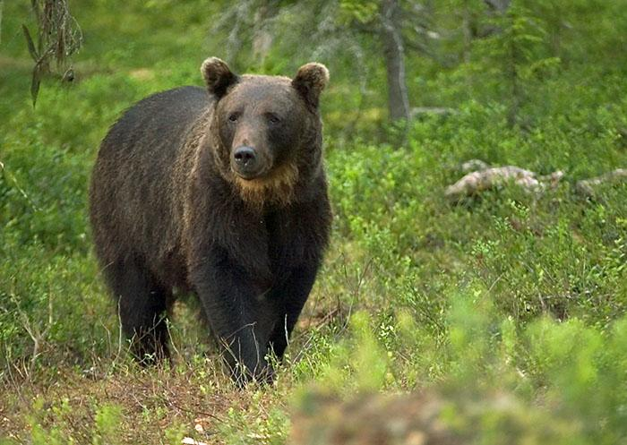
Brown bear. “Karhu”. National animal of Finland. (lat. Ursus arctos)

Slide 29
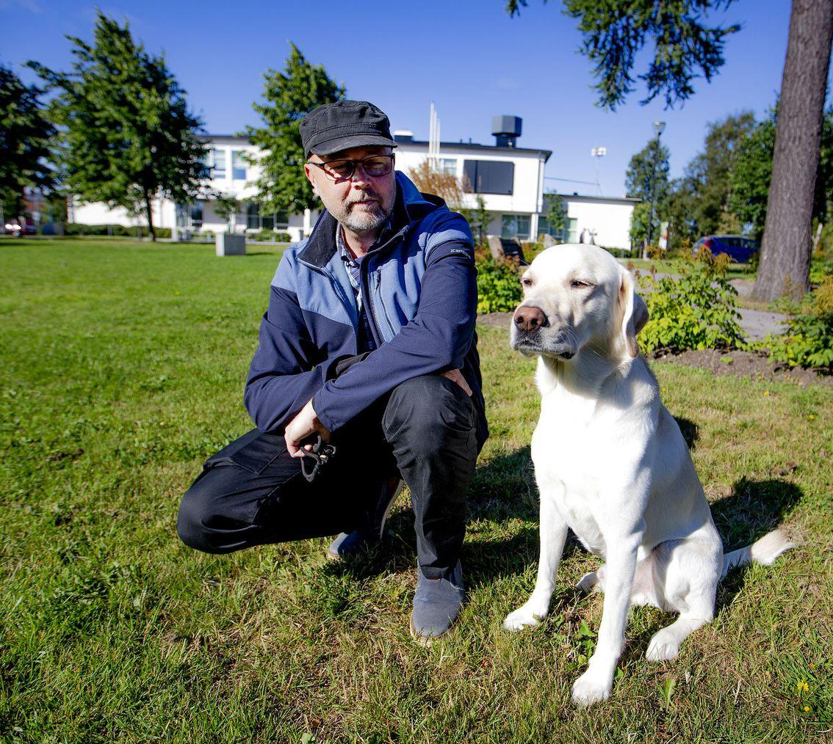
Labradorian retriever ”Viljo”. Very good working dog and inseparable company of mr. Heikki Peltoniemi.

Slide 30
Bordercollie ”Sumu”.
Bordercollie is considered world´s smartest dog breed.
Sumu is also working as official trademark of history classes of Raahen lukio school.
Sumu can retrieve Labradorian retriever or Labradorian retriever´s owner when they are lost.

Slide 31
City of
RAAHE

Slide 32
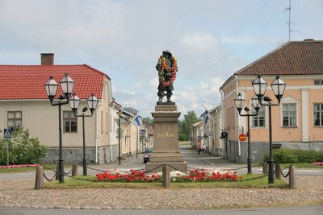
Swedish governor Pehr Brahe founded Raahe in 1649. His statue can be found at Pekkatori.

Slide 33
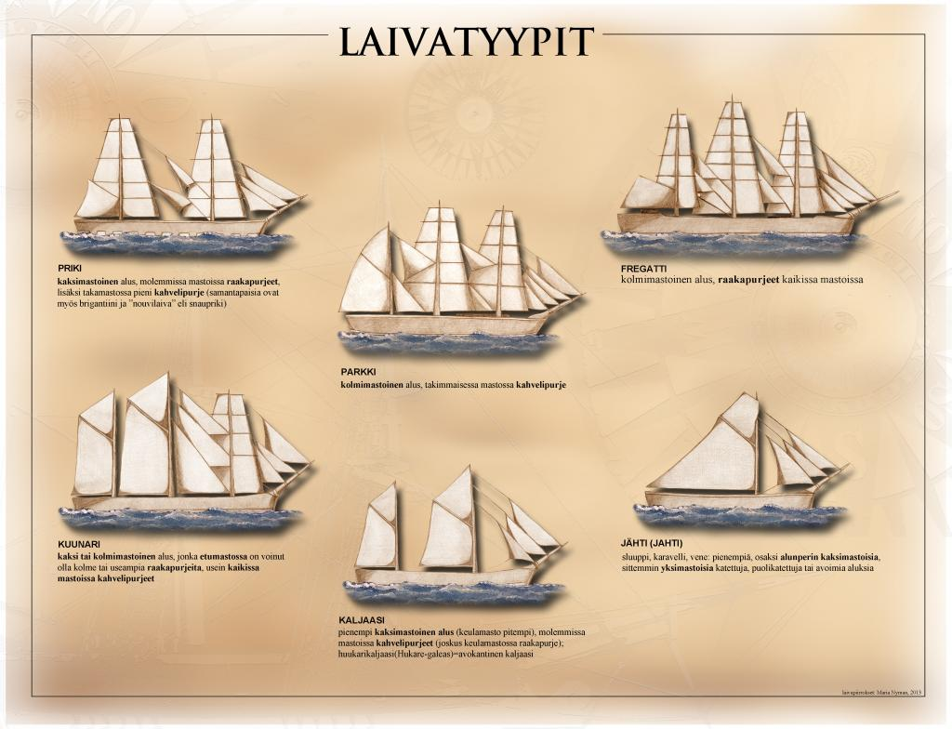
A coastal Raahe city was famous from its wooden ships.
Ship yards in Raahe produced more wooden sailships than any other city in Finland at late 1860s.

Slide 34
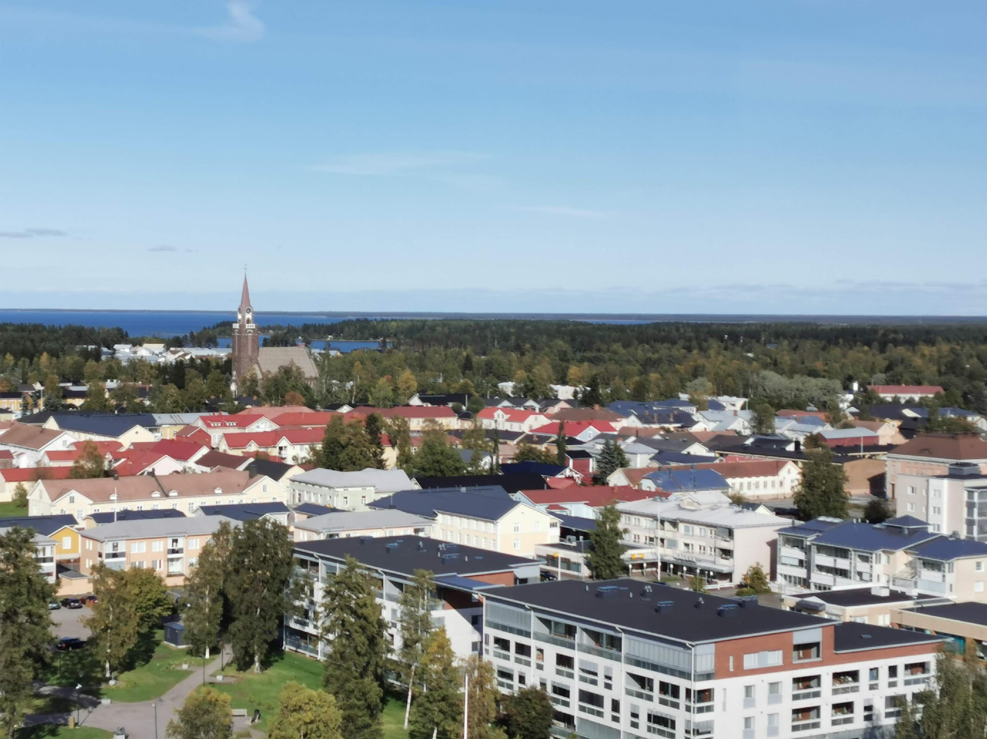
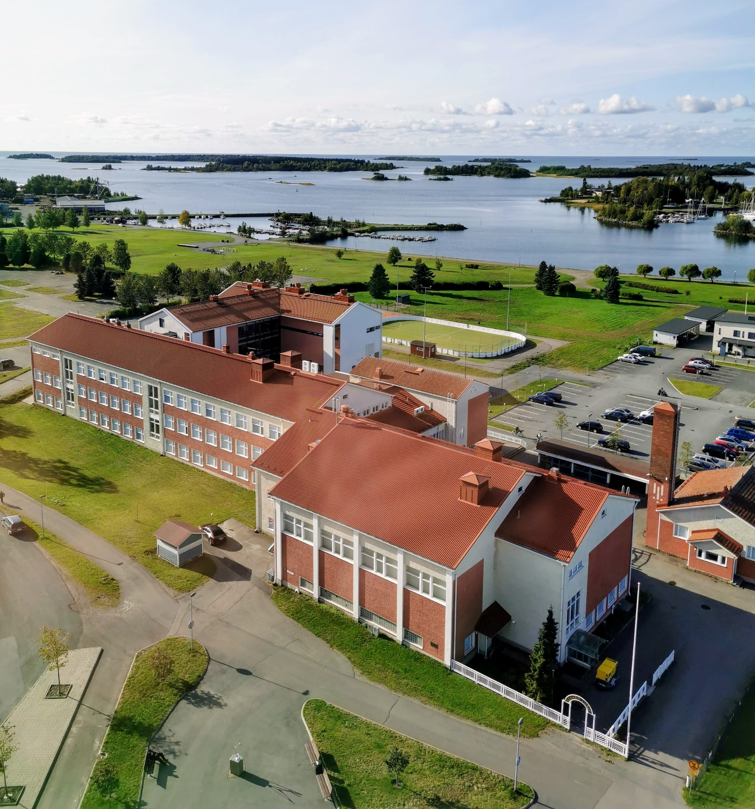
After industrializion production of wooden ships wasn´t profitable.
So now Raahe is small and peaceful coastal city.

Slide 35
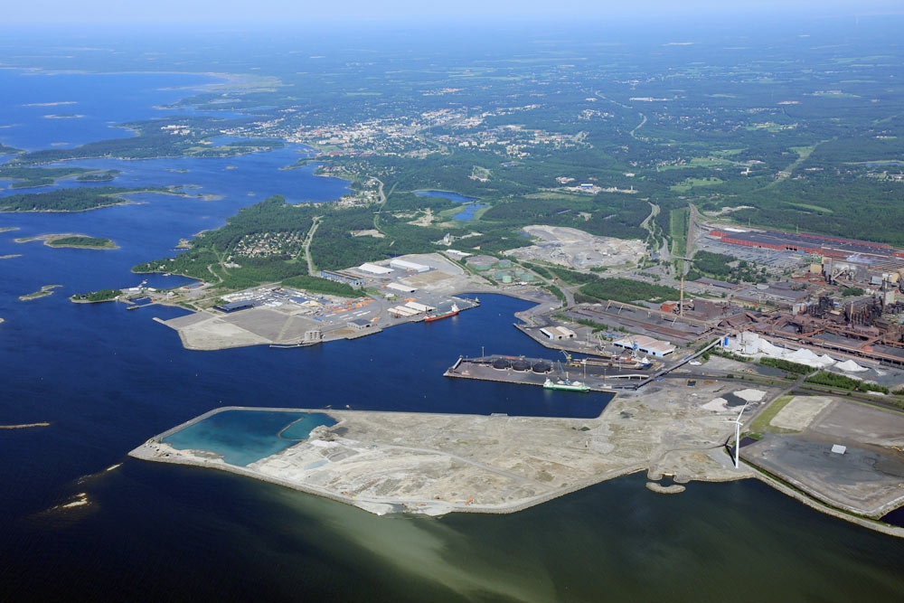
Now steel factory of SSAB and harbor area construct the industrial zone of Raahe.
They are source of livelihood for many people at nearby area.

Slide 36
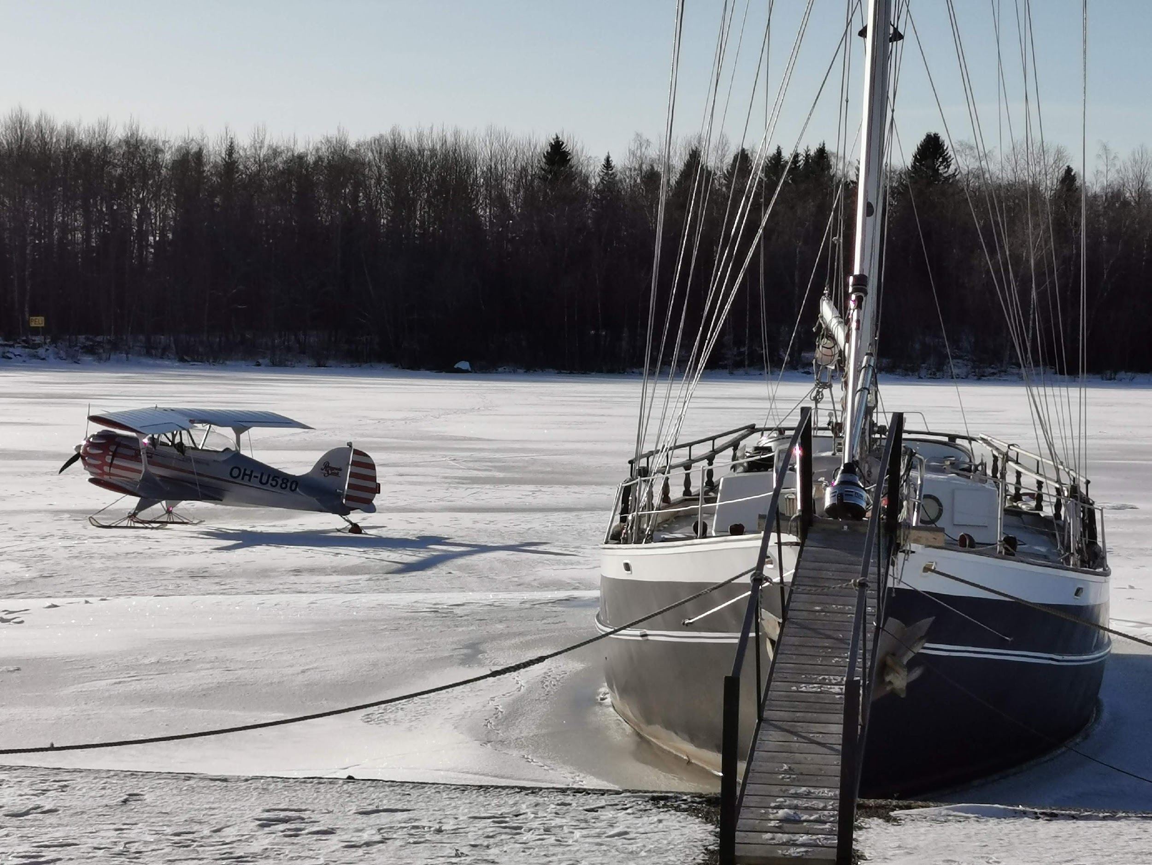
Sea freezes in December, sometimes even earlier.
It´s possible to use frozen sea and lakes for different kinds of activities…

Slide 37
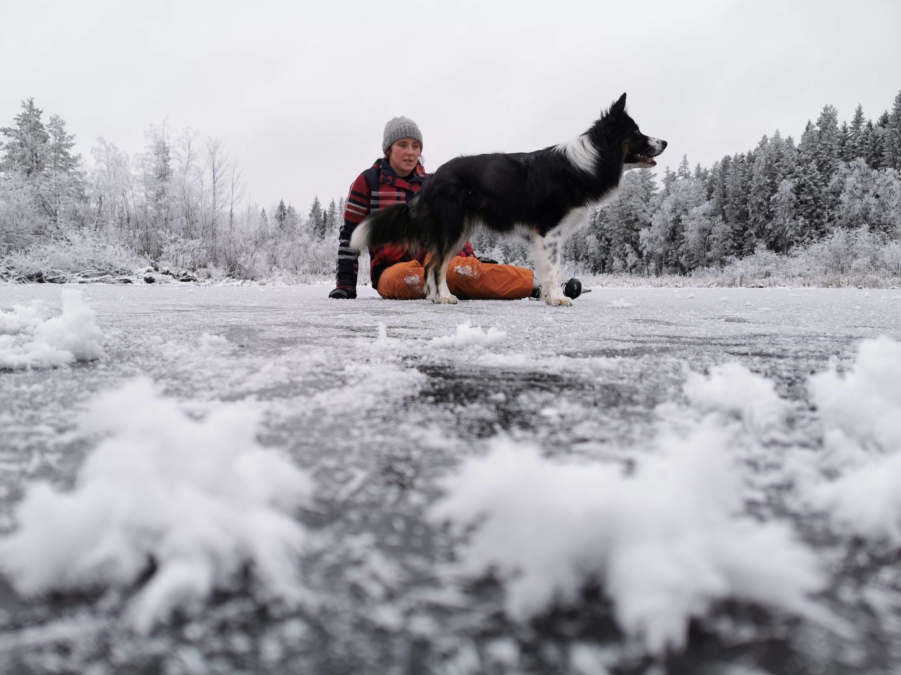
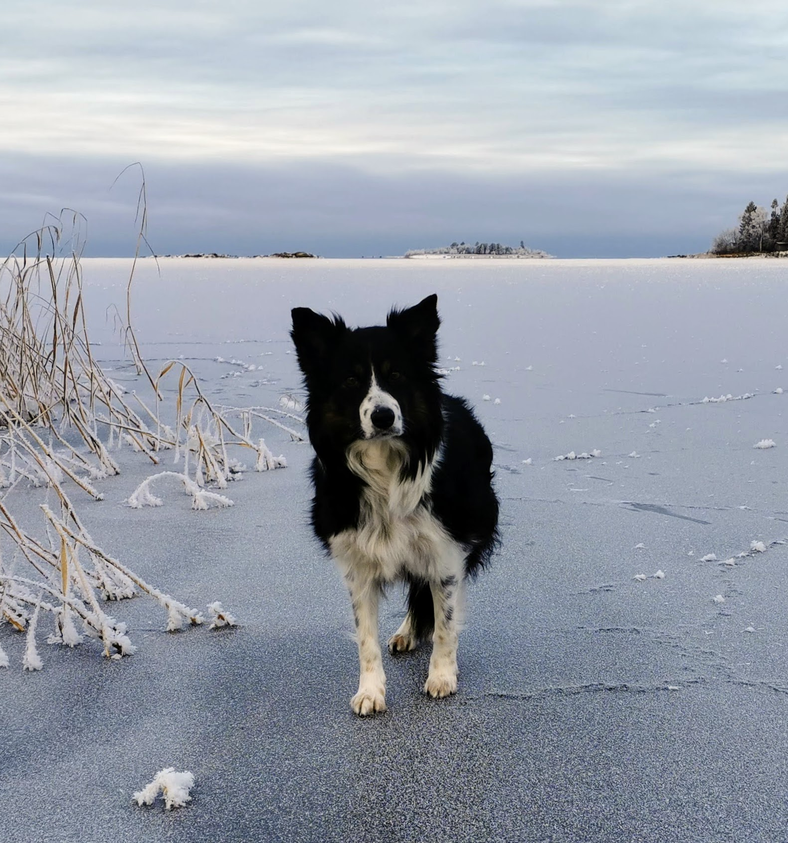

Slide 38
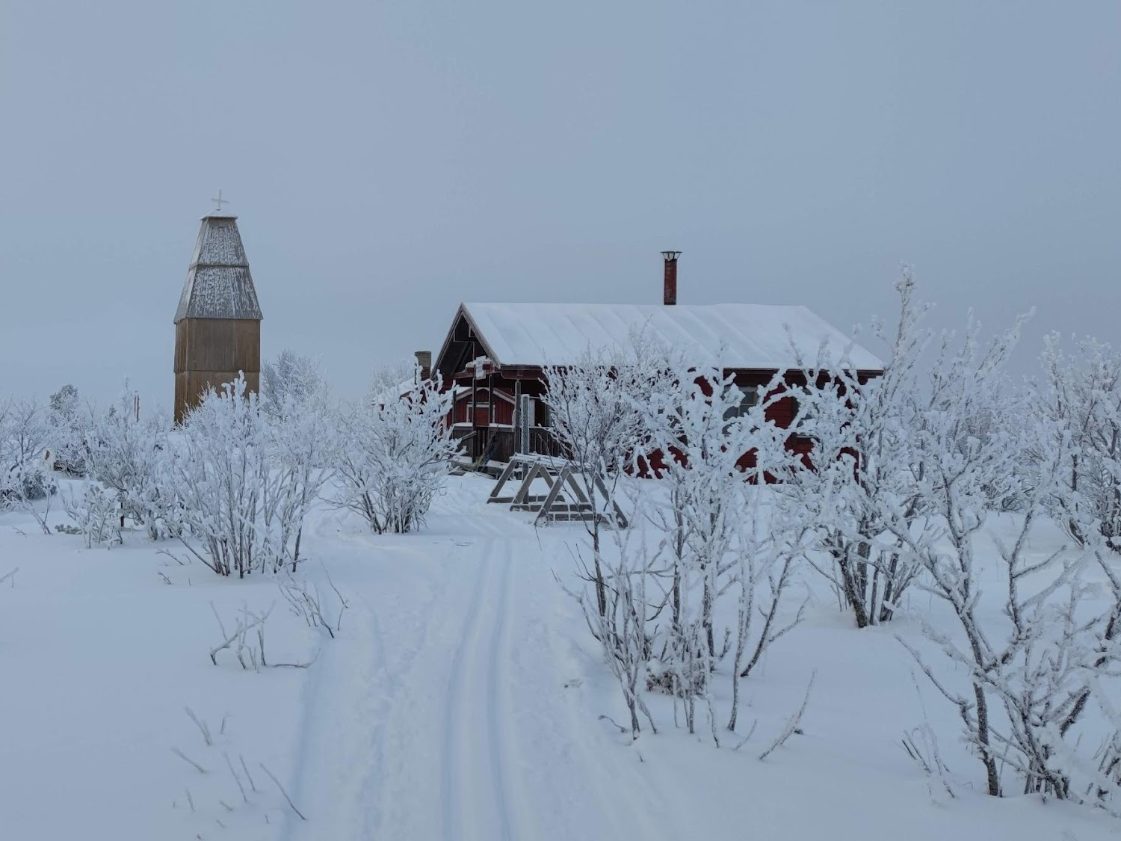
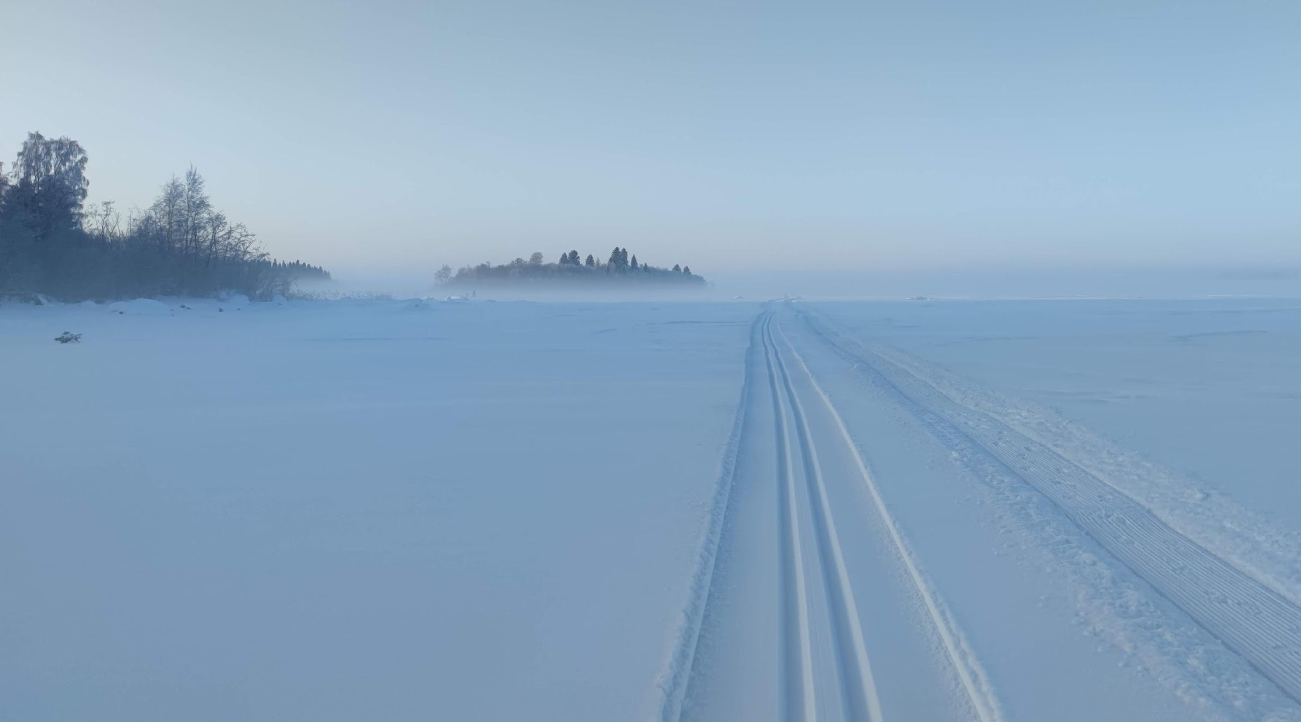
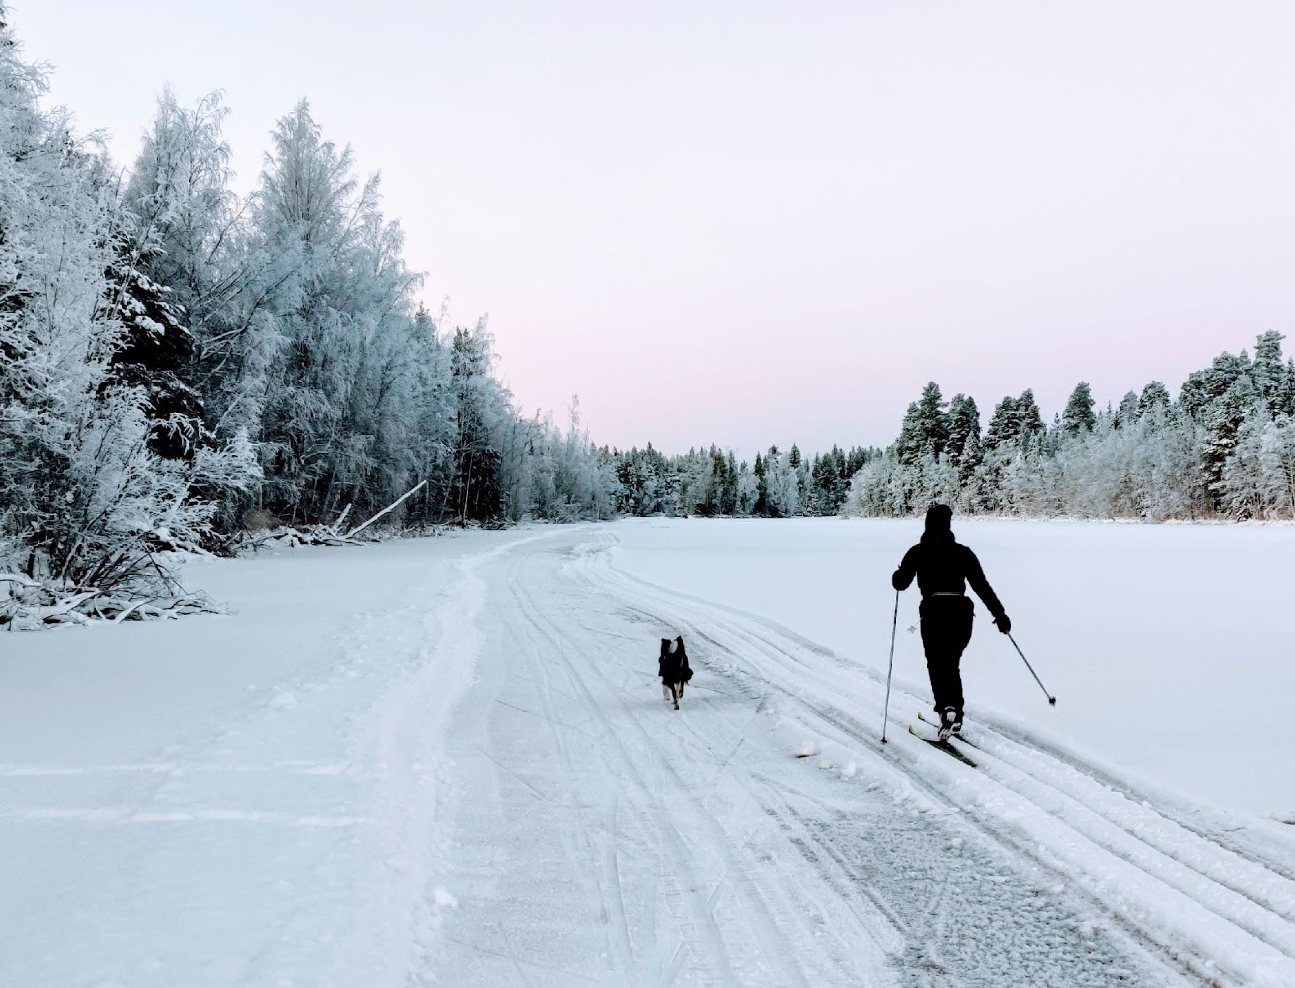

Slide 39
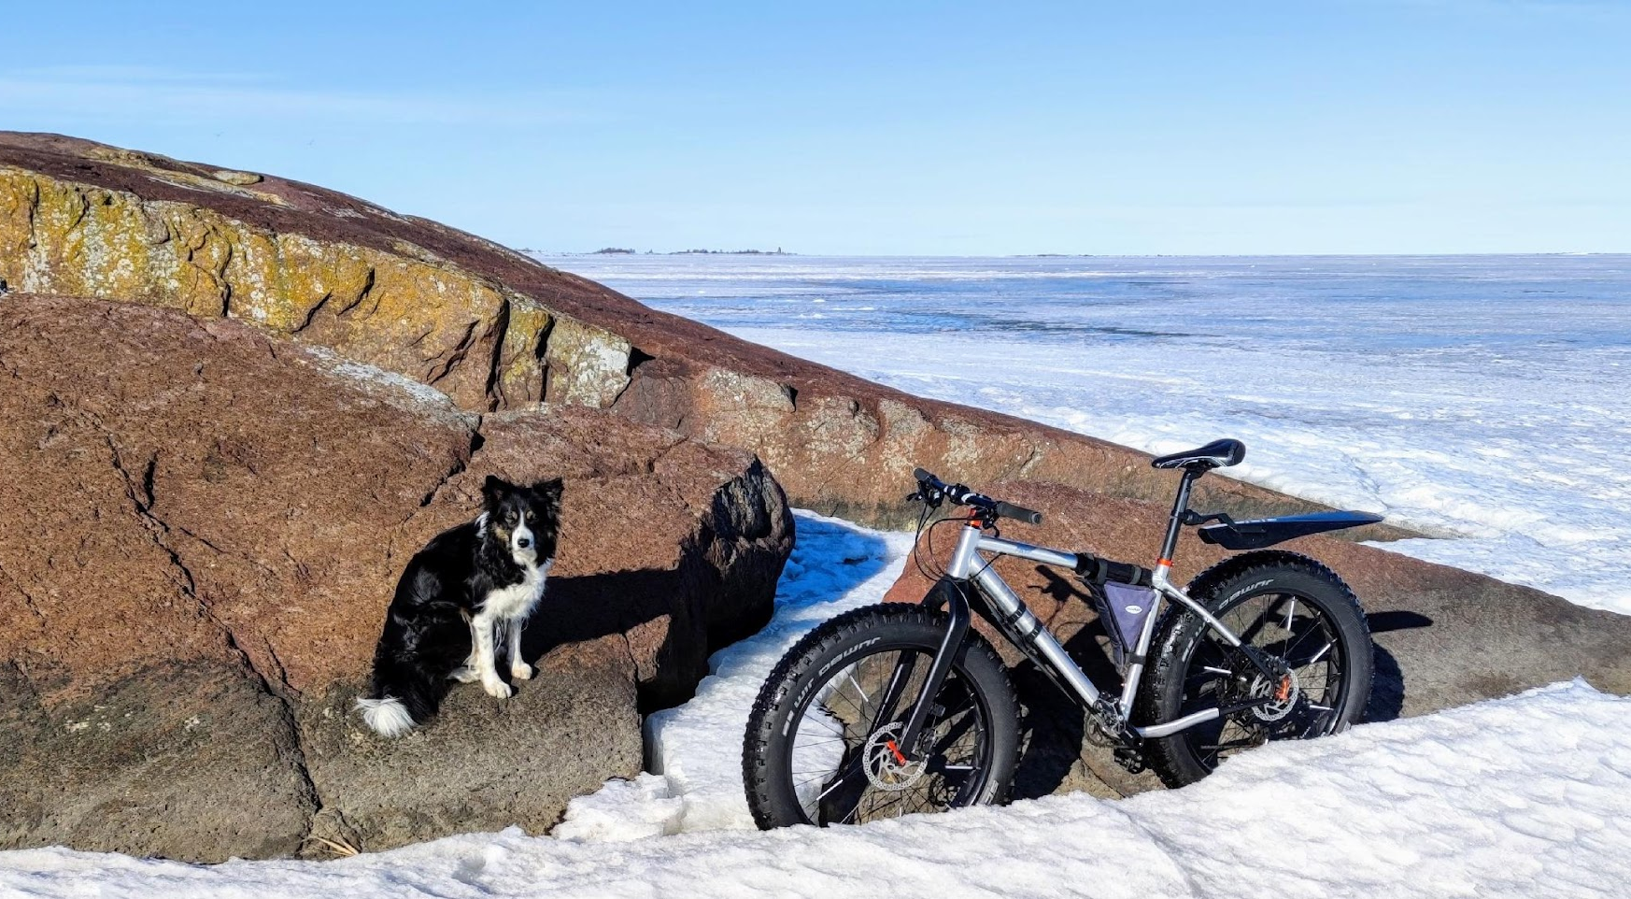

Slide 40
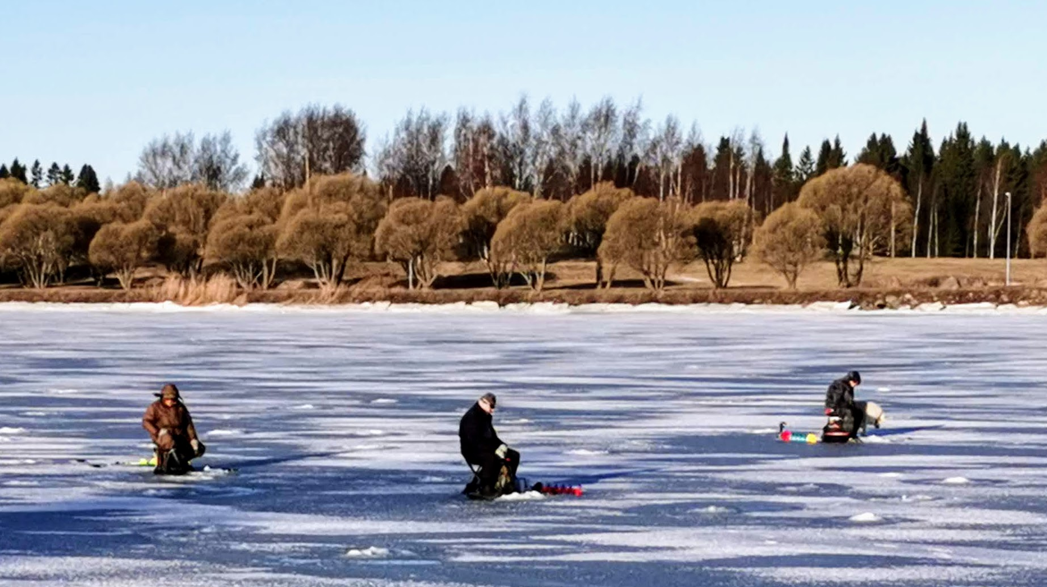

Slide 41
Active life style as part of everyday life in Finland
https://www.youtube.com/watch?v=s3Sx_OH_wok

Slide 42
Retkiluistelu – Nordic skating – Tour skating

Slide 43
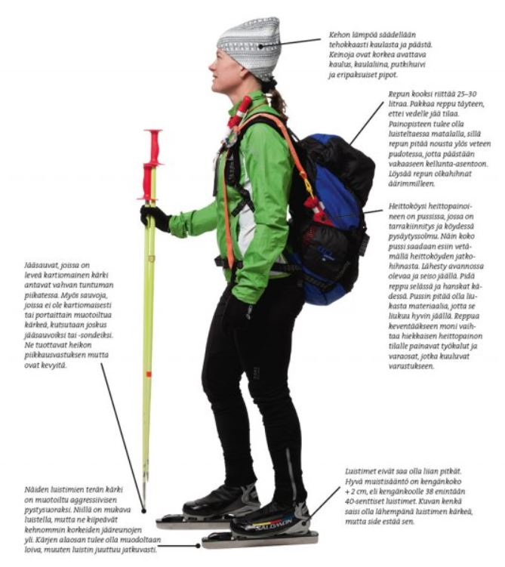
For who?
Nordic skating reminds of Nordic skiing: it can last hours and travel tens of kilometres
easy way to explore frozen environment and nature
Raahe area´s islands are excellent for skating
suits for every age group, but mostly skaters are bit older people

Slide 44
Where and when?
Originally Nordic skating is done on natural ice (lakes, canals, sea) but there is even frozen and maintained paths on dry land
best times for skating are just when waters freezes at the beginning of the winter and just before ice melts at the end of winter
Some cities or communities maintain certain track for skaters through the winter time

Slide 45
Equipments
there is two kind of skates: Some skates are attached to Nordic skiing boots and others are suitable for any boots
skates have longer blade than in ”normal” ice hockey skates and it makes skating more stable

Slide 46
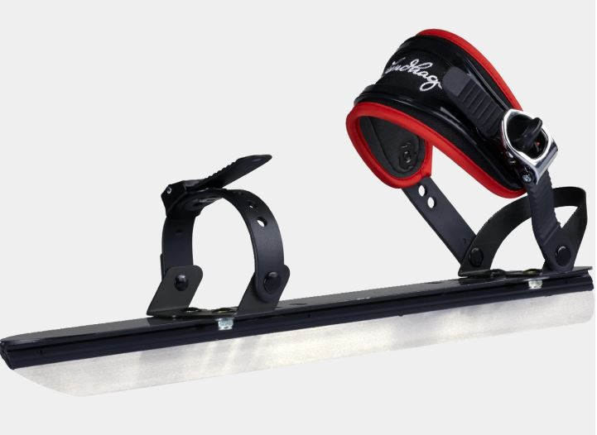
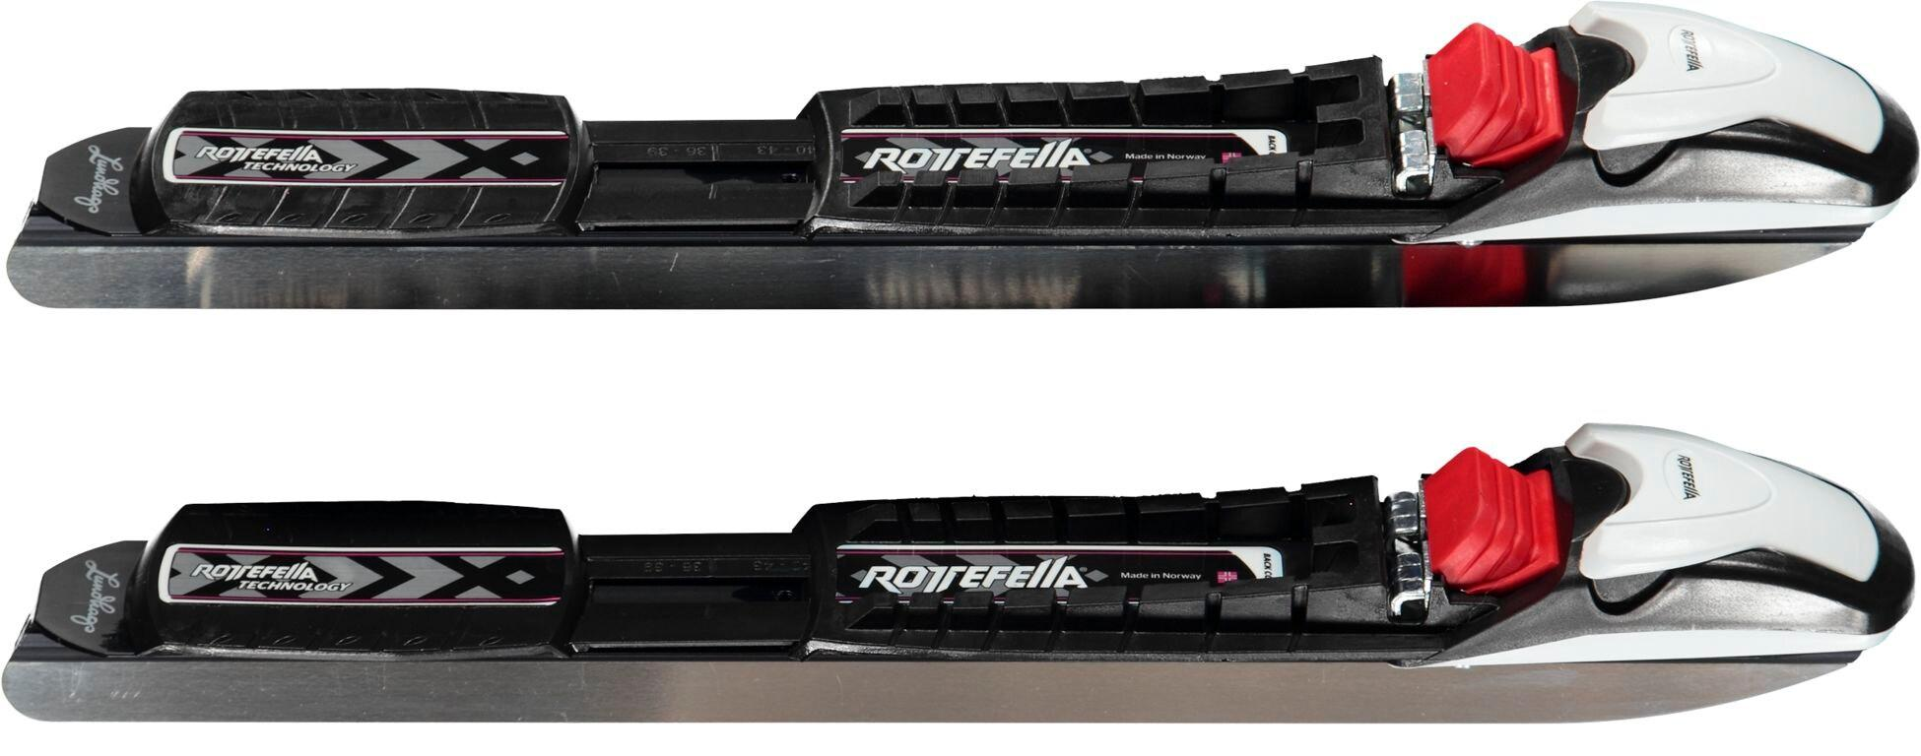

Slide 47
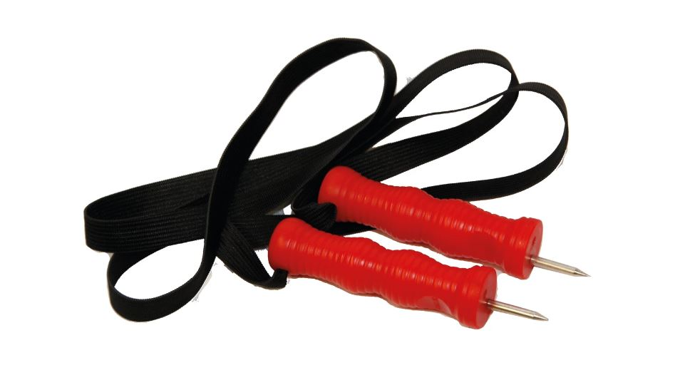
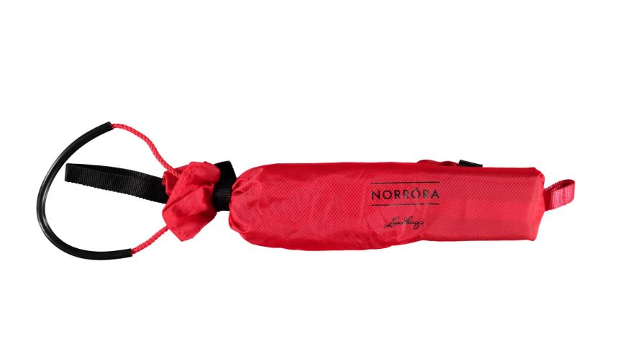
ski poles or such are useful to gain speed and to try that ice is thick enough
sharp, needle like knife ”naskalit” and rope are safety equipment (in case one drops through the ice)
it's recommended to have dry clothes in pack back and pack back should help floating
most valuable safety factor is to have friend skating with you

Slide 48
Retkiluistelun perusteet suomeksi: https://www.youtube.com/watch?v=WcQ44PxE6q4
Retkiluistelua merellä: https://www.youtube.com/watch?v=9ZGxN5nXyww
Retkiluistelua järvellä: https://www.youtube.com/watch?v=N0lG3uZX_p4

Slide 49
Potkukelkkailu – Kicksled

Slide 50
Origin
Kicksleds were originally a practical mean of transportation
during wintertime roads were slippery and chair-like sled was cheap and safe way to move around
recent decades roads have have been maintained with gravel in order to avoid slippery, so kicksleds are not every day transportation anymore
some people still use kicksleds moving on ice (fisherman and old people mostly)

Slide 51
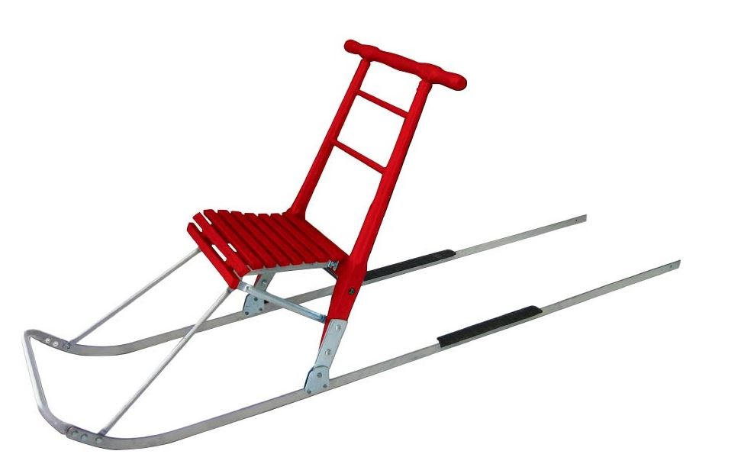
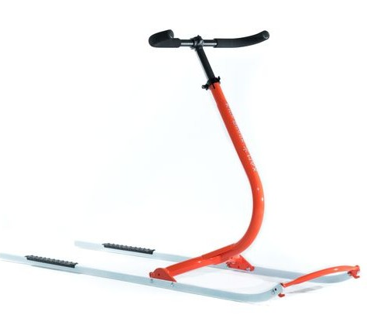
Equipment
traditional kicksled works also as a chair
modern kicksleds are for fun and sport and have more high tech appearance than the original ones
no longer chair-like shape
the edge of the sled can be iron edge or plastic ski
handlebar is adjustable for different high

Slide 52
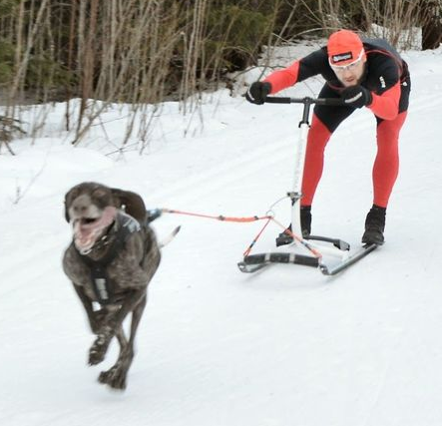
kicksledding is a marginal sport
there barely is suitable track just for kicksleds and mostly kicksledding on skiing tracks is forbidden
some cities or communities maintain certain track for skaters through the winter and also kicksleds can be used there

Slide 53
Peruspotkukelkka: https://www.youtube.com/watch?v=c3L4EnRtWQA
Kehittyneemmät mallit: https://www.kainpo.com/potkukelkat/esla-adventure/esla-adventure
Peruspotkukelkkailua: https://www.youtube.com/watch?v=i6cY1xGQ5Xc
Potkukelkkailua Tšekeissä: https://www.youtube.com/watch?v=YA7d0DEDgaA
Maailmanmestari Kai Immonen: https://www.youtube.com/watch?v=1MFbpSh6Xn8

Slide 54
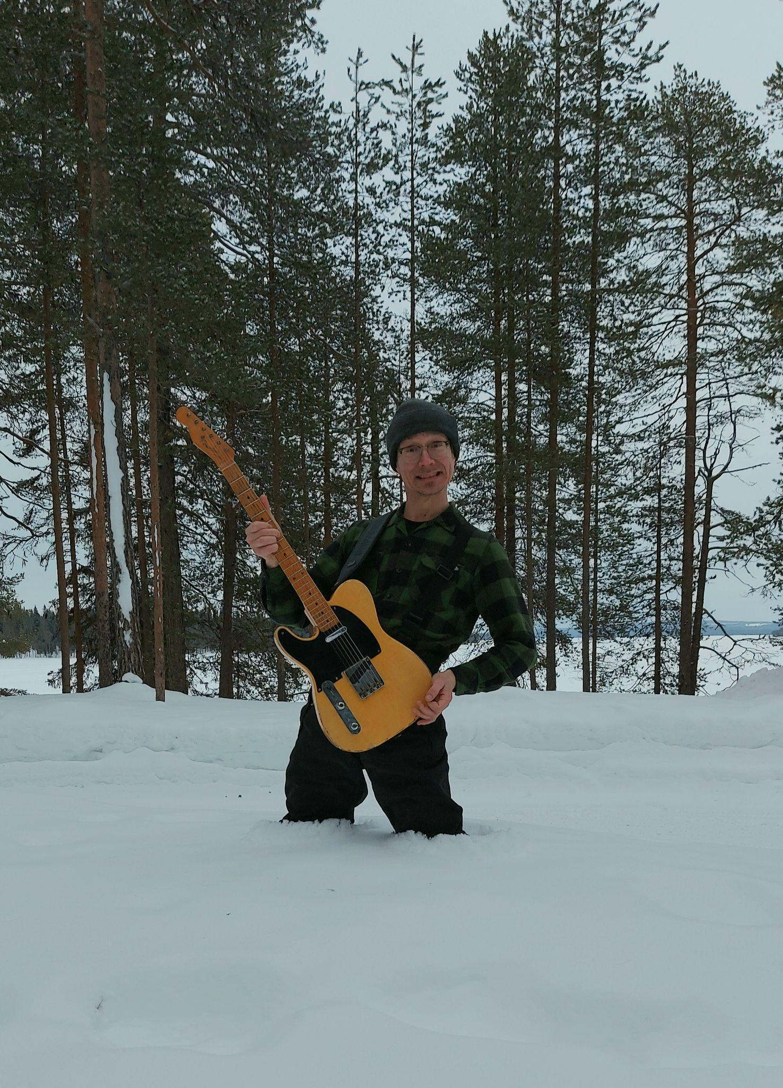
Recovery & relaxation
after winter sports

Slide 55
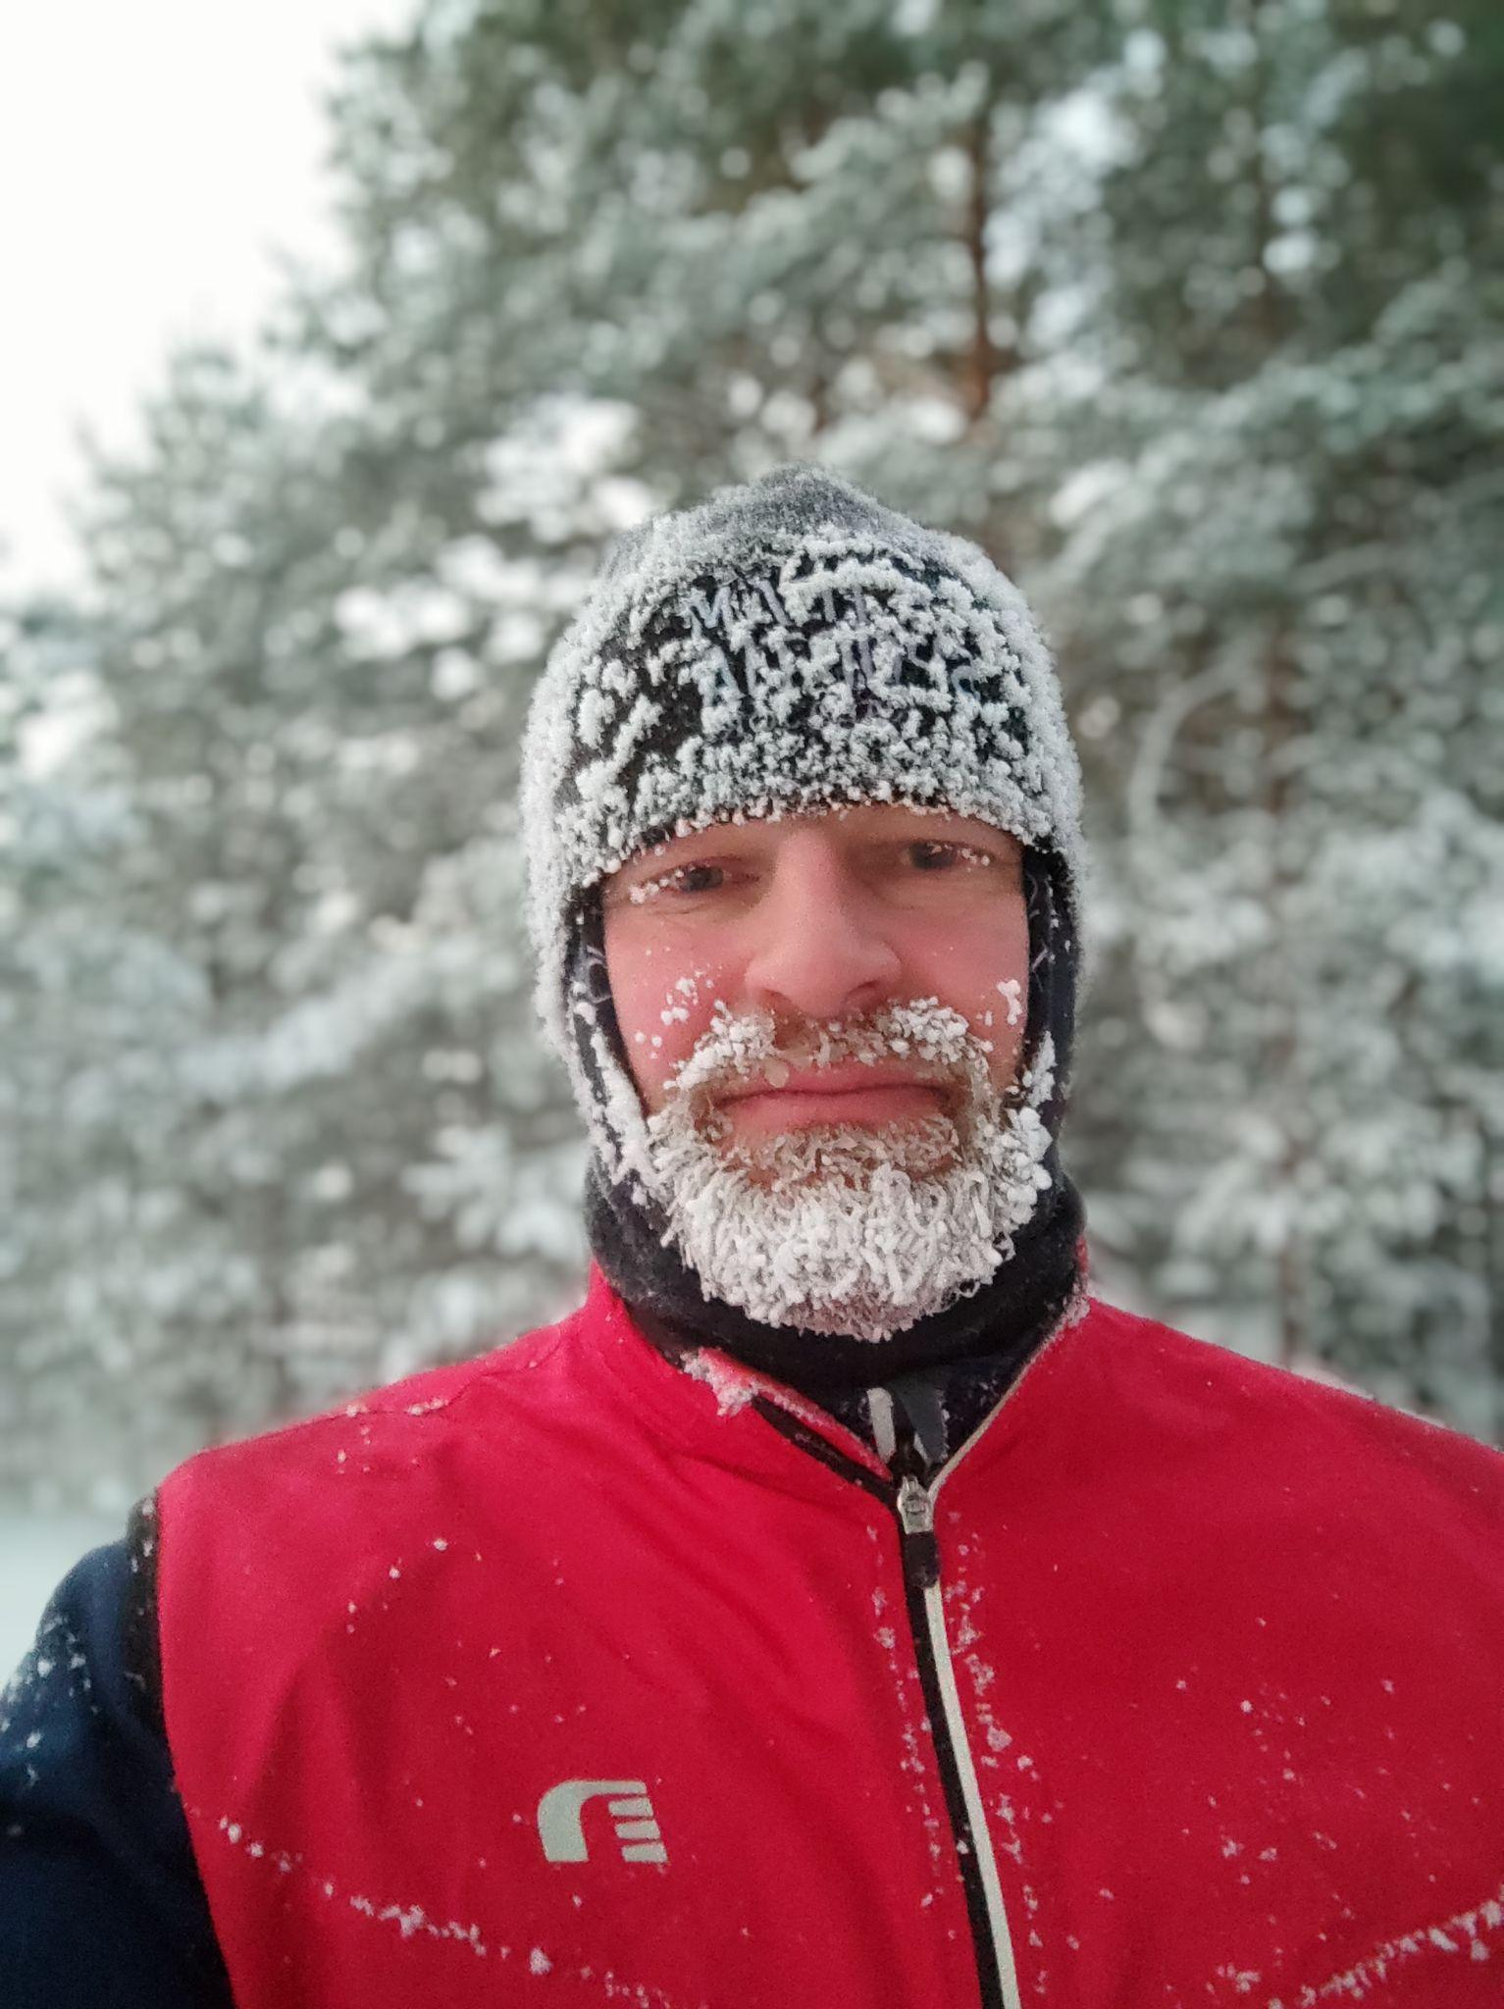
In winter it is all about staying warm

Slide 56
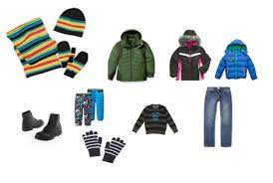
1. Change dry warm clothes

Slide 57
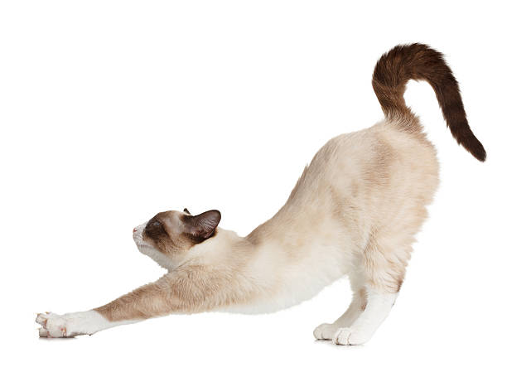
2. Stretch

Slide 58
3. Get some energy
Eat something within 30 minutes of exercise!
This will help you to keep warm and recover faster

Slide 59
4. Get your body & mind rest
WAYS TO RELAX
cozy clothes
warm drink
nice music
good company
fireplace
and above all…

Slide 60
FINNISH SAUNA
(UNESCO Intangible Cultural Heritage List 2020)
important part of Finnish culture
essential part in Midsummer and Christmas celebrations
ancient tradition: oldest saunas known are from the stone age
3 million saunas within 5,5 million Finns!

Slide 61
TYPES OF SAUNA
SMOKE SAUNA
WOOD STOVE SAUNA
ELECTRIC SAUNA
traditional type
no chimney
heating takes 4 to 10 hours
wood heated oven
common outside cities
in city apartments

Slide 62
SAUNA CUSTOMS
“VIHTA” (VASTA in Eastern Finland)
= bunch of leafy birch
- you gently beat yourself
- relaxes muscles
- helps if you have mosquito bites
“LÖYLY”
= steam created in sauna when you throw water to the hot stones

Slide 63
THINGS TO DO WHILE HAVING A SAUNA IN WINTER
cooling off outside
ice swimming
rolling in snow

