Slide 1
ALCHEMIA
Alliance of Cultural Heritage Exchange for Musical Innovation and Acquisition
Day 9 (Sep 30)
Canon (flourishing & cadences) / Faux bourdon à l’anglaise
Academie voor Muziek, Woord en Dans, Bornem

Slide 5
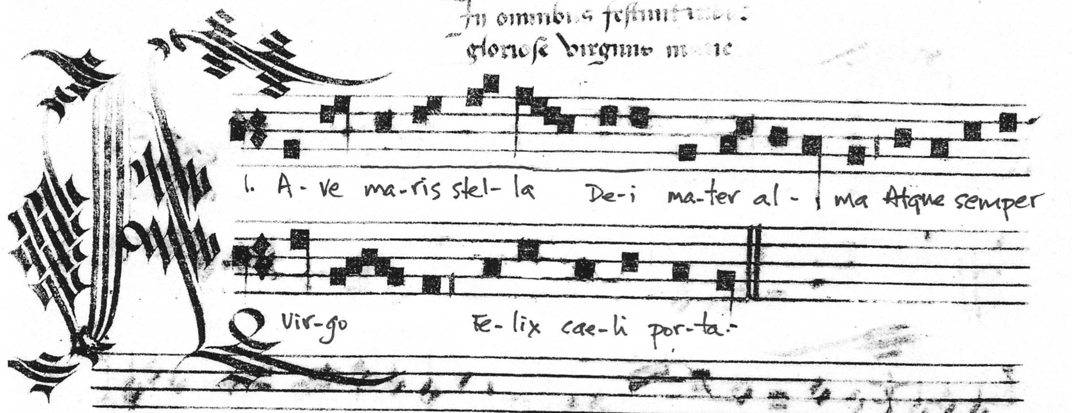
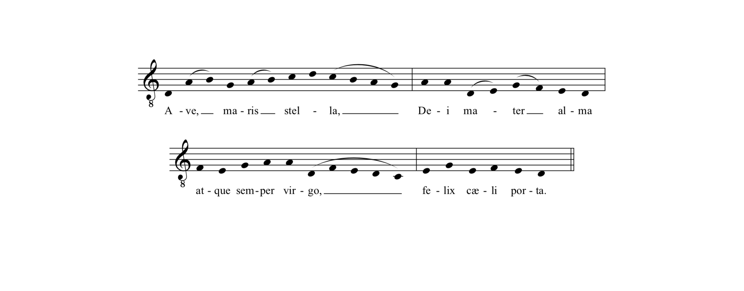
Ave Maris Stella

Slide 6
Faux bourdon à l’anglaise
Adding a cadence formula!!
Cantus Firmus in superius
2nd part always in parallel 4ths
3rd part starts octave and continue in lower 6ths

Slide 8
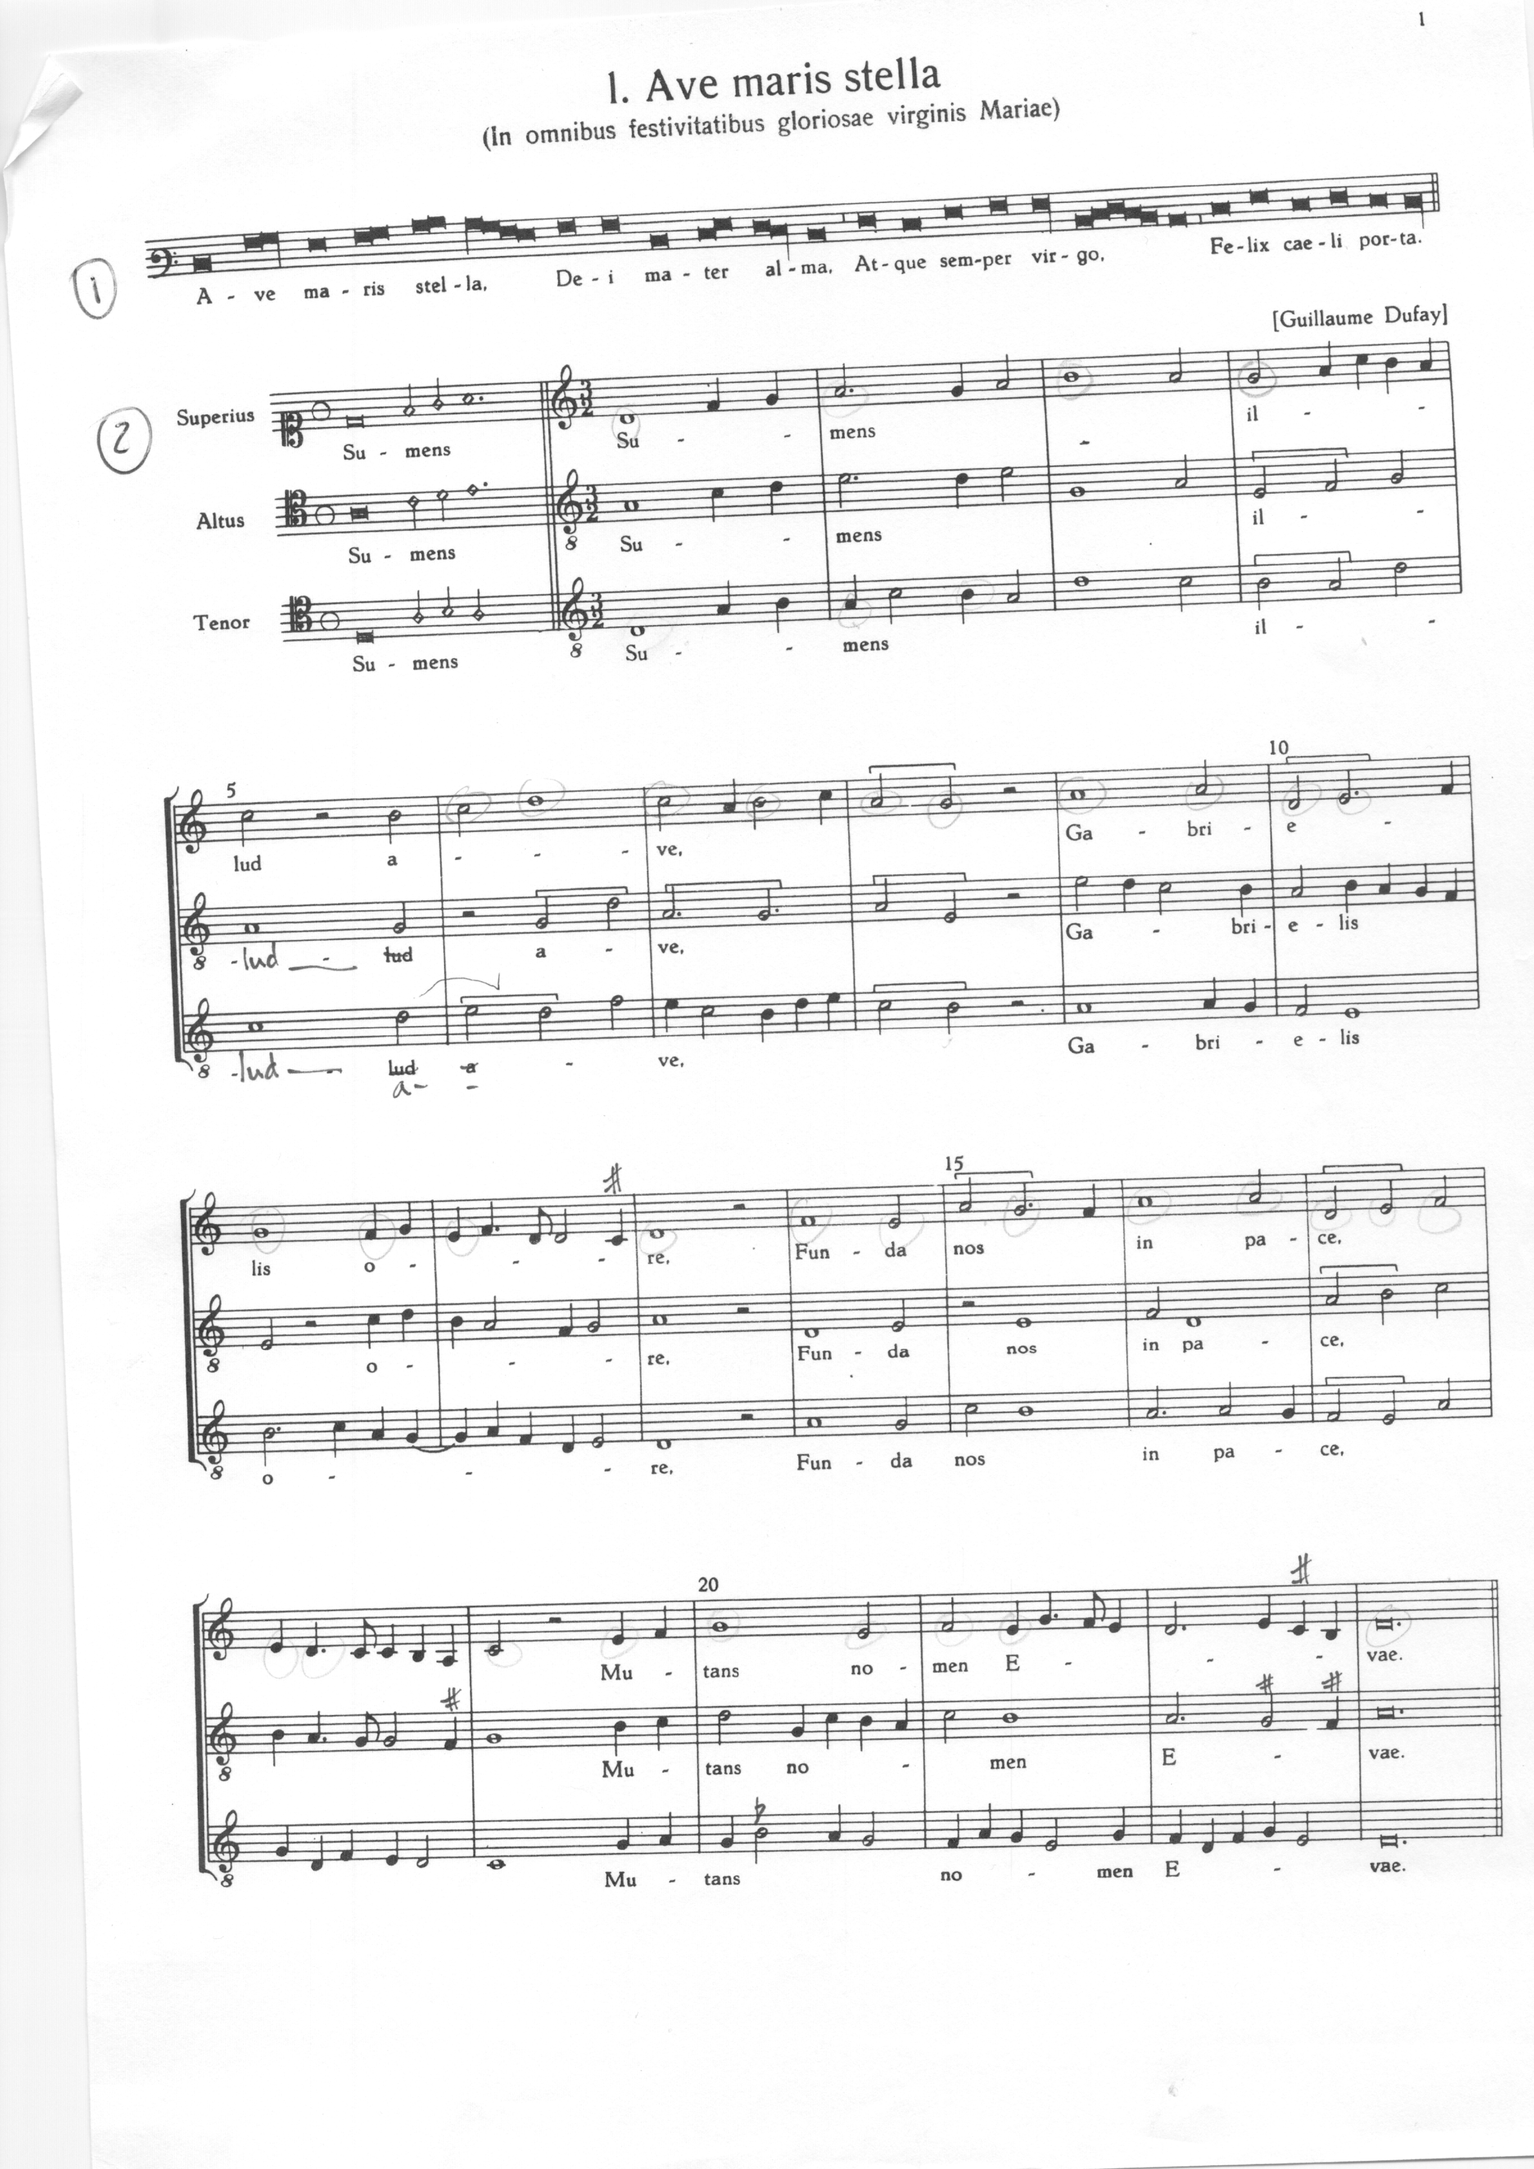

Slide 9
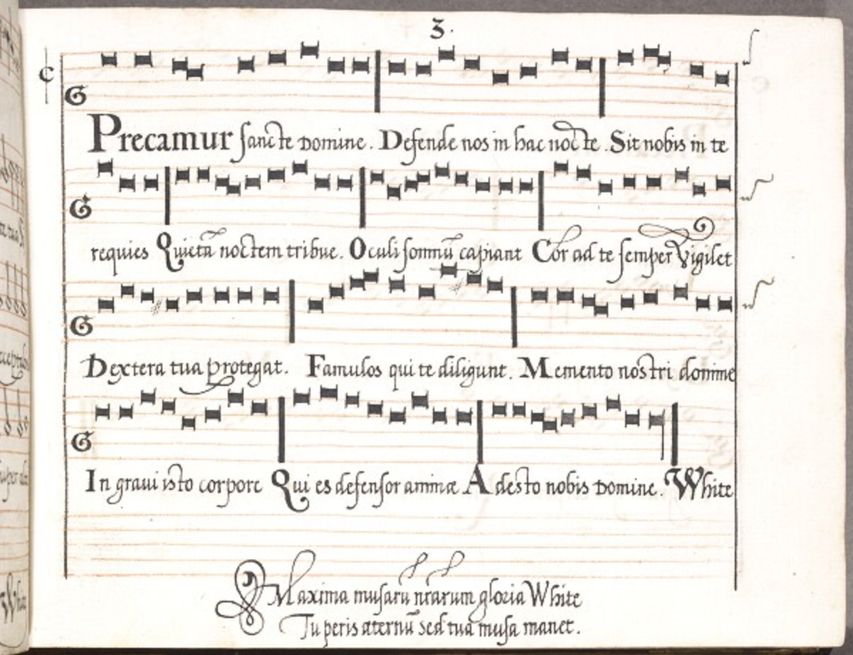
1.
Christe qui lux es et dies,
Noctis tenebras detegis,
Lucisque lumen crederis,
Lumen beatum praedicans.
2.
Precamur Sancte Domine,
Defende nos in hac nocte,
Sit nobis in te requies,
Quietam noctem tribue.
3.
Ne gravis somnus irruat,
Nec hostis nos surripiat,
Nec caro illi consentiens,
Nos tibi reos statuat.
4.
Oculi somnum capiant,
Cor ad te semper vigilet,
Dextera tua protegat
Famulos qui te diligunt.
5.
Defensor noster aspice,
Insidiantes reprime,
Guberna tuos famulos,
Quos sanguine mercatus es.
6.
Memento nostri Domine
In gravi isto corpore,
Qui es defensor animae,
Adesto nobis Domine.
7.
Deo Patri sit gloria,
Eiusque soli Filio,
Cum Spiritu Paraclito,
Et nunc et in perpetuum. Amen.

