Slide 1
ALCHEMIA
Alliance of Cultural Heritage Exchange for Musical Innovation and Acquisition
Day 2 (Sep 27)
Canon (principles)
Academie voor Muziek, Woord en Dans, Bornem

Slide 2
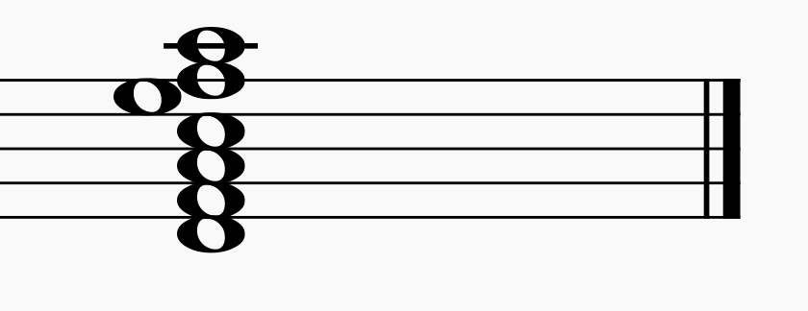
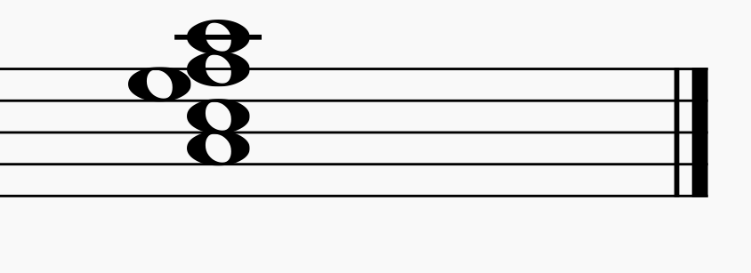
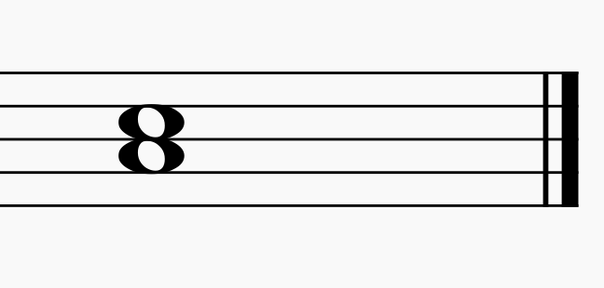
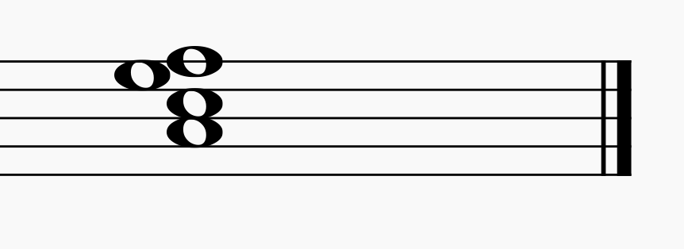
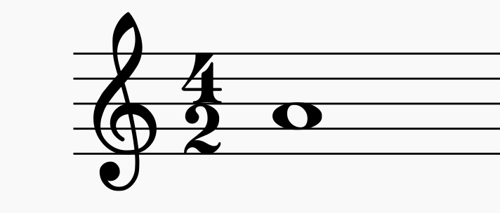
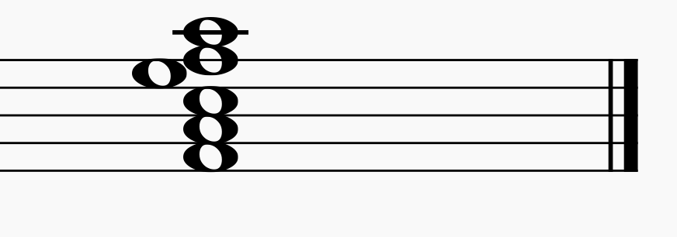
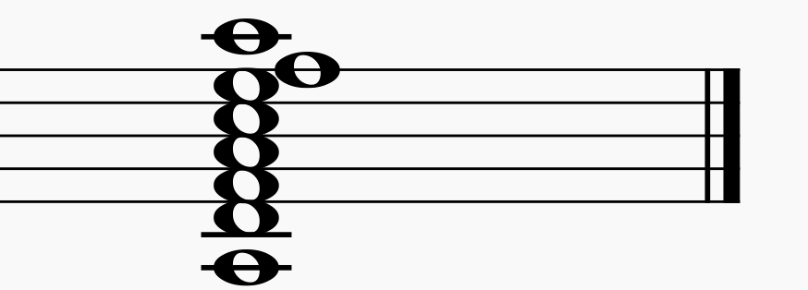
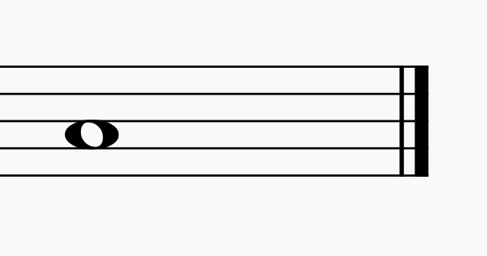
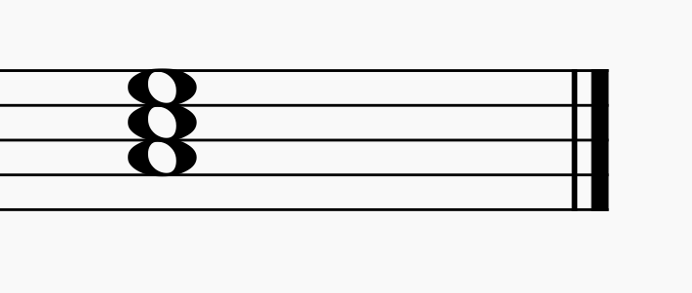
Consonants
3 5 6 8
U
3 5 8

Slide 3
3
3
3
8
3
3
3
3
3
5
3
3
3

Slide 4
passing notes
rythms

Slide 6
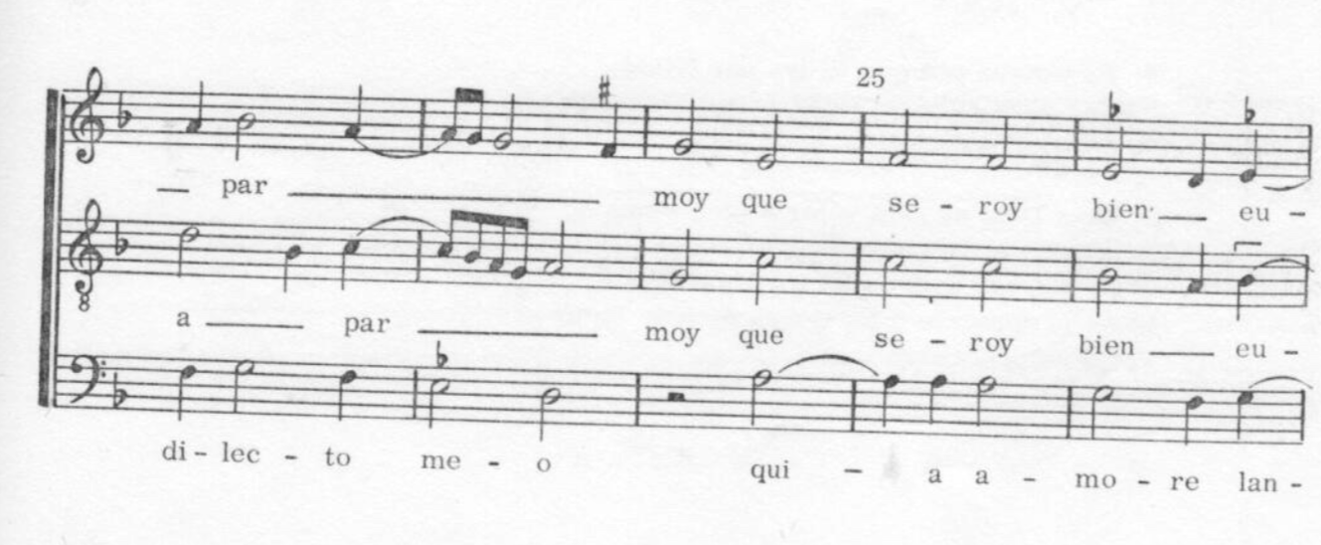
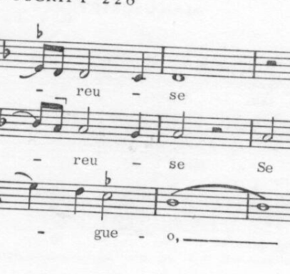
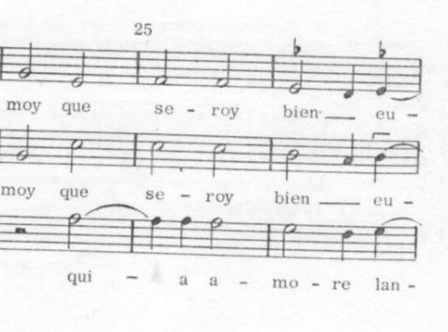
Faux-bourdon à la française

Slide 7
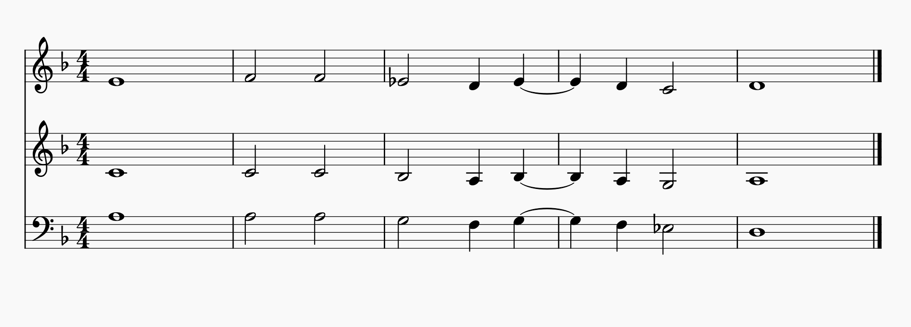
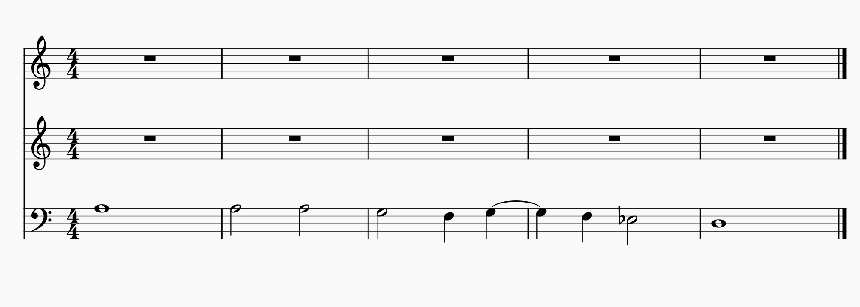
Adding a gymel on the upper 6th
Adding a 3th above the tenor
Double leading notes!!

Slide 8
Double leading notes!!

Slide 9
Ecce quod natura (carol)

Slide 10
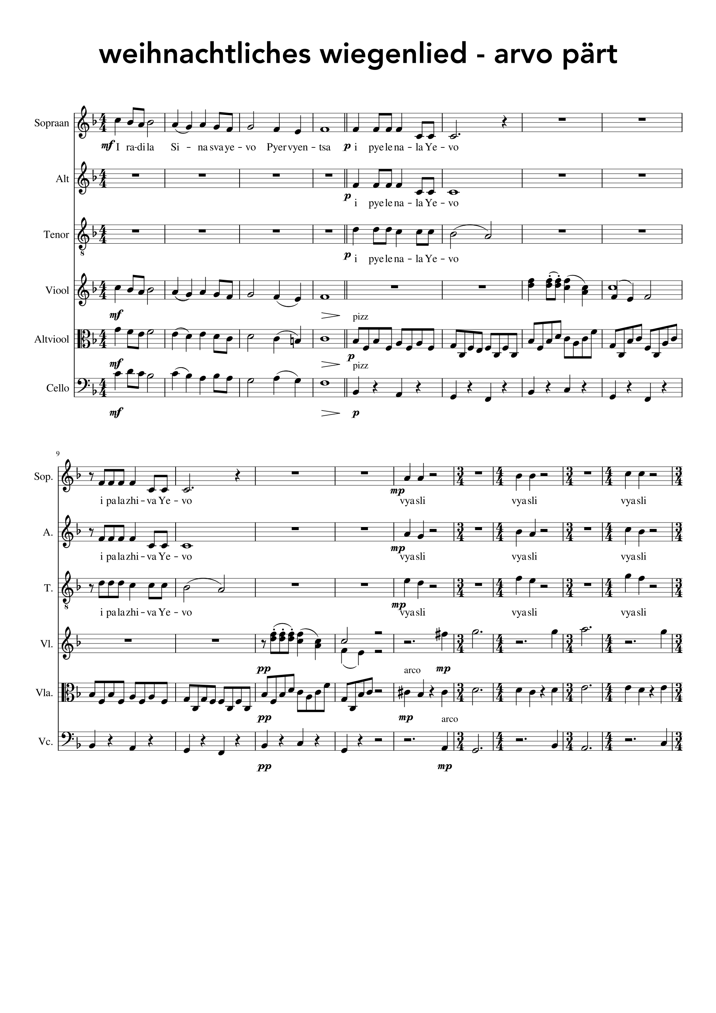

Slide 11
