Slide 1
ALCHEMIA
Alliance of Cultural Heritage Exchange for Musical Innovation and Acquisition
Day 1 (Sep 26)
Gymel
Academie voor Muziek, Woord en Dans, Bornem

Slide 2
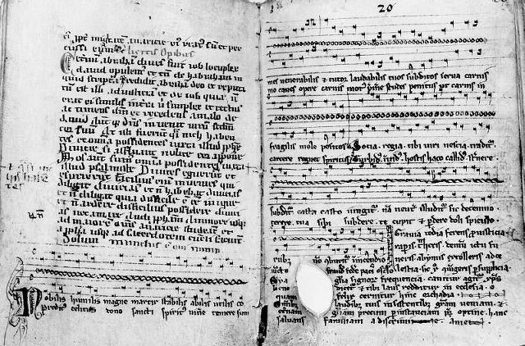
The St Magnus Hymn, or "Nobilis humilis" is a piece of music which celebrates St Magnus of Orkney, XIIIth century

Slide 3
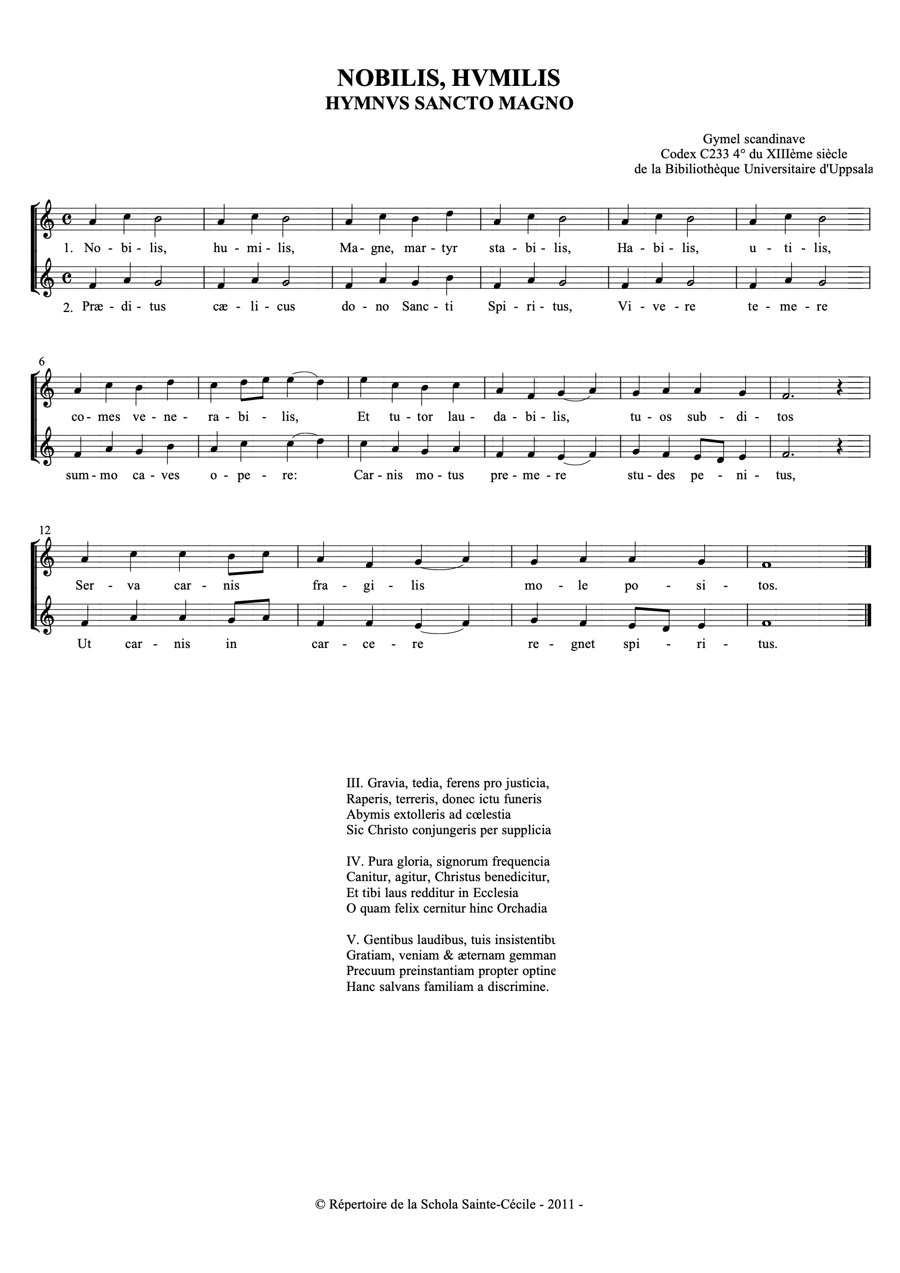

Slide 4
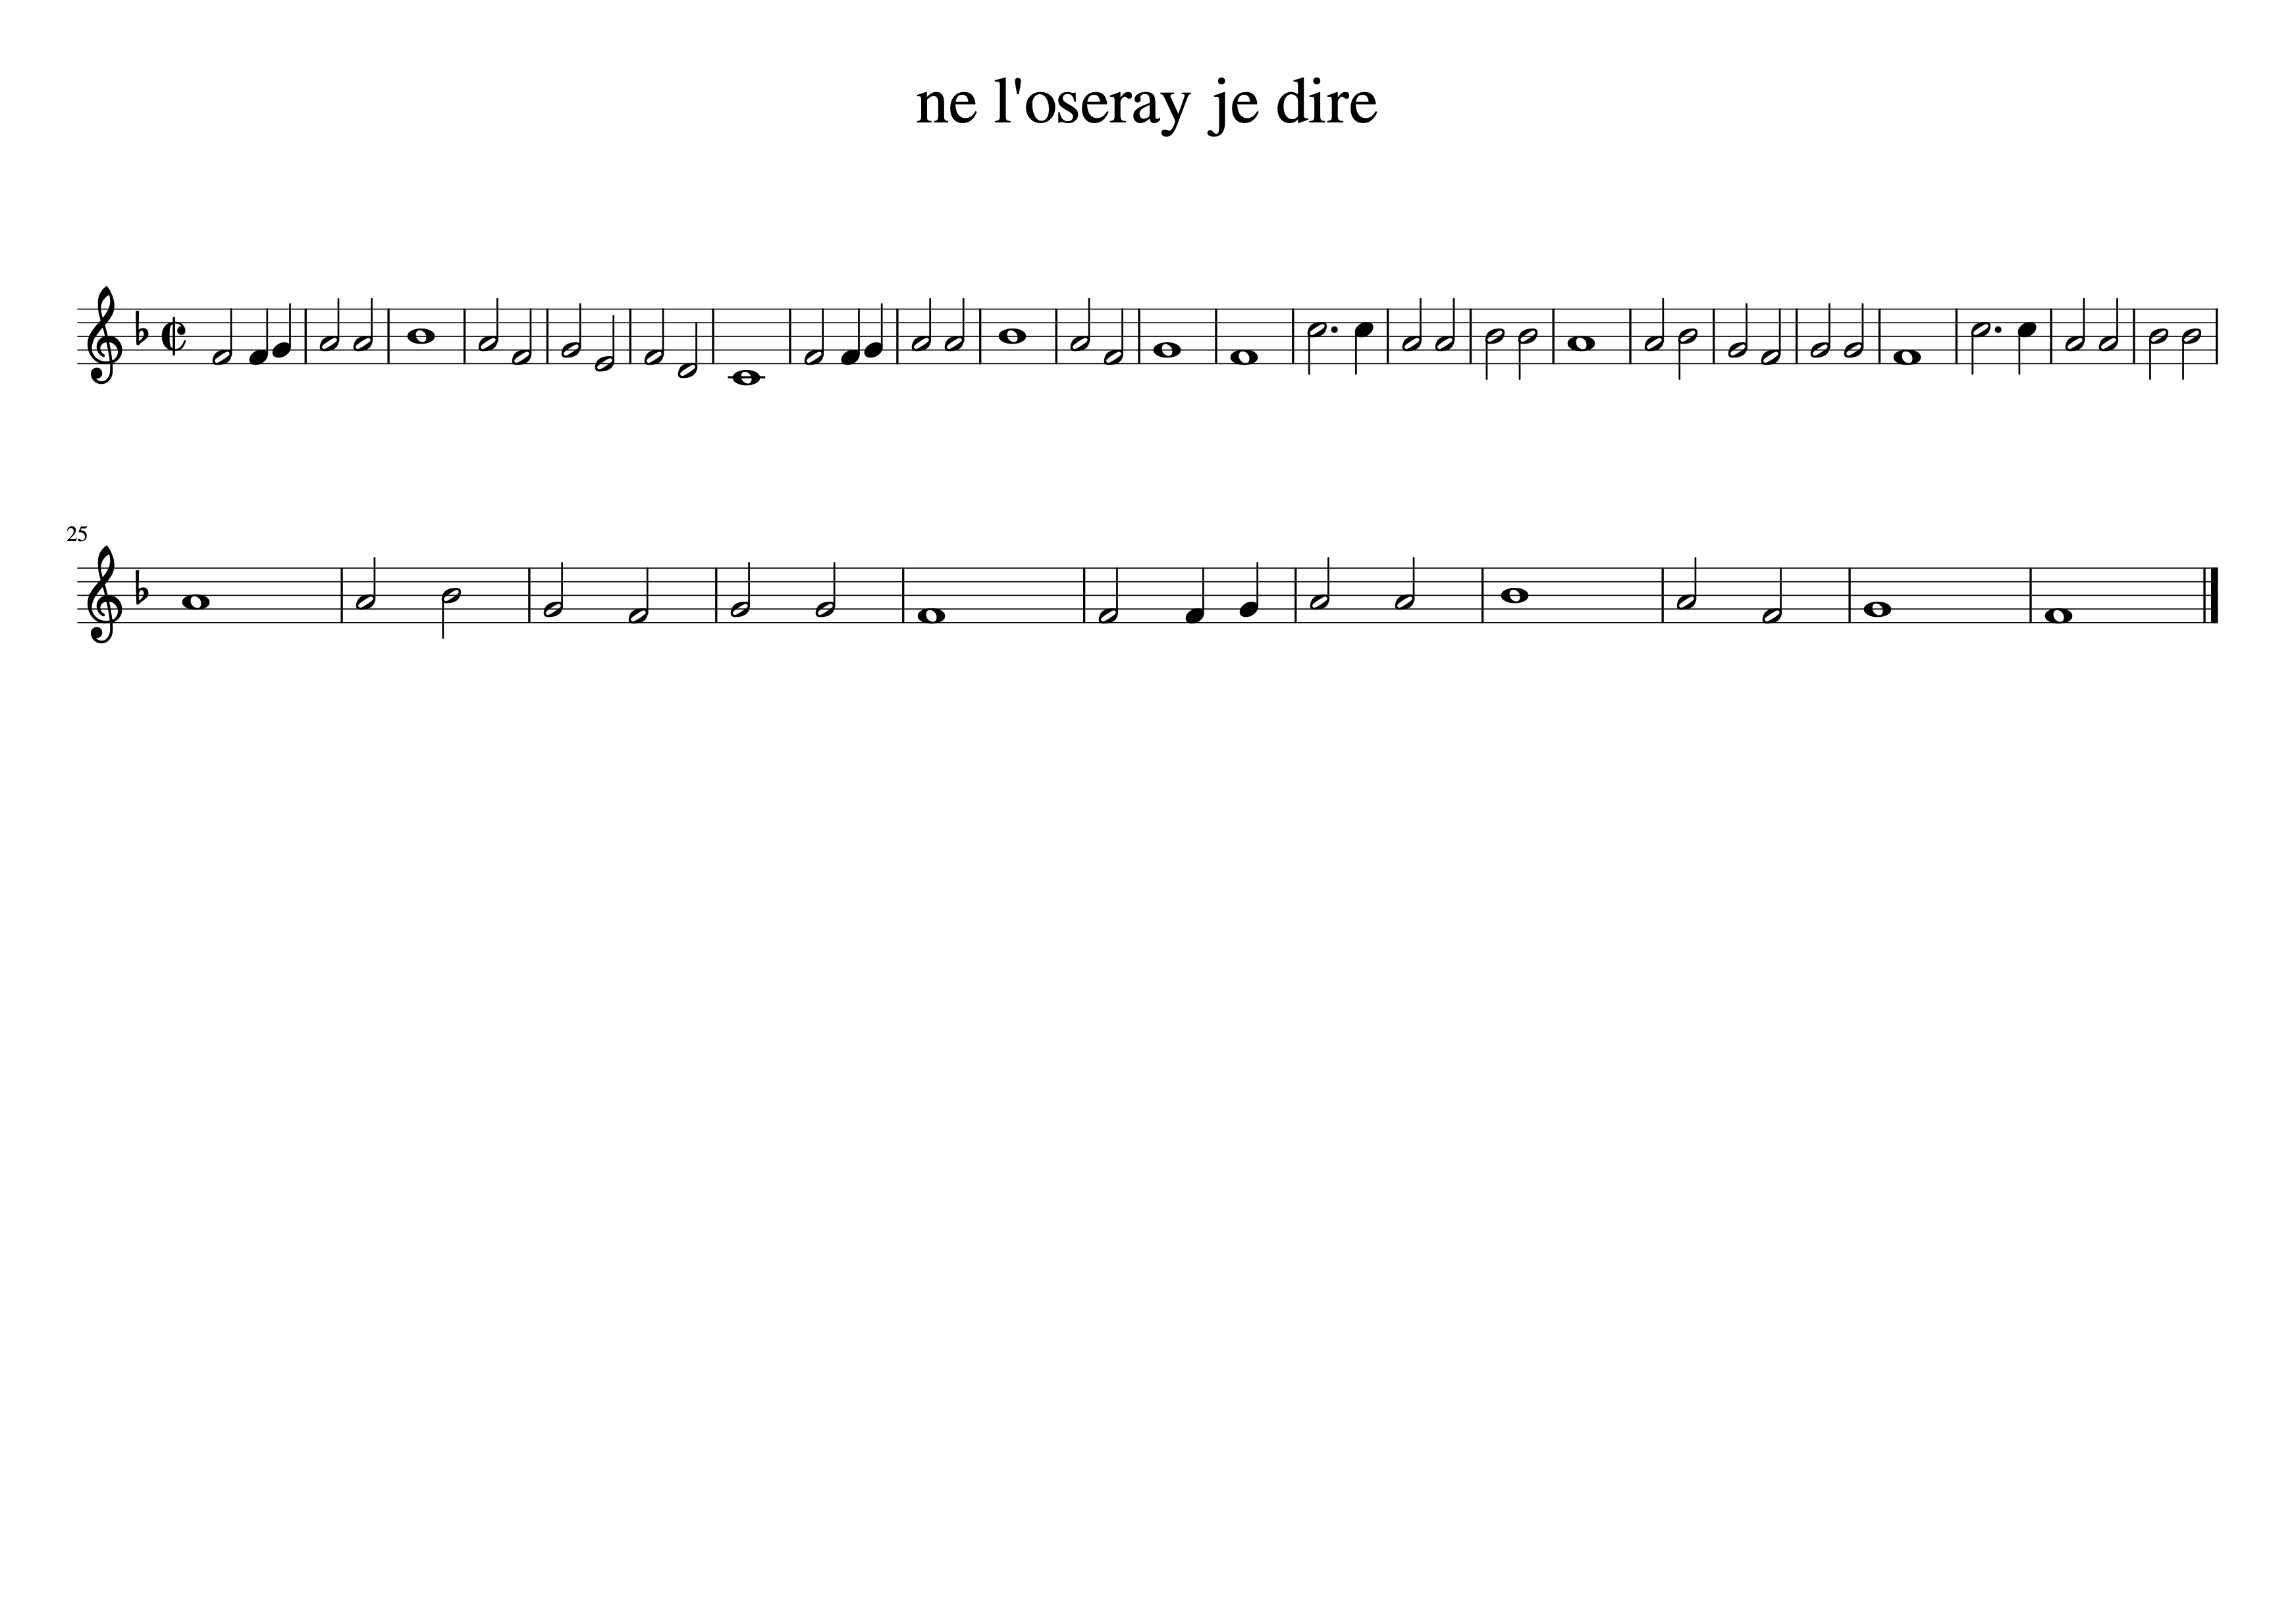

Slide 5
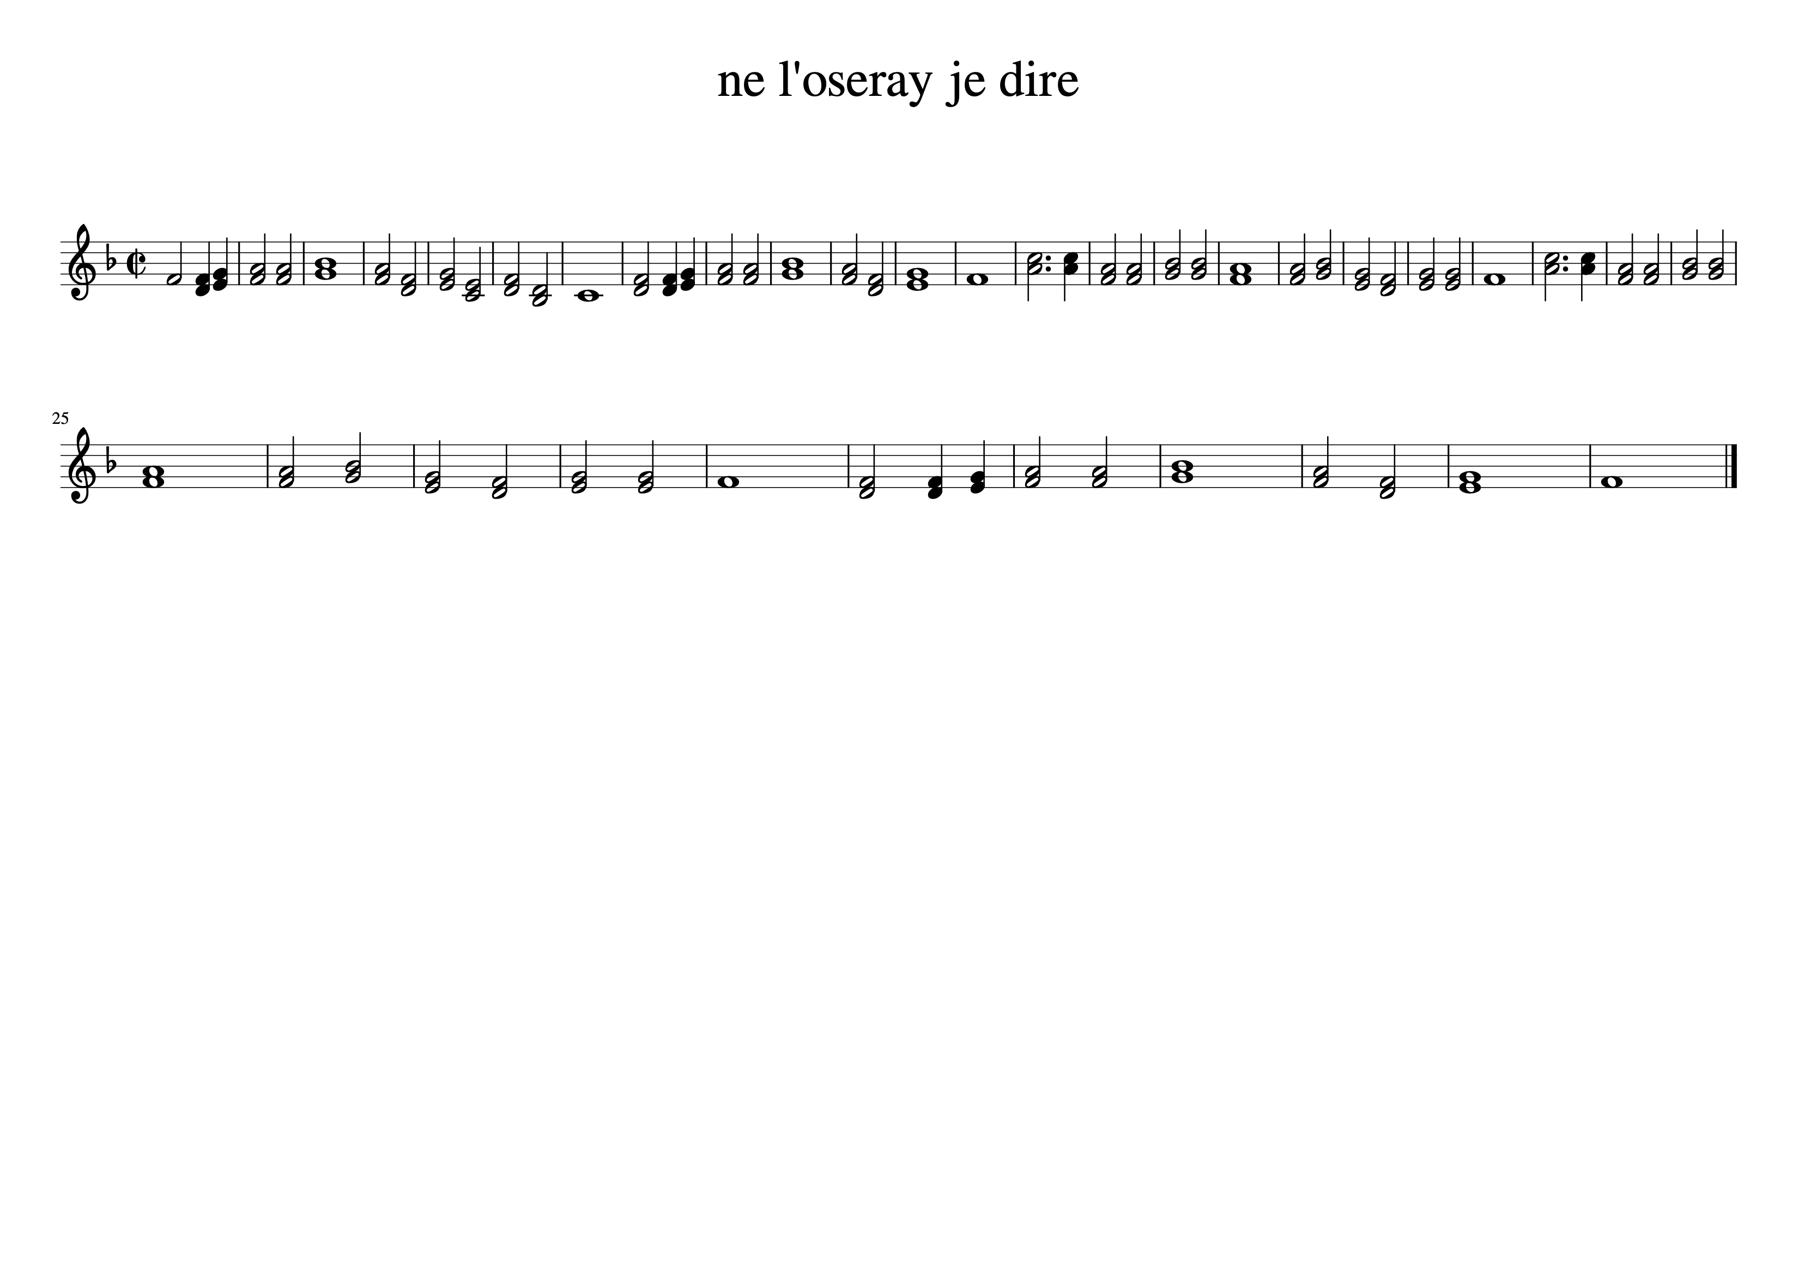
Gymel in thirds

Slide 6
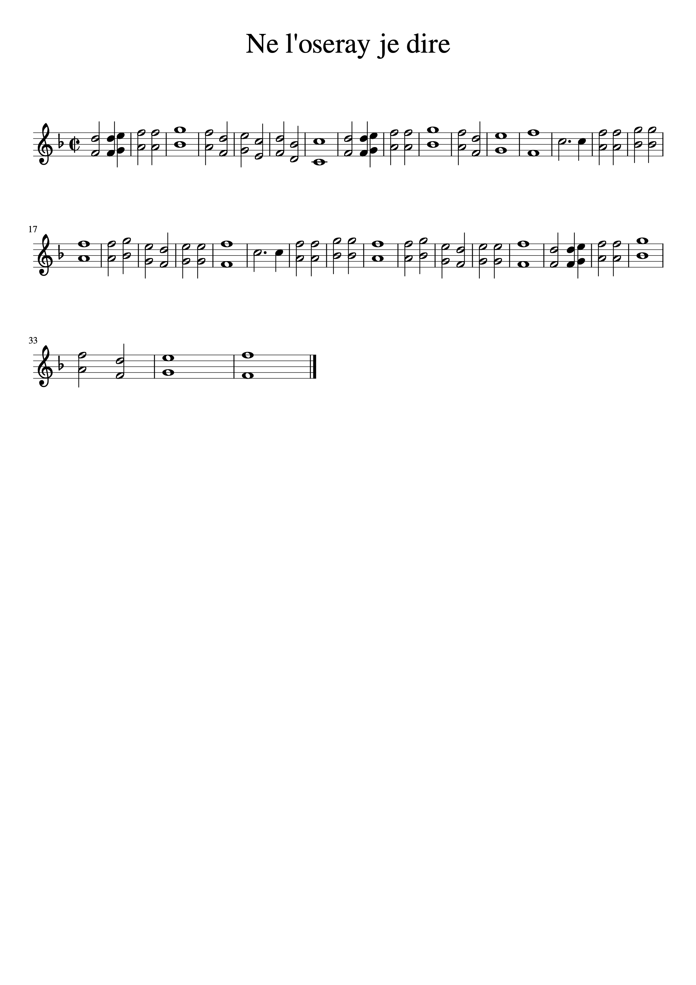
Gymel in sixths

Slide 7
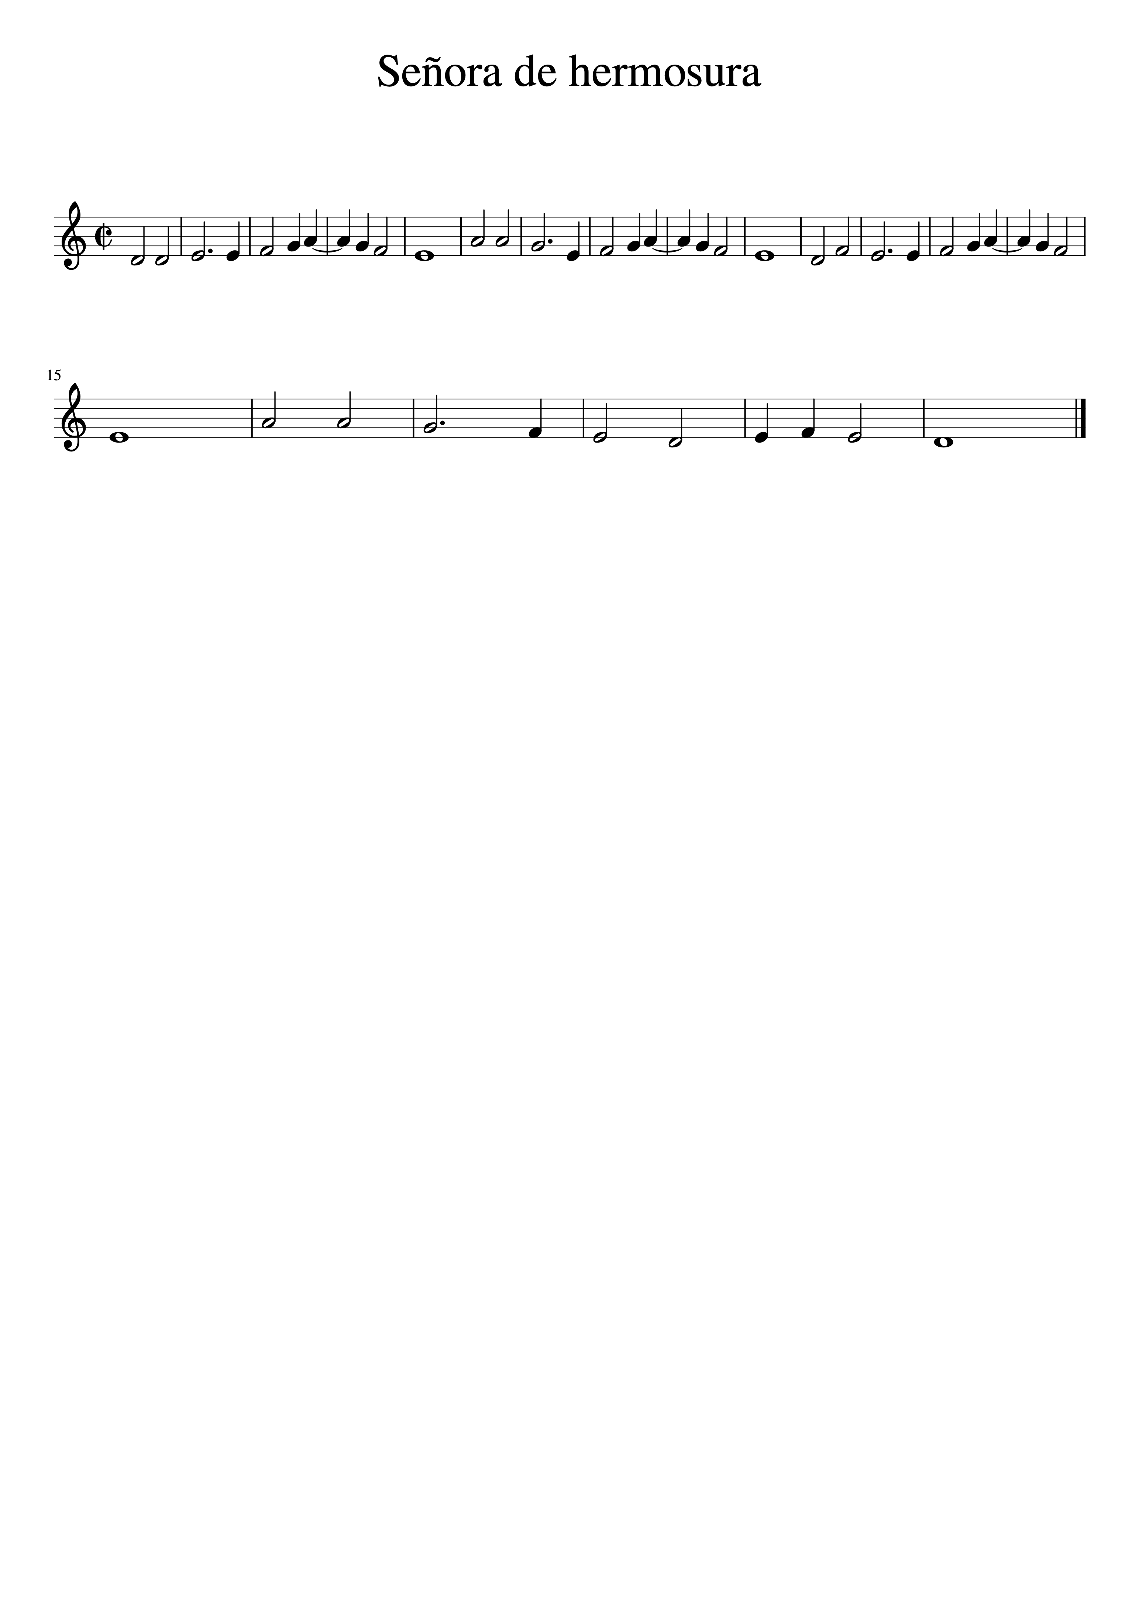
Cancionero de Palacio, Madrid
Juan del Encina

Slide 8
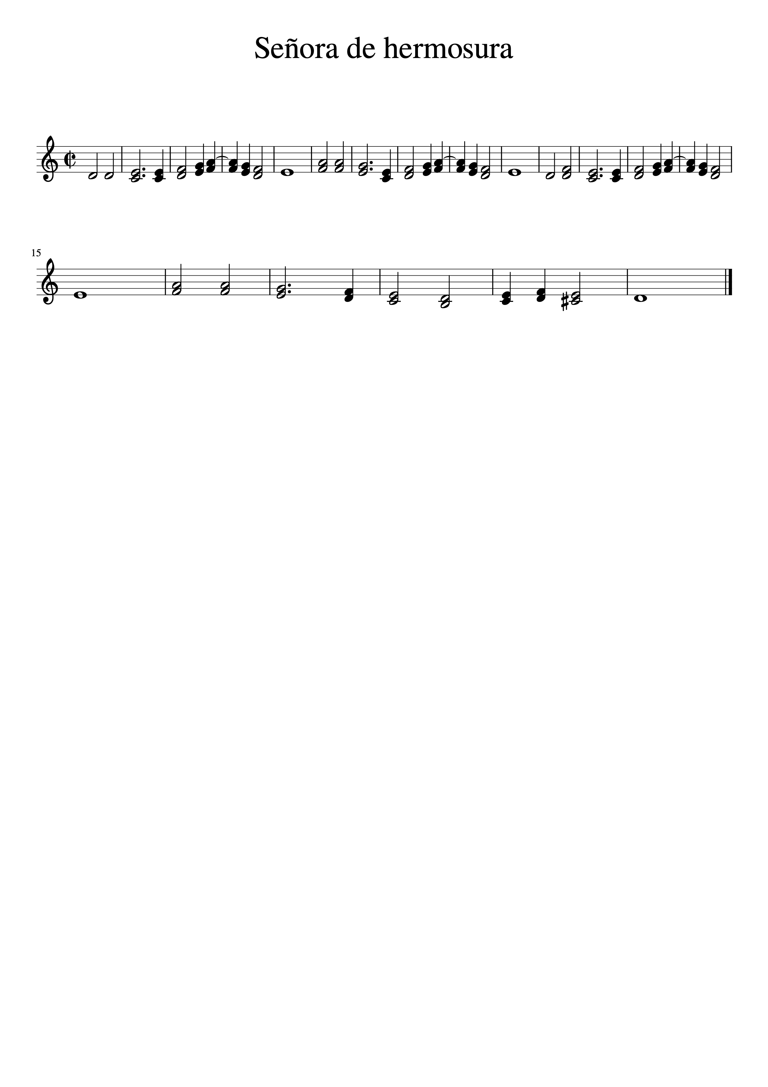

Slide 9
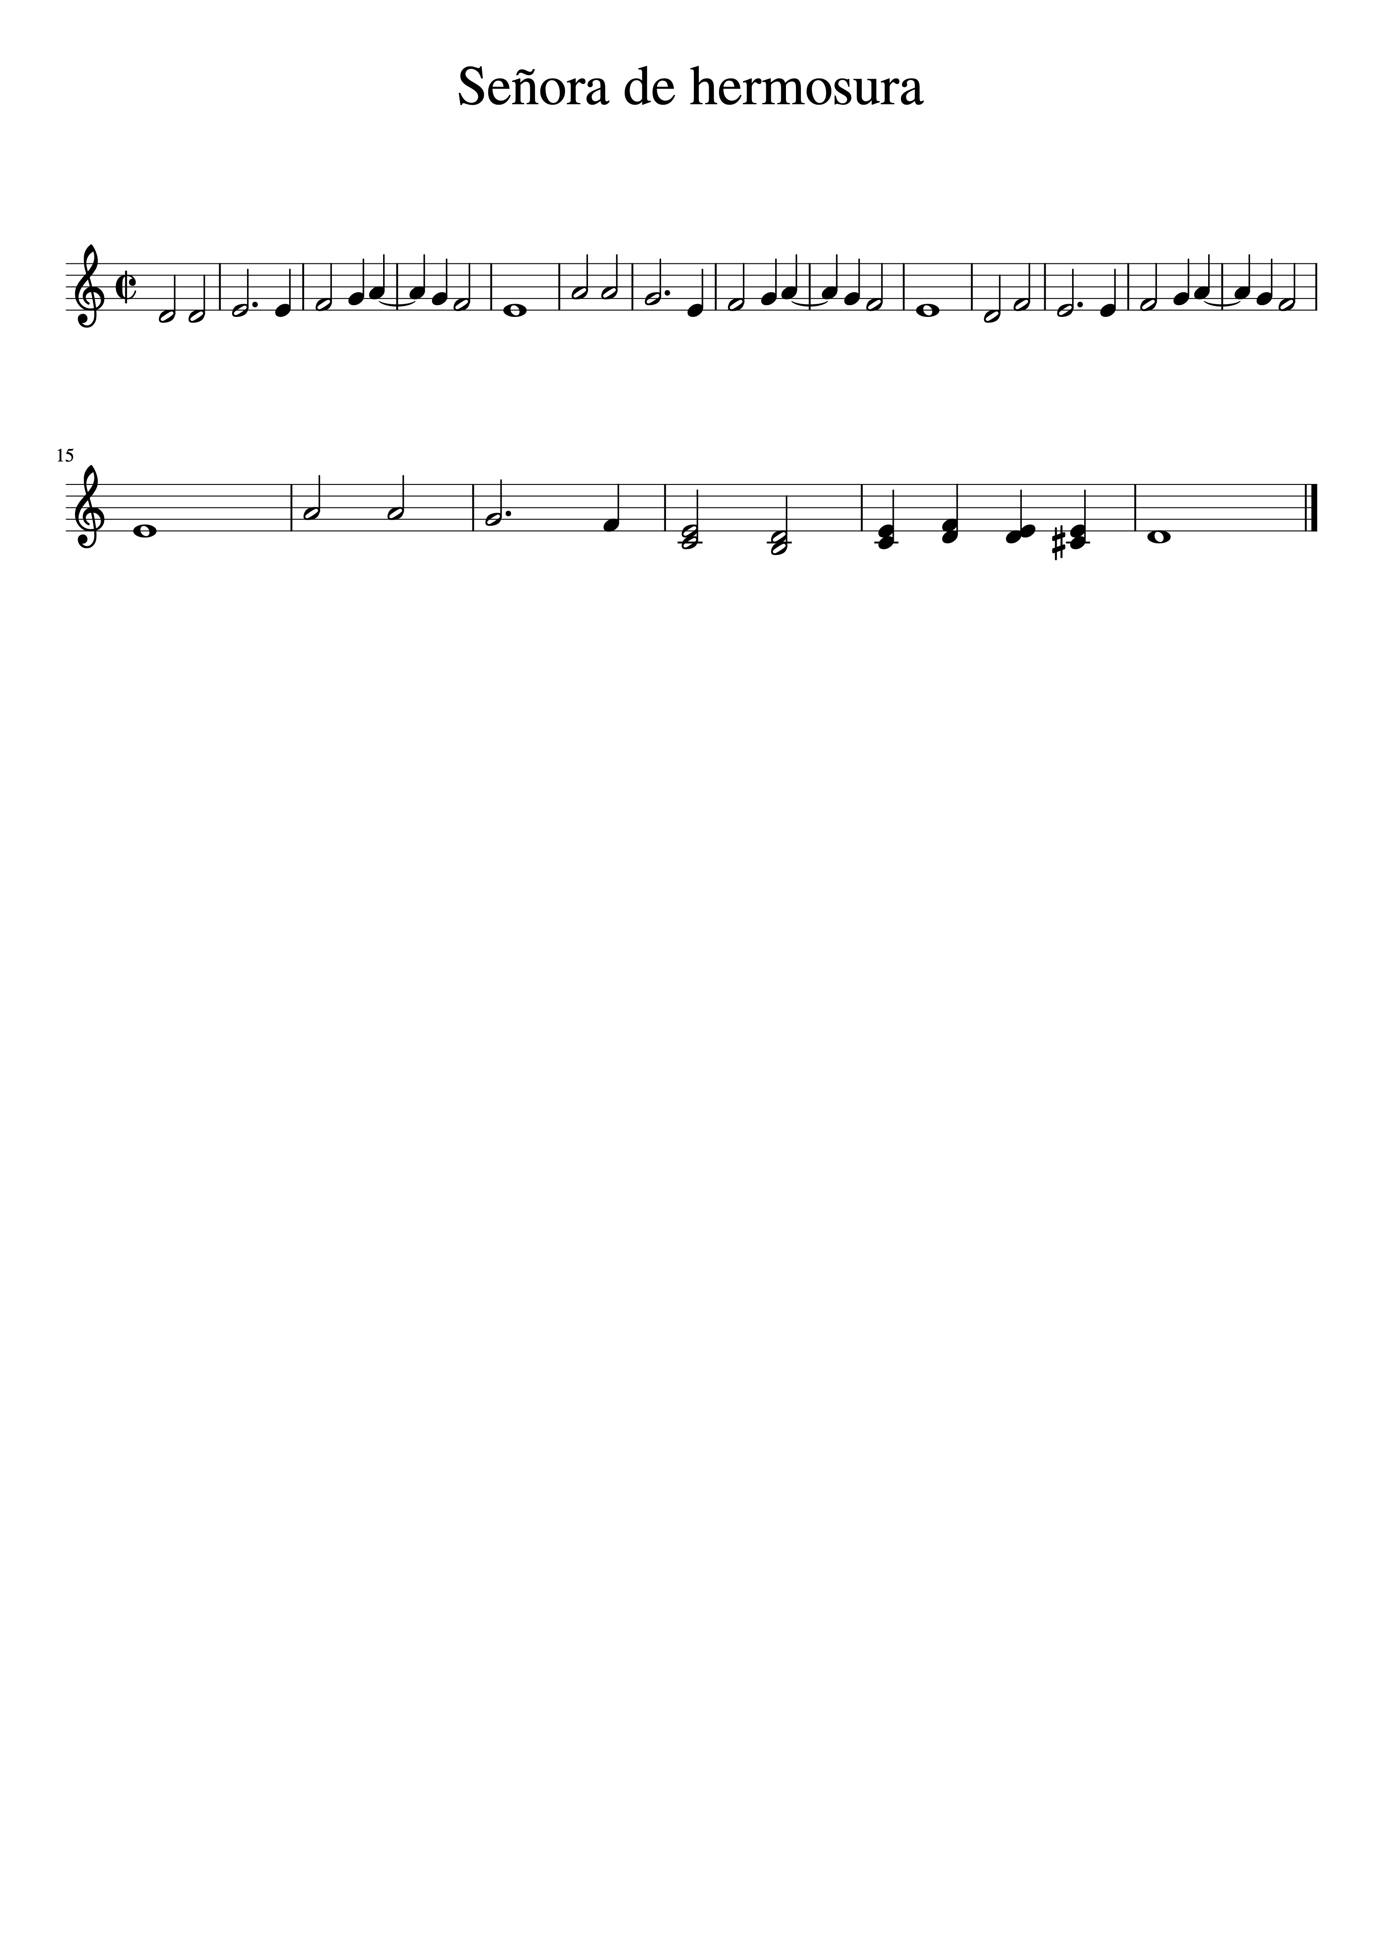

Slide 10
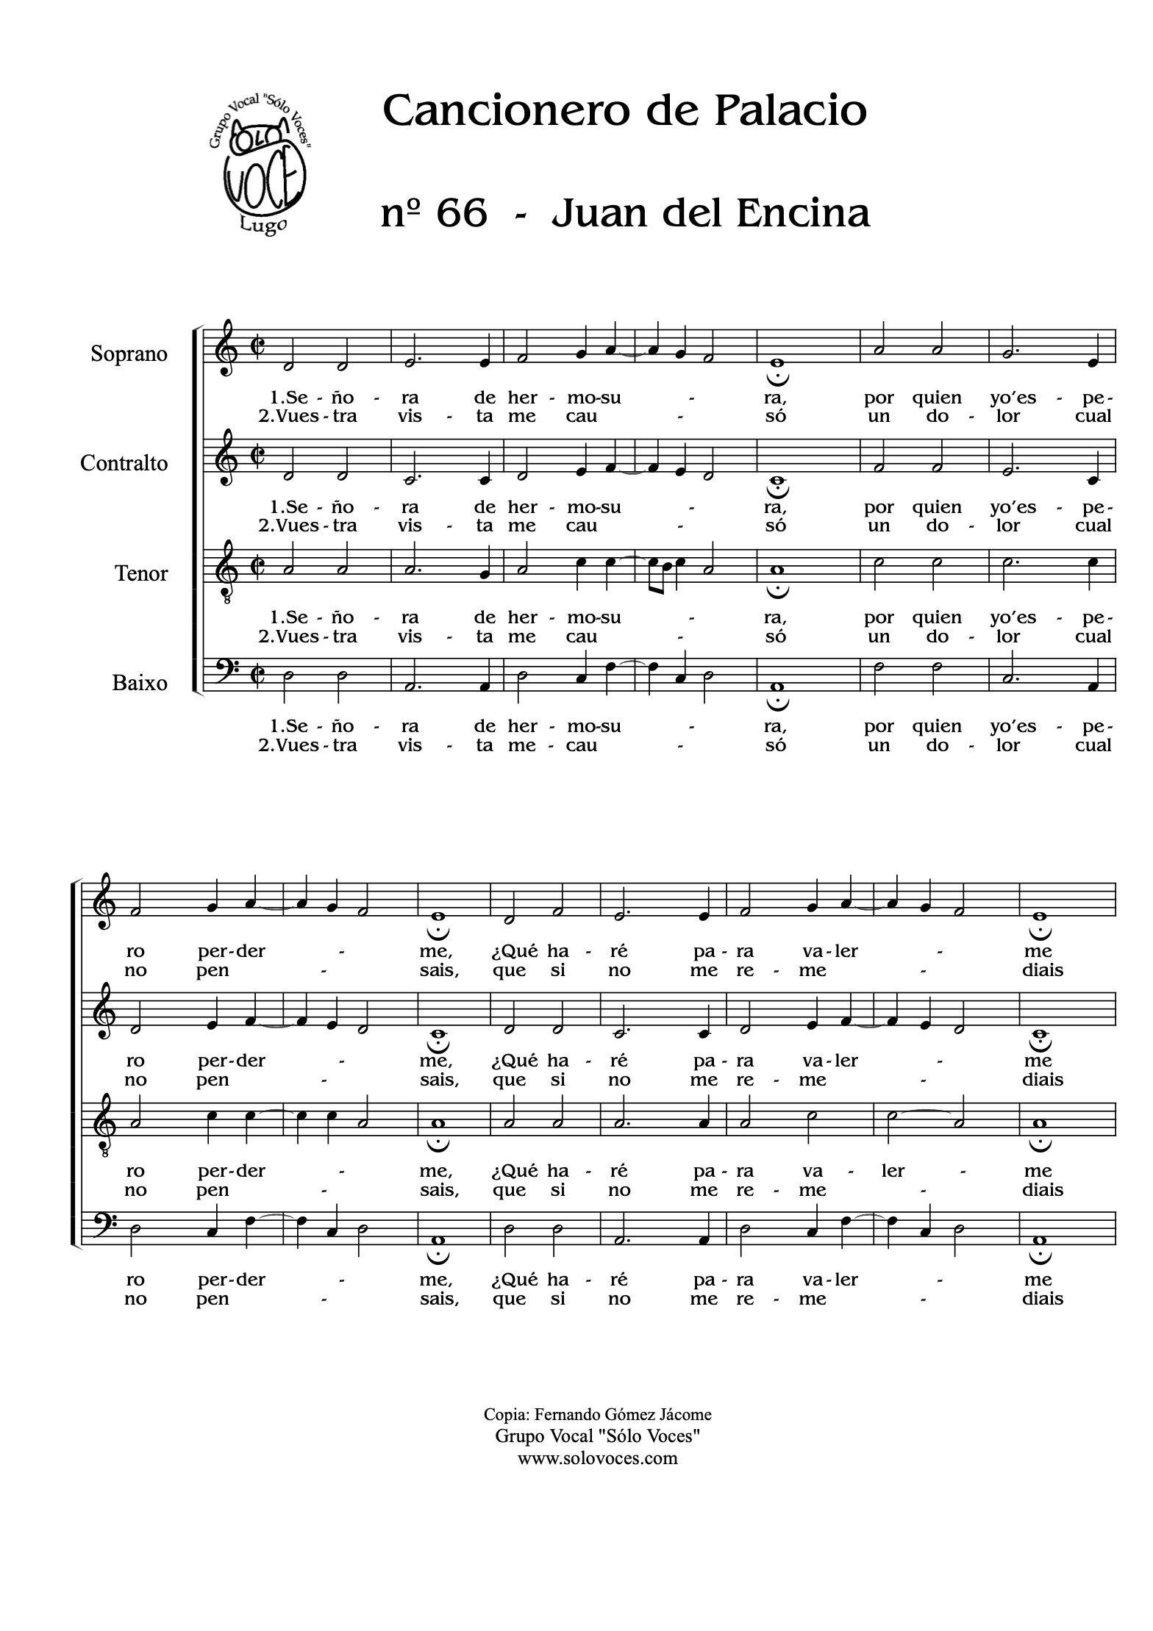
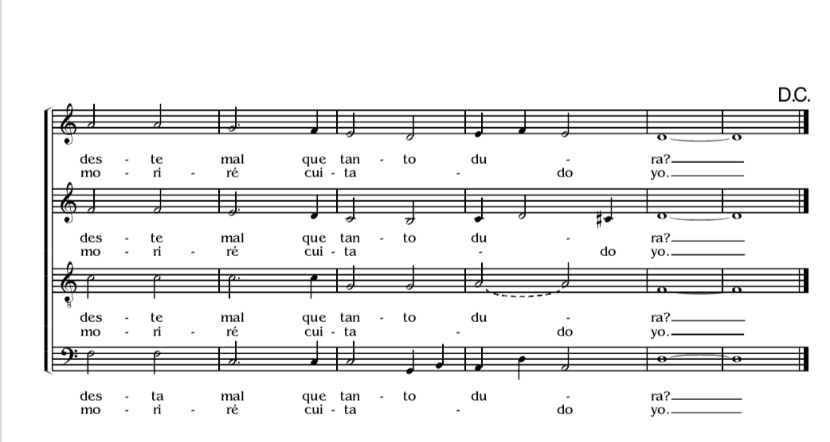

Slide 11
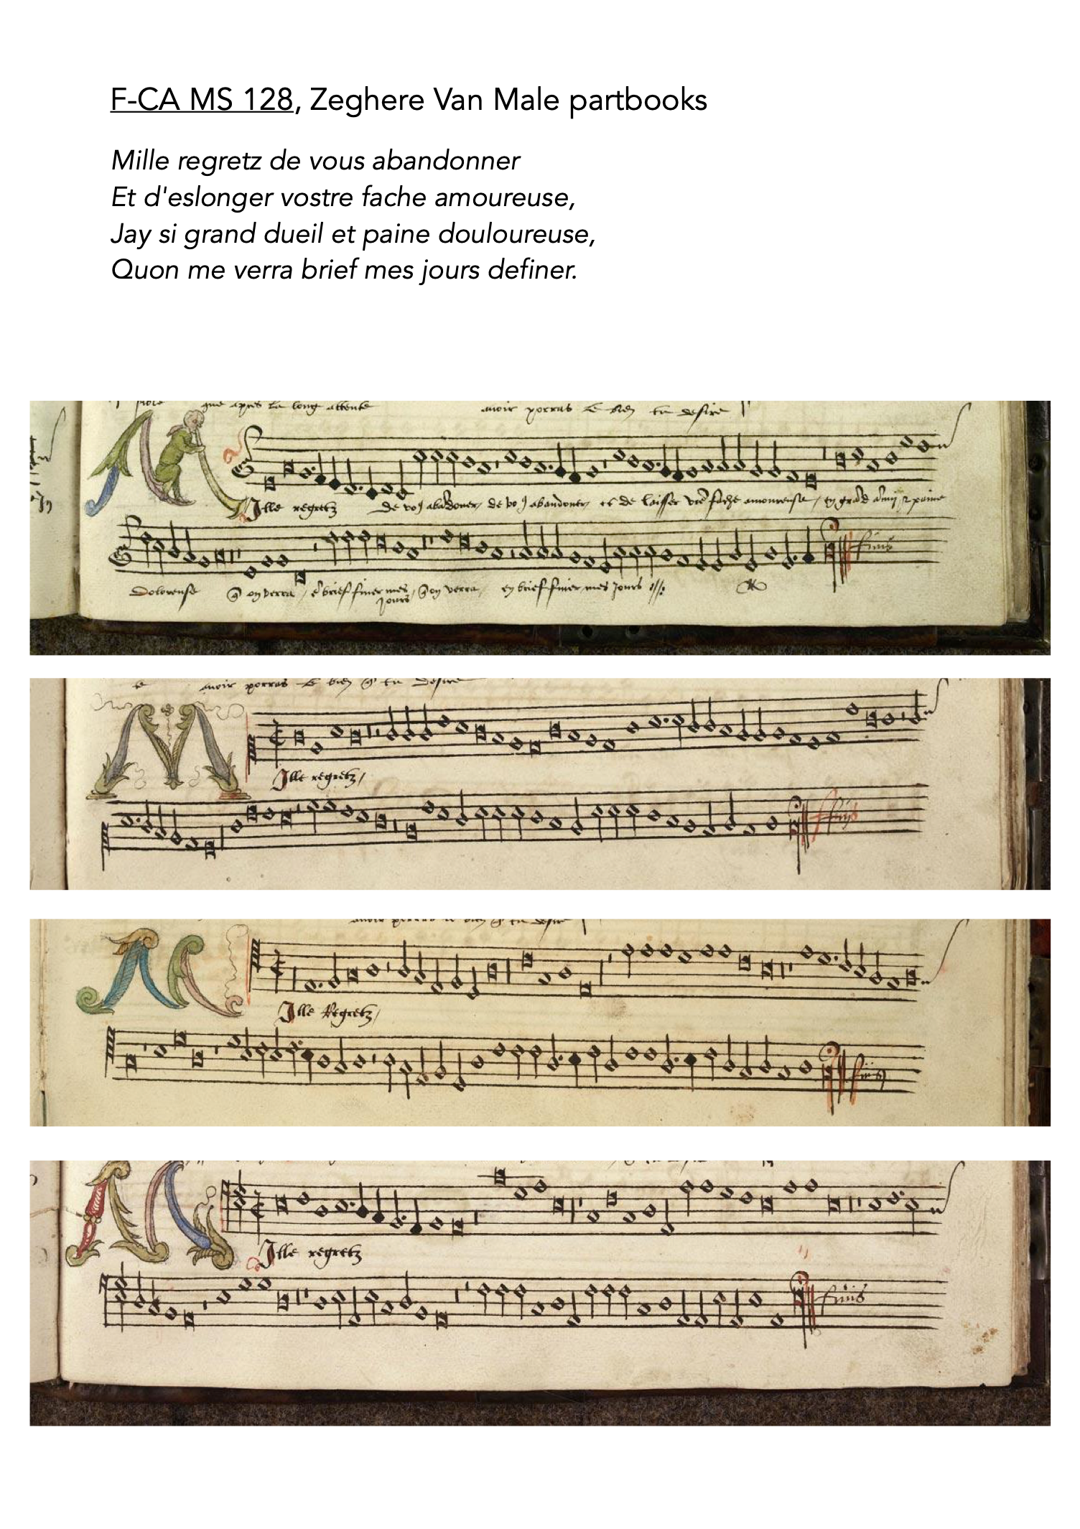

Slide 12
ASCENDING
DESCENDING
BL
BL
BEAUTIFUL LIGATURE
BASIC LIGATURE
LL
LL
BB
BB
LB
LB

Slide 13
SEMIBREVE LIGATURES
Always come in a pair

Slide 14
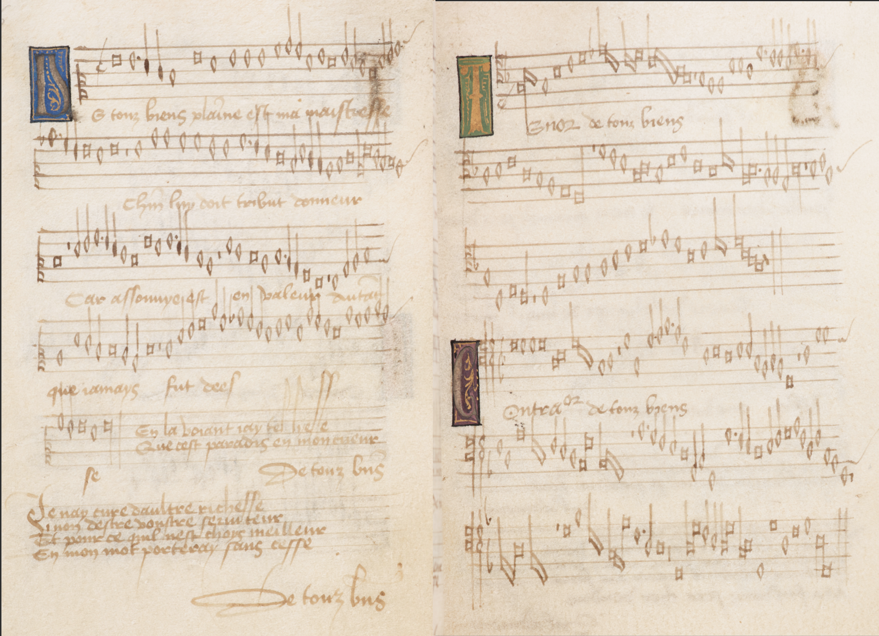
LBB
SSB
SSB
SSBBL
BB
SS
SS
SS
SSBL
BB
SSB
SS
BB
SSB
SS
SS
SS
SS
SSB
SS
SSBB
BL

