Slide 1
ALCHEMIA
Alliance of Cultural Heritage Exchange for Musical Innovation and Acquisition
Day 3(Sep 1)
How to practice & Ligatures
Academie voor Muziek, Woord en Dans, Bornem

Slide 2
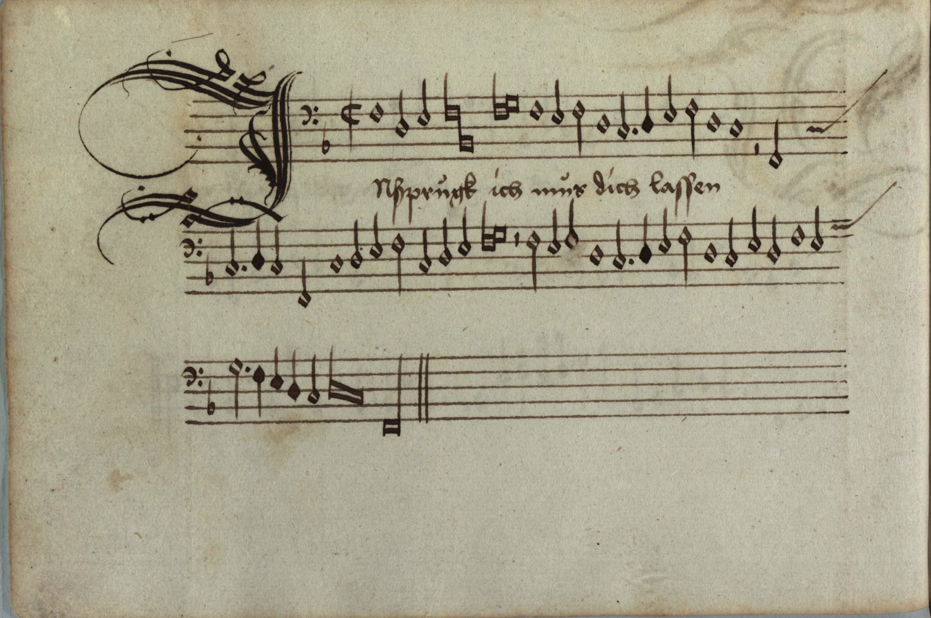
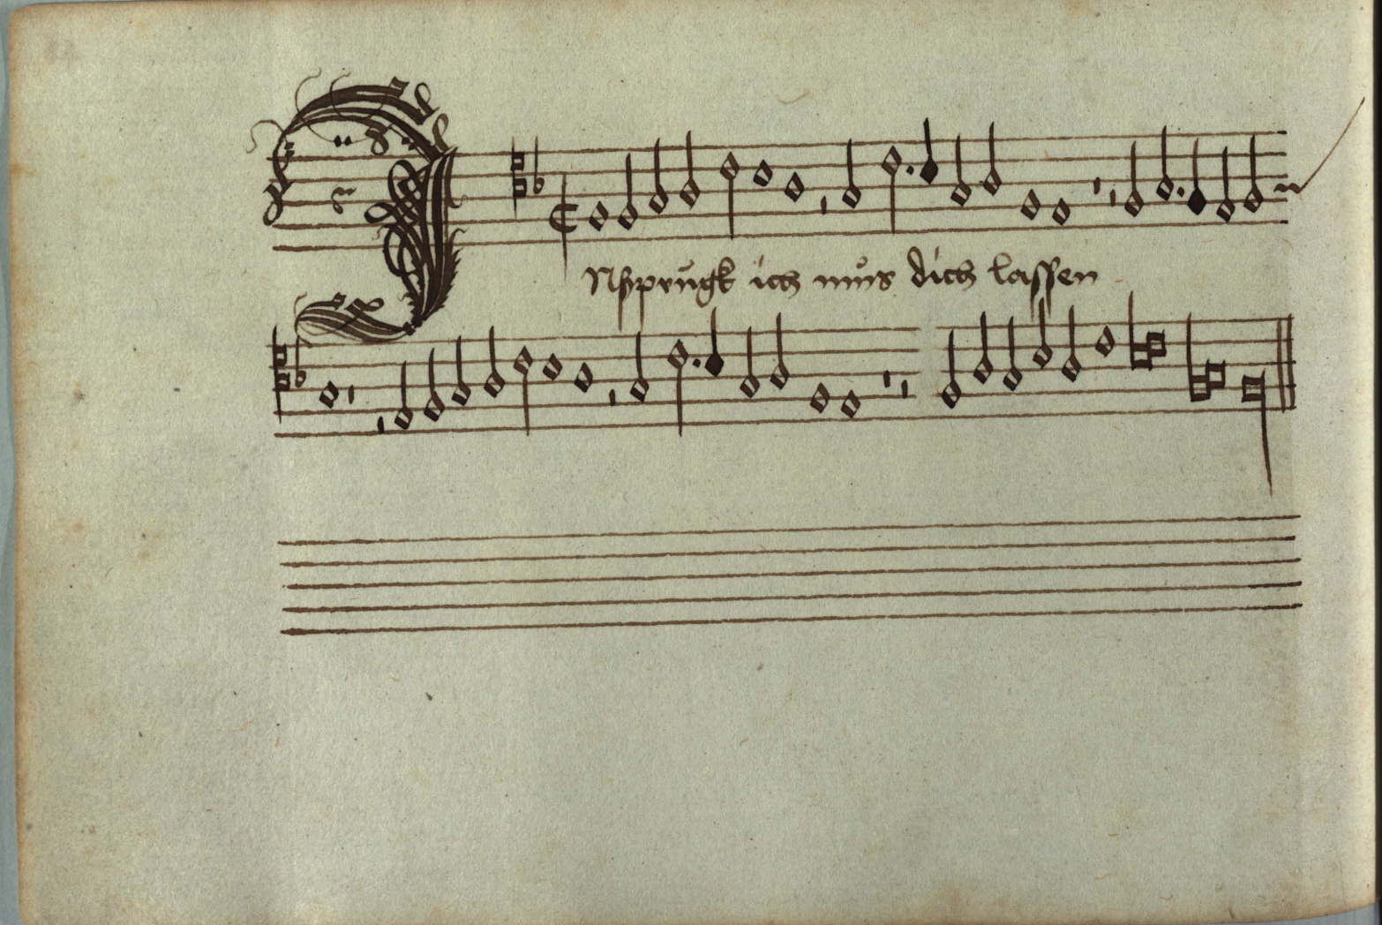
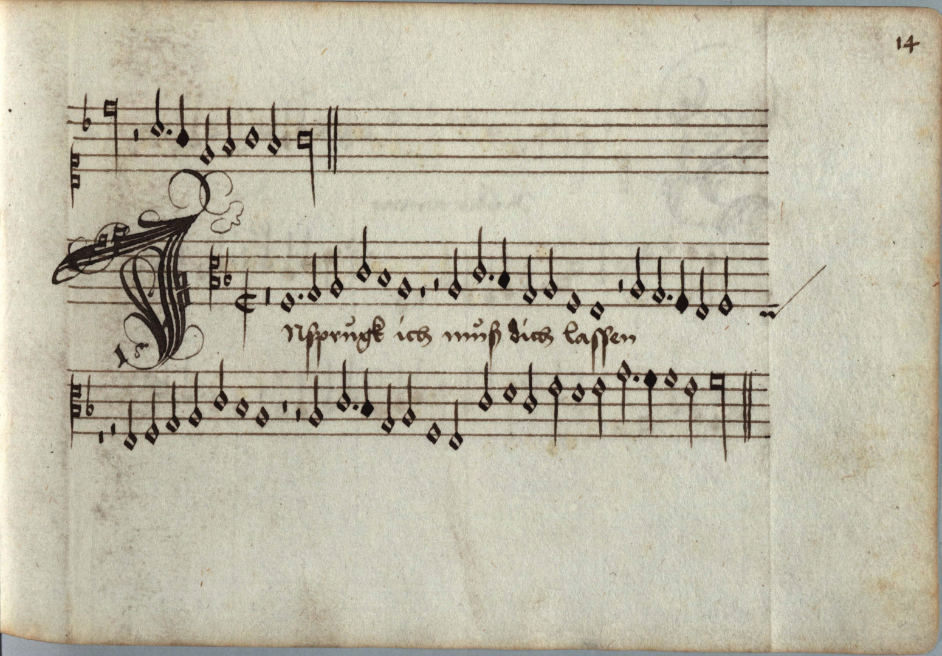
Innsbruck ich muss dich lassen, Heinrich Isaac D-Mu MS 8 328/329/330/331)
FIND THE MISTAKE

Slide 3
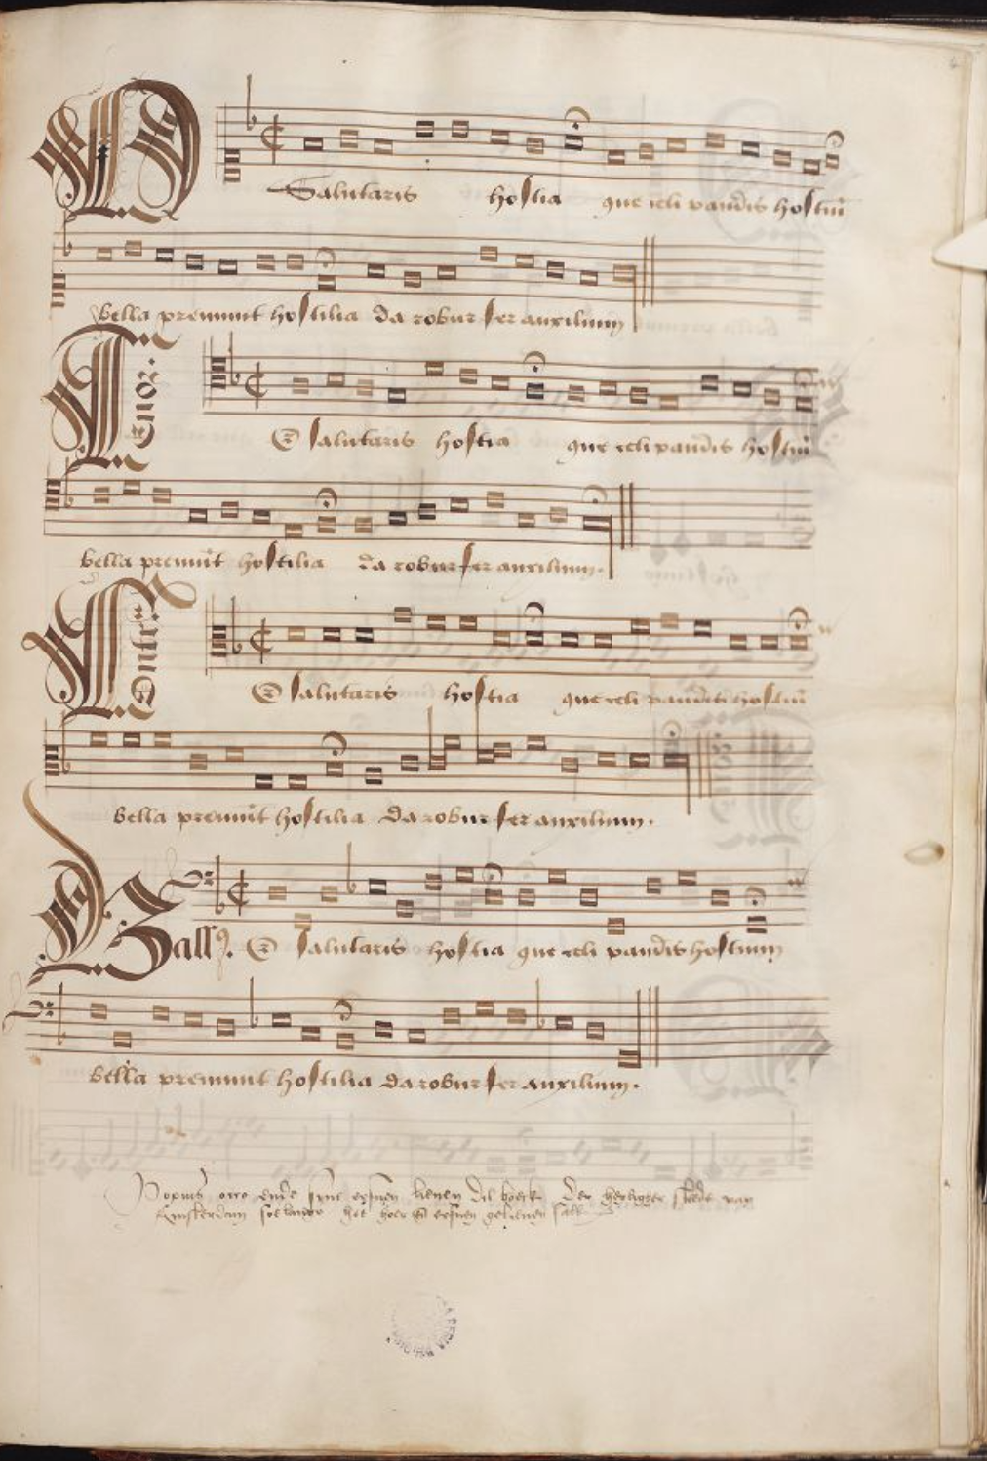
B-Br-ms-IV-922, Occo Codex
IT’S TIME TO SING!!

Slide 4
Mille regretz de vous abandonner
Et d'eslonger vostre fache amoureuse,
Jay si grand dueil et paine douloureuse,
Quon me verra brief mes jours definer.
A thousand regrets at leaving you
And going far away from your loving face.
I feel such great grief and woeful pain
That you'll soon see me make an end of my life.
F-CA MS 128, Zeghere Van Male partbooks
Mille Regretz, Josquin Despres (superius)

Slide 5
F-CA MS 128, Zeghere Van Male partbooks
Mille Regretz, Josquin Despres (contratenor)

Slide 6
F-CA MS 128, Zeghere Van Male partbooks
Mille Regretz, Josquin Despres (tenor)

Slide 7
F-CA MS 128, Zeghere Van Male partbooks
Mille Regretz, Josquin Despres (bassus)

Slide 8
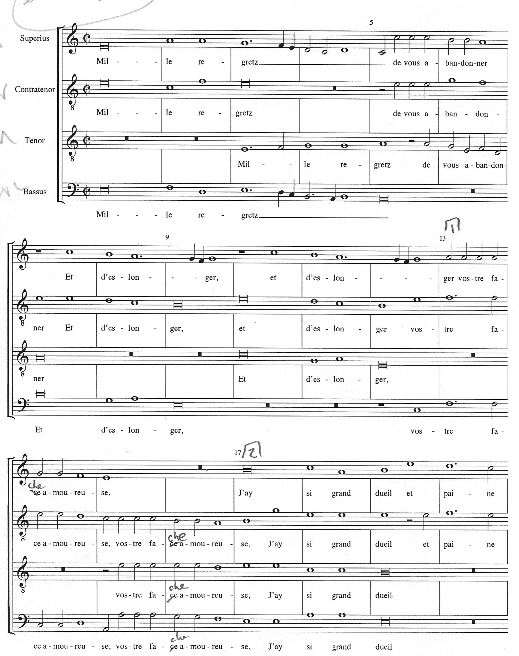
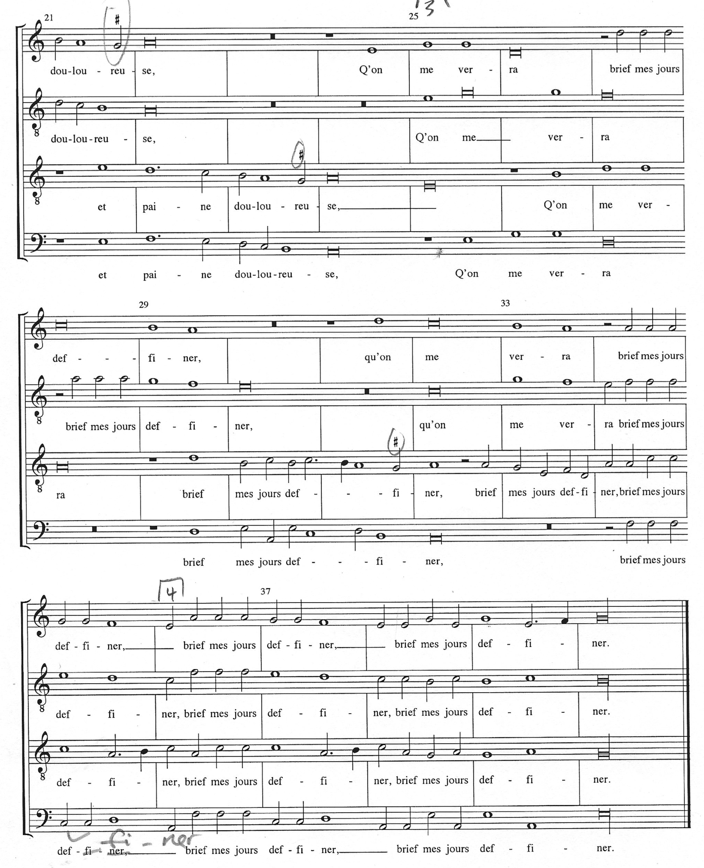

Slide 9
ASCENDING
DESCENDING
BL
BL
BEAUTIFUL LIGATURE
BASIC LIGATURE
LL
LL
BB
BB
LB
LB

Slide 10
SEMIBREVE LIGATURES
Always come in a pair

Slide 11
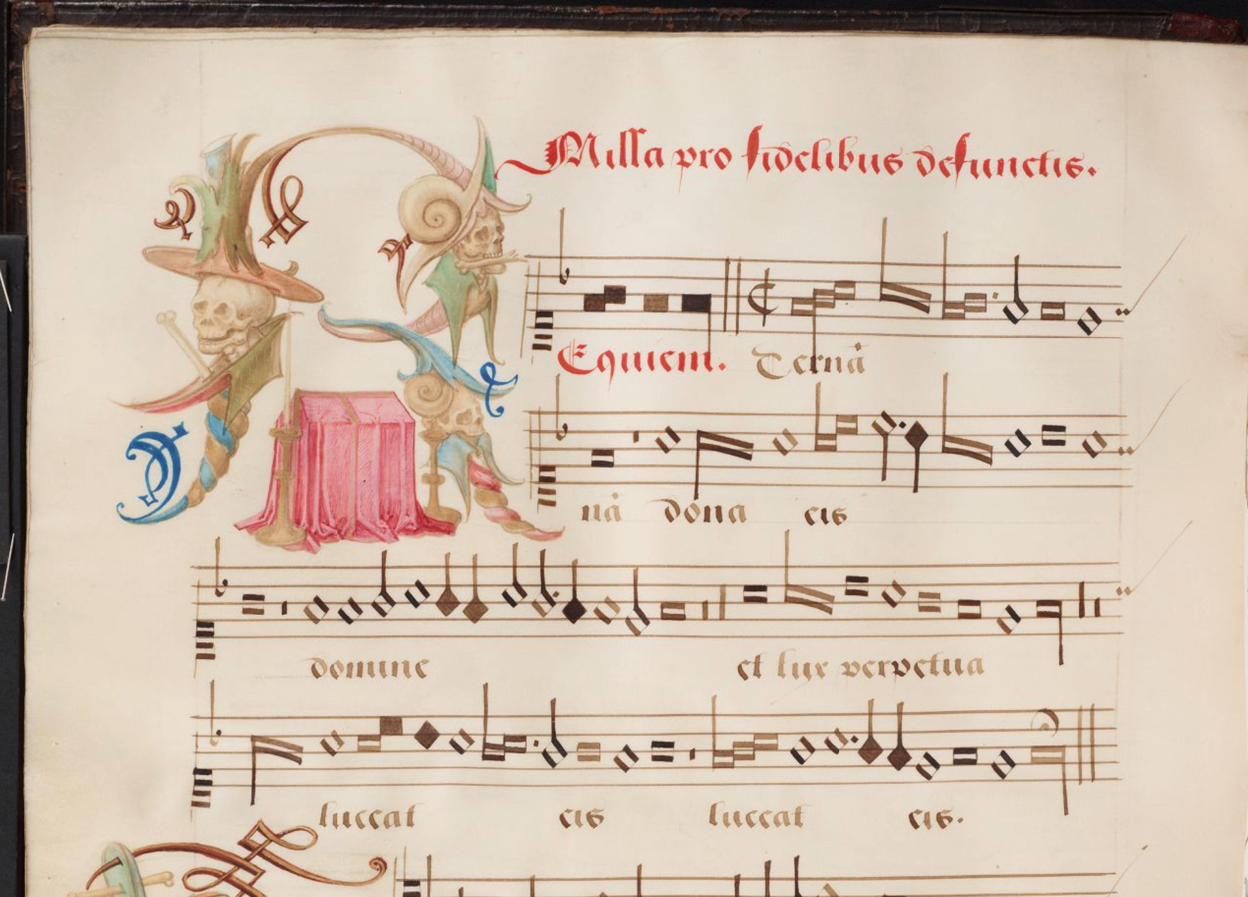

Slide 12
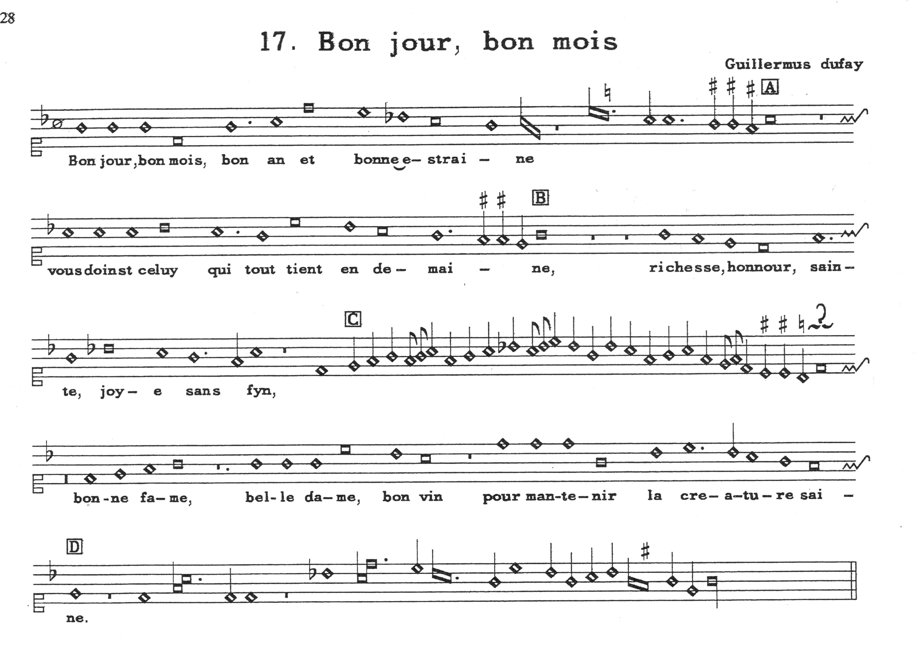
GB-Ob MS. Canon. Misc. 213, 44v

Slide 14
LIGATURES of 3 or more
Any middle one is a breve except if it looks different
The first and the last according to the rules of the Beautiful Ligature, except if the tail goes up
L B B L B
S S B B B B
L B M L

Slide 16
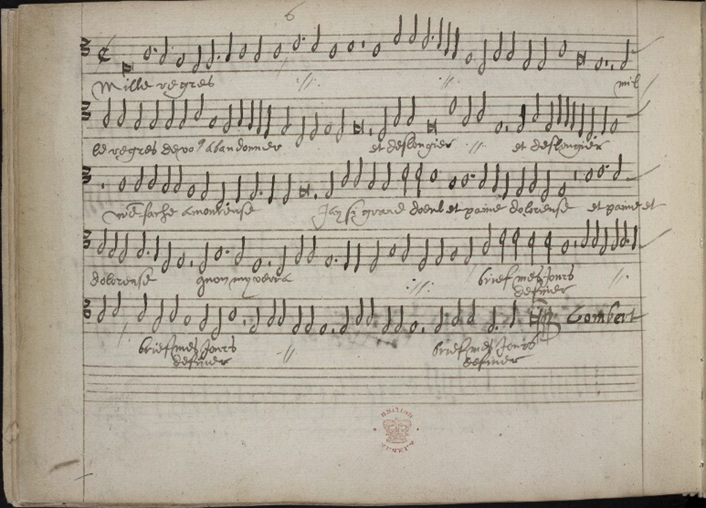
W

Slide 17
Nicolas Gombert (c.1500 - c.1557): Mille regretz
For 6 voices

Slide 18
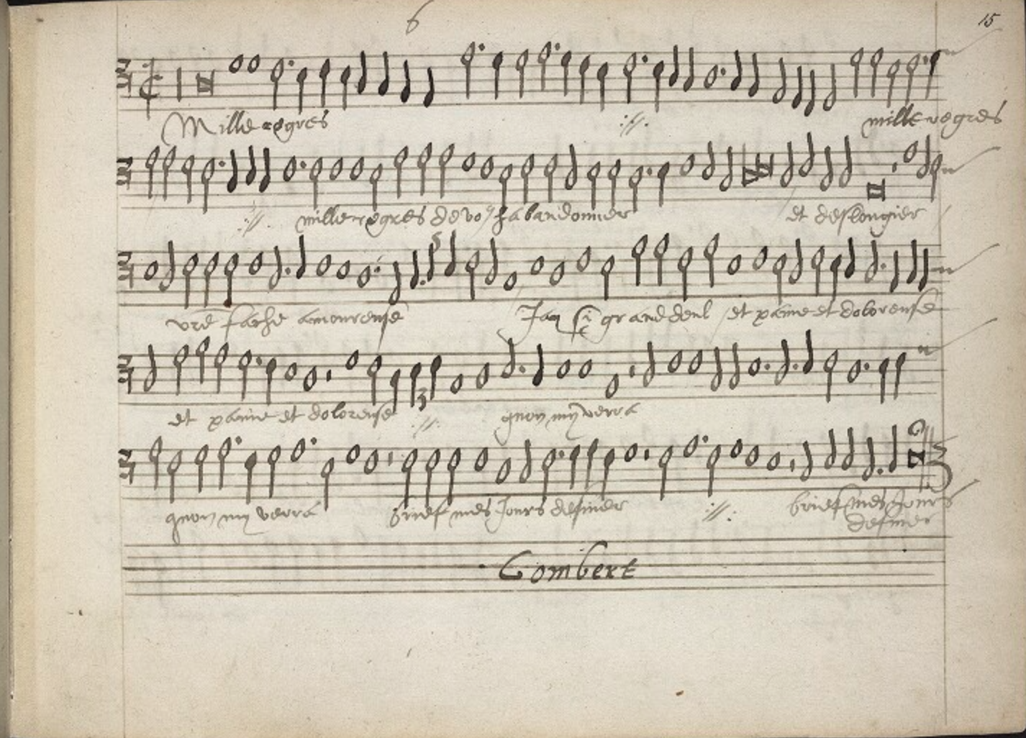

Slide 19
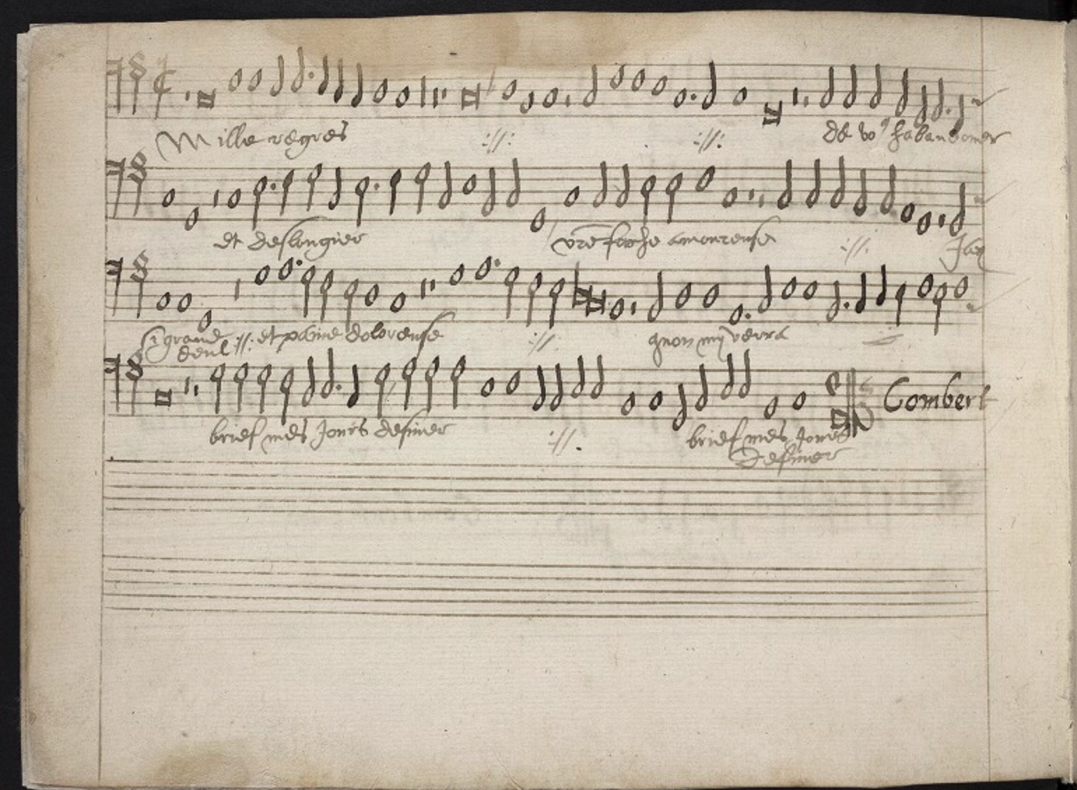

Slide 20
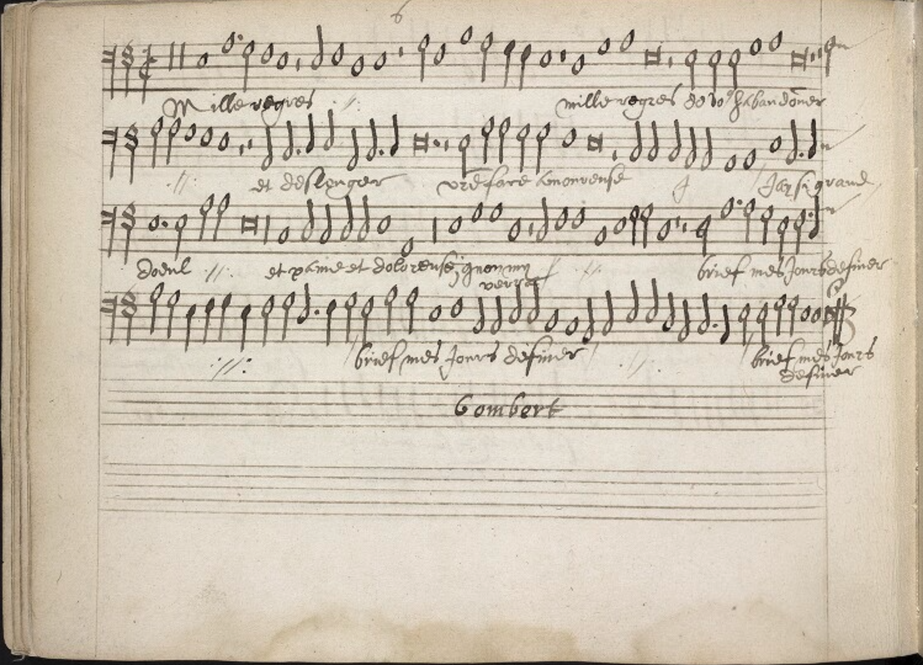

Slide 21
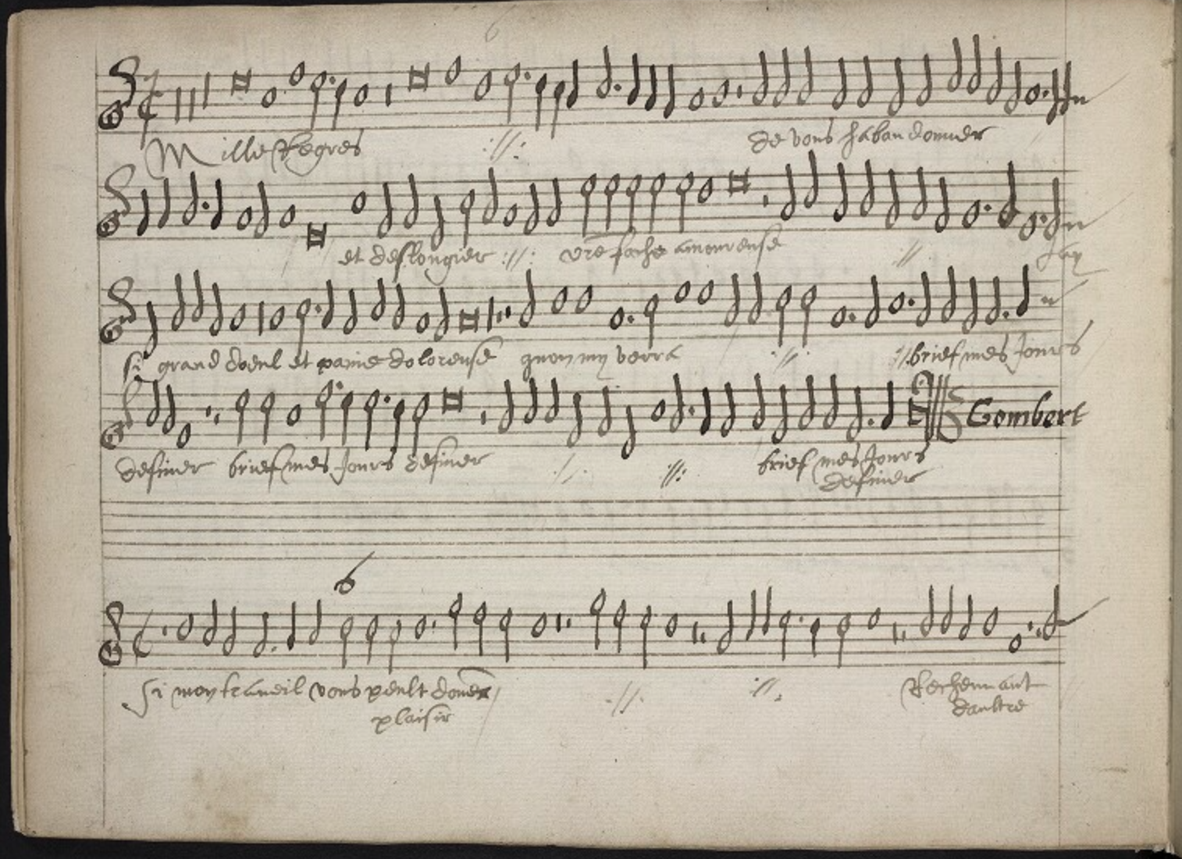

Slide 22
