Slide 1
ALCHEMIA
Alliance of Cultural Heritage Exchange for Musical Innovation and Acquisition
Day 2 (Aug 31)
Notes and values in context - theory and practical tips for instruction
Academie voor Muziek, Woord en Dans, Bornem

Slide 2
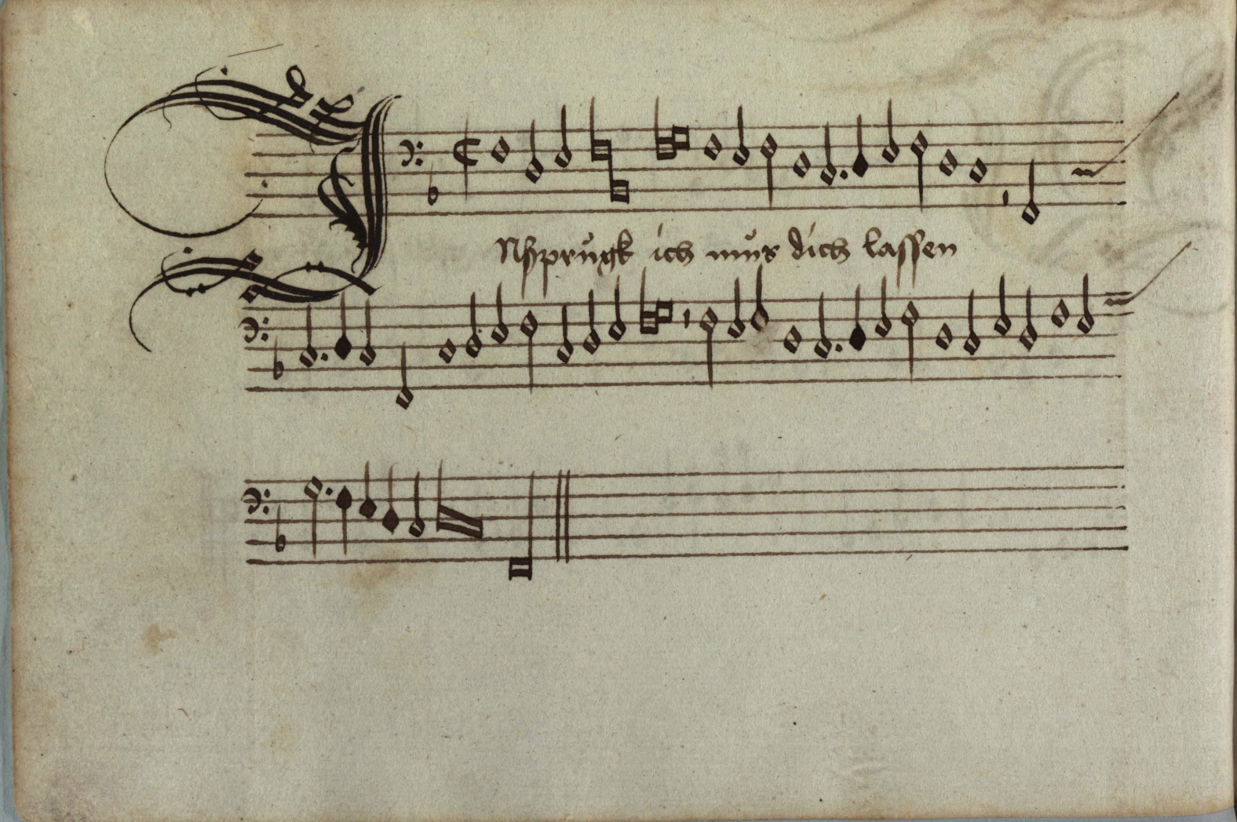
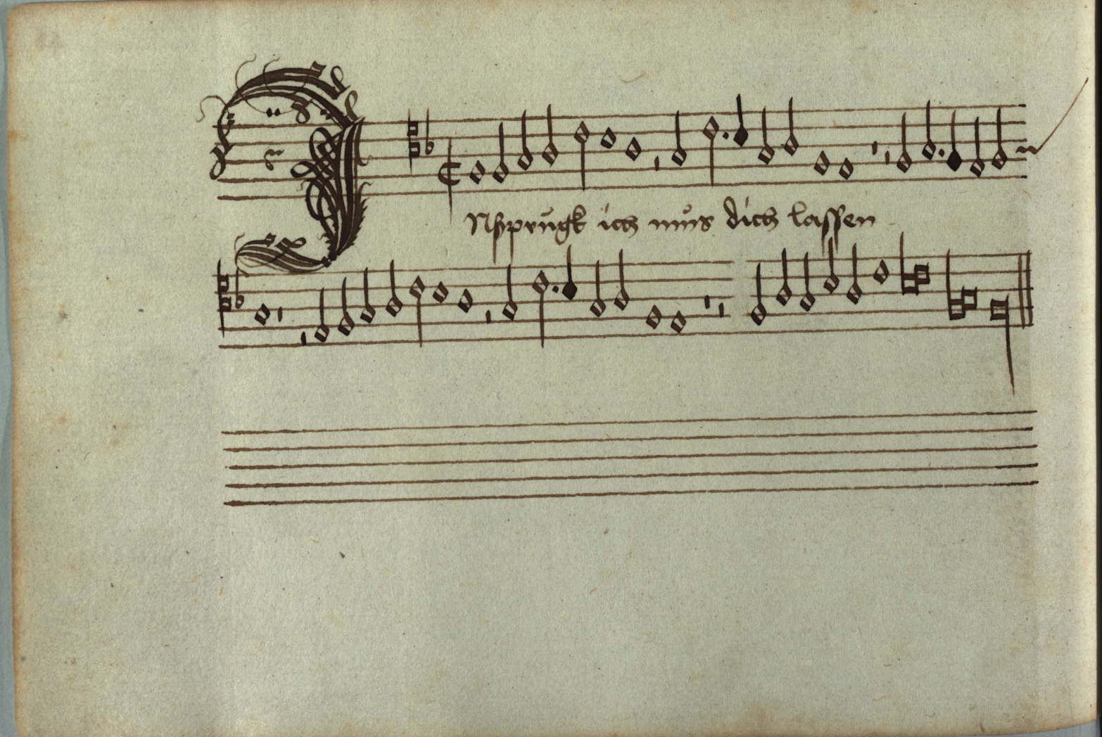
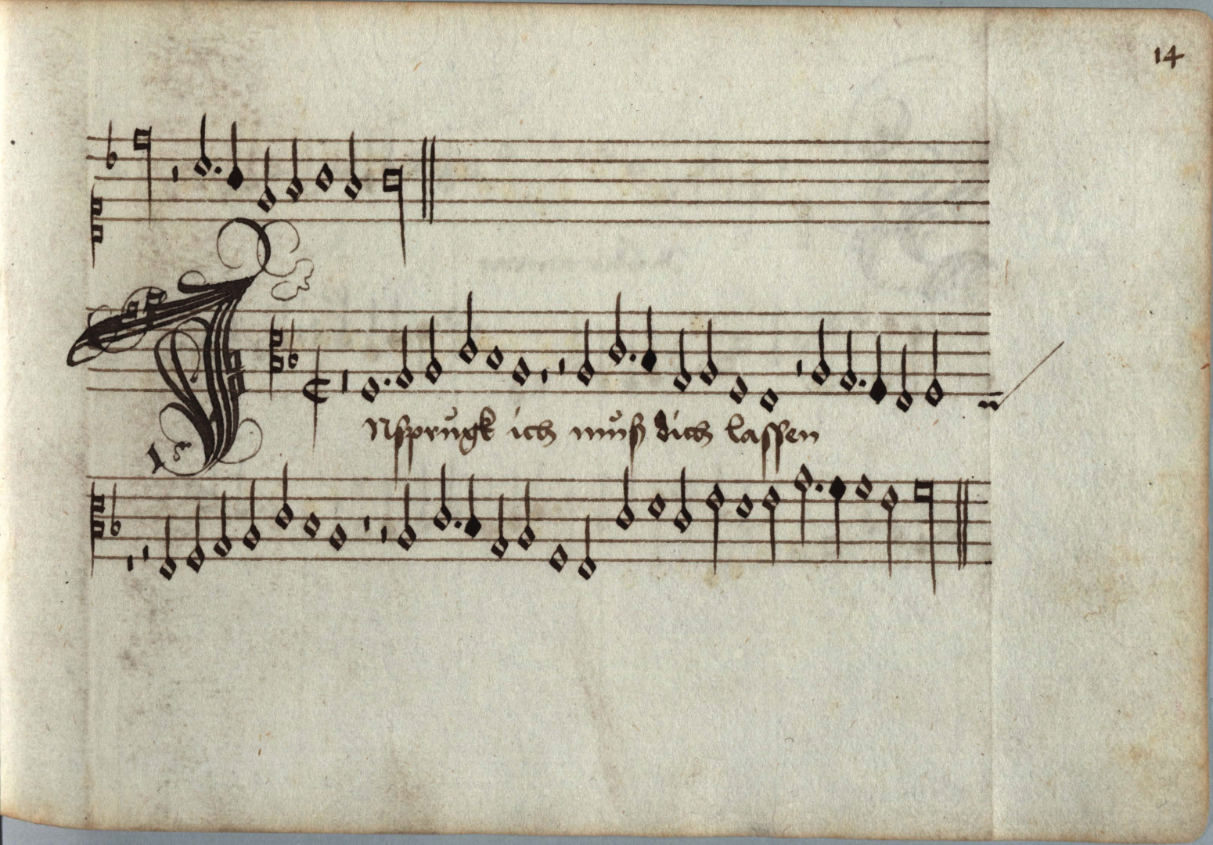
Innsbruck ich muss dich lassen, Heinrich Isaac D-Mu MS 8 328/329/330/331)
TIME FOR A CHALLENGE!!
FIND THE MISTAKE

Slide 3
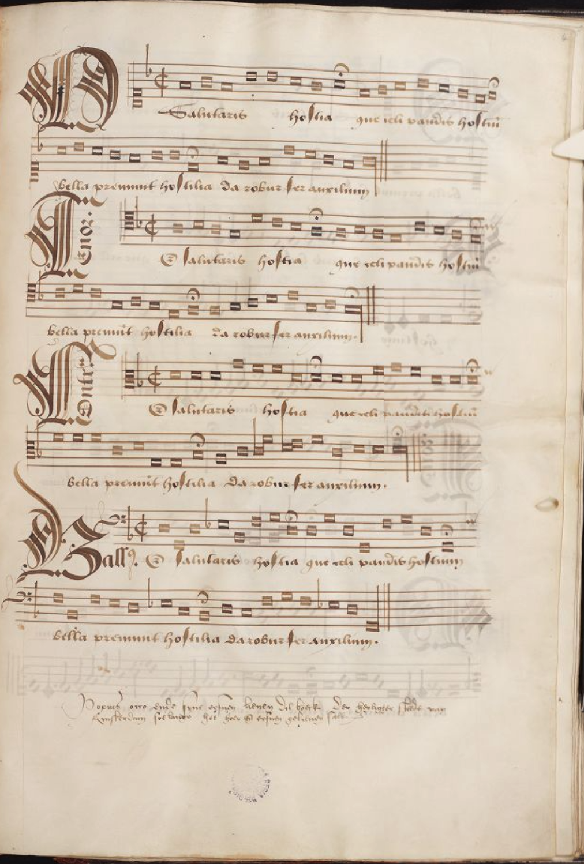
B-Br-ms-IV-922, Occo Codex
IT’S TIME TO SING!!

Slide 5
QUESTION: A problem arises. What sign can we use to write a note that last 2 half notes??
ANSWER: Sometimes the brevis (imperfected) and sometimes the semibrevis (altered)

Slide 6
IMPERFECTED BREVE

Slide 7
ALTERED SEMIBREVE

Slide 8
DOT OF DIVISION
May be used to prevent or enforce alteration or imperfection. It functions like a barline

Slide 9
Rests can imperfect notes.
Perfect rests can not be imperfected

Slide 10
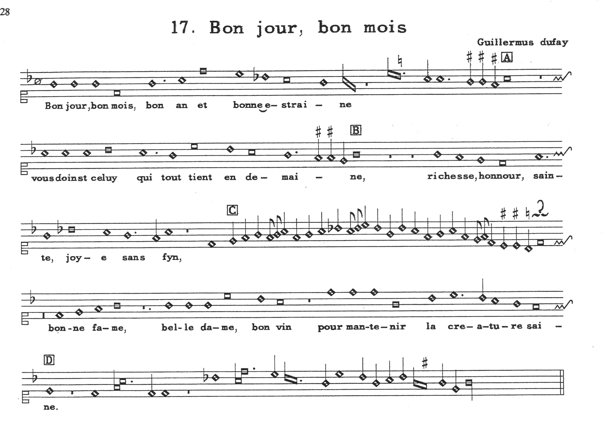
GB-Ob MS. Canon. Misc. 213, 44v

Slide 11
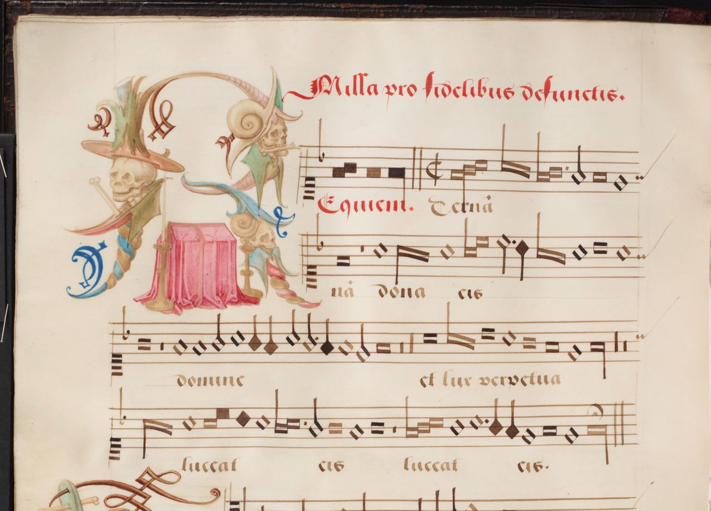
Occo Codex - B Br ms. IV 922 - 133v

