Slide 1
Results from the food quiz

Slide 2
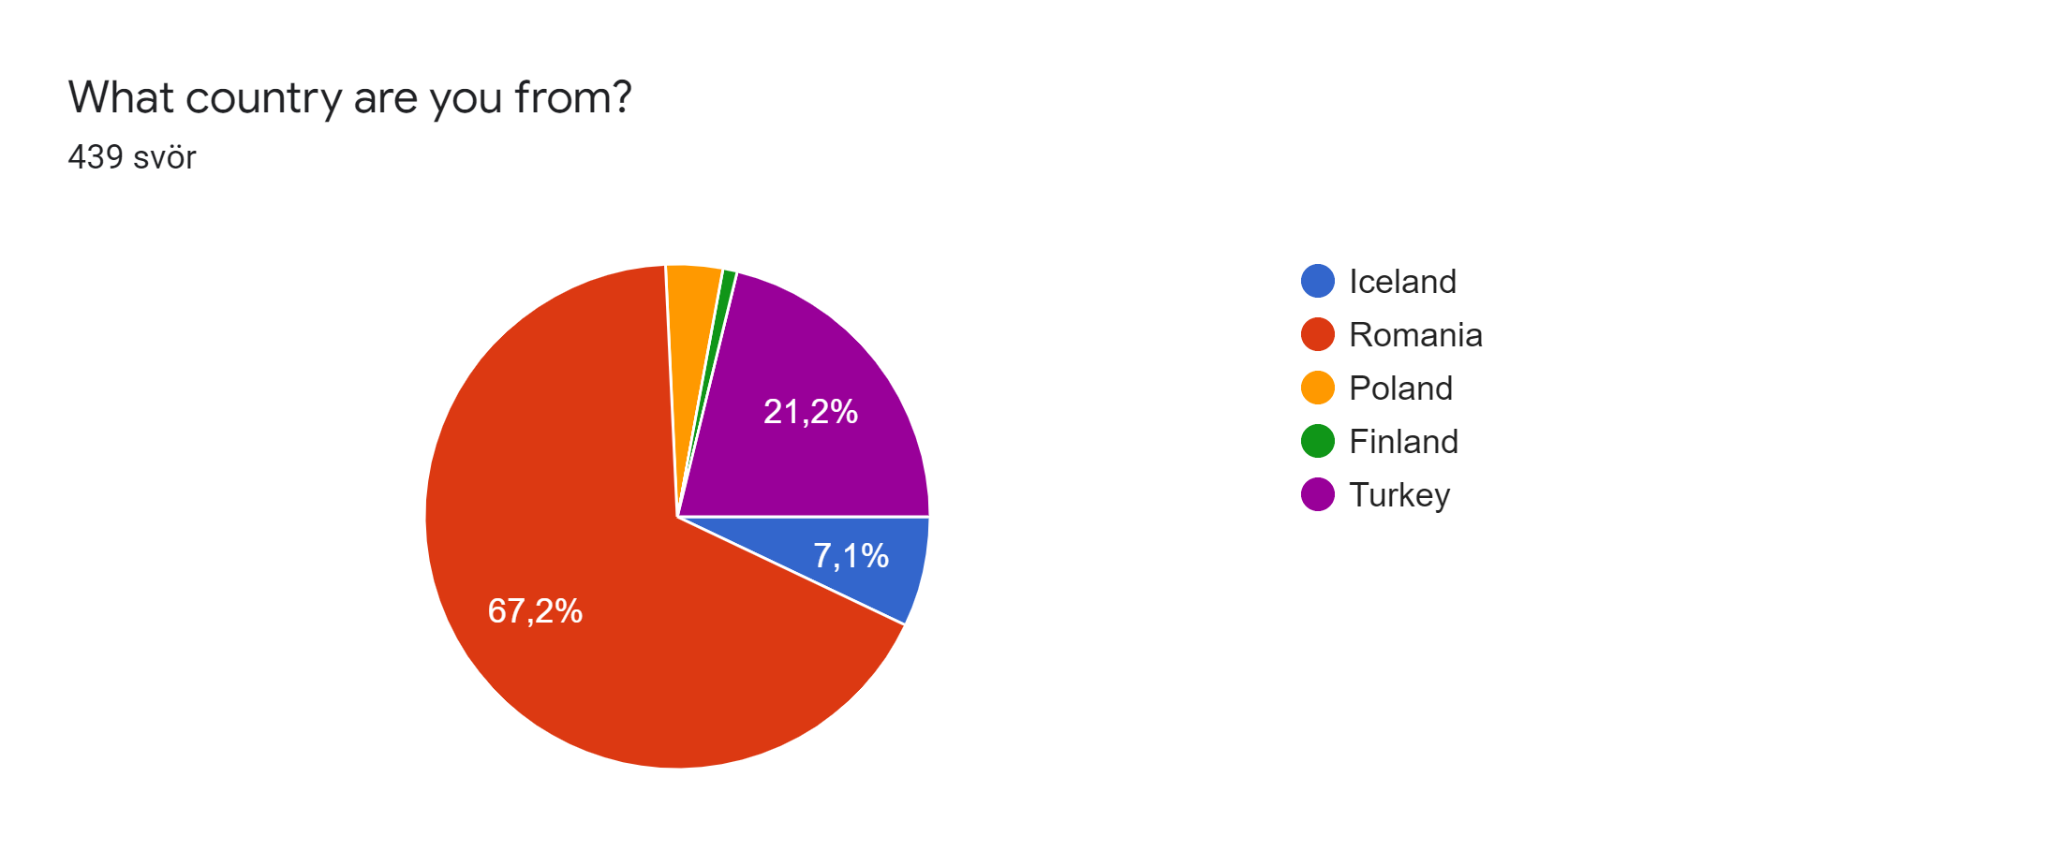
439 people answered this quiz
The age range was from 13-18+
Most of the answers were from Romania

Slide 3
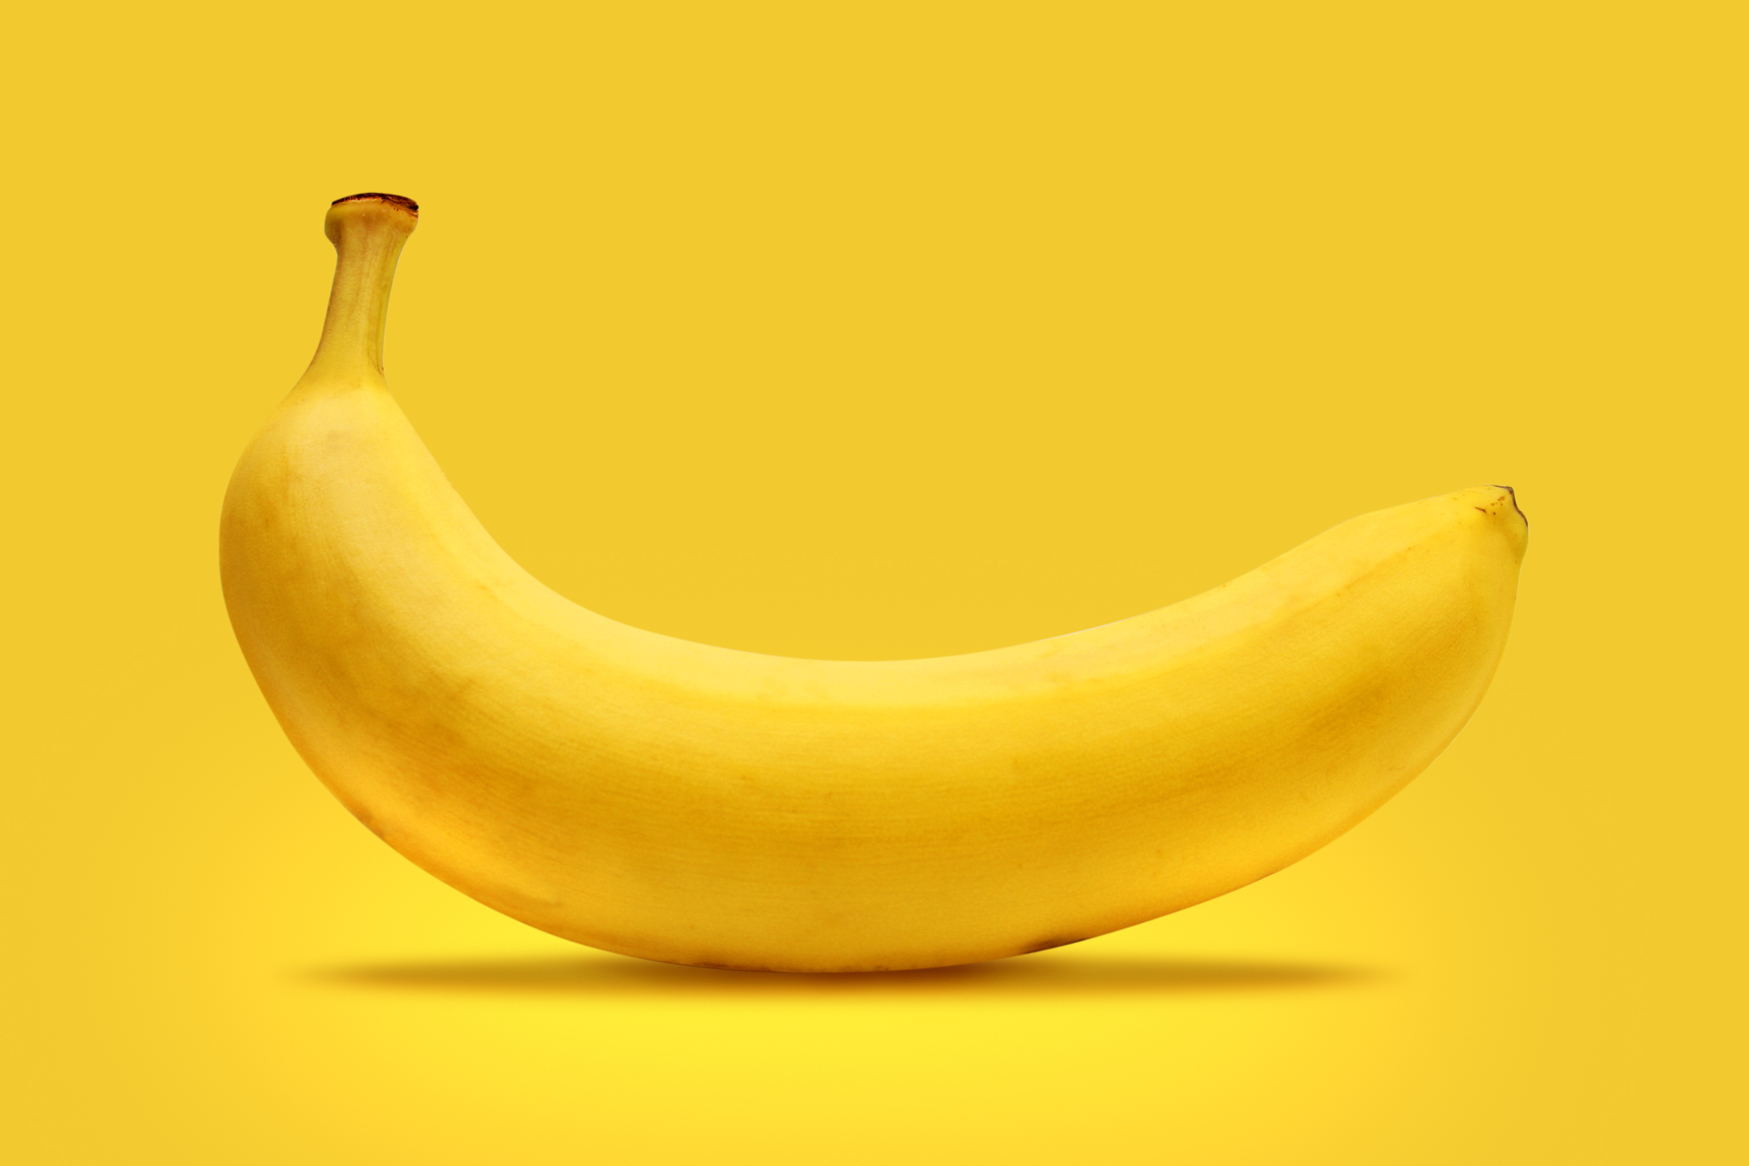
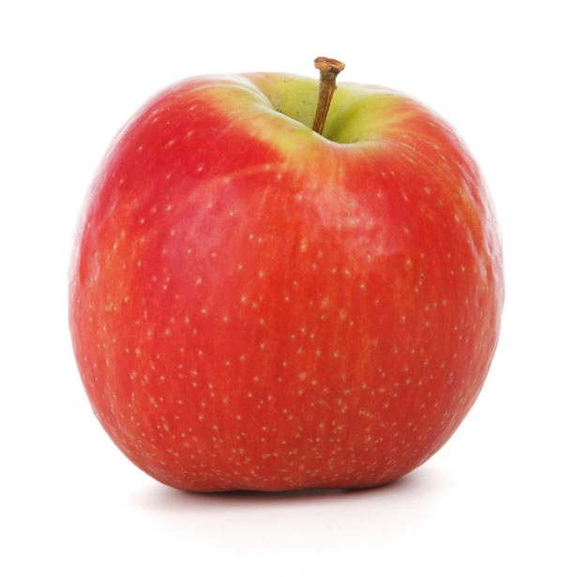
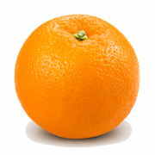
Question: what are your favorite fruits?
Most popular fruits were:

Slide 4
Question: how much of fruits do you eat per day?
The most popular answer was two servings

Slide 5
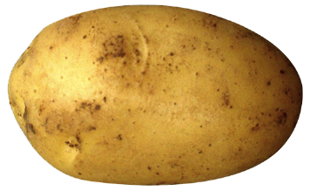
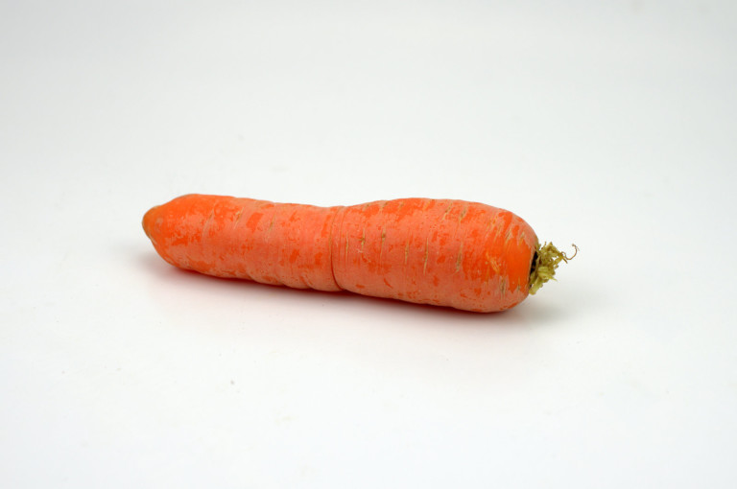
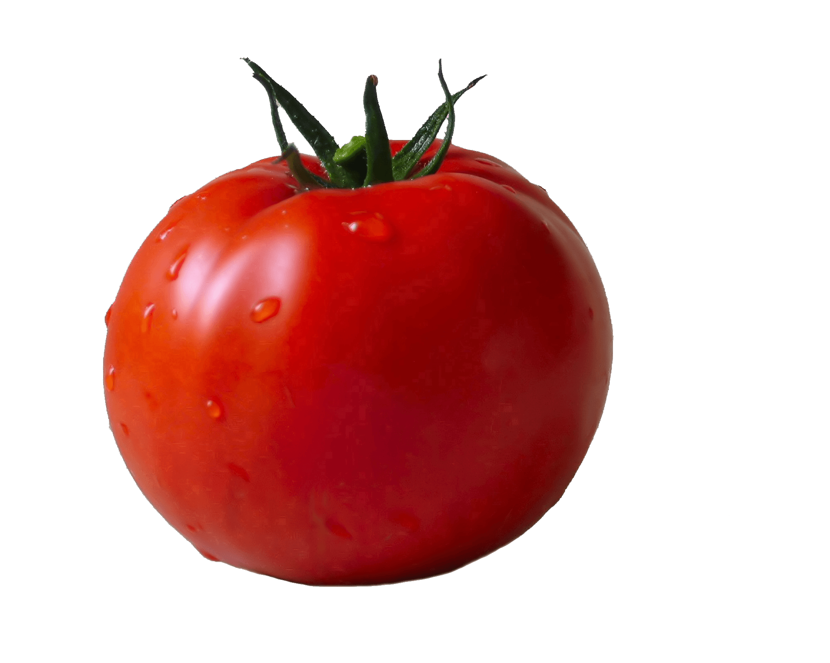
QUESTION: WHAT ARE YOUR FAVORITE vegetables?
Most popular vegetables were

Slide 6
Question: how much of vegetables do you eat per day?
The most popular answer was one servings

Slide 7
Question: how much water do you drink daily?
THE MOST POPULAR ANSWER WAS MORE THAN 5 CUPS

Slide 8
QUESTION: WHAT KIND OF SODA DO YOU DRINK?
THE MOST POPULAR ANSWER WAS COCA COLA

Slide 9
QUESTION: WHAT DO YOU DRINK MORE OFTEN?
THE MOST POPULAR ANSWER WAS WATER

Slide 10
ThE LAST QUESTION WAS: wHAT IS YOU FAVOURITE FOOD?
FOR THIS QUESTION EVERYONE SUMBITTED THEIR FAVOURITE FOOD
BY FAR THE MOST POPULAR FOOD WAS PIZZA
A LOT OF THE ANSWERS HAD PASTA AND MEAT

