Slide 1
The ideal world based on sustainable energy
Taika, Leo, Emma-Julia, Veeti and Nelli

Slide 2
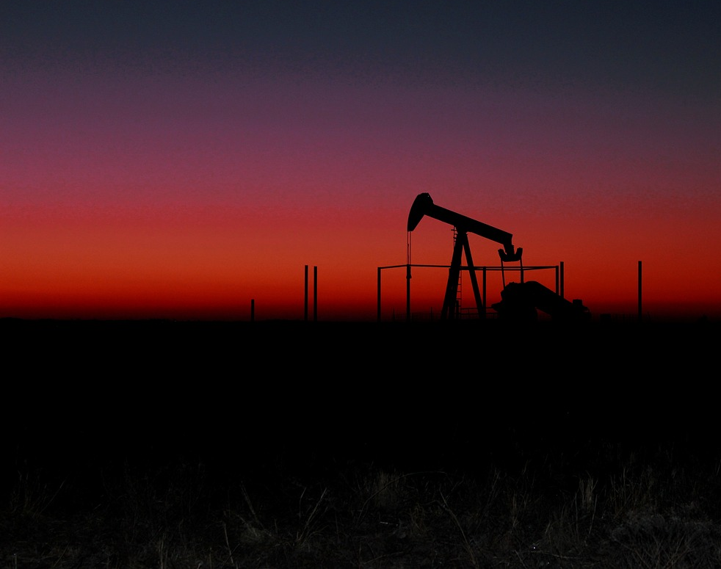
Method 1
Reusing old fossil fuel production sites for renewable energy production sites.
For example the large fossil fuel sites make great space for wind turbines.

Slide 3
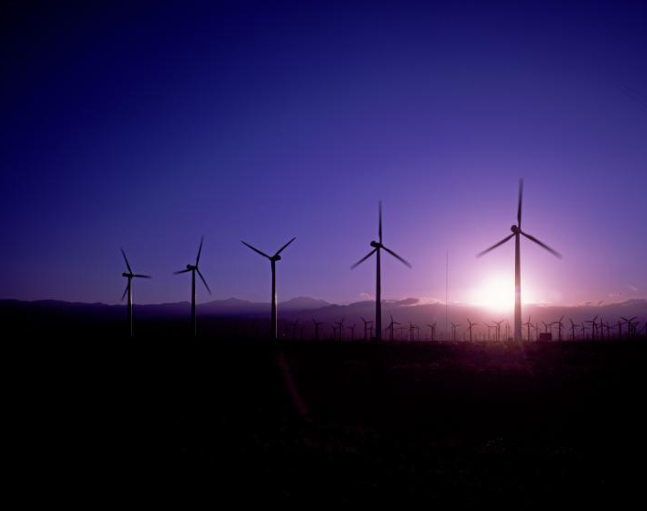
Method 2
All production and consumption is decreased so renewable energy sources are enough for global usage.

Slide 4
Method 3
Areas that have suffered from erosion are used to produce sustainable energy.
For example wind and solar power.

Slide 5
Method 4
Using seashores and waves for wave- and wind power production would be efficient and would not require much space

Slide 6
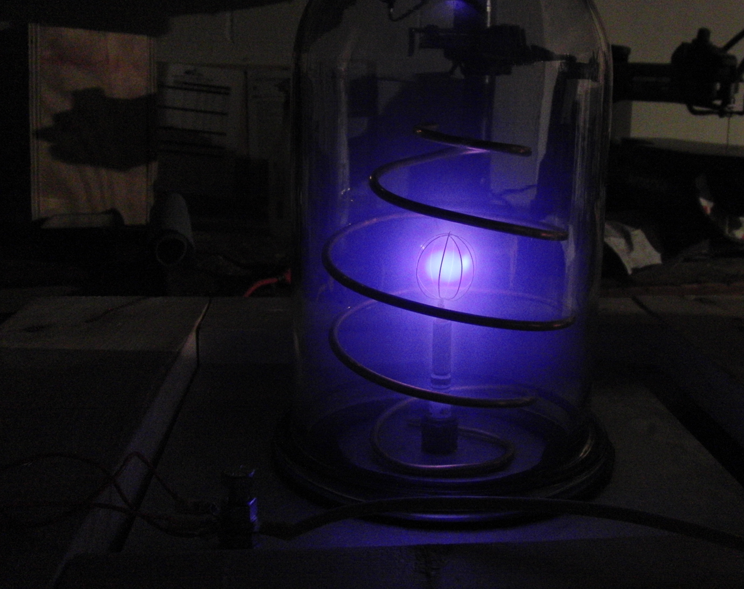
Method 5
Find a way to use fusion to produce nuclear energy as it is much more efficient and safe. It also produces less waste than fission

Slide 7
Method 6
Find a replacement for lithium-based batteries. This would allow electric cars to expand on the market and lower the prices. This would decrease the use of gasoline

Slide 8
Method 7
Instead of fast fashion, which is usually made with poor conditions and takes alot of energy, we could prefer second hand stores and produce less clothing in general.

Slide 9
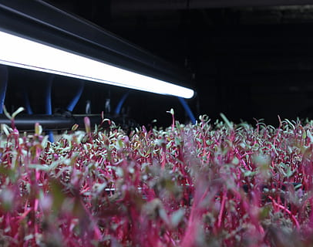
Method 8
Make food farming at home easier and more accessable for consumers. Less energy would be used for food transportation.

Slide 10
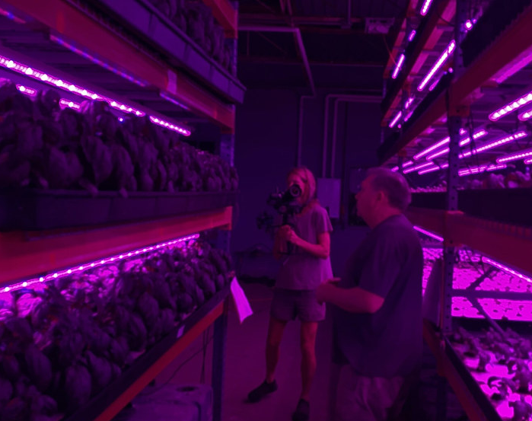
Method 9
Encourage buying fair-trade products and supporting independent farmers.
Supporting small farmers will make less space for large energy consuming companies

Slide 11
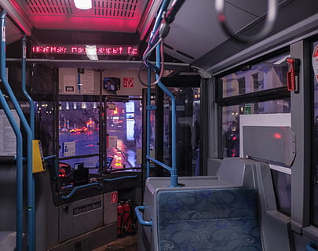
Method 10
Design cities around rural areas, which will decrease the need for transportation from distant areas
This way we wont need to use needless energy on transportation.

