Slide 1
The ideal world based on sustainable energy

Slide 2
Renewable energy in everyday life
In the ideal world :
Every rooftop would be covered in plants and/or solar panels.
Solar panels should be efficient enough so the residents of the building don't need any other energy source.
You would see windturbines producing energy while walking down the street.

Slide 3
The future of transportation
Airplanes and ships would work on bioenergy.
Private motoring would be replaced by public transportation.
There would only be electric and gas cars.
I use electric cars!

Slide 4
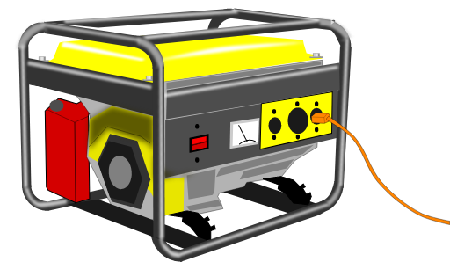
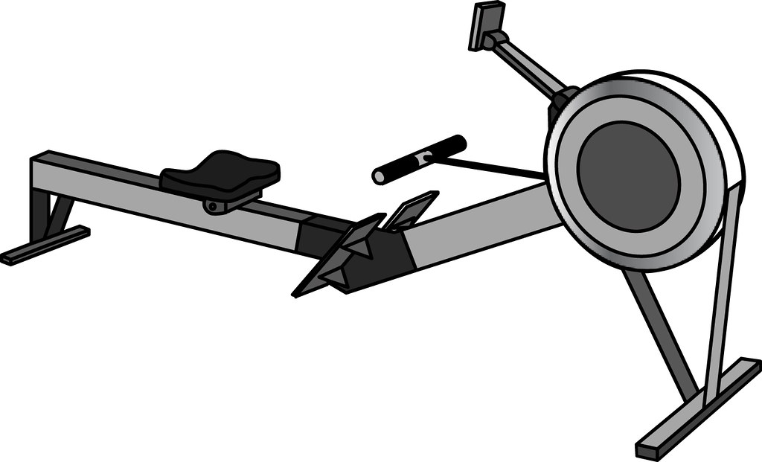
In an ideal world we only use sustainable energy
IDEAS FOR NEW RENEWABLE ENERGY SOURCES
The use of a rowing machine -> kinetic energy causes turbine to spin -> turbine is connected to a generator that produces electricity for the gym
It rains -> chutes with many turbines collect the rain -> moving water -> kinetic energy causes the turbines to spin -> turbines are connected to a generator that produces energy for the household

