Slide 1
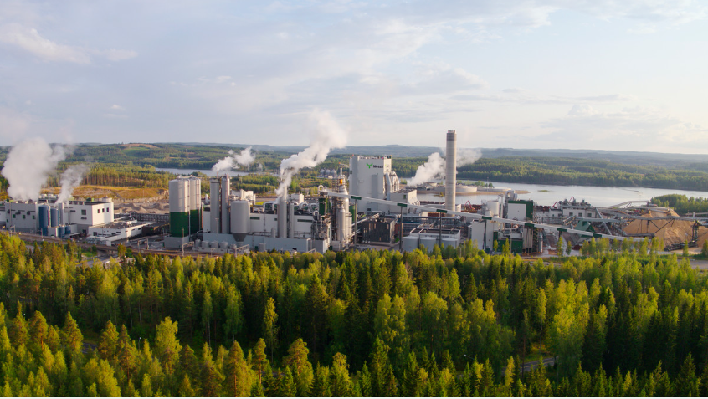
Äänekoski bioproduct mill
Is a part of Metsä Group (a forest industry​ group that operates in about 30 countries)​.
Is located in Äänekoski​, Finland.

Slide 2
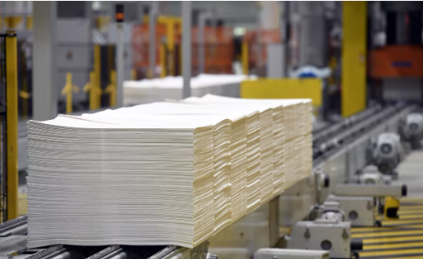
Information about bioproduct mill in Äänekoski
The largest forrest industry investment
in Finland.​
The largest wood processing plant in the
northern hemisphere.​
Was launched in the year 2017.​
The pulp mill produces softwood and birch pulp (1.3 million tons / year) and other factories produce other bioproducts (-> bioeconomy).​
The majority of the pulp is sold to Europe and Asia.​
Employs 150 people.​
The mill produces bioenergy beyond it’s own need (doesn't use fossil fuels).​
Closed chemical cycle.

Slide 3
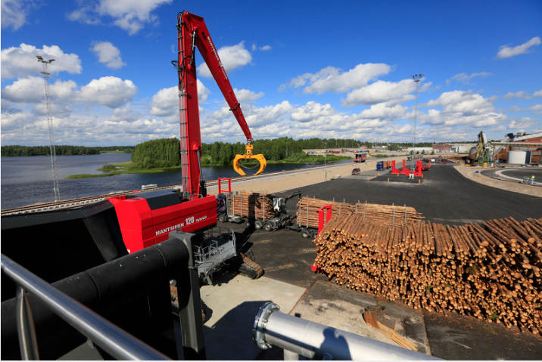
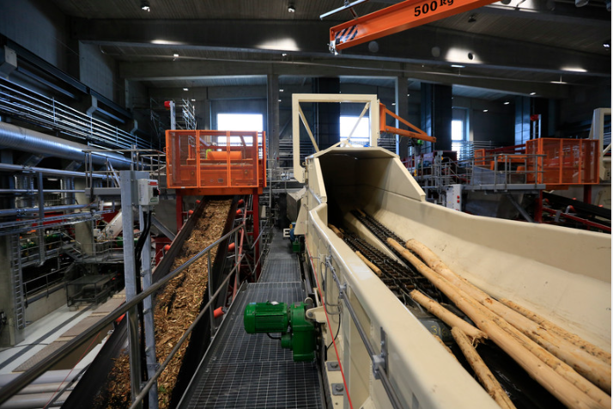
250 timber trucks​ and 70 train wagons arrives at the
factory daily.
44 train wagons of pulp is transported daily to port of Vuosaari in Helsinki.

Slide 4

What is a bioproduct mill?
Produces a variety of bioproducts​
A) From wooden raw material​:
- Softwood and birch pulp
-> carton, tissue, printing paper
and special products produced
at other Metsä Group factories.​
B) From pulp production by-products:
- Pine oil, turpentine and sulfuric acid​.
- Textile fibers, biocomposite and refined lignin (in the future)​.
- Energy: bioenergy, bioelectricity, process steam, distance heating,
bark and sawdust together with process gas (from bark),
biopellets and biogas (in the future).
Exhibition at school (forest industry products).

Slide 5

Sustainable development and the mill
a) Circular economy​
- The aim is to utilize 100 % of wooden raw
material and production by-products
(no landfill waste)​.
b) Achieving renewable energy goals​
- The factory produces 2,4 times more
bioelectricity than it needs itself (the amount of electricity produced by the factory
corresponds to 2,5 % of Finland´s total electricity production)​.
c) Wooden raw material​
- Mainly domestic timber (storage areas are located 100-150 km from the factory).
- 90% of the used timber is certified (timber comes from a sustainably managed forests).​
- Produced bioproducts replace fossil products and fossil fuel.

Slide 6
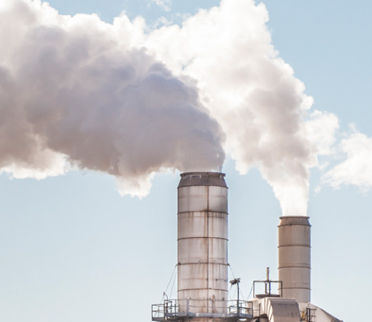
The environmental impact of the mill
Logging of the forests​.
Emissions don't have an effect on the use nor
the ecological state of the waters near the plant
(the status of the waters is monitored by sampling)​.
The temperature of cooling water can effect the thickness of the ice
(weekly monitoring from different locations)​.
Sewage and heat load doesn't affect the route of brown trout​.
Inconveniences from the smell can occur during process malfunctions.​
Daily amount of large vehicles increases noise pollution and traffic risks.
https://dreambroker.com/channel/g01yqu5c/xgb480o5

