Slide 1
School meals in Finland

Slide 2
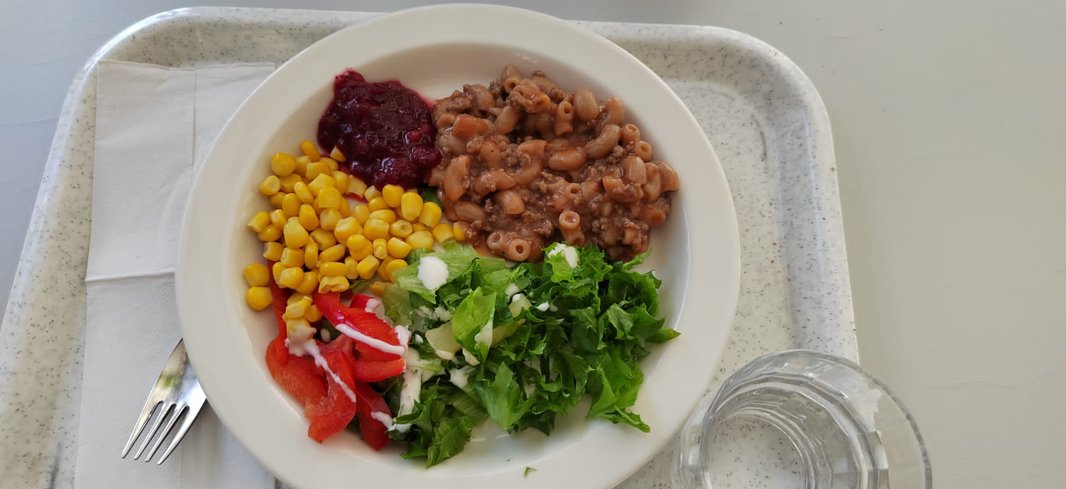
School meal meaning
School lunch helps the students physical well being and performance in school. It has instructive and also educational meaning.

Slide 3
History of free school lunch till this day
In 1943 Finland legislated a law, which makes school lunch free for everyone. But the starting year to the free lunch was 1948.
Nowdays 840000 children eats school lunch everyday in school. The food needs to be healthy and also full of nutrients to follow the rules of curriculum.
In 1977, when all the places in Finland moved to the comprehensive school, everyone in the school had free lunch everyday.​

Slide 4
Menu from 1960
Friday ​ Delicacy porridge/rye porridge​ Grahan bun 50 g​ Margarine 5 g 3 dl of milk Liver sausage 20 g ​ Saturday Spinach soup Rye bread 20g​ Margarine 5 g 3 dl of milk Cheese 20 g ​
Monday Porridge (for water)​ Margarine 5 g Rye bread 20 g 3 dl of milk Cheese 20 g Tuesday Cabbage soup Margarine 5 g Rye bread 20 g 3 dl of milk
Wednesday​ Buckwheat/lingonberry porridge​​ Margarine 5 g​ Rye bread 20 g​ 3 dl of milk​ Cheese 20 g​
Thursday Tuesday soup Margarine 5 g Rye bread 20 g 3 dl of milk

Slide 5
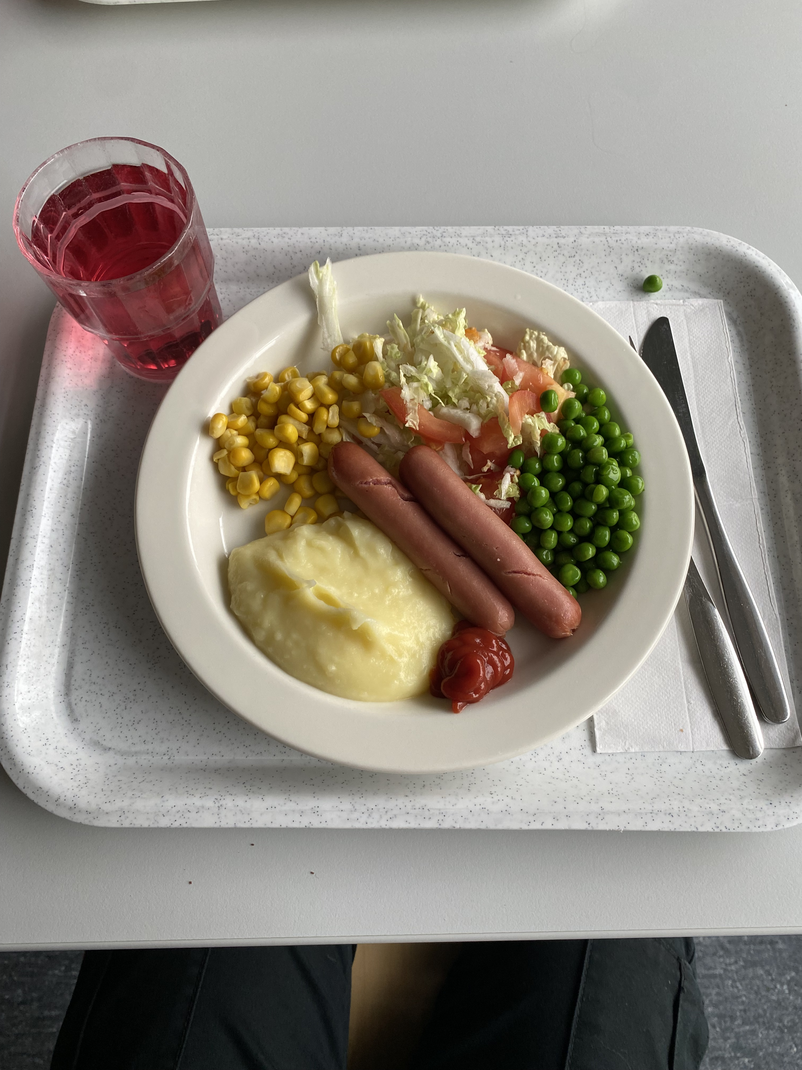
Menu from 2022
MAANANTAI KALAKEITTOA RUISPYÖRÖJÄ TIISTAI JAUHELIHAPIHVEJÄ PUNAJUURIPIHVEJÄ PERUNAMUUSIA KESKIVIIKKO BROILERIPASTAA TORSTAI POSSUKASTIKETTA KASVISGRATIINIA PERUNOITA PERJANTAI KINKKUKIUSAUSTA PUNAJUURIKIUSAUSTA

Slide 6
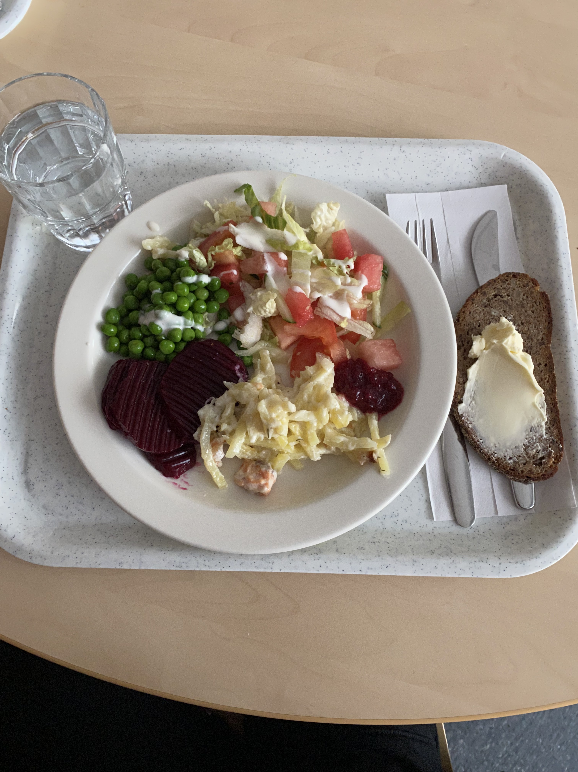
School catering in Petäjävesi
Morning porridge, lunch and special dietary requirements are served in Petäjävesi secondary school.
The school meal ingredients are from wholesale for example Valio etc.

Slide 7
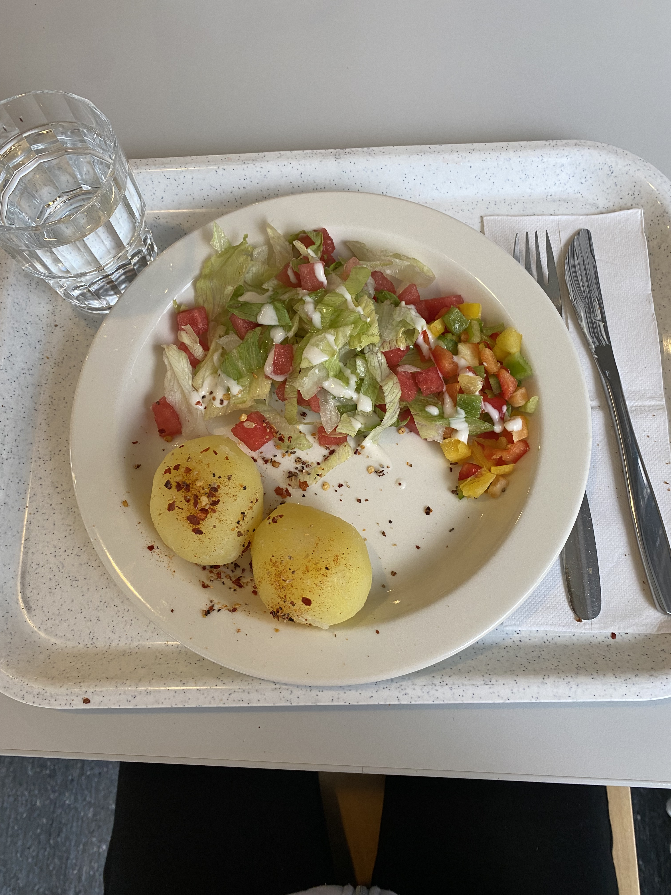
Favourite and least favourite school meals
Porridge and spinach pancakes are favorites
​
All foods that includes fish are least favorites

Slide 8
The importance of school meals
The school lunch helps you focus on your school works. In school meals you can learn to interaction and social skills and you take a break for your brain.
The school lunch also teach you recpect for the food. It teaches you to know food culture.
School lunch includes 1/3 of the day's nutritional needs

