Slide 1
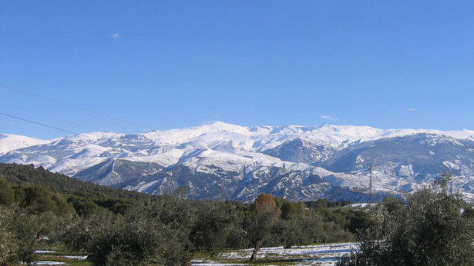
Sierra Nevada

Slide 2
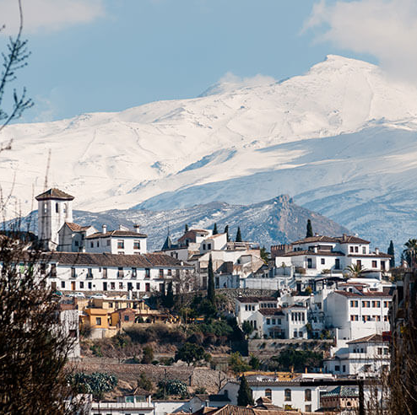
Sierra Nevada
Sierra Nevada is a mountain and a ski resort in Spain
Location in Sierra Nevada National Park in the Penibético
Sierra Nevada have English Ski School
There teachers are helping you to learn very simple triks

Slide 3
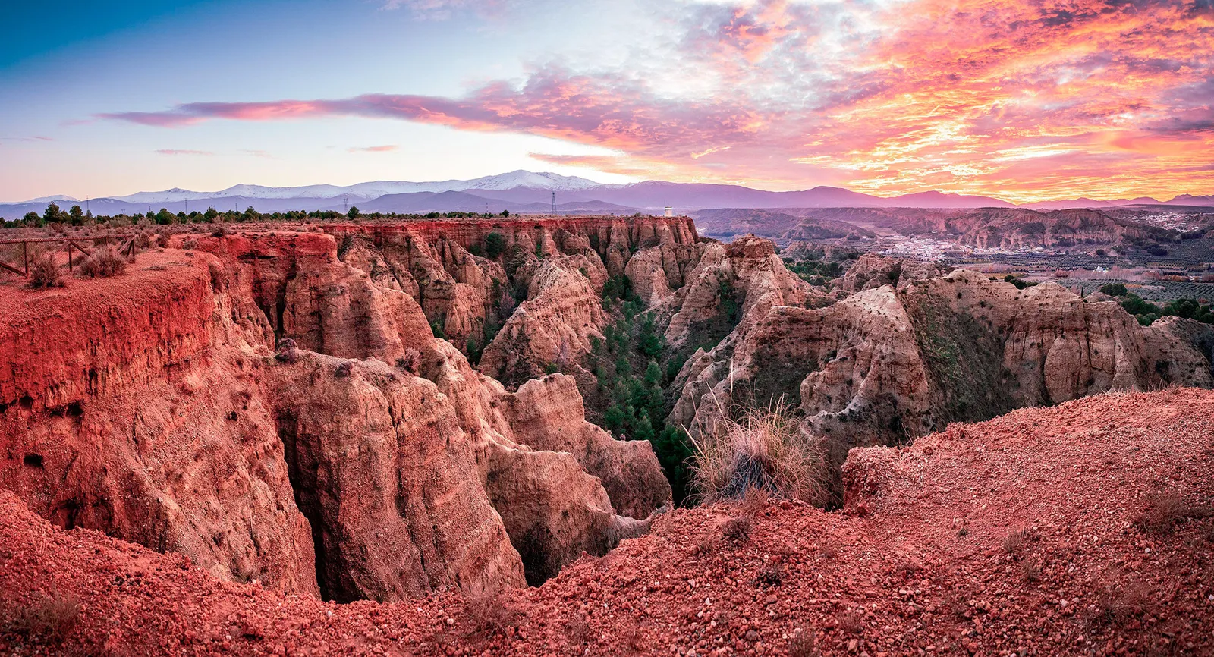
Geopark of Granada

Slide 4
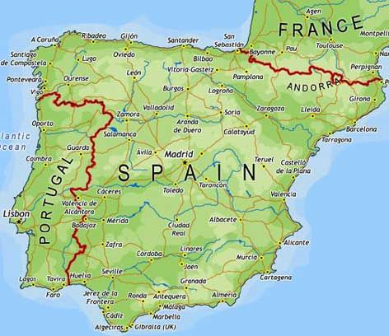
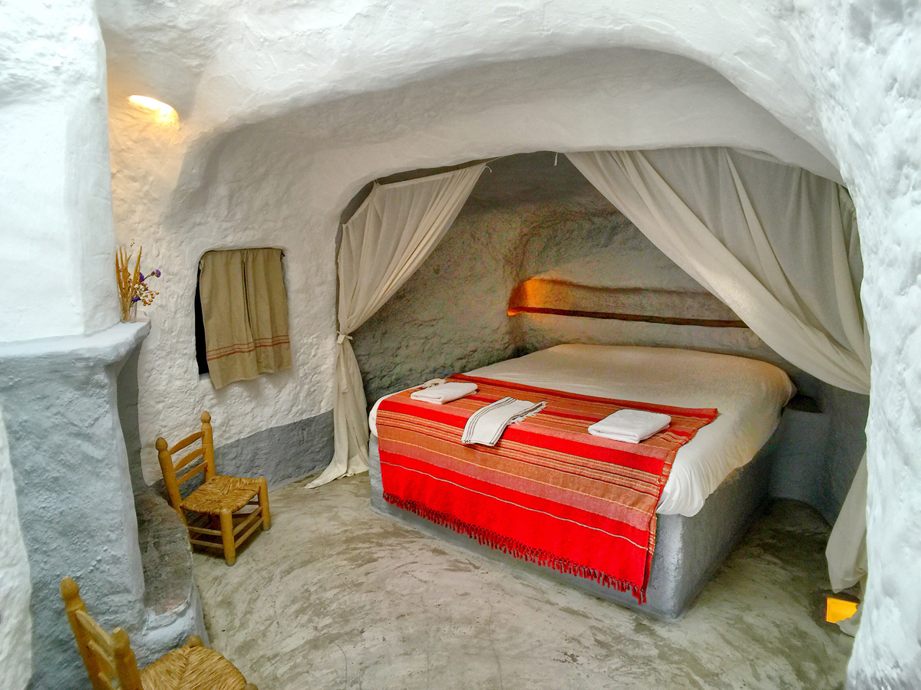
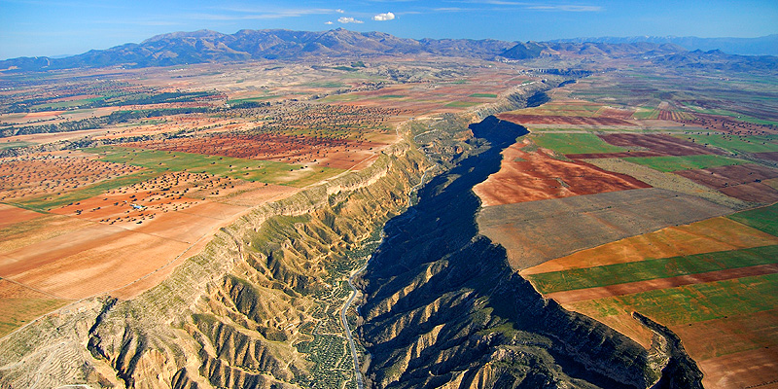
Located: South-West Spain,
In province of Granada
Geopark of Granada
One of the few natural deserts in Europe.
In Geopark of Granada you can walk, ride a bicycle and a horse.
There are Cave hotels in Geopark of Granada where you can stay the night.
History:
During the last 5 million years Geopark have had no connection with sea. Before that there where sea in the lowest levels.

Slide 5
Source
https://www.englishskischool.com/
Granada Geopark (turgranada.es)
Geoparque de Granada | UNESCO Global Geopark in Spain (geoparques.es)

