Slide 1
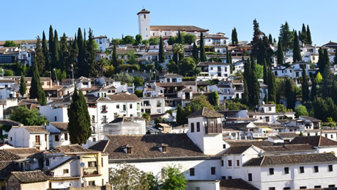
Albayzin
Eeti and Tinja

Slide 2
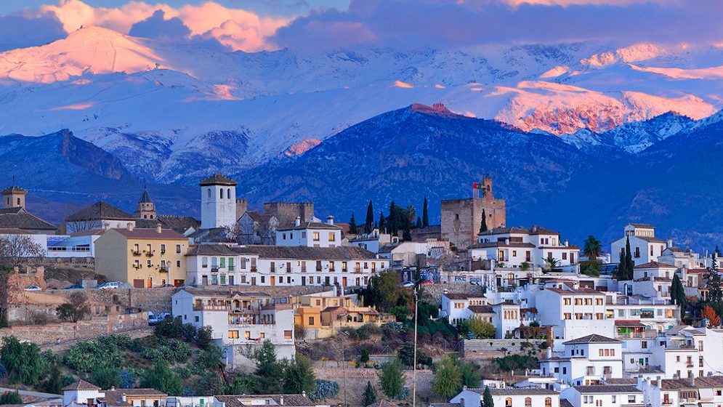
What is Albayzin
Albayzin is part of town in Granada.
It is a Unesco World Heritage Site

Slide 3
Albayzin

Slide 5
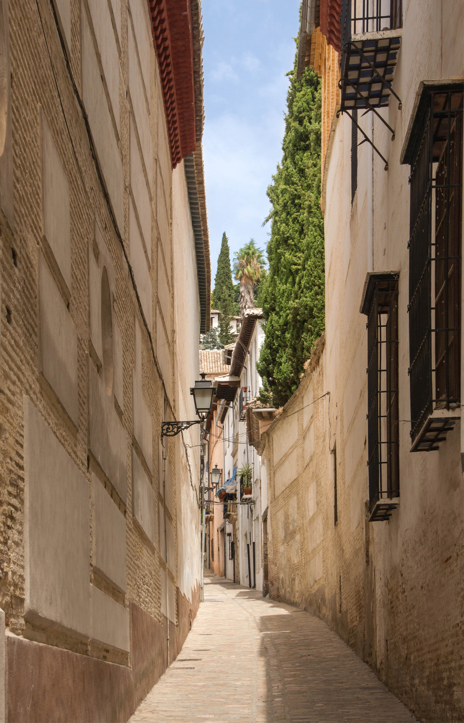
The area
There is narrows and complicated alleys
There you can see Alhambra
Albayzin have Arabic baths, Granadas archaeological museum and church of San Salvador

Slide 6
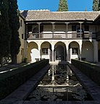
Information
Muslims lived in the city
They called big houses and palaces carmen
It was the place where the first Siri court was built in the eleventh century
Albayzin is the oldest part of Granada

Slide 7
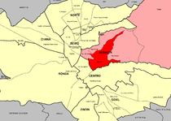

Slide 8
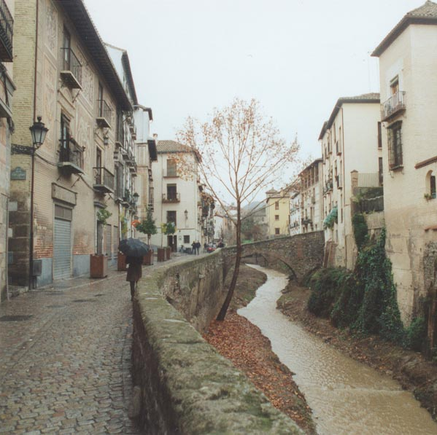
data sources
https://www.lovegranada.com/places/albaicin/
https://es.wikipedia.org/wiki/Albaic%C3%ADn

