Slide 1
Olive Oil Mill
Jani Virkkunen and Nelli Souru

Slide 2
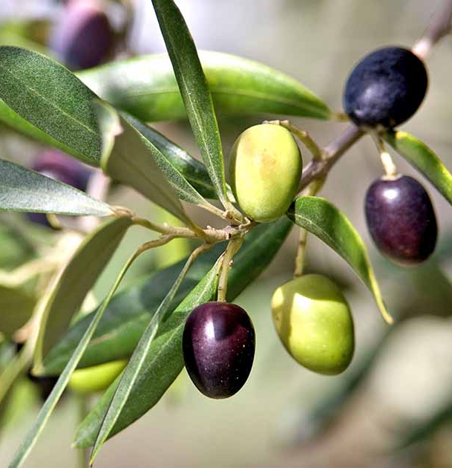
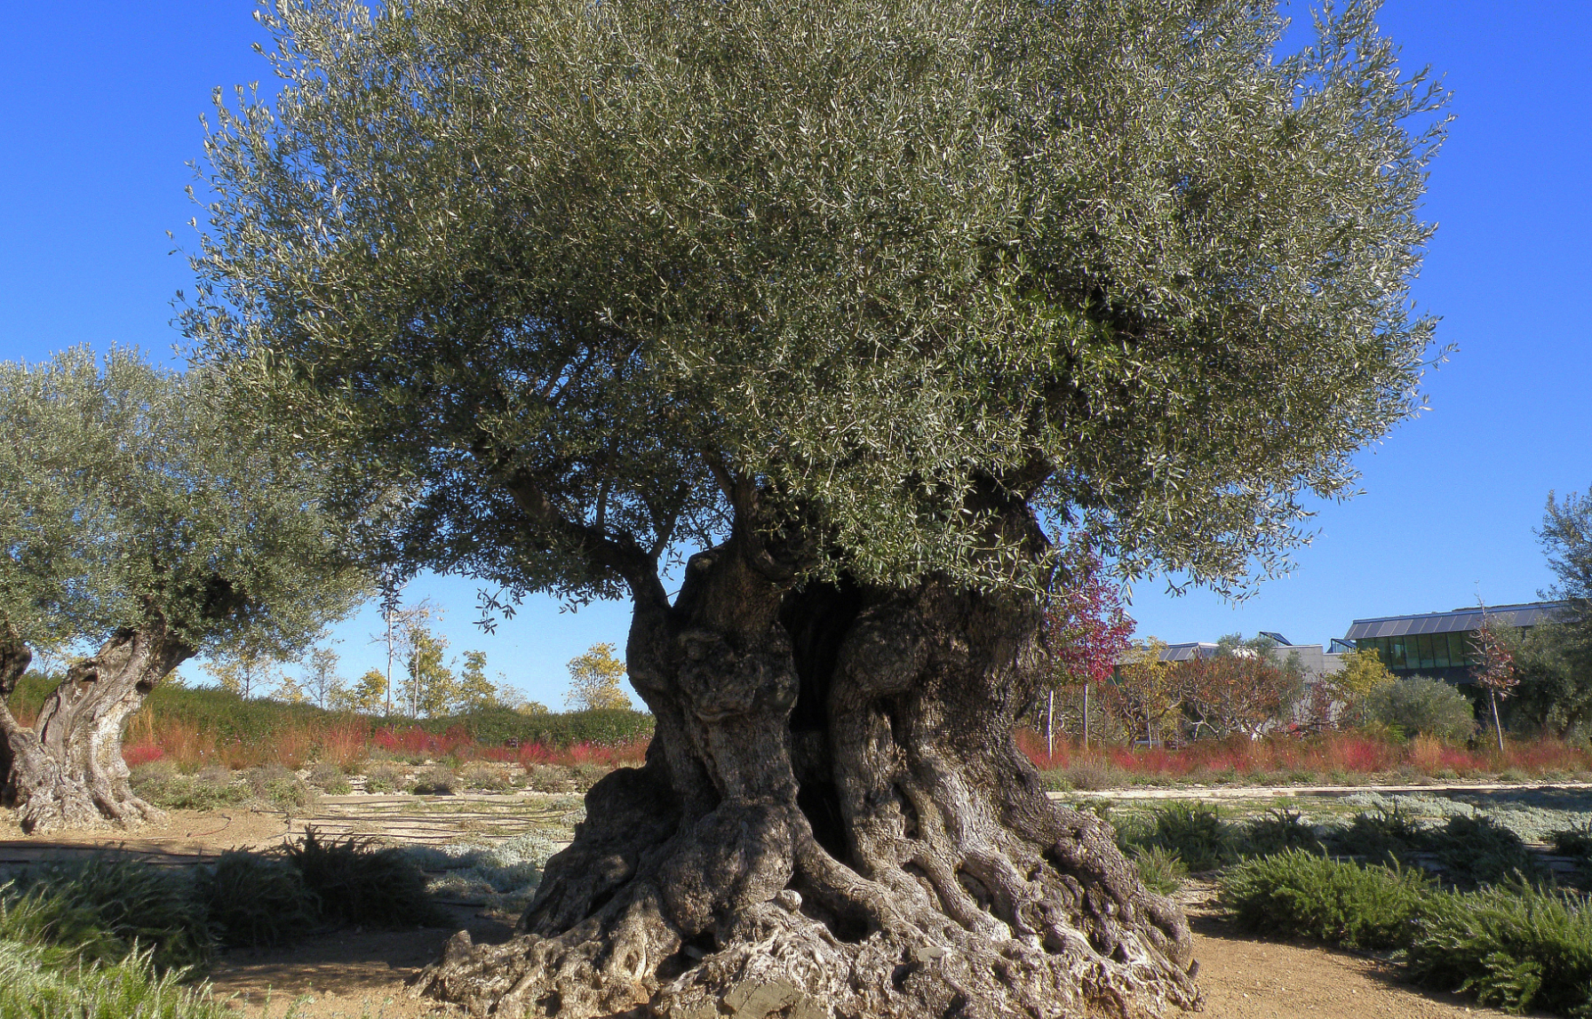
General information
Source: https://simple.wikipedia.org/wiki/Olive_tree
The olive tree height usually from 3-12 meters or more and it grows about 15-20 kilograms of olives each year.
The trees grow in climate where the summer is hot and dry and winter cool. They grow in subtropical and mediterranean areas.
There is one harvest from December to January in a year. They first pick the good ones by hand and after that the rest with a machine.
In 2019 there were about 6 000 000 tons of olives produced in Spain.

Slide 3
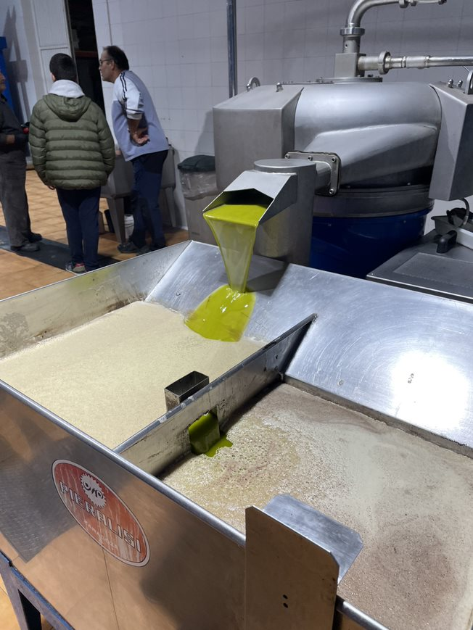
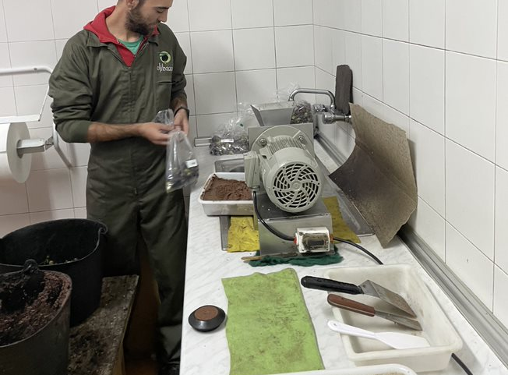
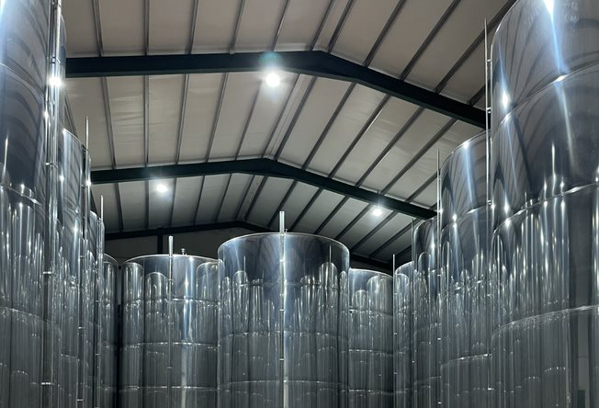
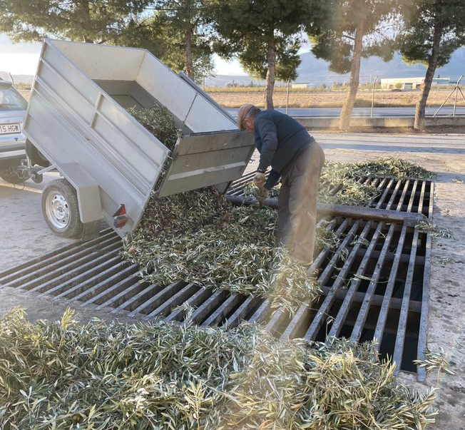
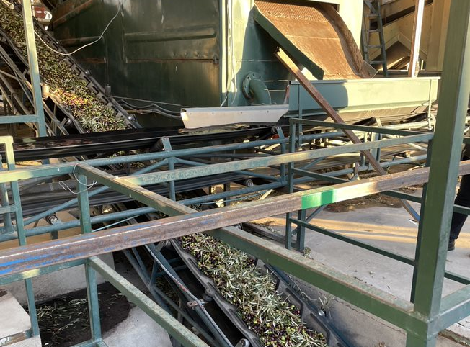
Different stages of production
First the olives are harvested in the olive farm.
Then the olives are delivered from the olive farm to the olive oil mill.
After that the olives are weighed ,washed and pressed.
After pressing they test out what percentage of the olive has oil in them from the olive paste.
After that they start the kneading operation where the olive oil is extracted from the olive paste.
Finally the olive oil is separated from the water and the final olive oil comes out.
Source: https://www.villacampestri.com/blog/en/olive-oil-production-steps/

Slide 4
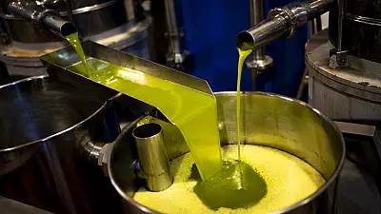
Olive oil production in Spain 2022
This year olive oil production in Spain will be lower than usual because the heatwave harmed the production of it.
Last year they produced about 1.3 million tons of olive oil. This year according to the farmers it may be lower than 1 million tons.
Source: https://www-oliveoiltimes-com.translate.goog/production/harvest-outlook-worsens-in-spain/112086?_x_tr_sl=en&_x_tr_tl=es&_x_tr_hl=es&_x_tr_pto=sc

