Slide 1
Patron Virgin's day
Edvin and Aada
21.11

Slide 2
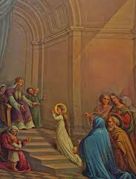
The Presentation of the Blessed Virgin Mary
In November 21st
Celebrated: Catholic, Eastern Orthodox, and some Anglo-Cathoclic churches
According to New Testament: Mary's parents (Joachim and Anne) had been childless, and they received a heavenly message that they would have a child

Slide 3
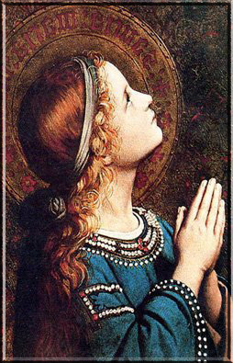
Who is Patron virgin?
The Virgin Mary is presented as a little girl with her hands crossed over her chest.
She is wearing blue and white.

Slide 4
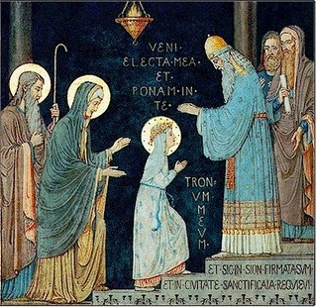
How we celebrated.
We had no subjects on Child virgin's day. There was a big party and we had hot chocolate and buns.
There was procession.
Some of the spanish students performed for the school.
Later on you had the opportunity to dance to music or watch ball games football.

Slide 5
Sources
Wikipedia
https://en.wikipedia.org/wiki/Presentation_of_Mary
https://www.museodelprado.es/en/the-collection/art-work/the-immaculate-conception-as-a-child/0c63700c-c6bf-4970-a69b-73f198f3105c
25.11.2022
:)

