Slide 1
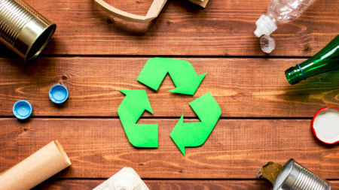
Research on recycling at shcool

Slide 2


What did we do in our research?
We studied how recycling is organized in different locations at the school and we took photos of trash and garbage.
Our research targets were the following places: schools corridors and classrooms, teachers’ study room, teachers´ lounge, copy room, school kitchen and home economic class.
Our goal was to improve waste recycling at the school in cooperation with the student union.

Slide 3
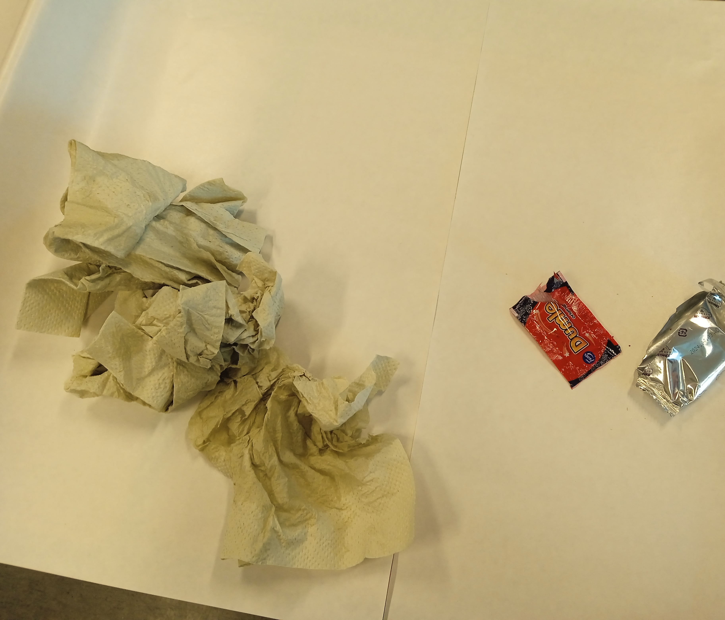
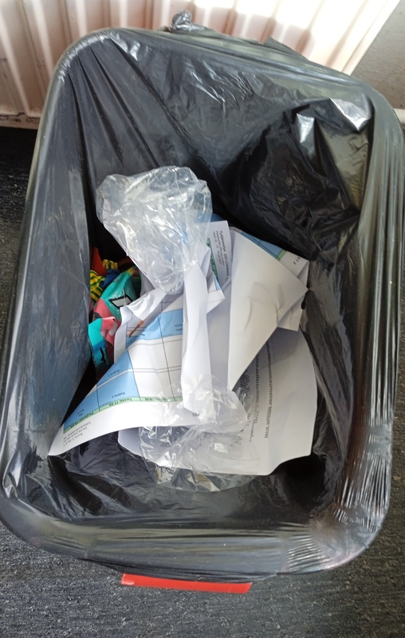
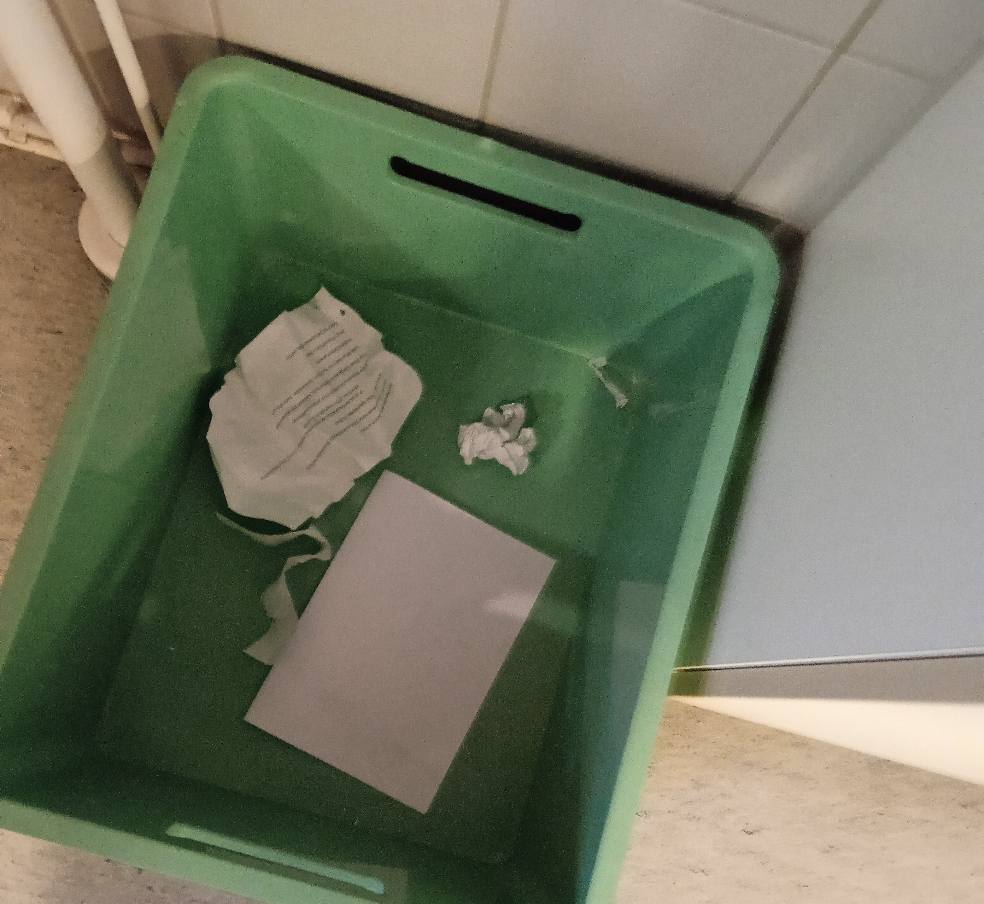
Recycling at school corridors and classrooms
There is mixed waste containers in school corridors and there are both mixed waste containers and paper collection containers in the classrooms. From the mixed waste containers you can find for example hand towel paper, bottles and candy wrappers.

Slide 4
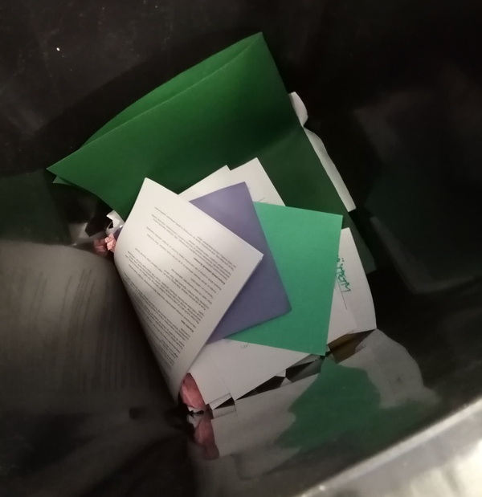
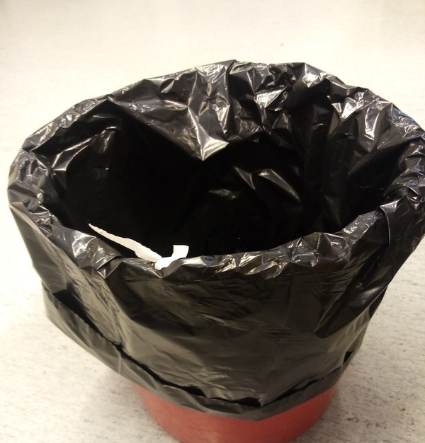
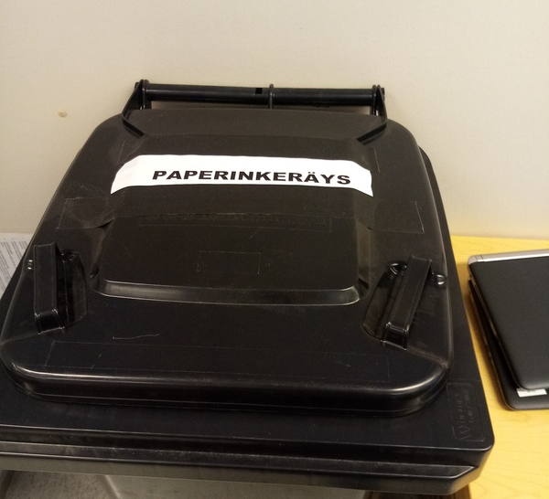
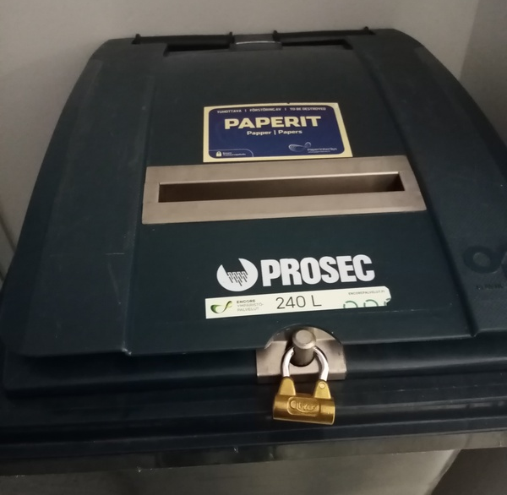
Recycling in the teachers’ study room
Each teacher has their own waste paper
bin in their own workspace.
There is a general mixed waste bin, paper
collection container (for books) and secure
paper collection in the teachers’ work room.

Slide 5
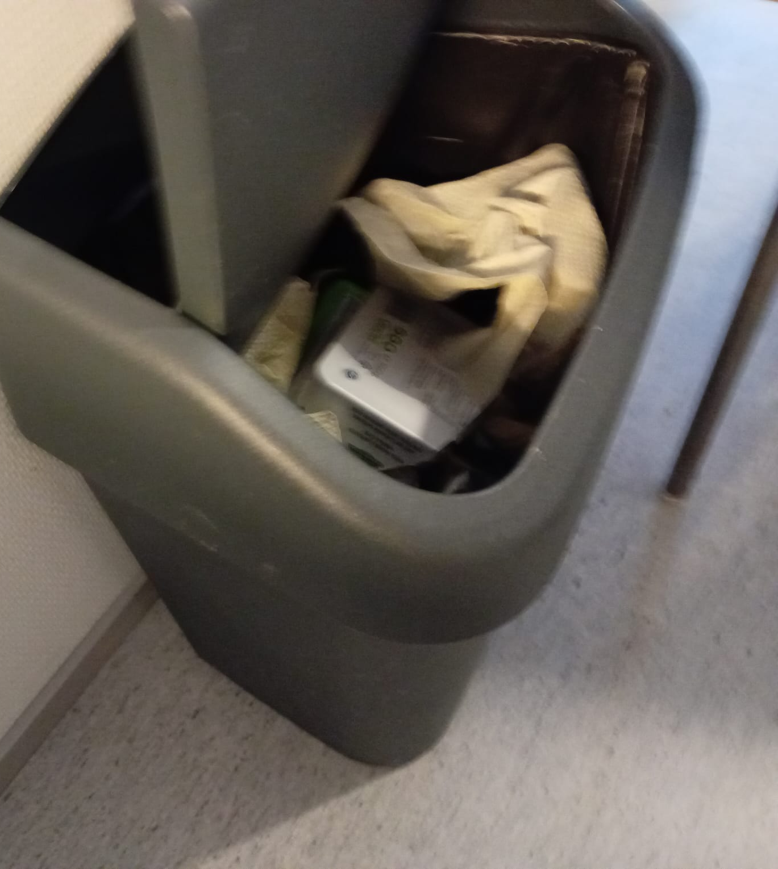
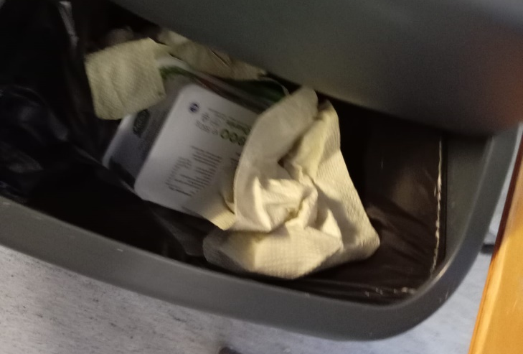
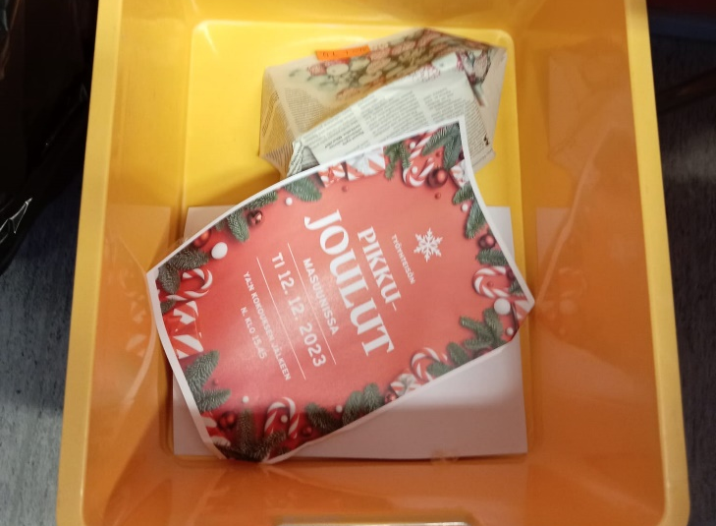
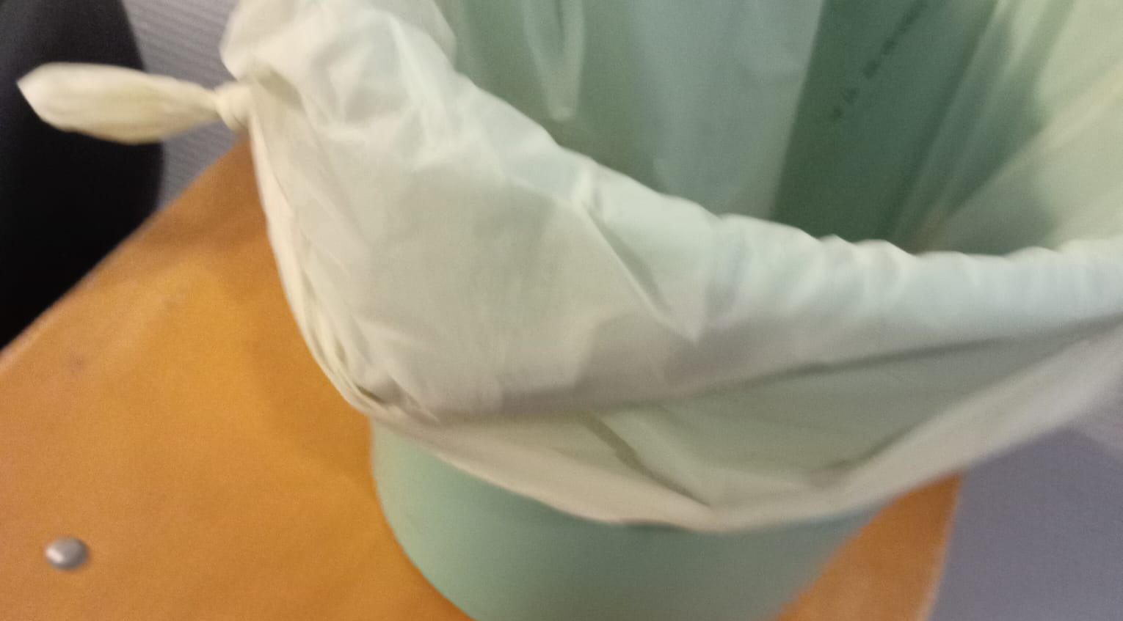
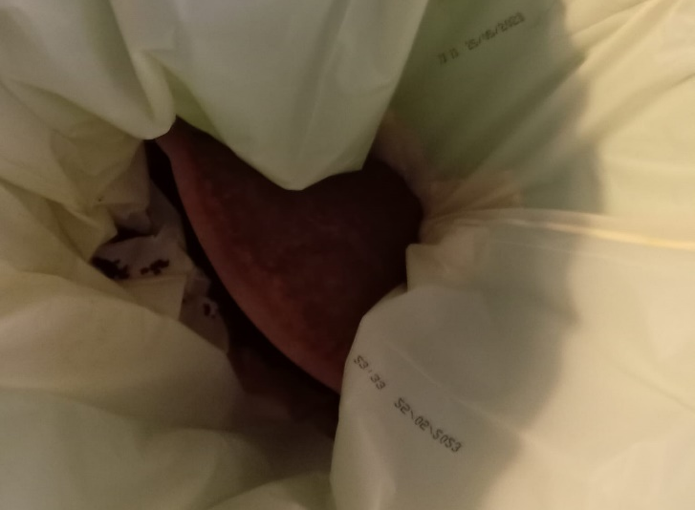
Recycling at teachers´ lounge
There are mixed waste container, paper collection container and bio-waste container in the teachers’ lounge. There are plenty of plastic, metal or cardboard wrappers from ready-made food in the mixed waste container.

Slide 6
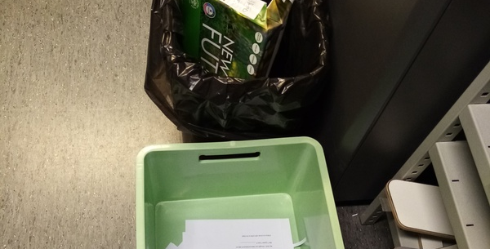
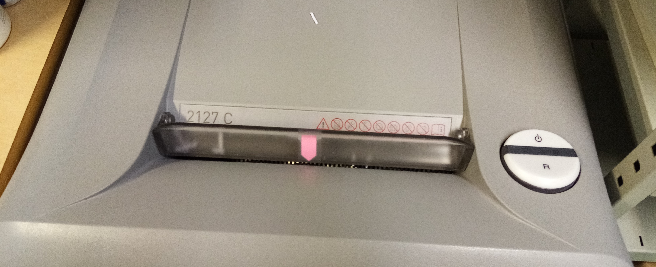
Recycling in the copy room
The copy room has a paper collection container, mixed waste container and a paper shredder.

Slide 7
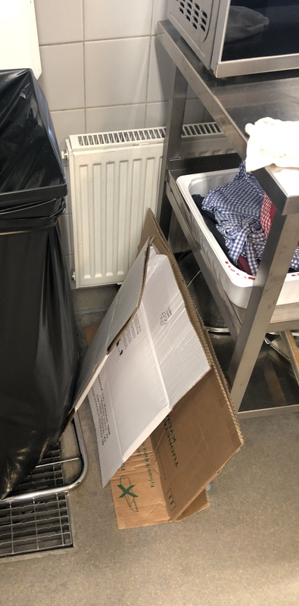
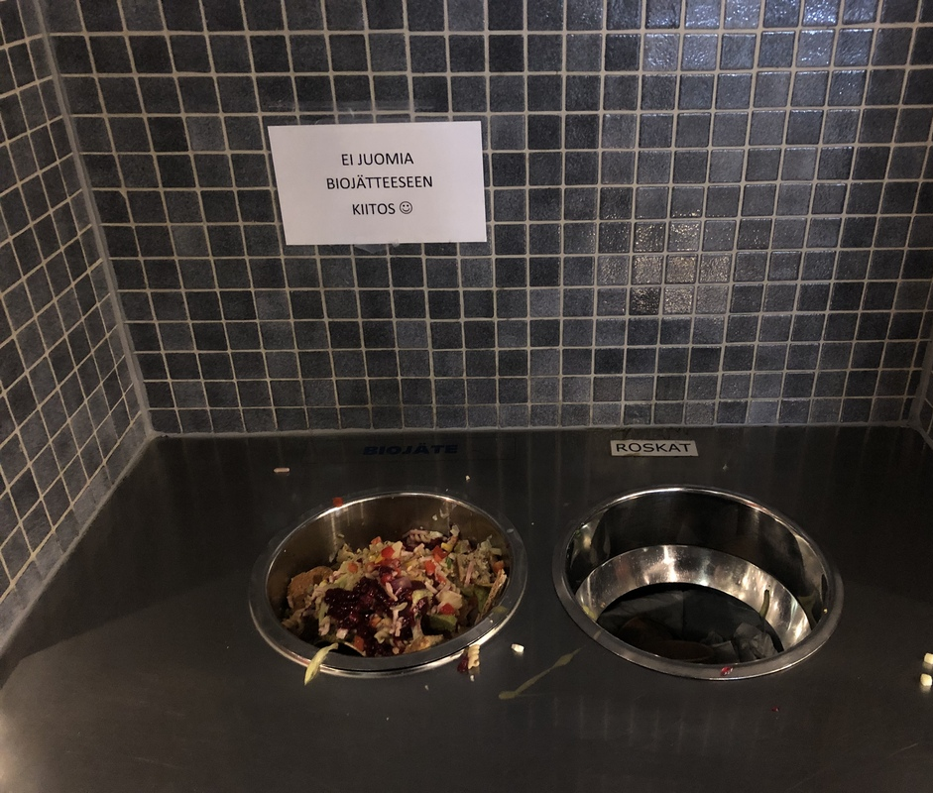
Recycling in our school kitchen
We recycle bio-waste, cardboard, mixed waste and glass.

Slide 8
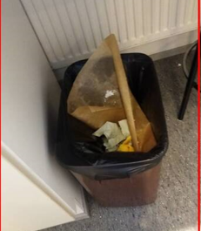
Recycling in the home economics class
Each kitchen has its own garbage can for mixed waste.
In addition, there is a common garbage point for metal, bio-waste and glass in the class.
The mixed waste containers in question are emptied after lessons, and the metal, bio-waste and glass rubbish bins are emptied after the school day.

Slide 9
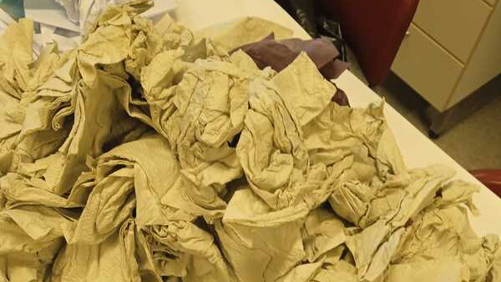
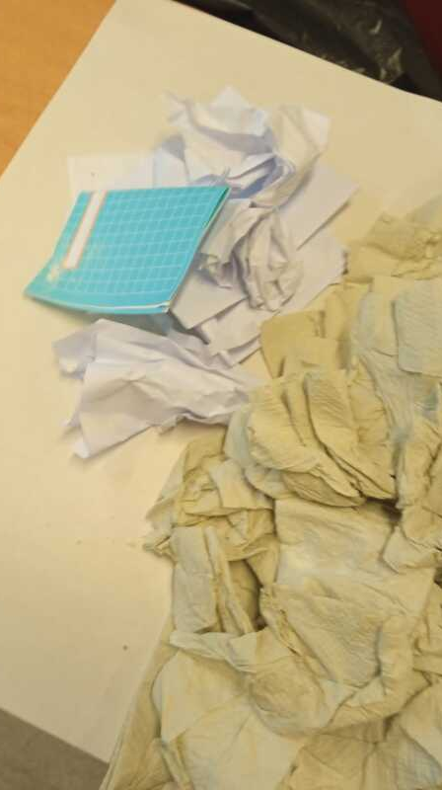
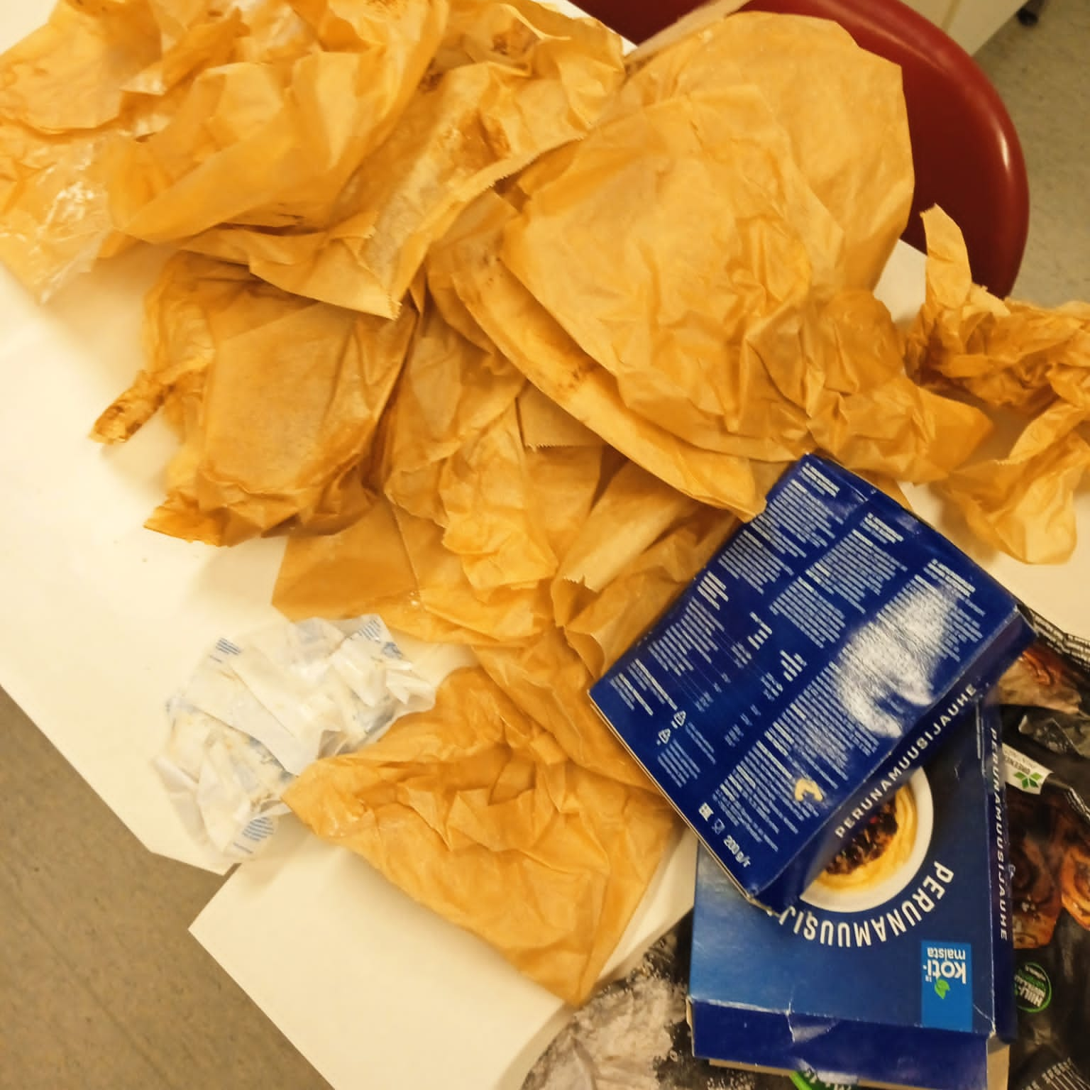
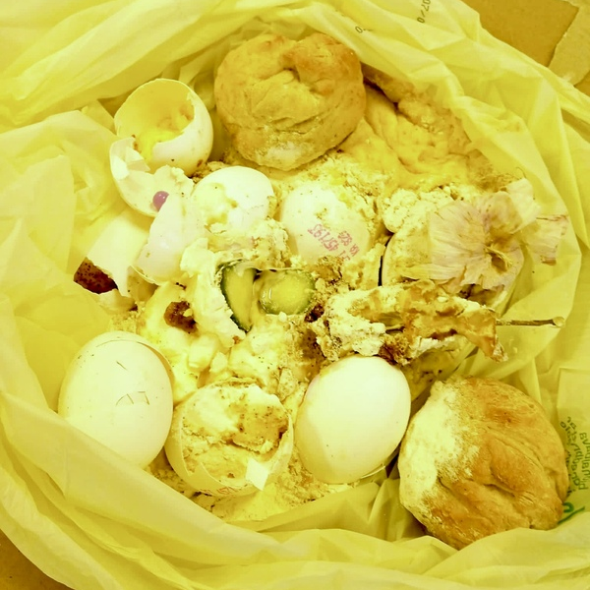
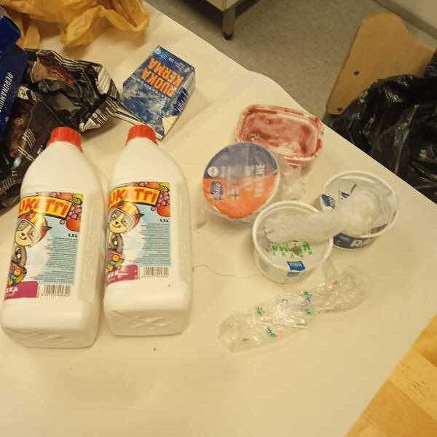
Pictures of home economic class mixed waste
There is bio-waste, plastic and different kind on paper (writing paper, cardboard, baking paper and a lot of hand towel paper).

Slide 10
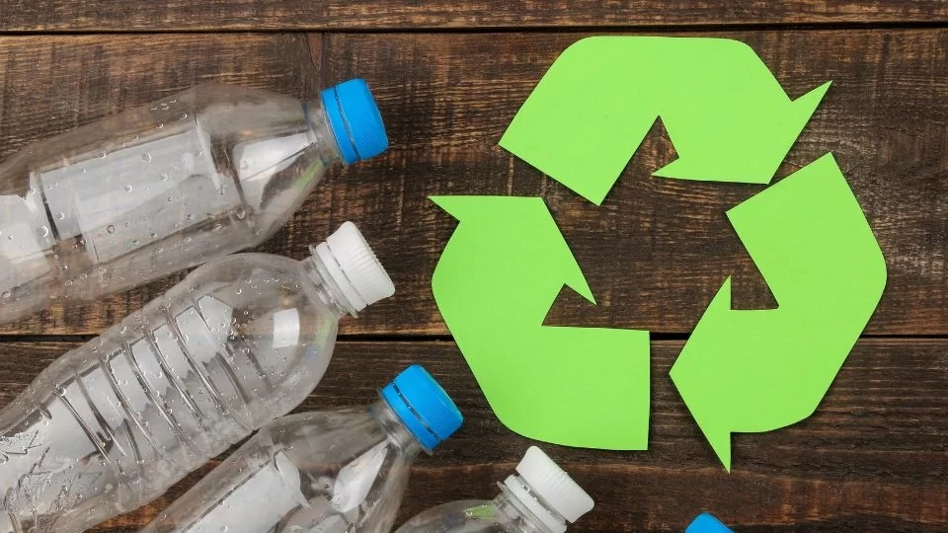
What is our recycling problem?
Our problem is that there is no recycling bins for plastic, so it is thrown into the mixed waste. We try to reuse plastic packaging whenever possible, but most plastic cannot be reused at school .

Slide 11
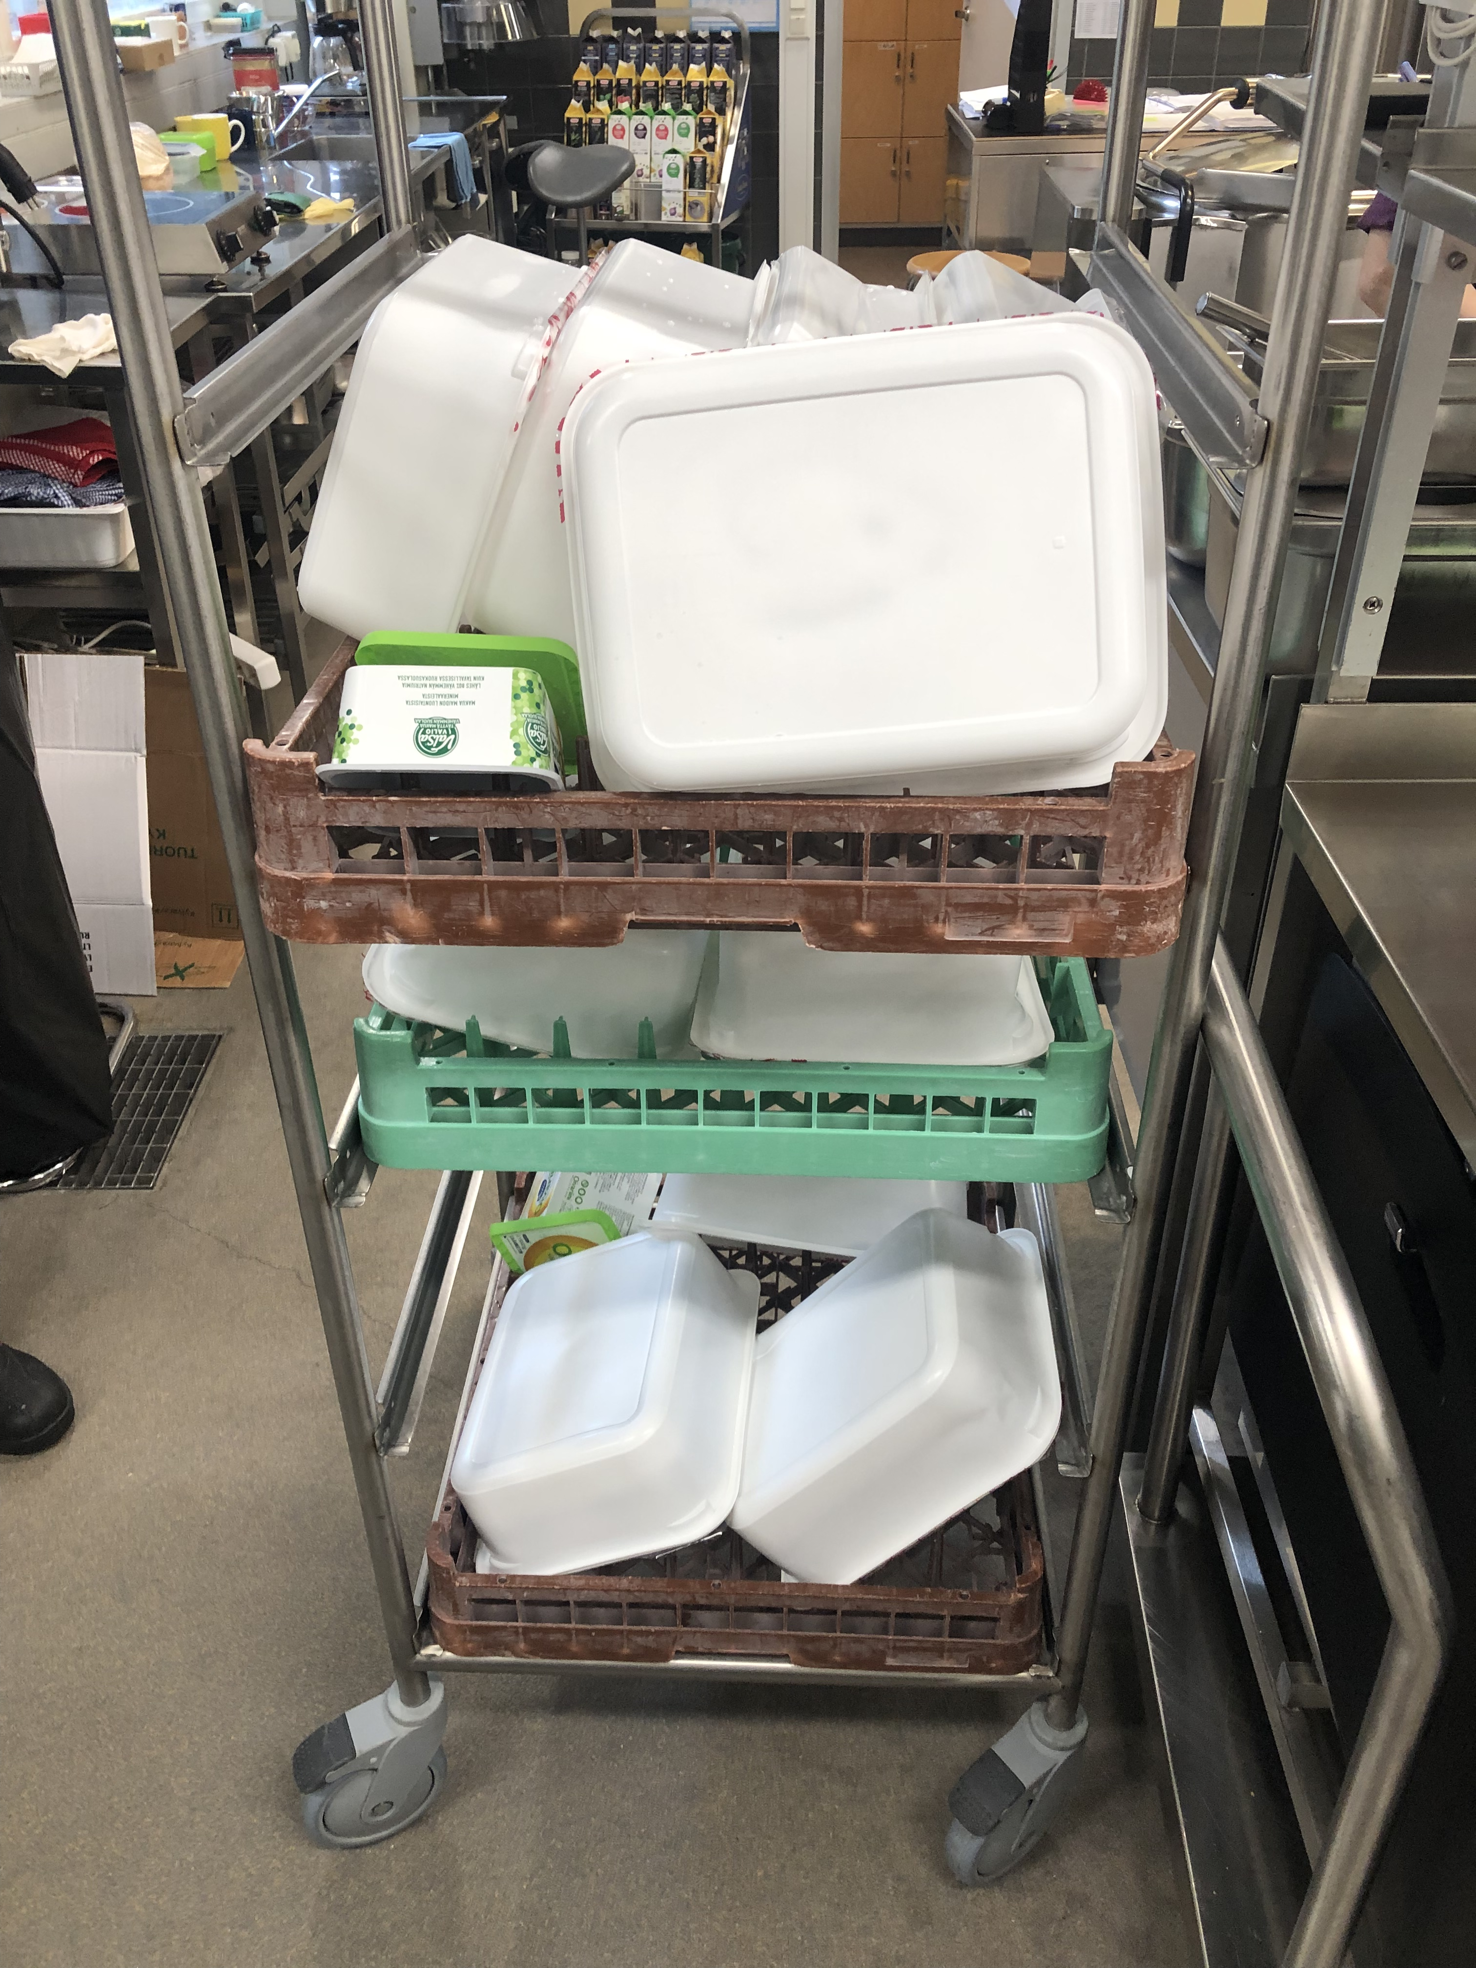
An example of reusing plastic packaging in the school kitchen

Slide 12
Cooperation with the students’ union – increasing plastic recycling at our school!
What kind of recycling containers are needed?
Where recycling containers are needed?
What prize recycling bins are available?
With whom the student union cooperates in this matter?
Will the organizing of the plastic recycling in Petäjävesi municipality be part of Petäjävesi municipality’s climate plan?
This work will continue in the coming years.

