Slide 1
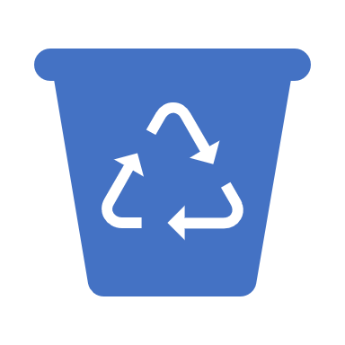
Research on recycling at home

Slide 2
We counted for a week the amout of waste we produced at our household (2 adults and 2 teenagers).
We recycle bio waste, glass, mixed waste, plastic, paper, cardboard and metal.

Slide 3
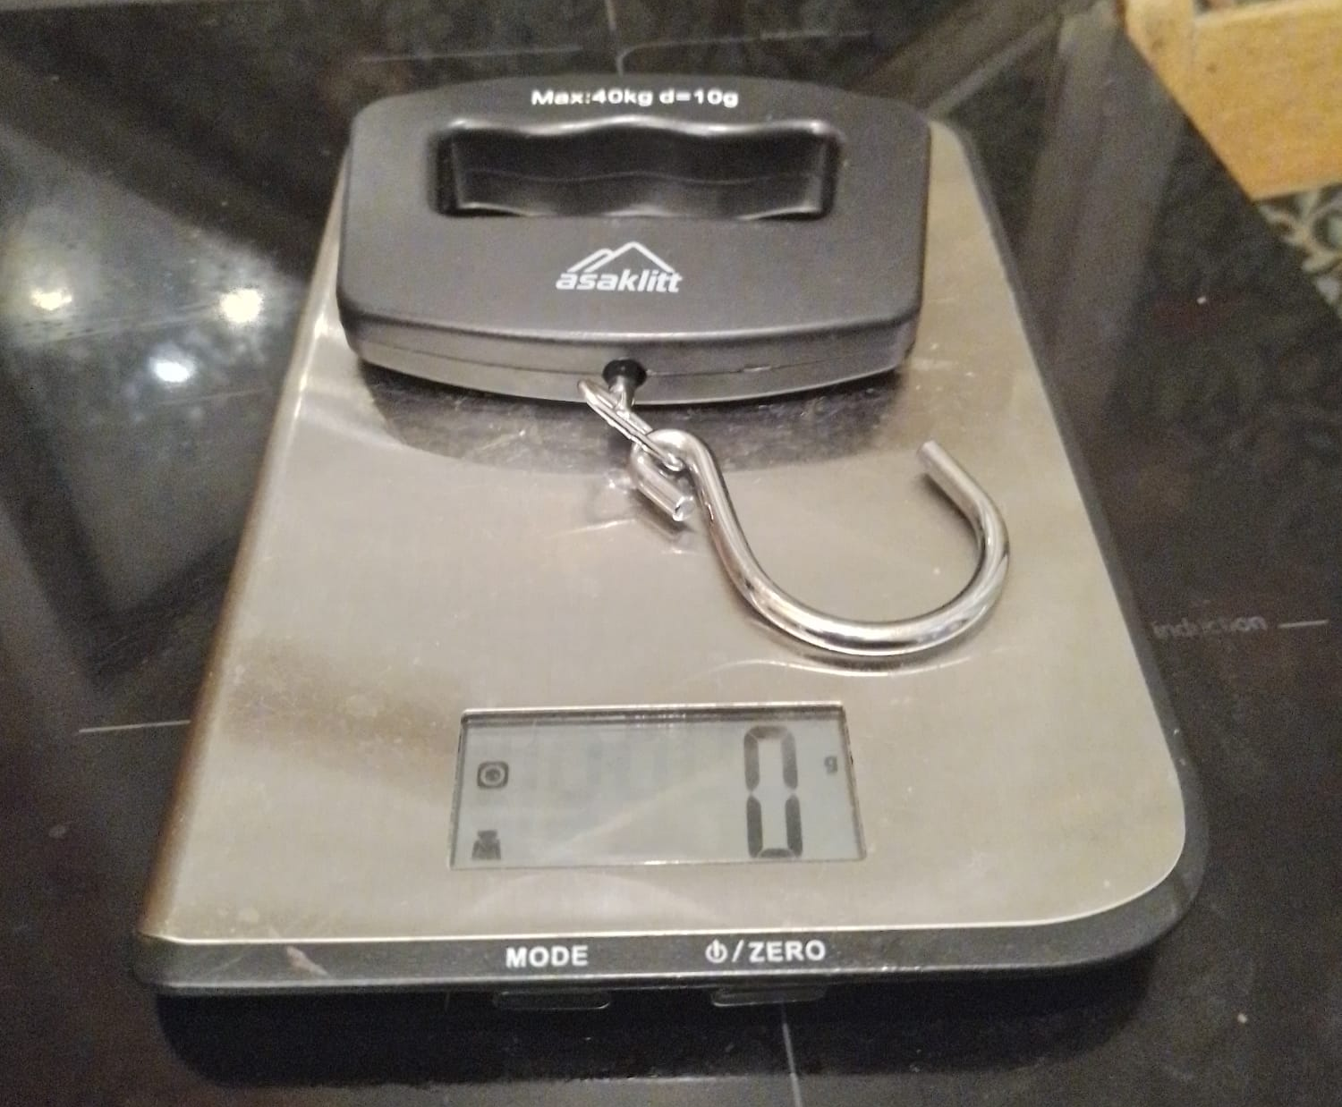
For weighing the waste we used kitchen scale and a scale that´s used for weighting fishes.

Slide 4
Total amount of waste:
Type of waste | Weight of wastes
Plastic | 480 g
Bio waste | 3543 g
Cardboard | 1173 g
Paper | 357 g
Mixed waste | 110 g
Metal | 230 g
Glass | 620 g

Slide 5
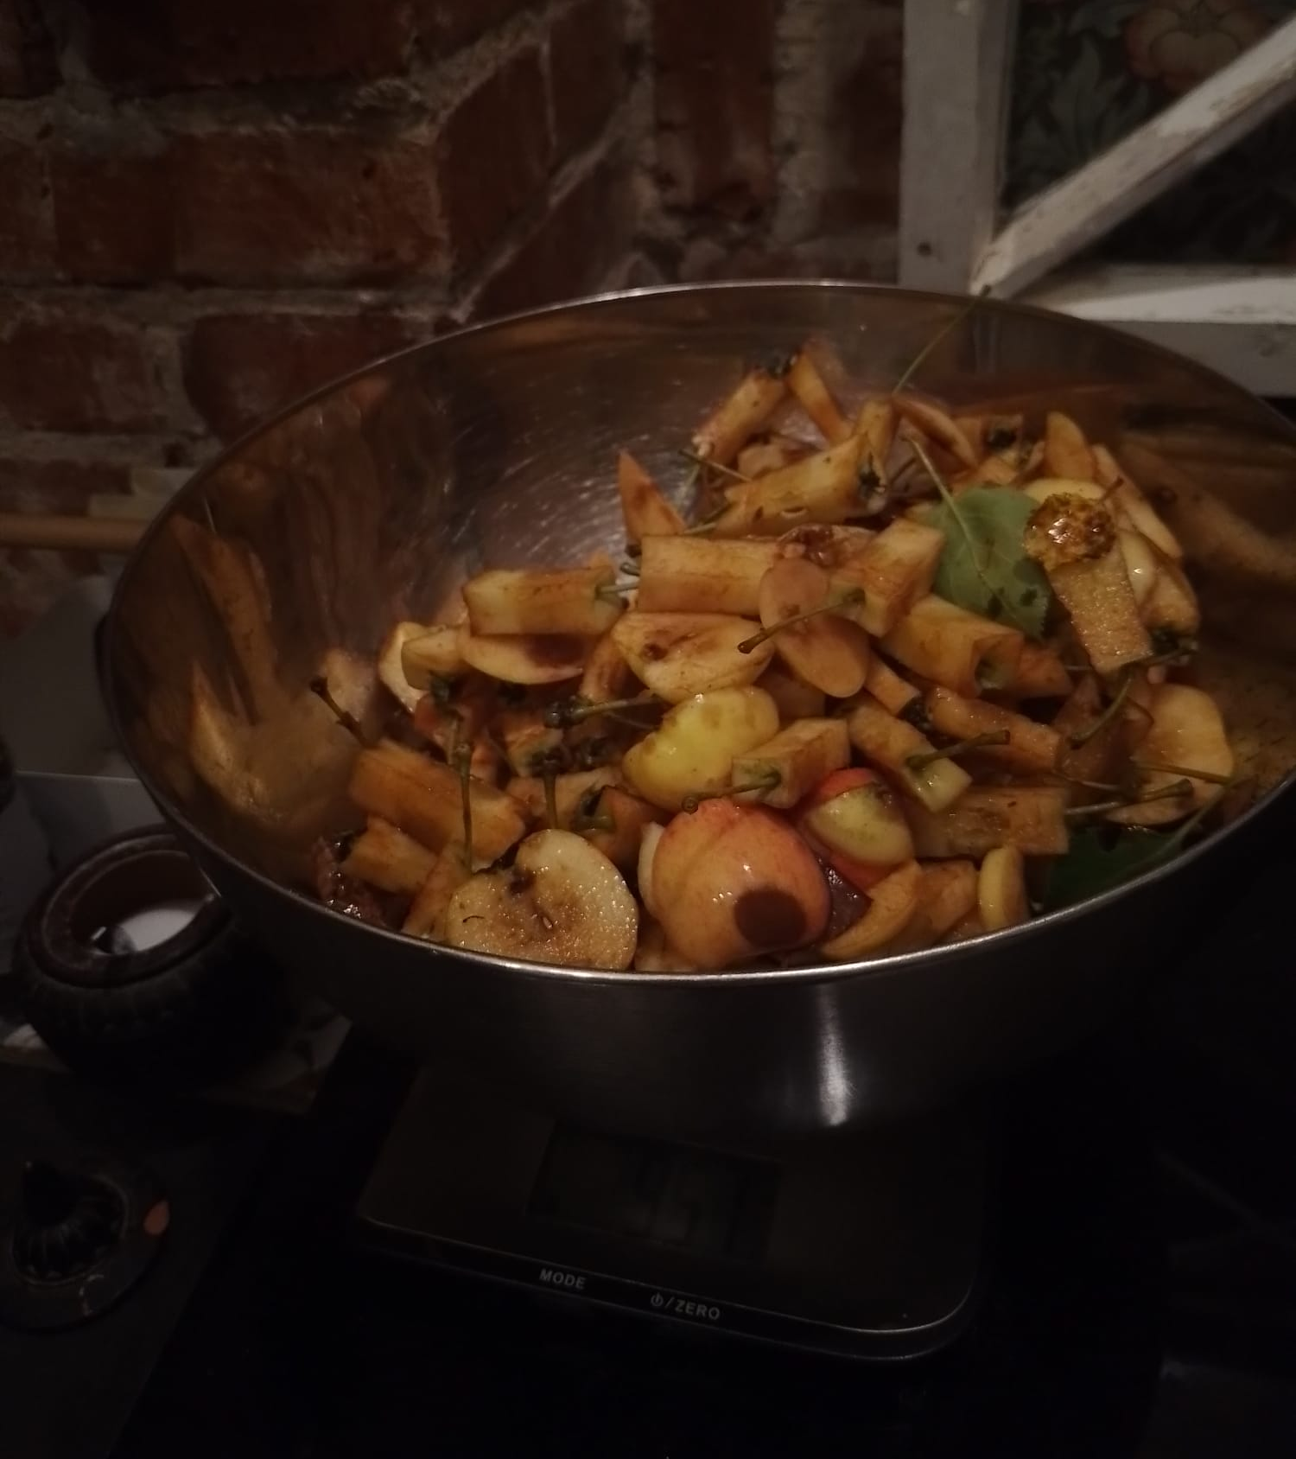
There was more bio waste than usually, because during the week we ate a lot of root vegetables and fruits. Our mom made apple jam out of our own apples, which made a lot of waste.
We have a composter in our home, so we don´t take biowaste to a recycling center. The closest recycling center is about one kilometer away. At the end biowaste creates a good soil to our garden. We also gave the peels of fruits and vegetables to our chickens.

Slide 6
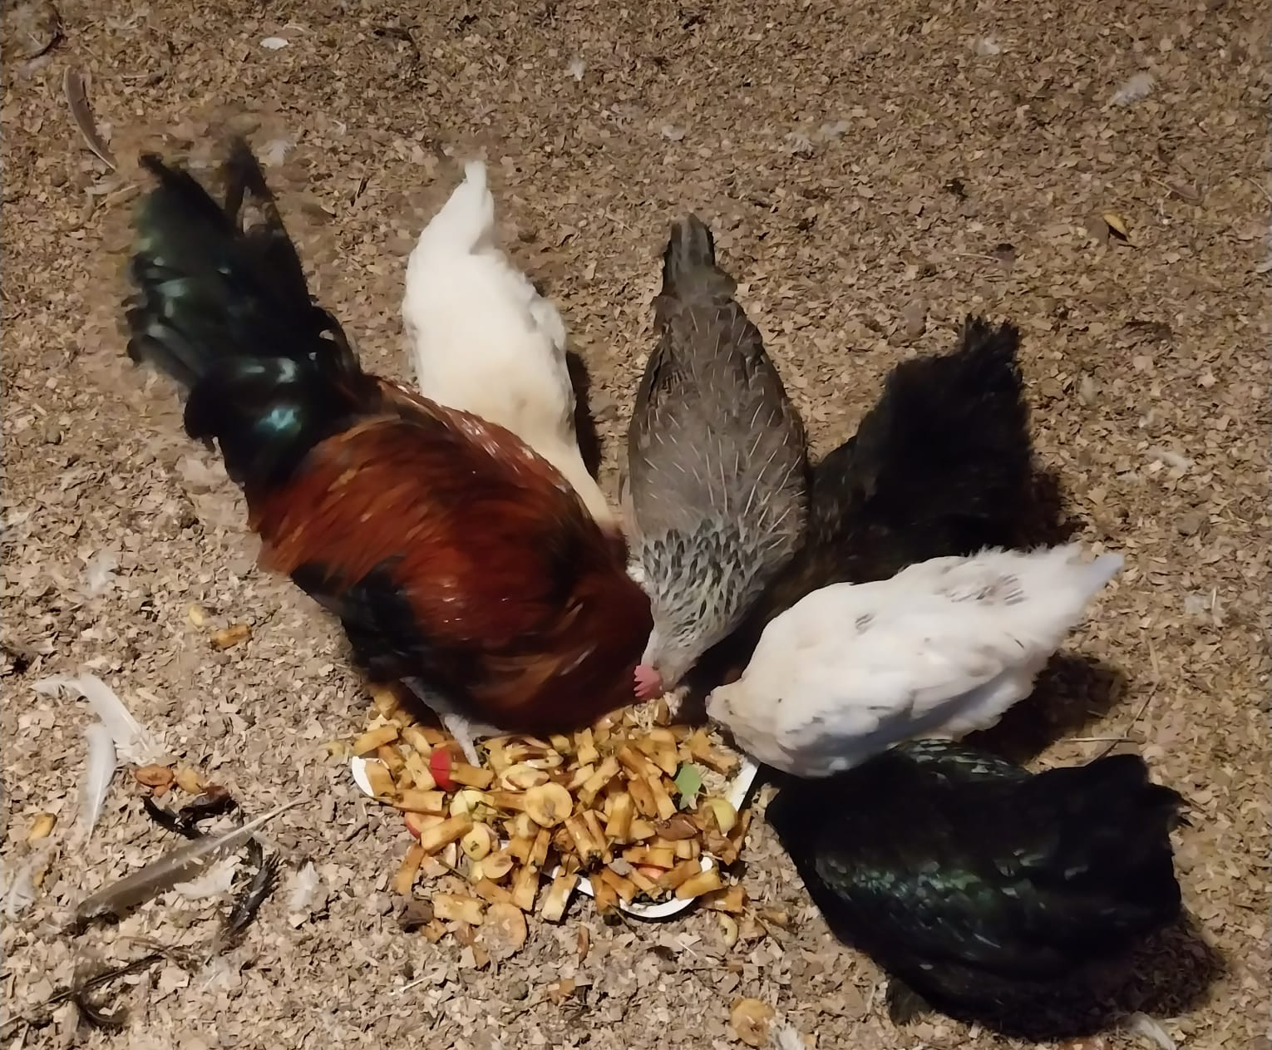
In our family we are recycling all our waste which is important.

Slide 7
Waste management in Petäjävesi
Petäjävesi has a general obligation to sort the waste.
- Recovarable waste, toxic waste and special waste has to be
sorted seperately either in recycling station or in recycling point in
the yard of apartment buildings and row houses.
Recovarable waste is a waste that can be used again by recycling or as
material or energy in producing process.
- for example waste cardboard, paper, plastic, glass, metal, waste
wood.

Slide 8
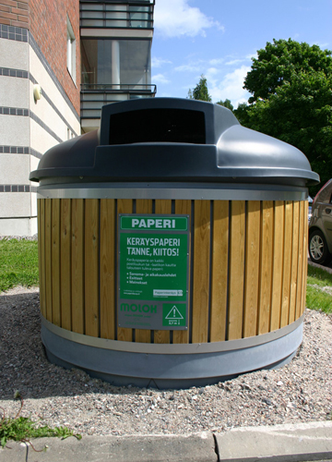
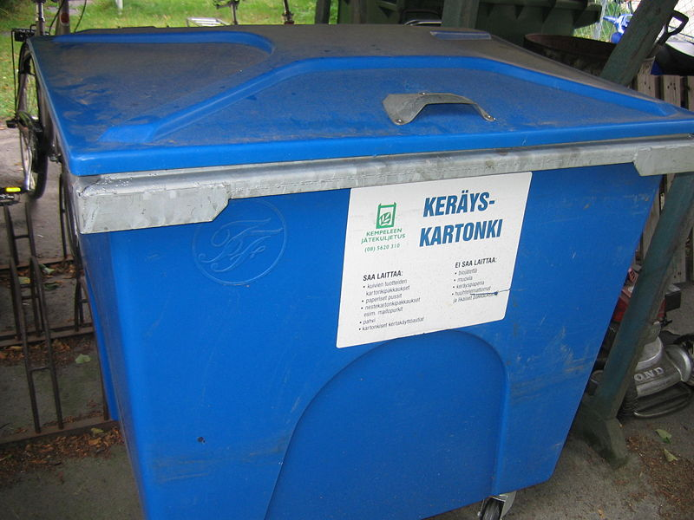
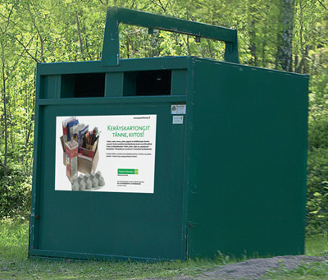
Recyclable paper, cardboard, plastic, metal and glass is collected in large containers in recycling station or smaller collection containers in recycling points in the yard of apartment buildings and row houses.
Cardboard collection containers

Slide 9
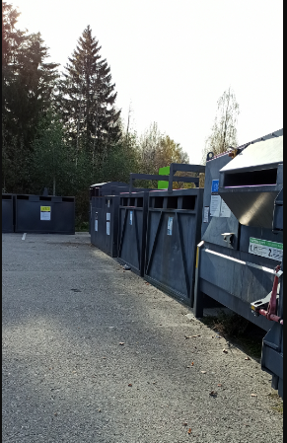
Recycling station in the yard of the local store

