Slide 1
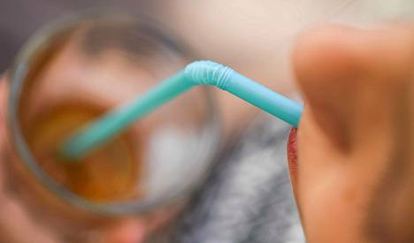
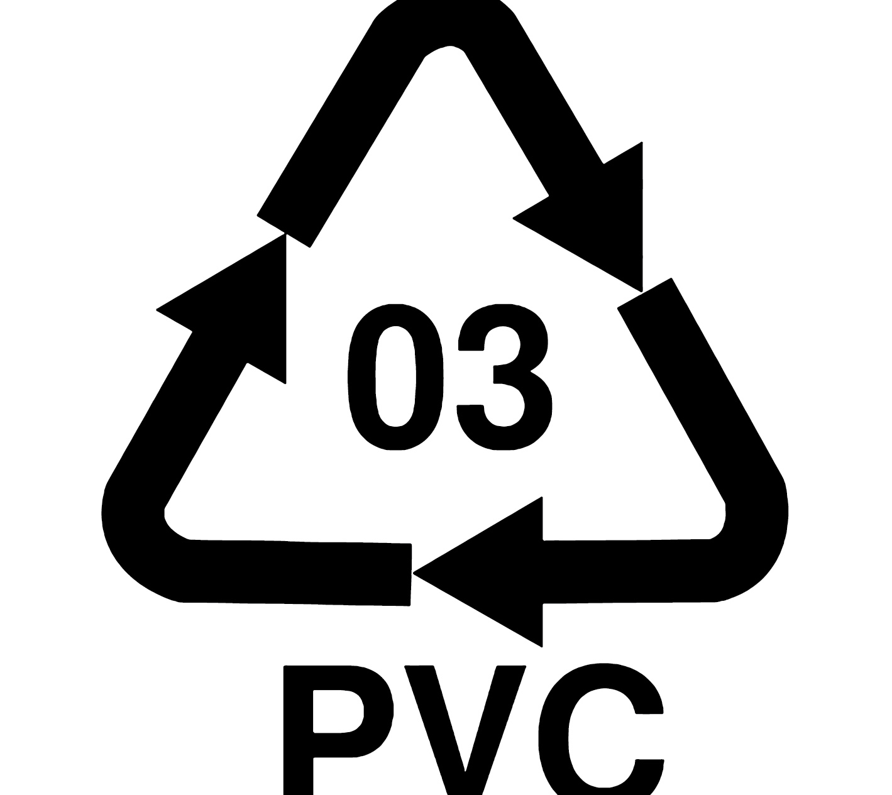


Plastics

Slide 2
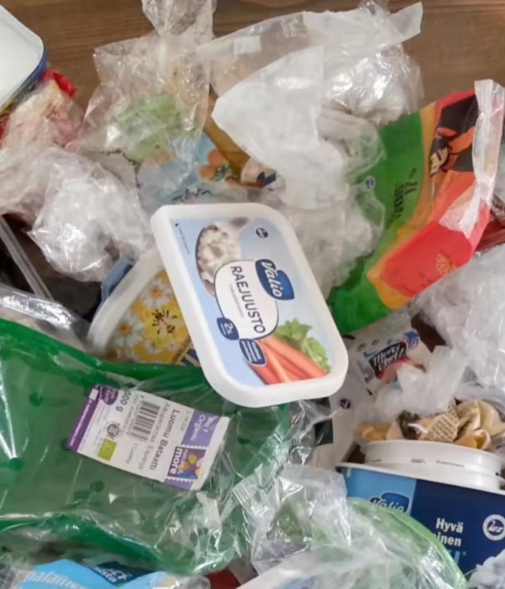

Plastics
Plastic is usually made from petroleum, natural gas and coal.
Plastics can also be made from renewable raw materials, such as plant-based biomaterial.
Plastics are made from the surplus hydrocarbon streams from fuel production, which were previously burned into the sky in the flares of oil refineries.
The plastic is light, protective, very freely shaped and colored. Plastic can be processed at a low temperature, which consumes little energy and almost no water. It is easy for humans to shape plastic. Plastic is a long-lived material.

Slide 3

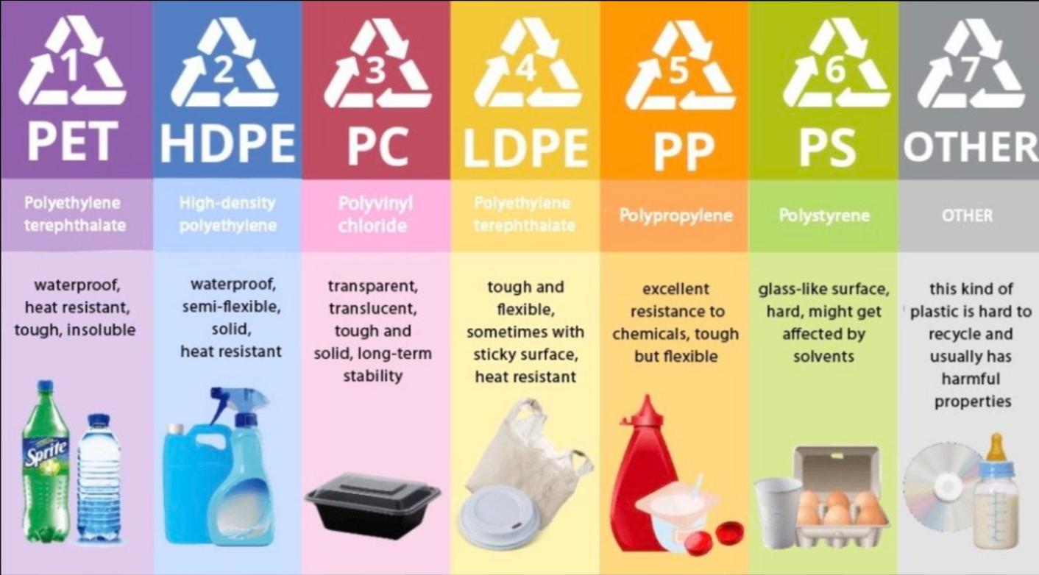
PLASTIC RECYCLING
Single-use plastic is plastic that cannot be reused. Disposable plastics include, for example, plastic bags, some medical equipment such as syringes, food packaging and packaging materials such as bubble wrap.

