Slide 1
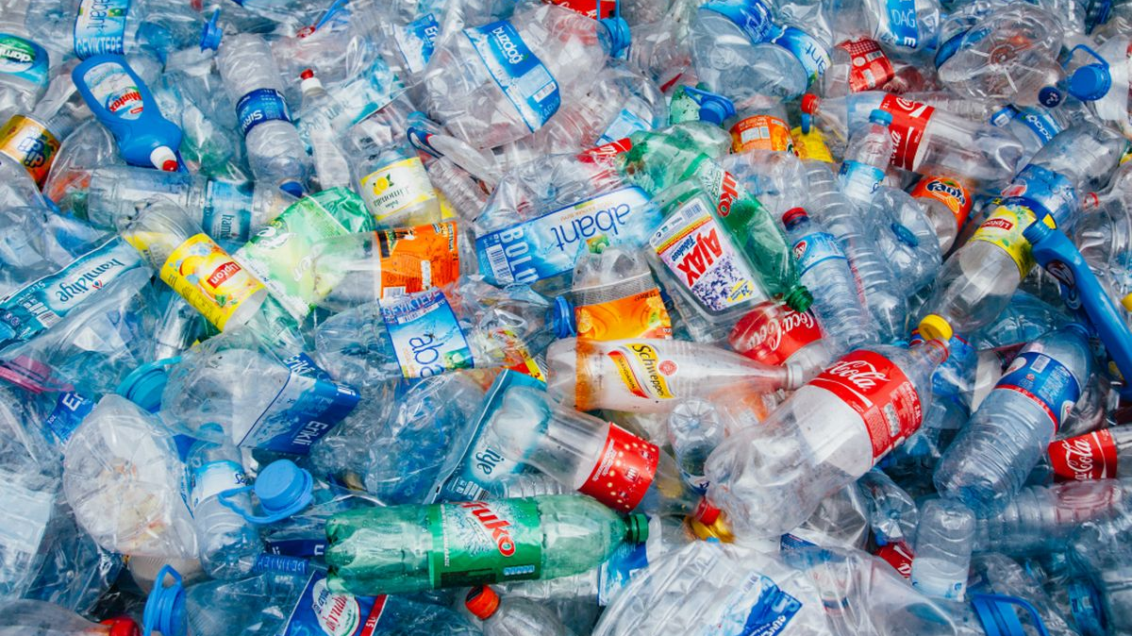
Plastic problem and EU

Slide 2
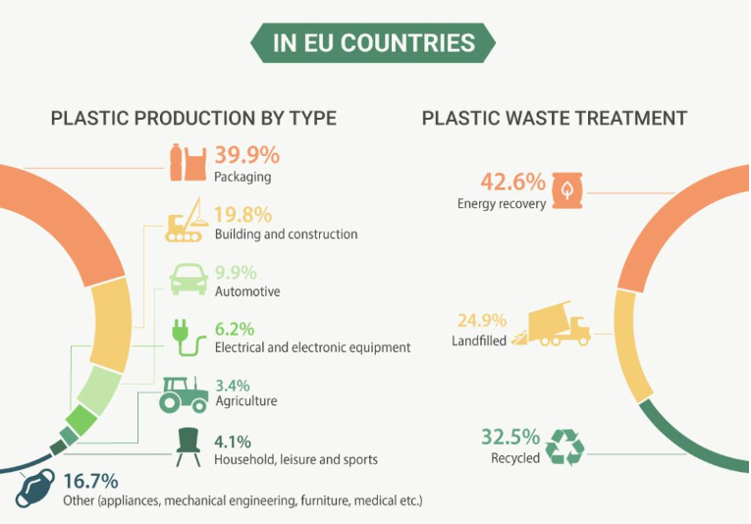

Slide 3
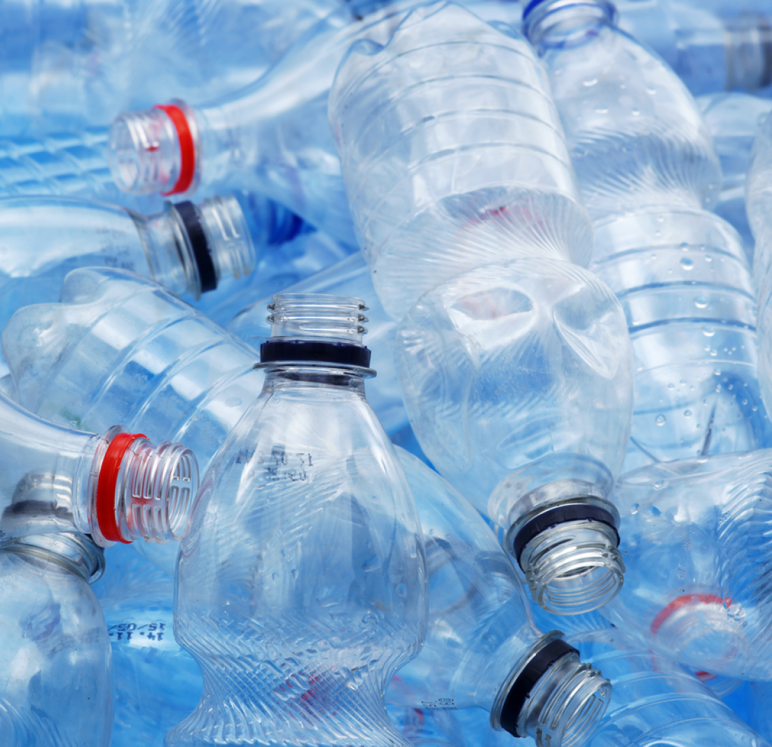
Plastic waste
EU wants to reduce plastic waste, increase it's recycling rate and minimise the release of microplastic for example from textiles and tyres.
Every year about 26 million tons of plastic waste are generated in the EU.
Less than 30% of it is recycled.
The rest either goes to landfill, is incinerated, or ends up uncollected in nature.

Slide 4
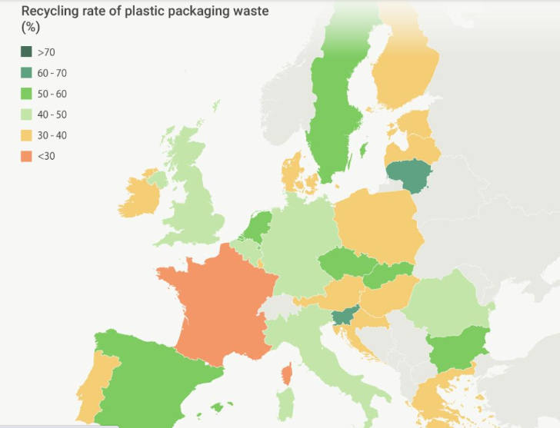

Slide 5
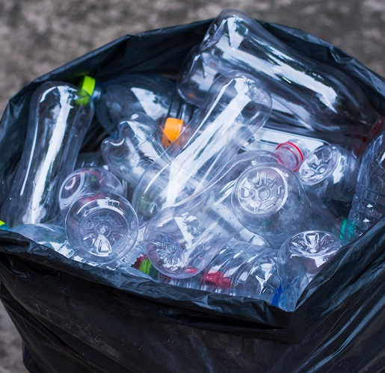
EU's solutions in plastic pollution
By 2030 all plastic packaging can be reused or recycled.
Reducing the consumption of single-use plastics and plastic bags.
Reducing the use and generation of microplastics.

Slide 6
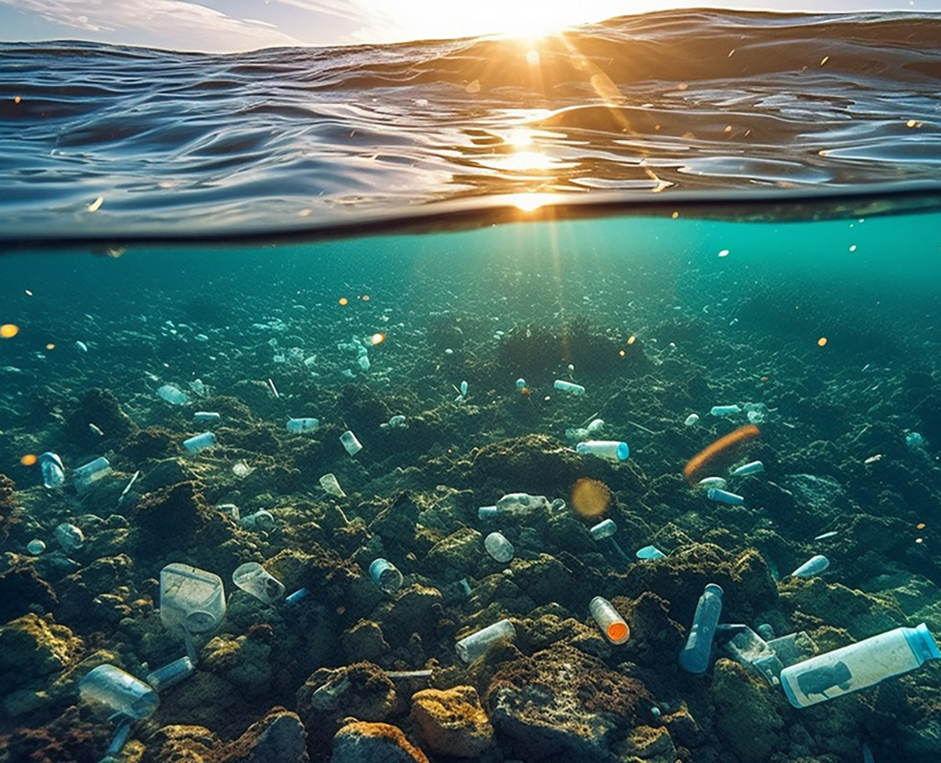
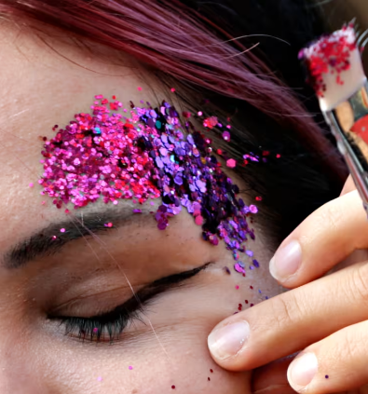
Reducing the use and generation of microplastics
EU has decided to ban to sell microplastics and products with added microplastics such as cosmetics and detergents, and to minimise the release of microplastics from textiles, tyres and paint.
The amount of microplastic decreases when the amount of plastic packaging and supports, that are often found in the sea, is reduced.​

Slide 7
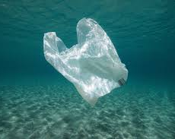
The Problem of Plastic bags
EU wants to reduce the use of plastic bags because they cause problems to the environment especially in aquatic ecosystems. Some animals eat plastic (accidentally) and plastic passes away in our food chain.
A policy goal: Most of the plastic bags should be replaced by biodegradable materials.

Slide 8
New legislation on plastic bags
In 2015 European Parliament voted in favour of halving the consumption of light-weight plastic bags by 2017 and reducing it by 80 % by 2019 (compared to 2010 level).
A mandatory charging for carrier bags in the food sector/recommendation to charge for bags in the non-food sector.
Replacing light bags that are used to wrap food (fruits, vegetables) by biodegradable and compostable bags by 2019.
.

Slide 9
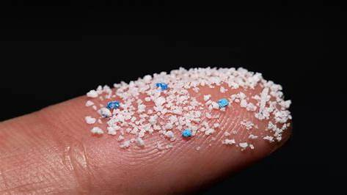
Oxo-degradable plastics are plastics that break easily into small pieces and cause microplastic to oceans. EU is banning certain single use plastics that cause oxo-degradable plastics that are found widely in the seas.
Oxo -degradable plastics

Slide 10
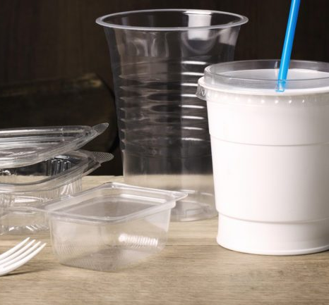
Banning single-use plastics
European union has banned
certain single-use plastics,
for example plastic plates,
cuttlery and balloon sticks.

