Slide 1
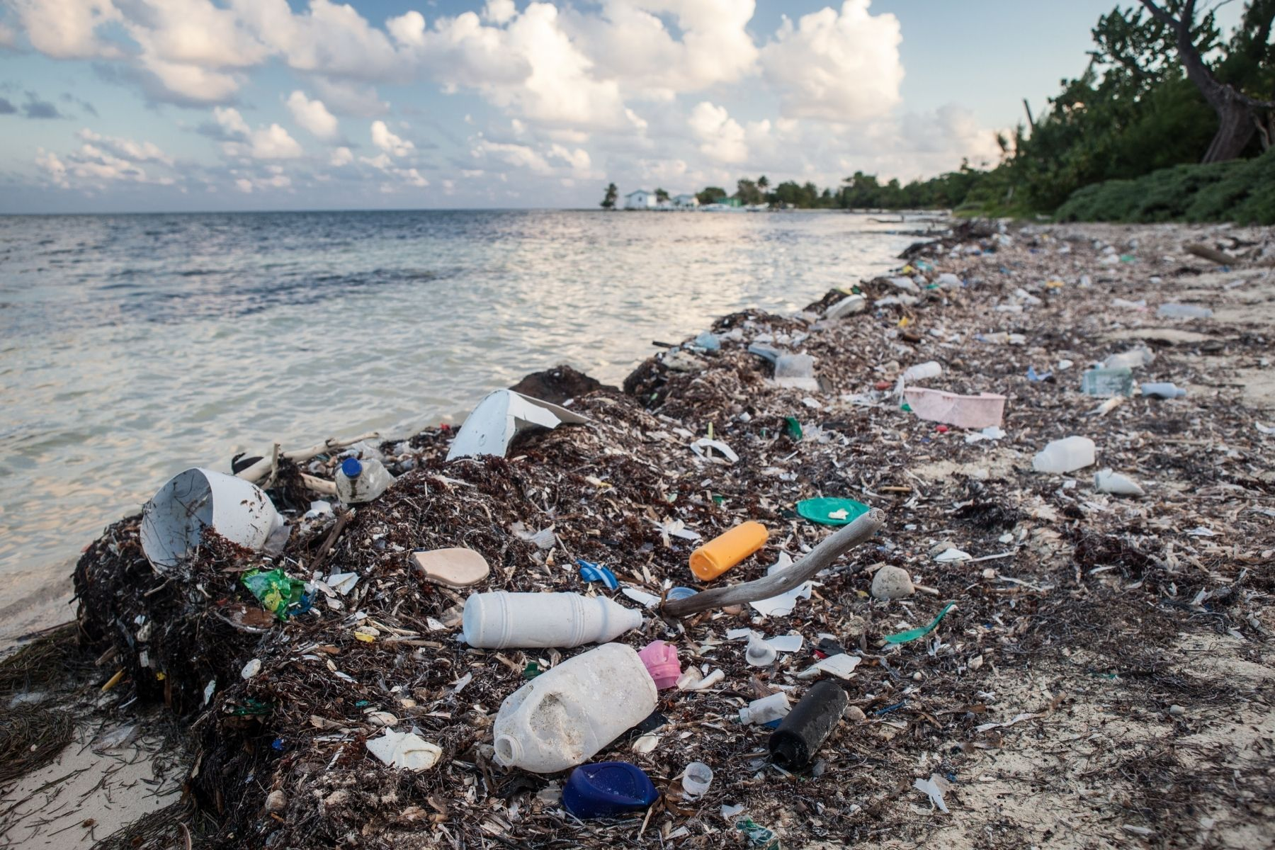
Marine plastic waste

Slide 2
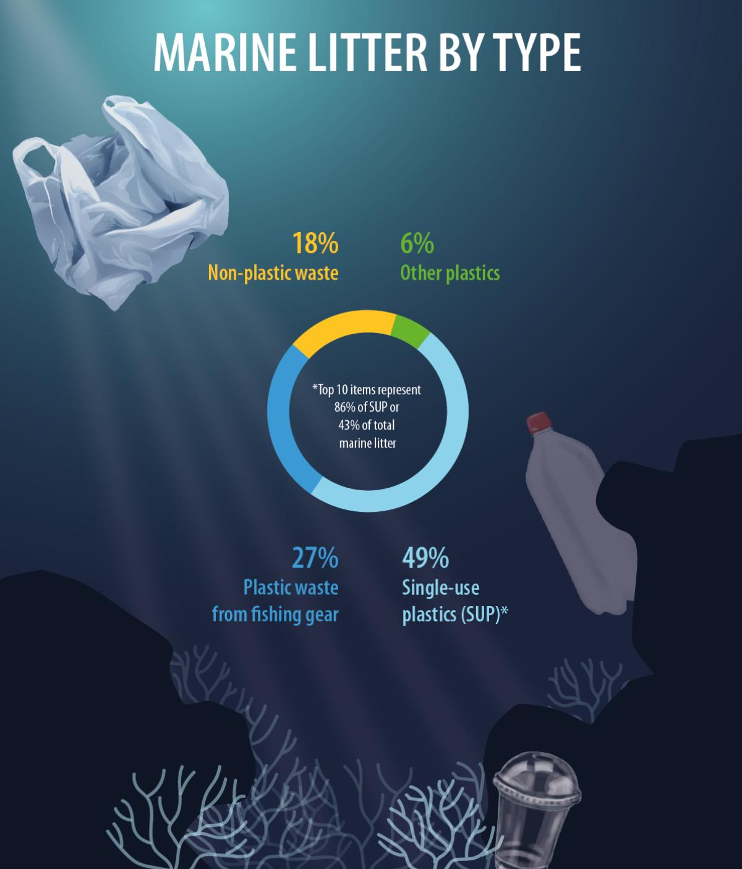
Common plastics in the oceans
Single-use plastic items are the biggest single group of waste found on sea shores: products such as plastic cutlery, drink bottles, cigarette butts and cotton buds make up almost half of all sea litter.
Other common single pieces of plastic litter in the oceans are plates, straws, drink stirrers and balloon sticks as well as fast food containers made out of polystyrene.
Also nets and other fishing gear lost in the ocean are a big problem.

Slide 3
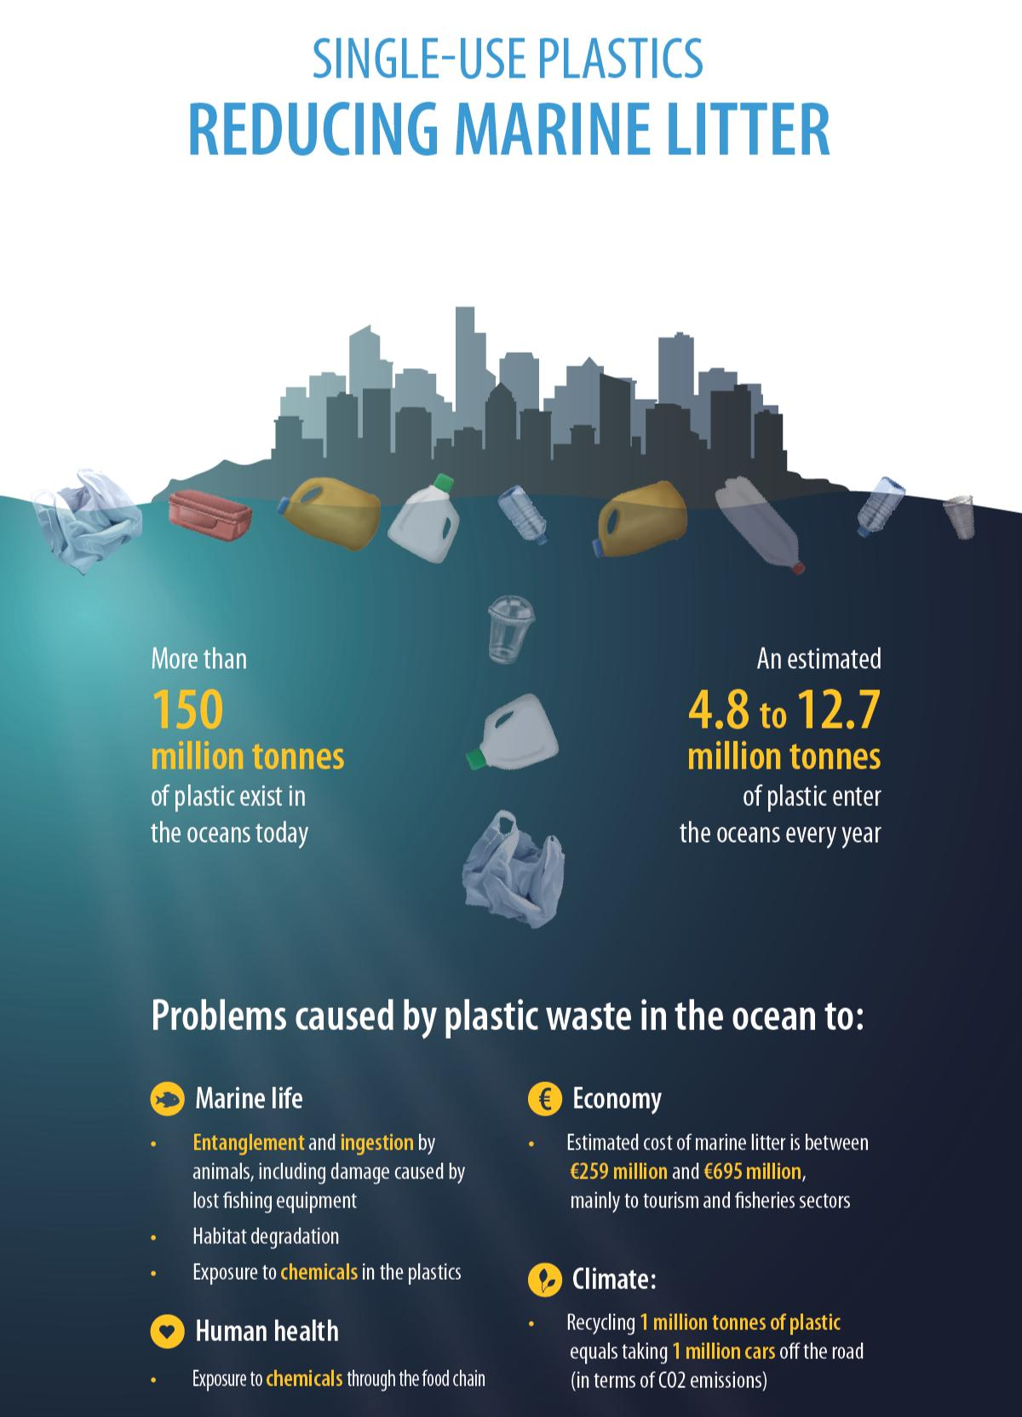
Problem
Plastic doesn’t just make a mess on the shores, it also hurts marine animals who get entangled in larger pieces and mistake smaller pieces for food. Ingestion of plastic particles can prevent them from digesting normal food and might attract toxic chemical pollutants into their organs.
Humans get plastic through the food chain. How this affects their health is unknown.
Sea litter causes economic losses for sectors and communities dependent on the sea but also for manufacturers: only about 5% of the value of plastic packaging stays in the economy – the rest is literally dumped, showing the need for a approach focussed more on recycling and reusing materials.

Slide 4
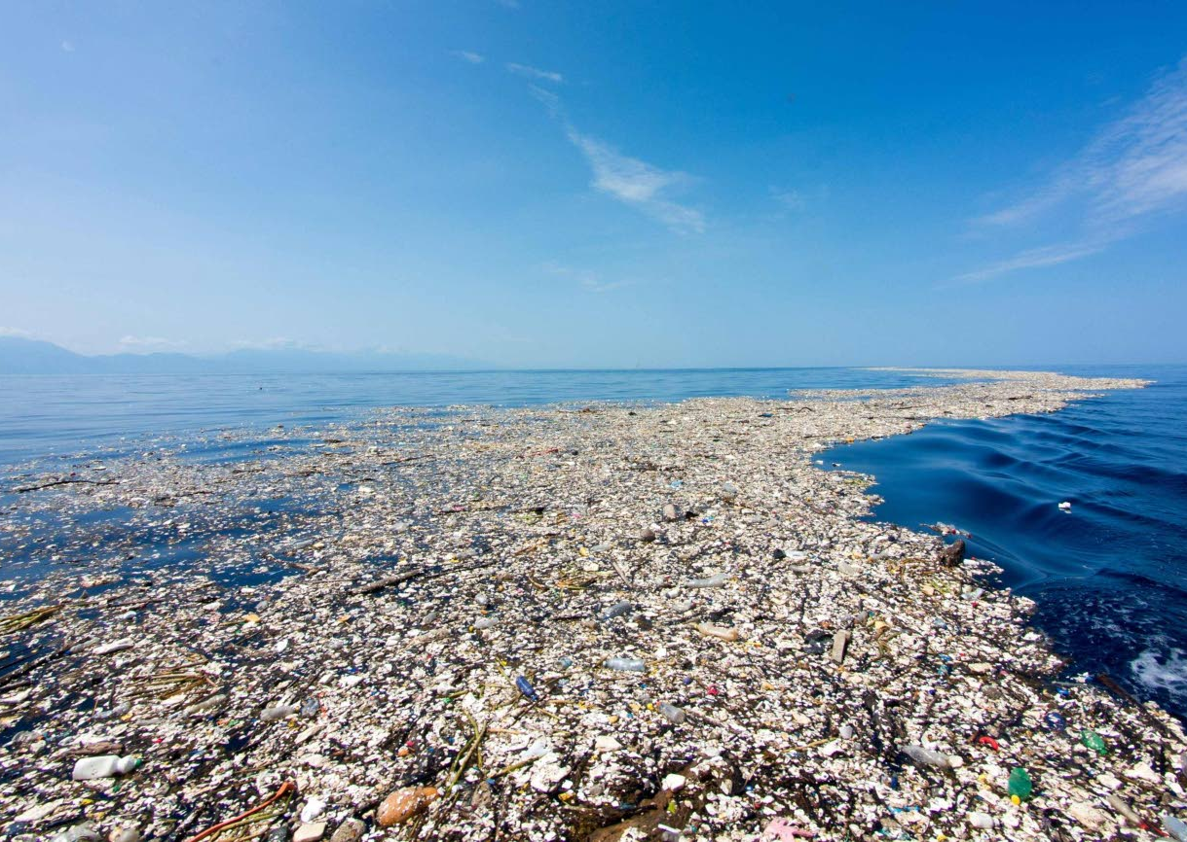
Great Pasific Garbage Patch
Is an area in the middle of the North Pasific Ocean where floating plastic waste from the coast is collected together by sea currents.
It has been characterized as the world’s largest landfill (2,41 million kilograms of plastic waste, twice the size of the United States).
The amount of waste is increasing.
A similar waste vortex is also in the Atlantic.

Slide 5
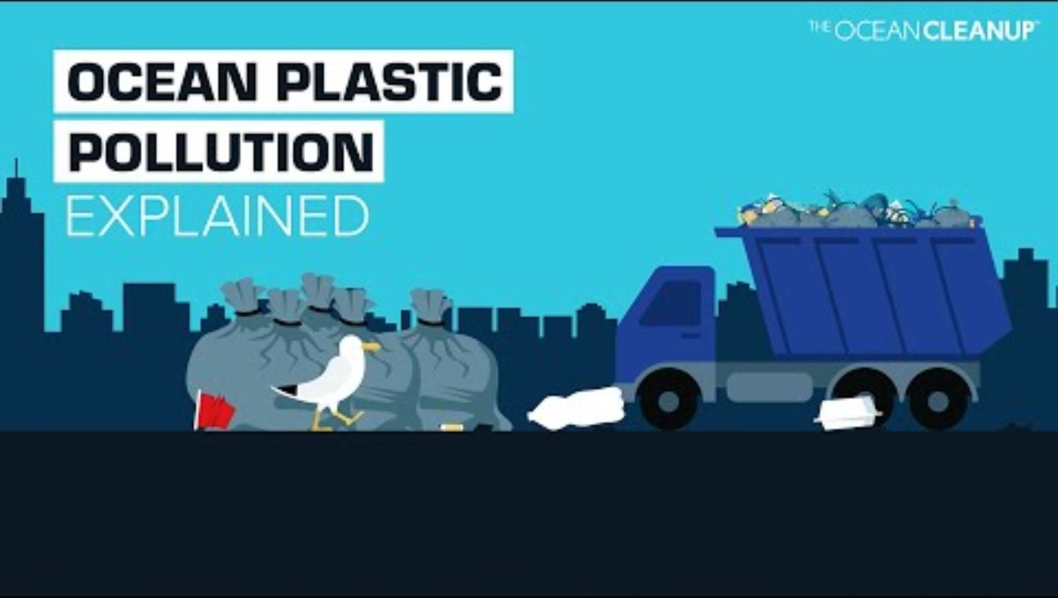
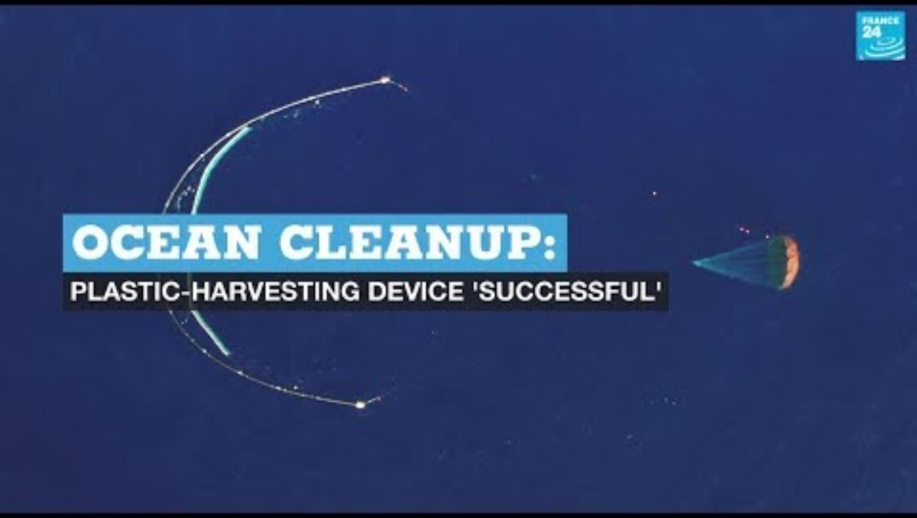
Videos about plastic waste in the seas and their cleaning

