Slide 1
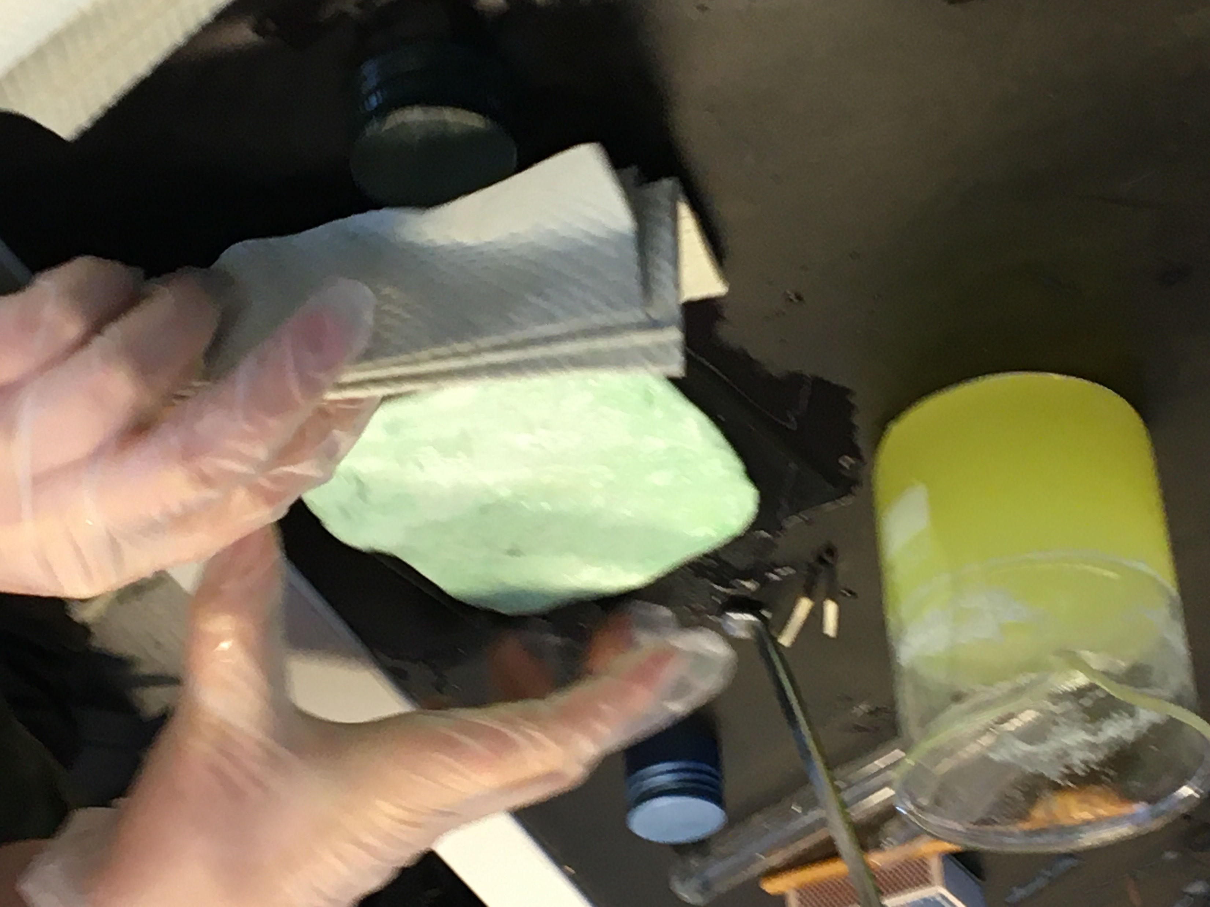
Plastic from milk Laboratory work 19.3.2024

Slide 2
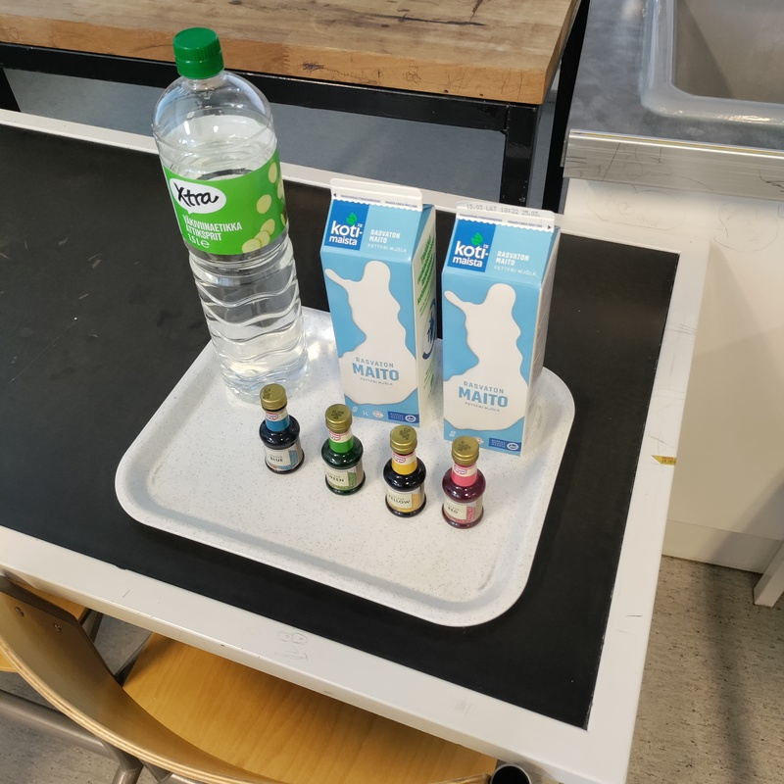
Substances
• 2 dl skim milk • 10 ml white vinegar • food colouring

Slide 3
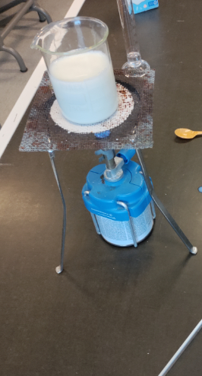
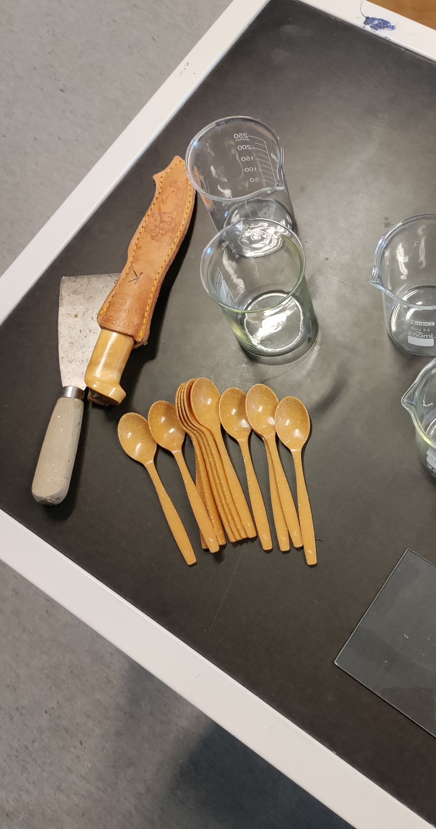
Working tools
• Beaker • Disposable spoon • Thermometer • Heating equipment (tripod, heating grid, gas burner)

Slide 4
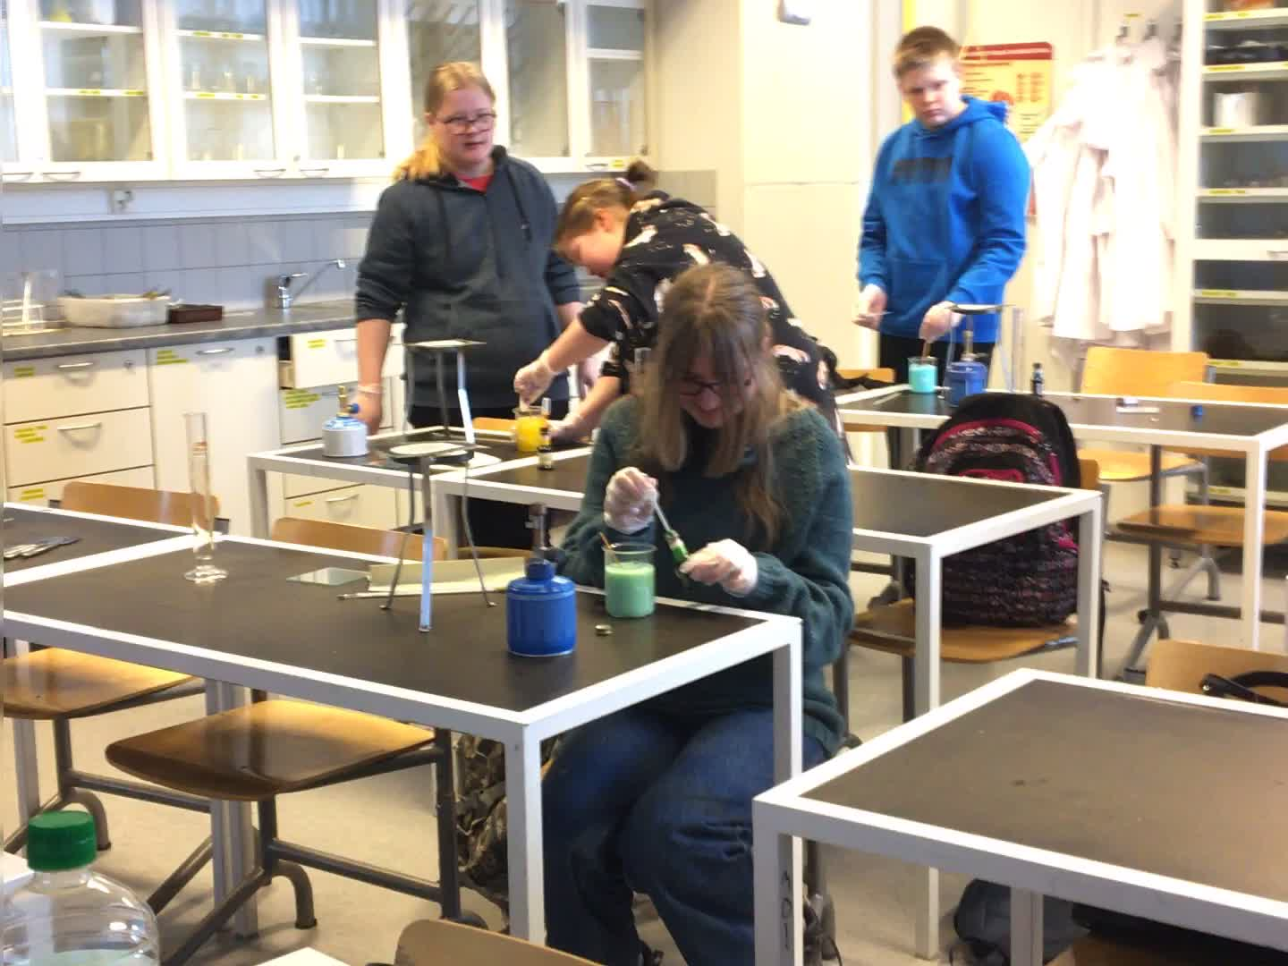
Doing the work
1. Measure 2dl (=200ml) of skim milk into a beaker. 2. Measure the vinegar (10 ml) into the small container. 3. If you want the plastic colored, you can add a little food coloring to the milk.

Slide 5
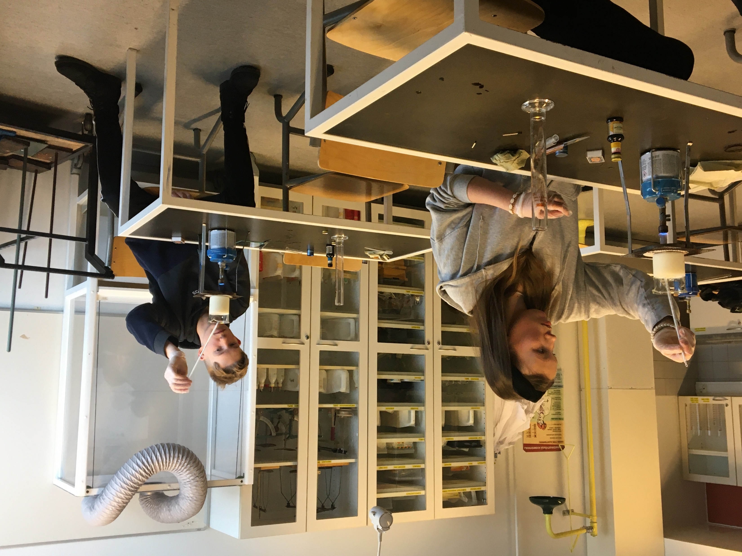
4. Warm the milk carefully to 50-60 °C. The milk must not be heated too hot ! 5. Lift the heated milk off the tripod.
6. Add the vinegar and stir vigorously with a spoon. Mixing must be done properly for the reaction to take place in its entirety. There is no rush at this point.

Slide 6
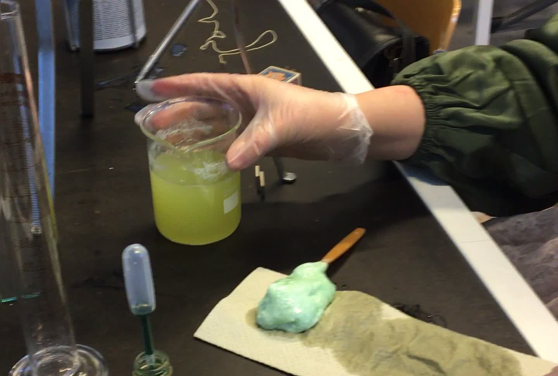
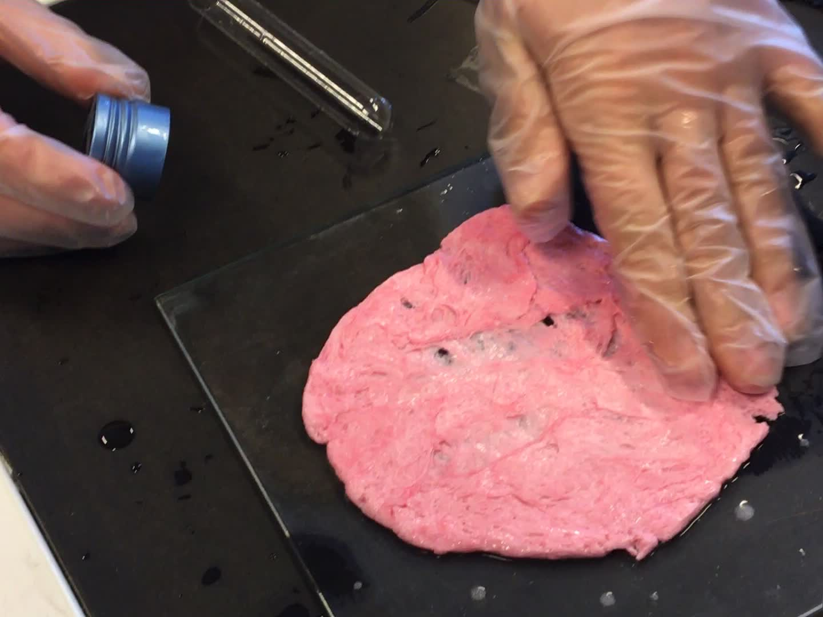
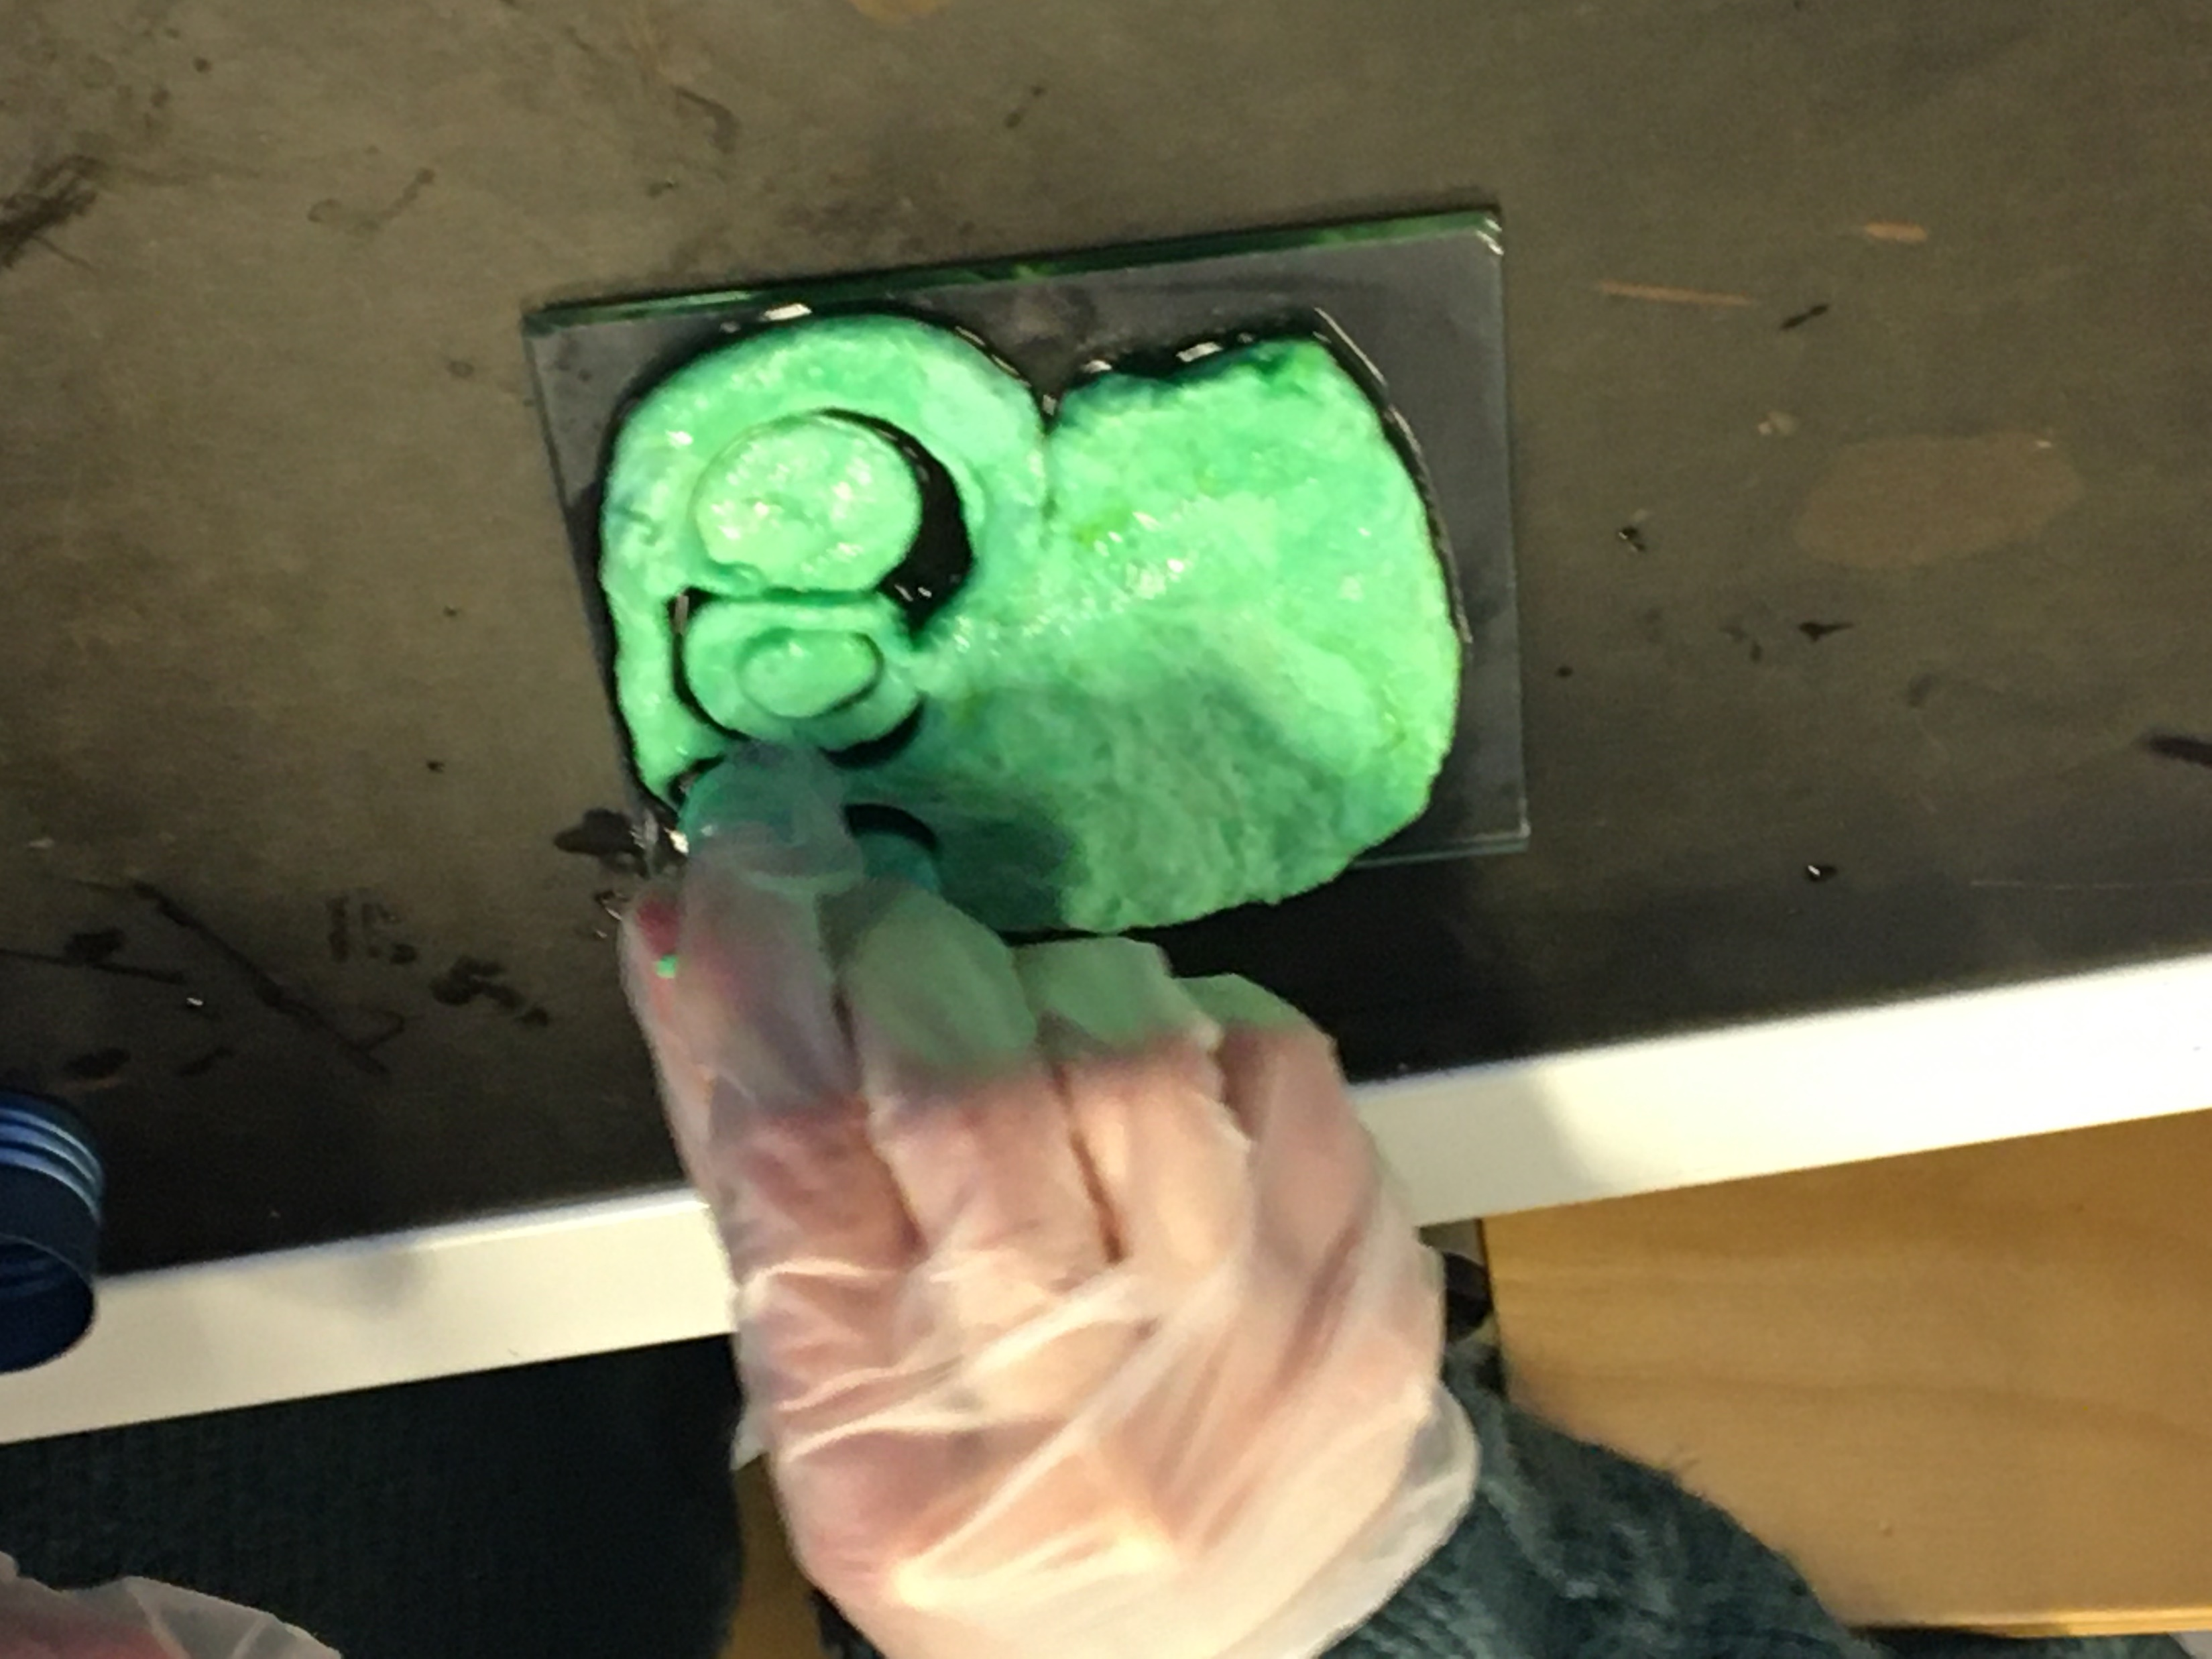
7. Remove the formed mass and shape it into a flat plate. The mass does not behave like plasticine, so it must be shaped quickly, for example using a mold.

Slide 7
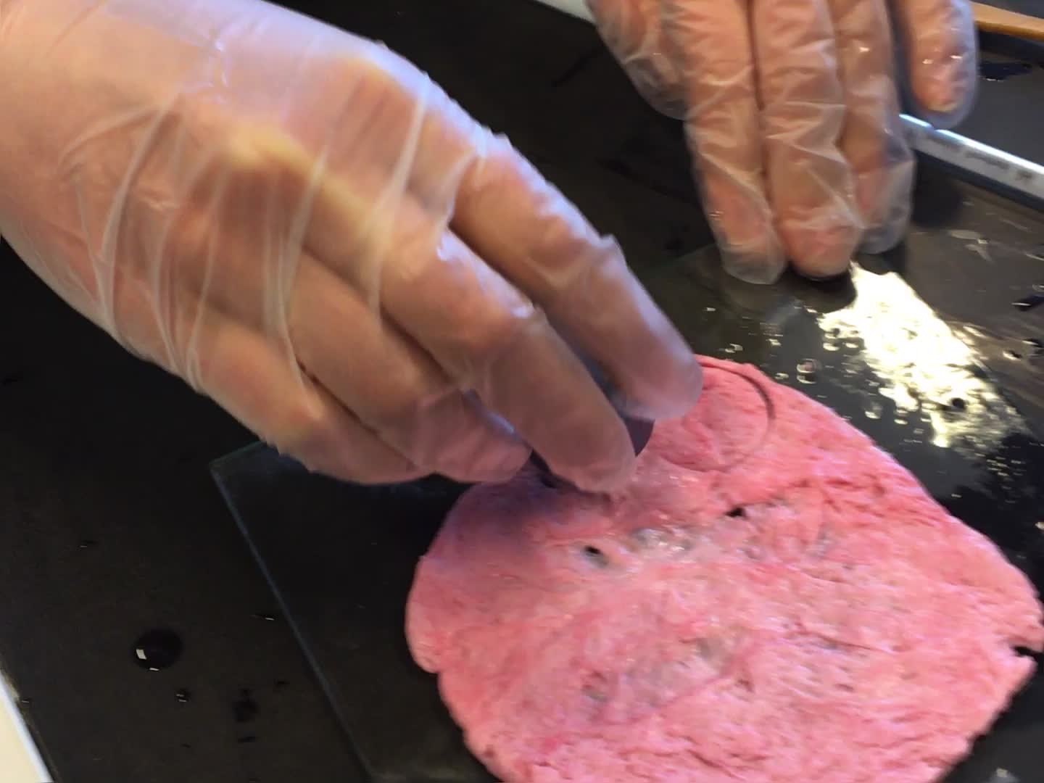
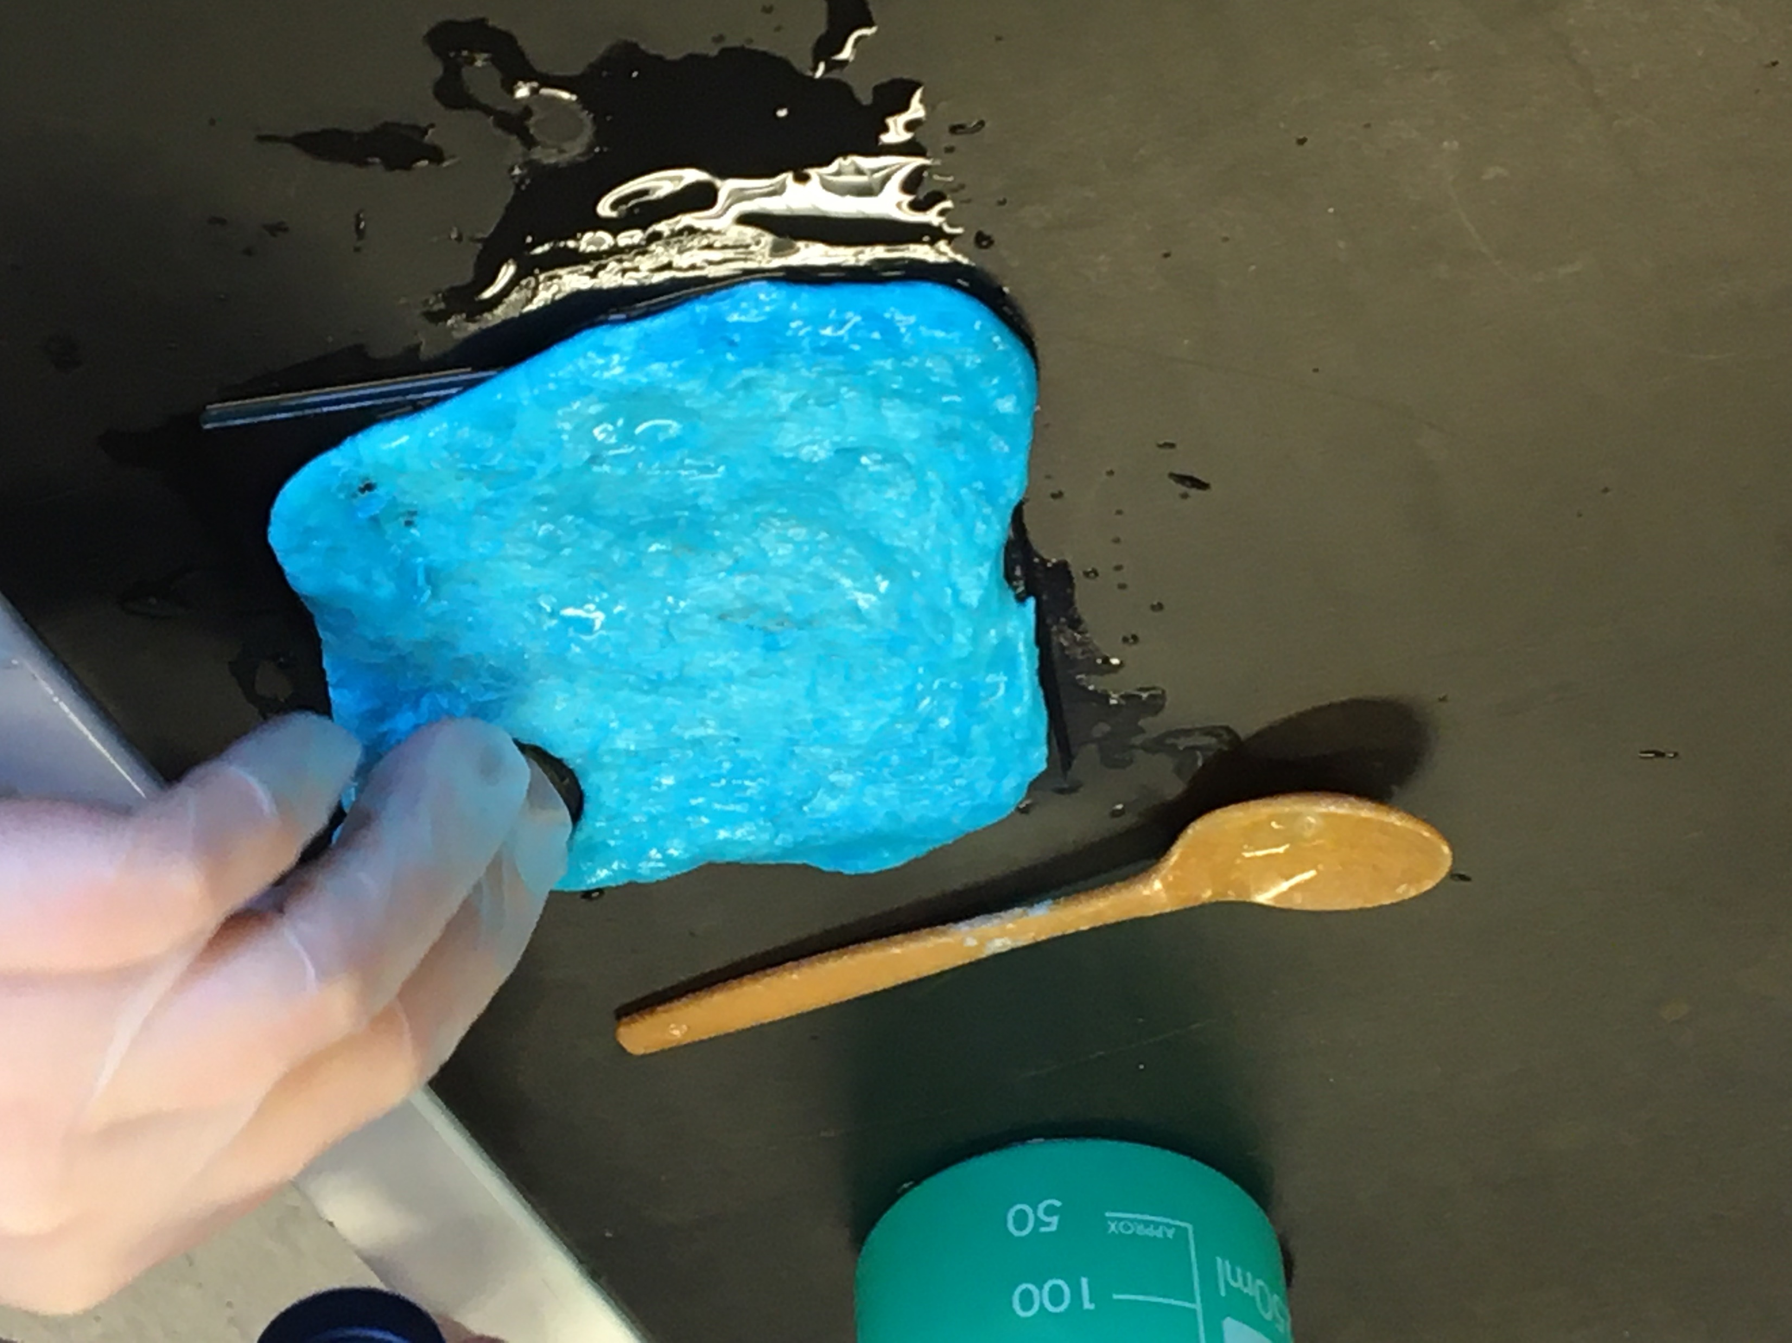
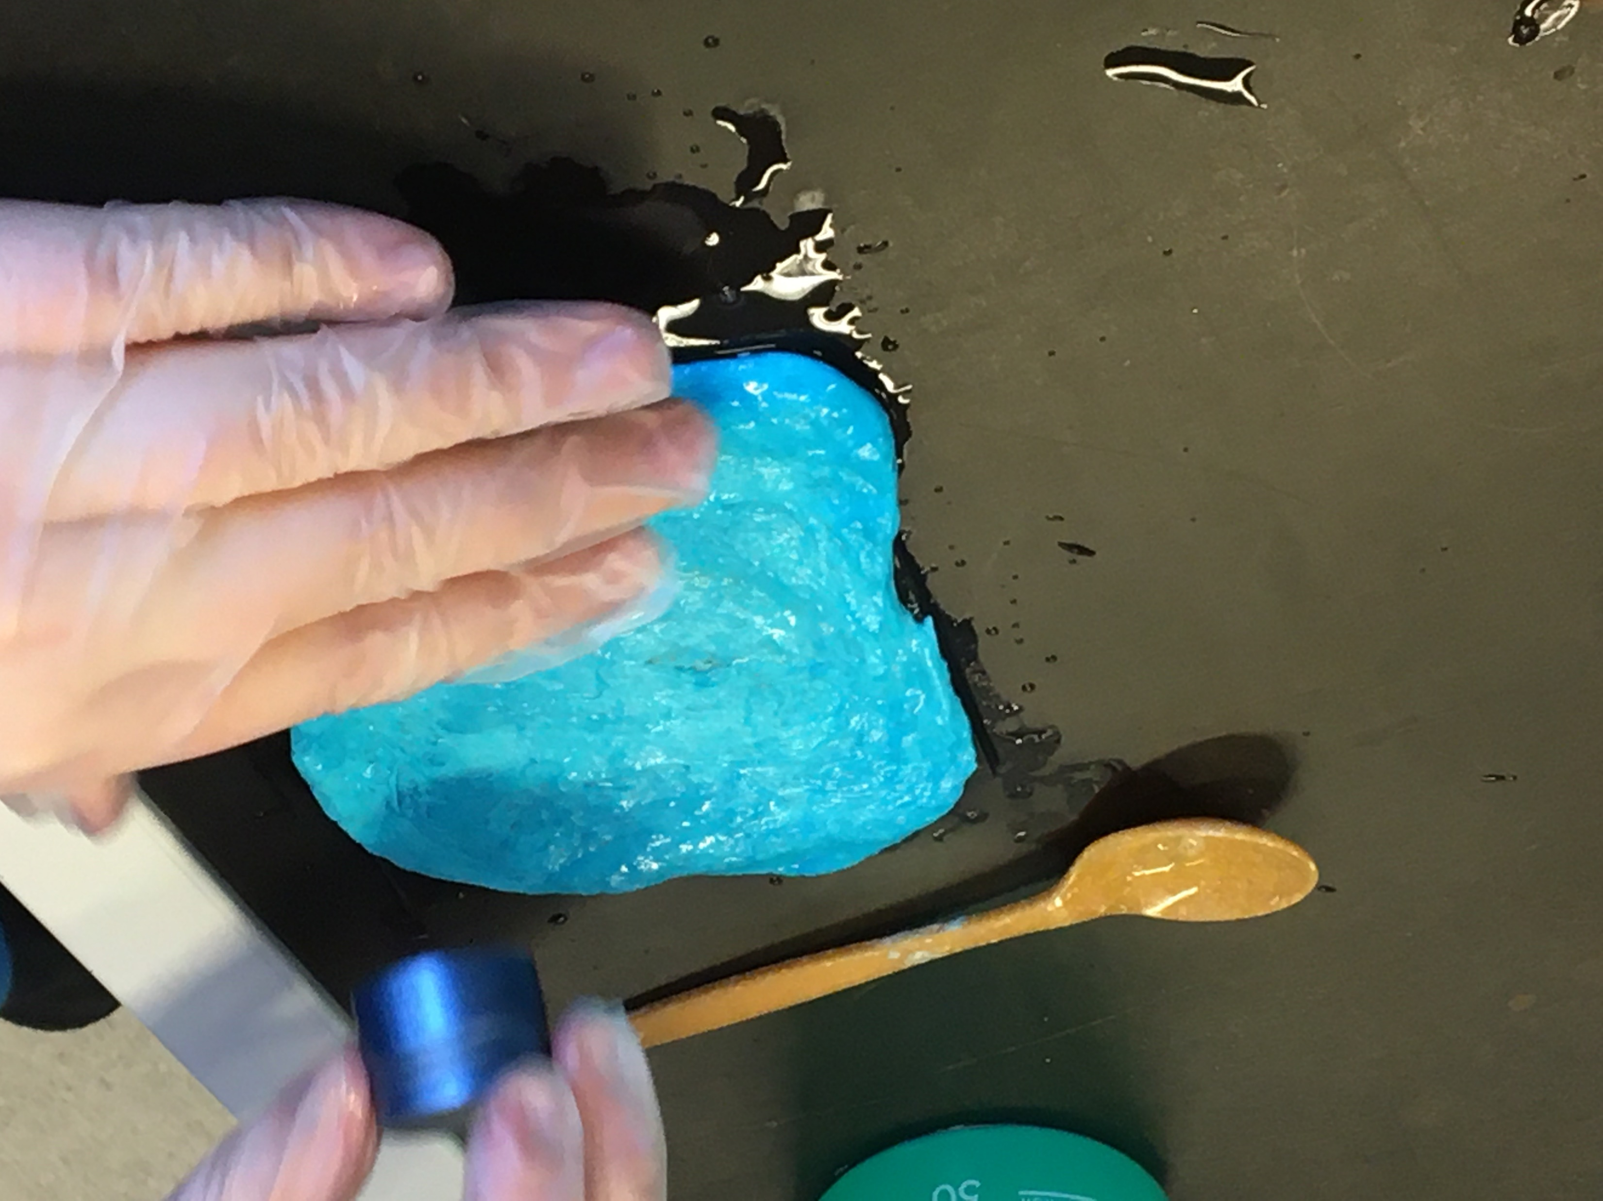
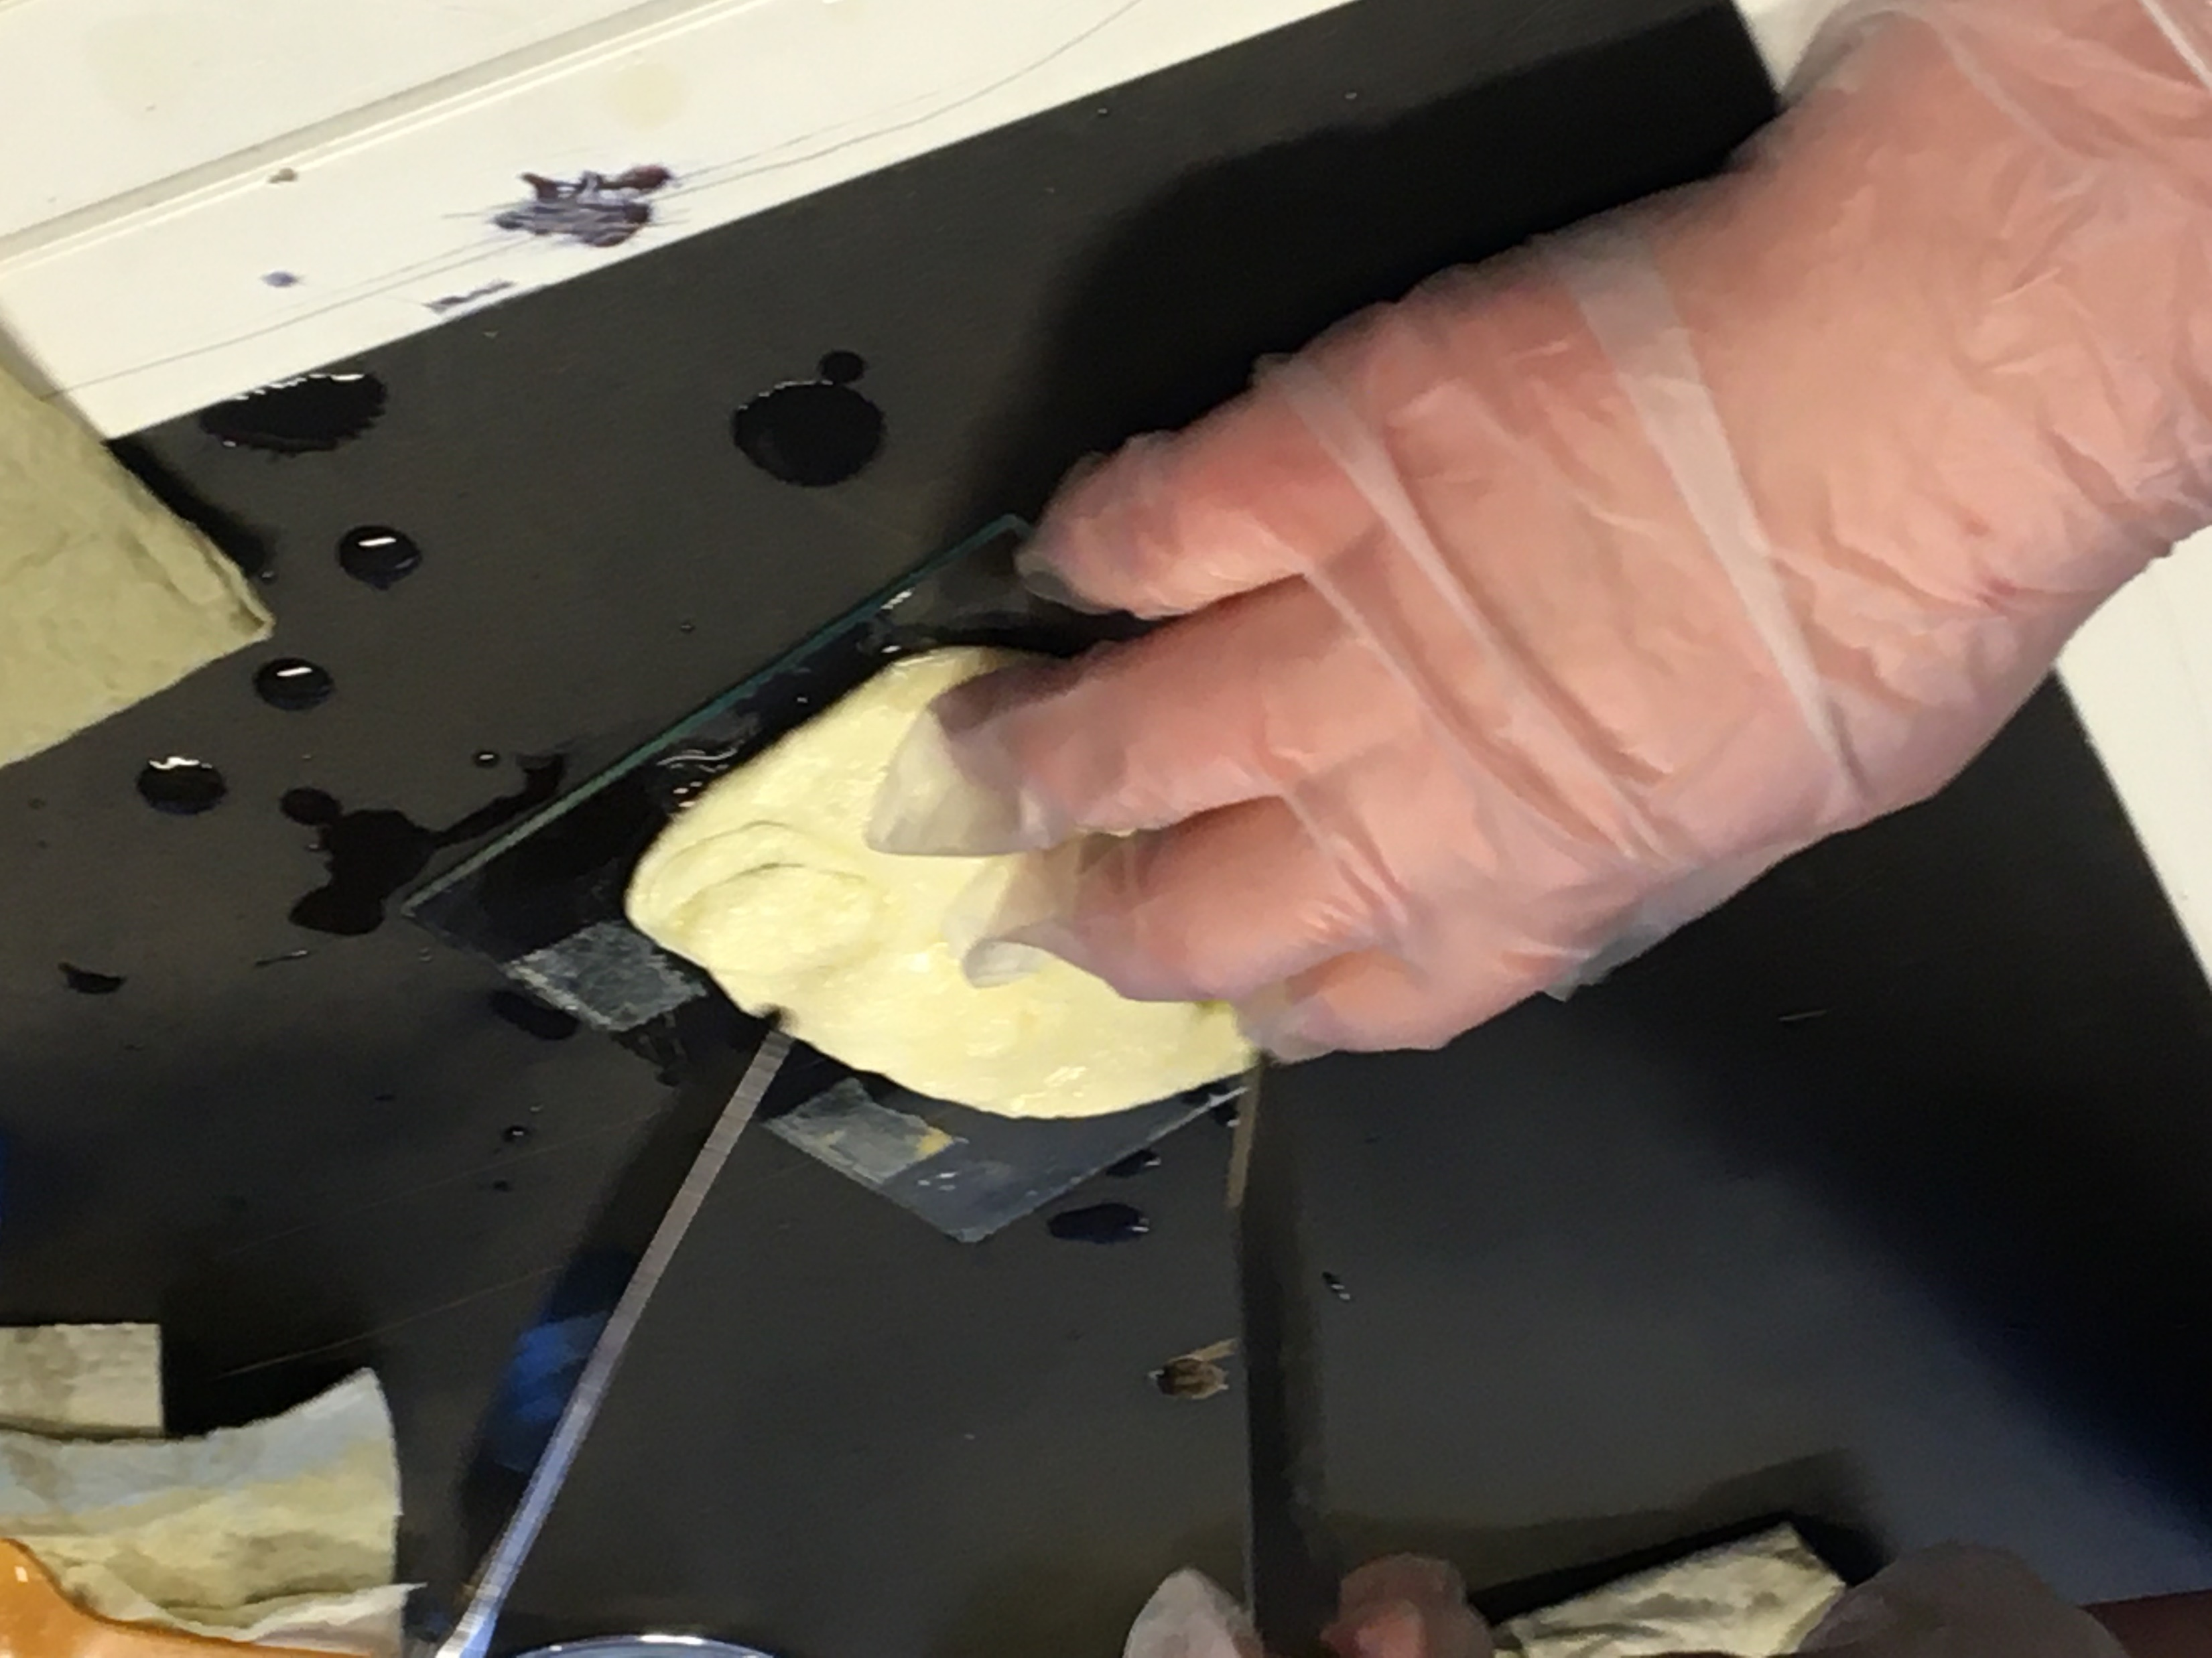
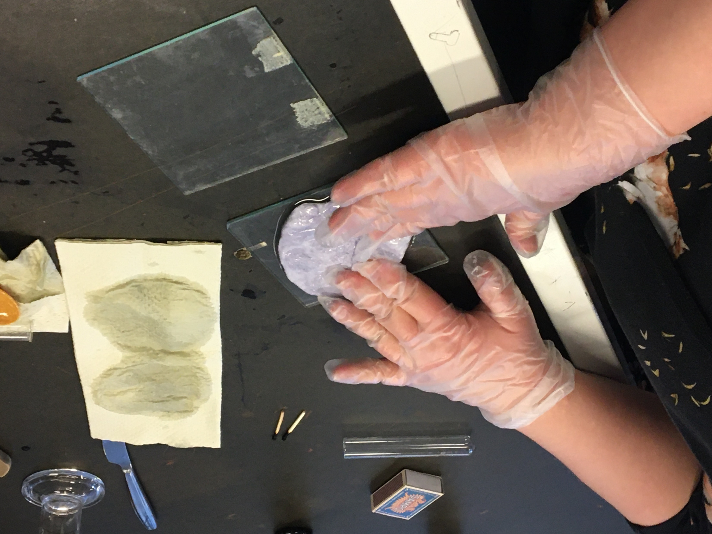

Slide 8
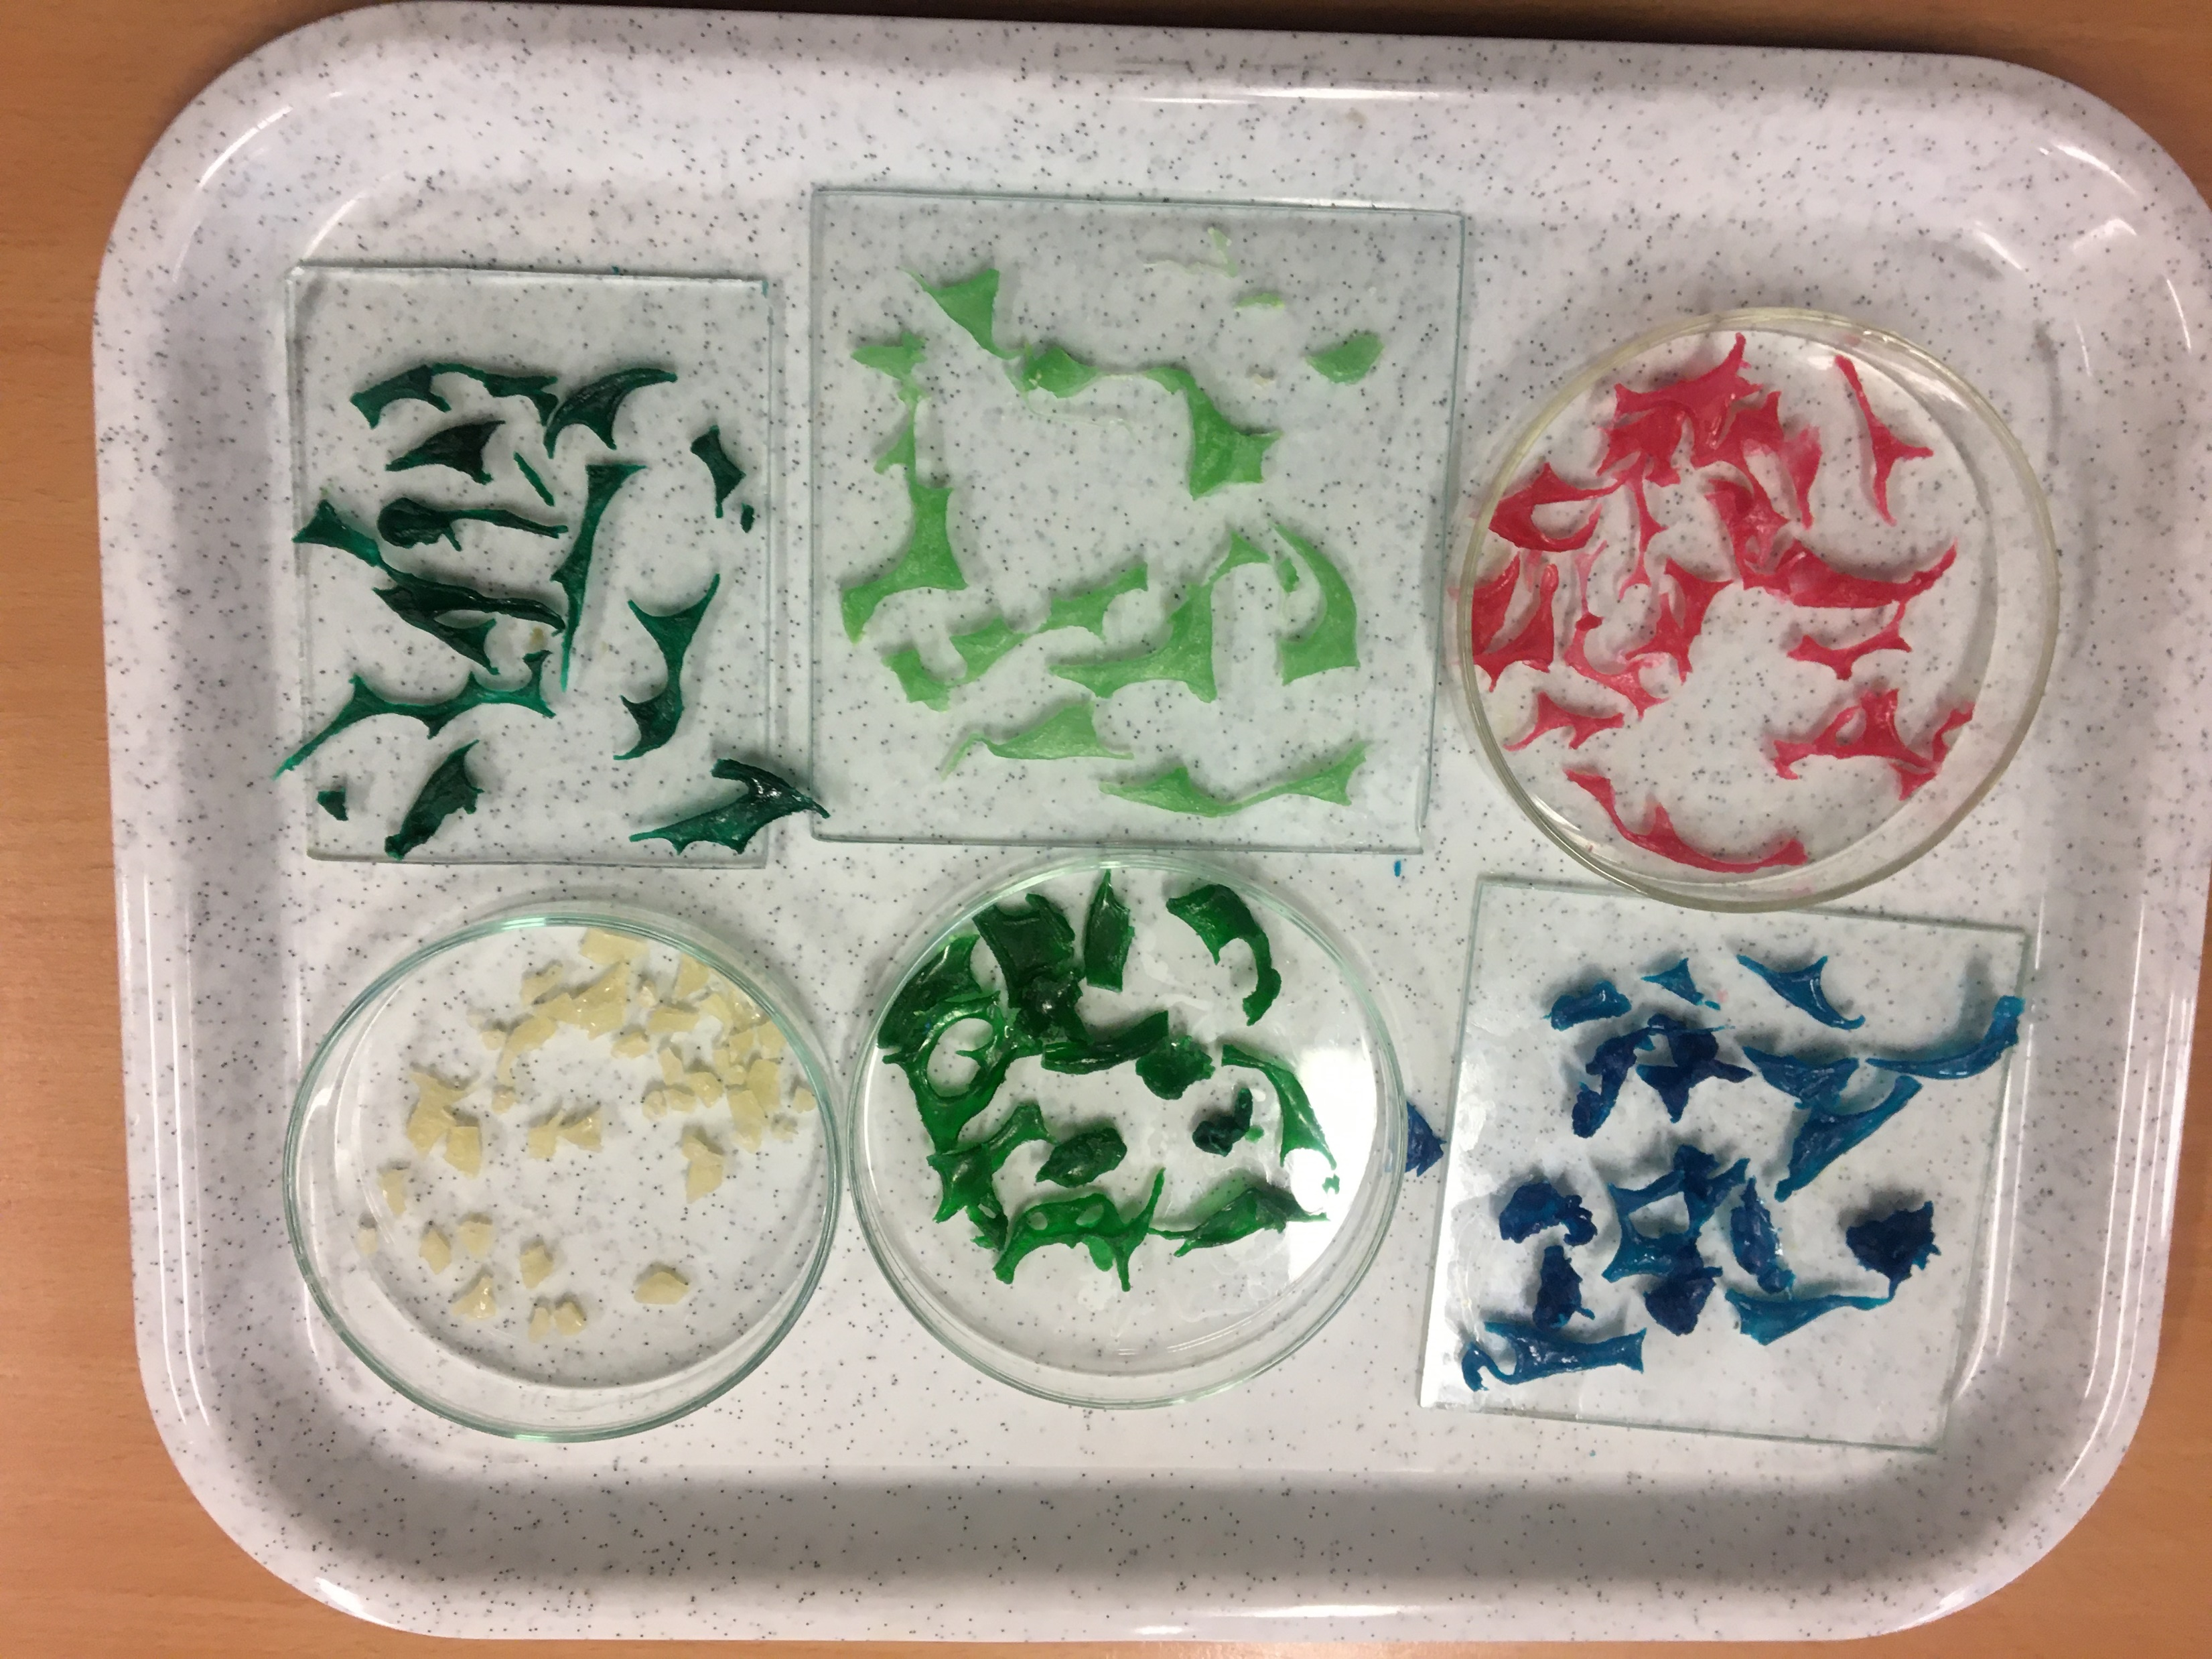
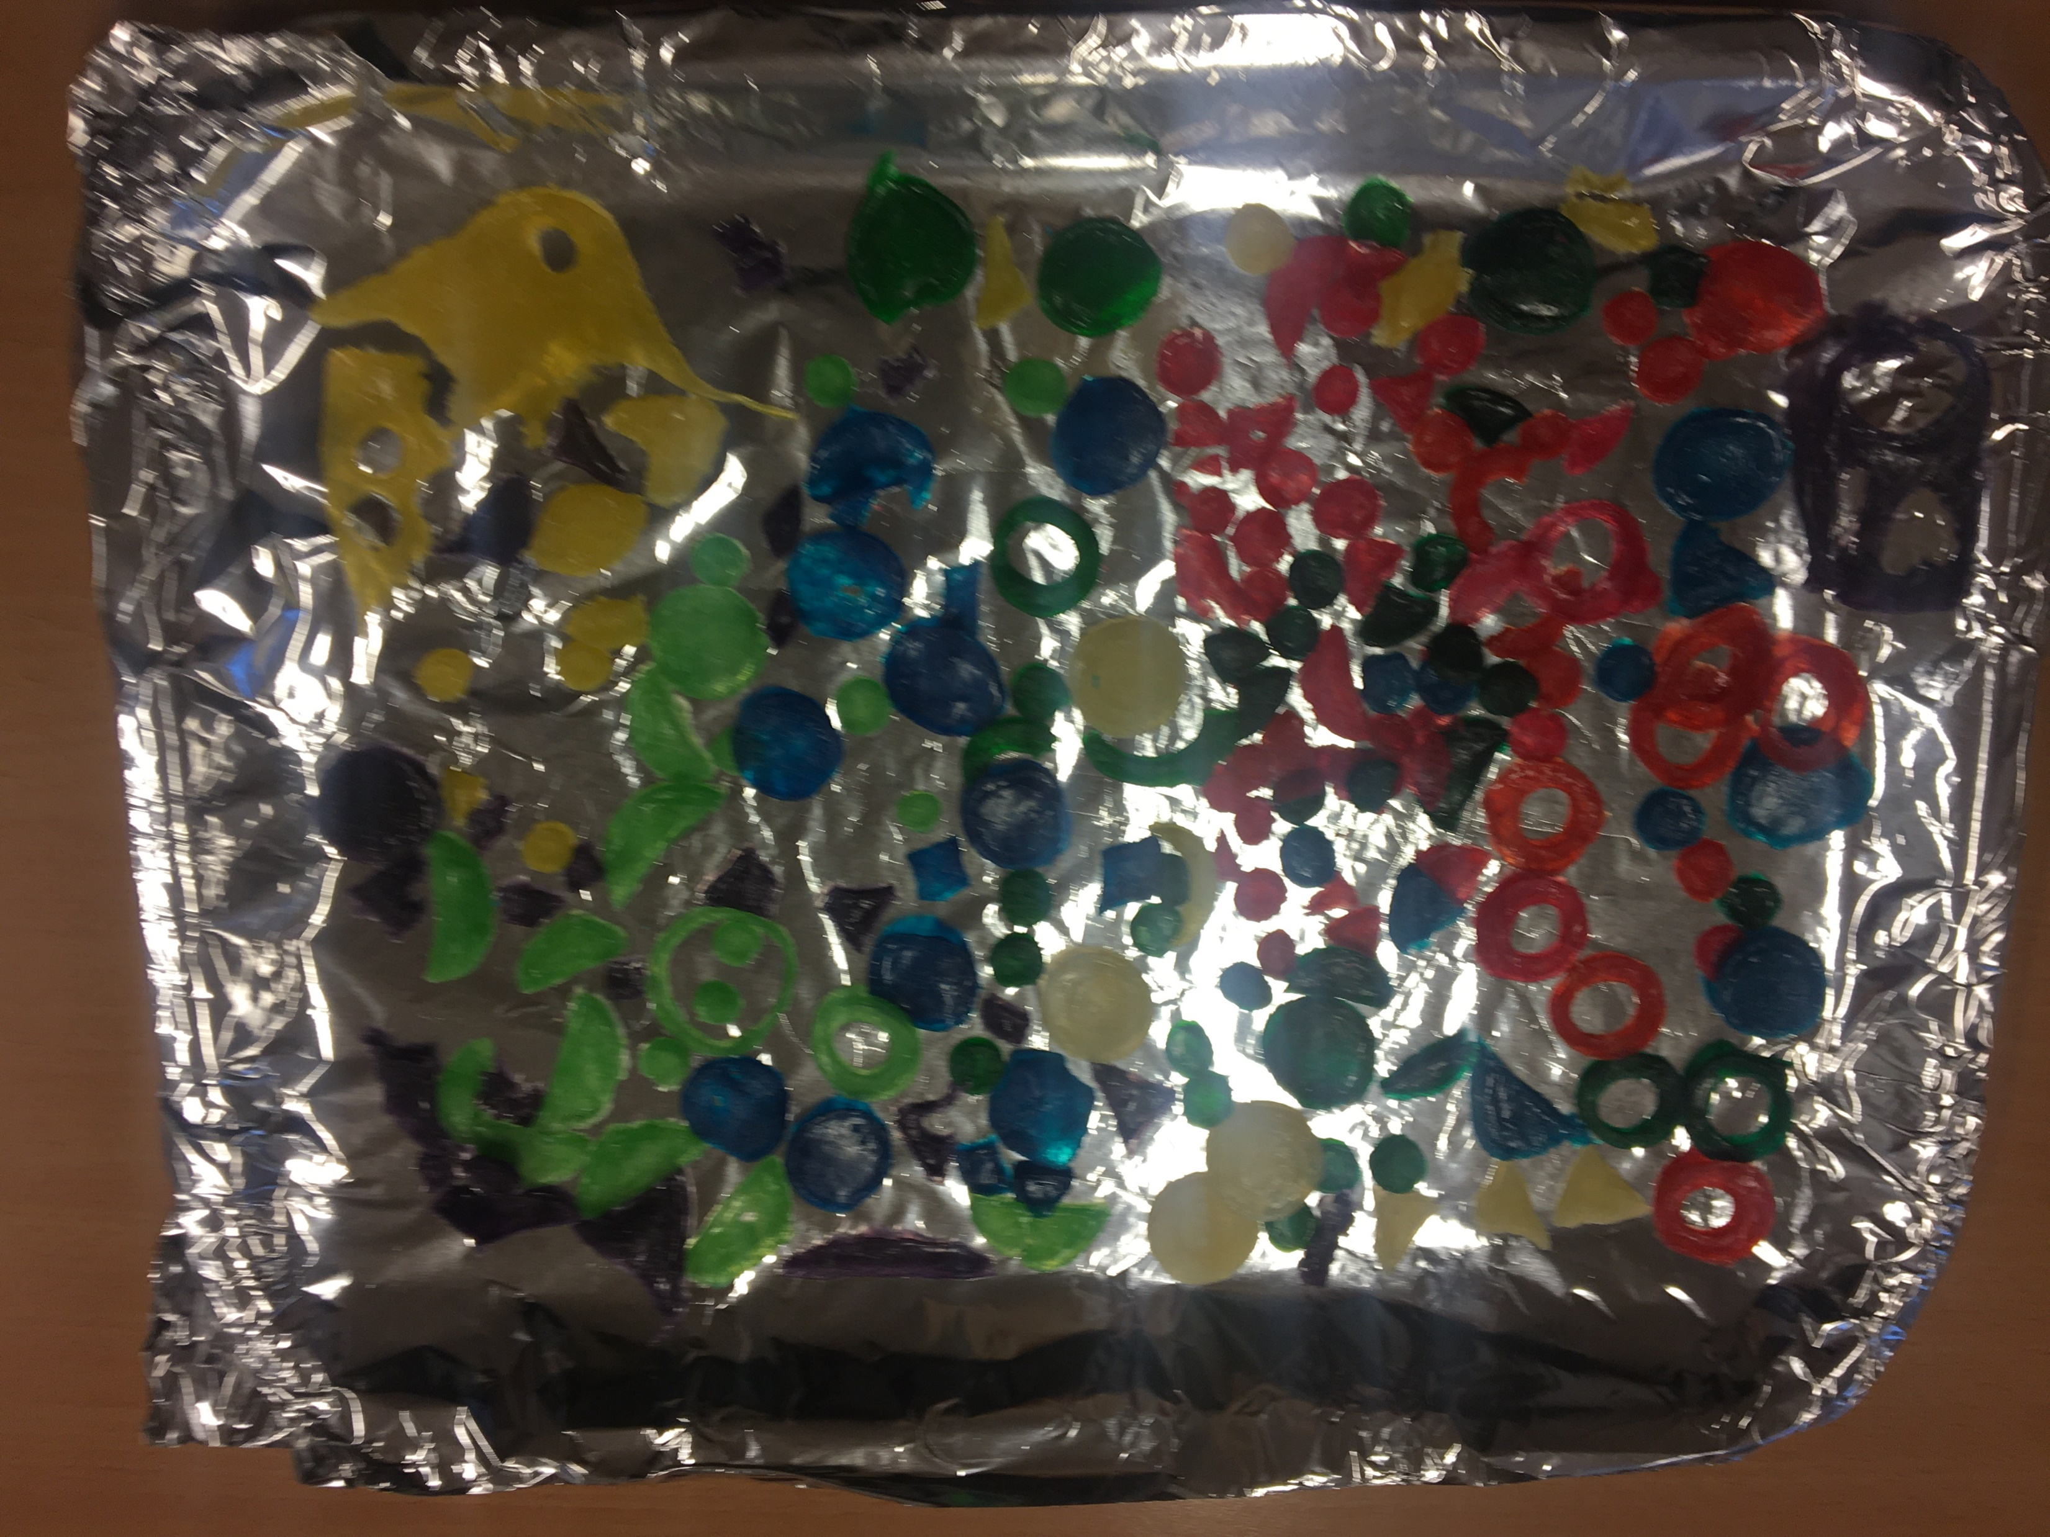
8. The product can be dried with paper, but it dries to its final shape in about a week.

Slide 9
https://www.youtube.com/watch?v=hJv06BT8Trc

