Slide 1
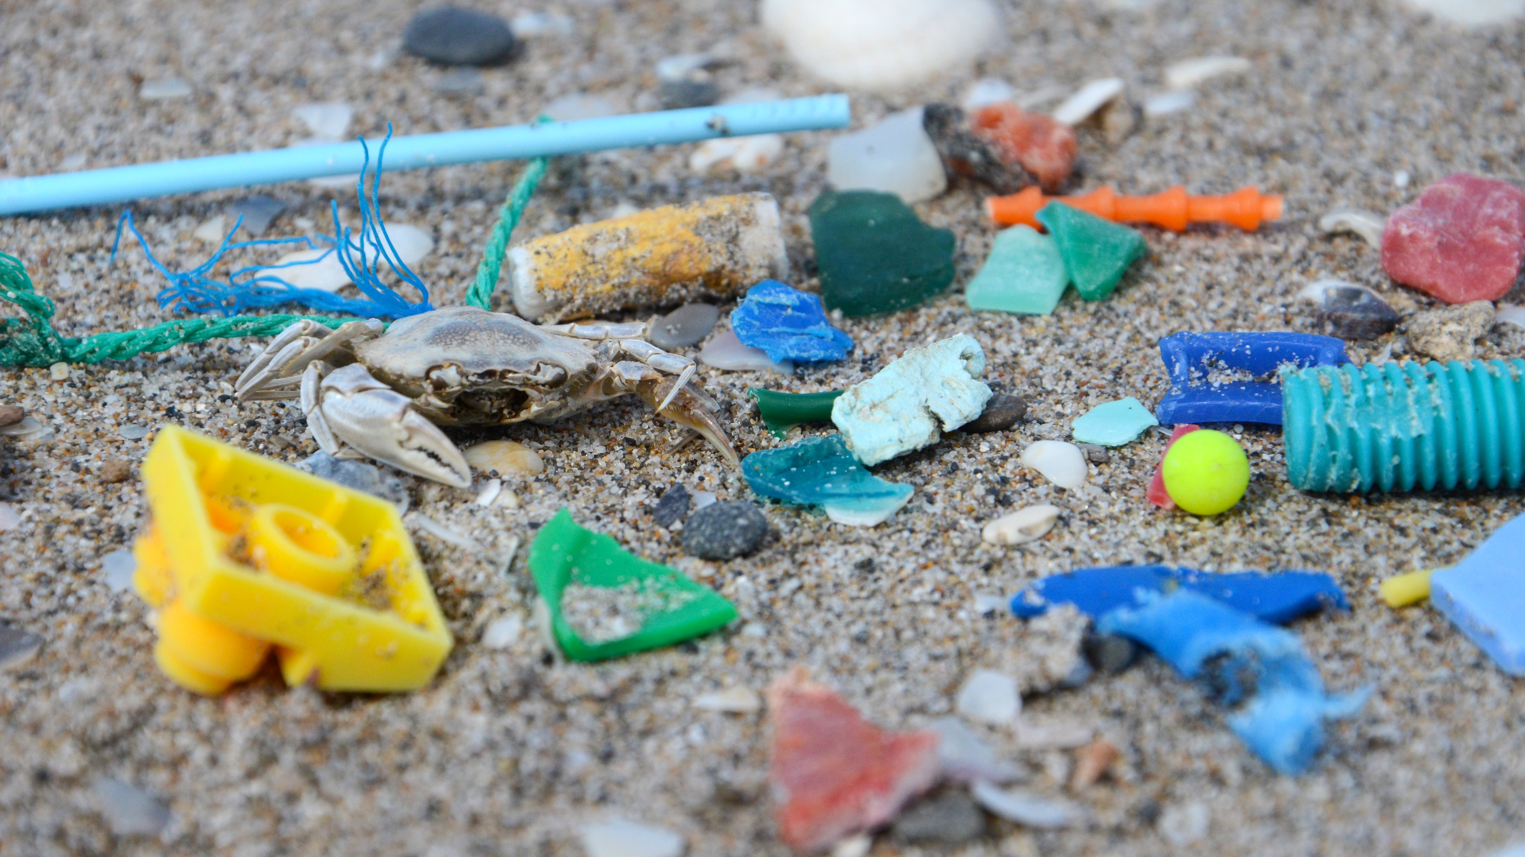
Microplastics

Slide 2
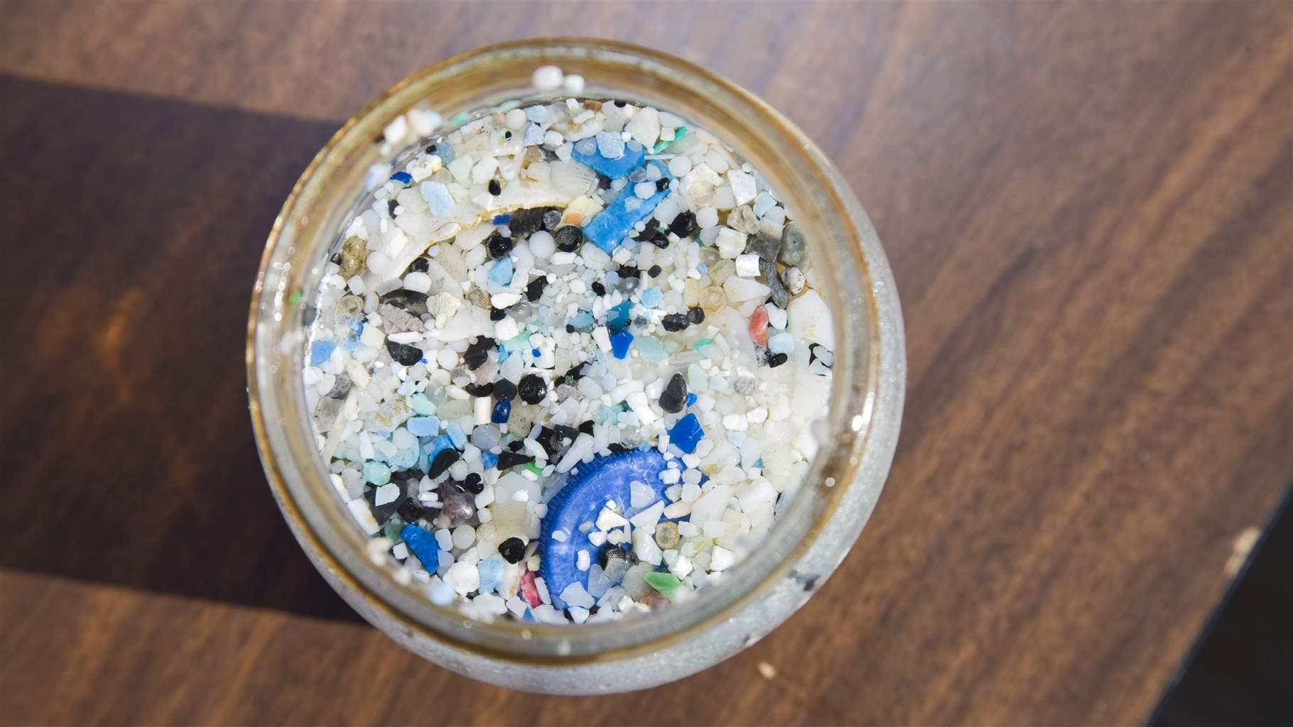
What are microplastics?
Microplastics are tiny pieces of plastic material typically smaller than five millimetres.
There is two main categories of them: primary microplastics and secondary microplastics.

Slide 3
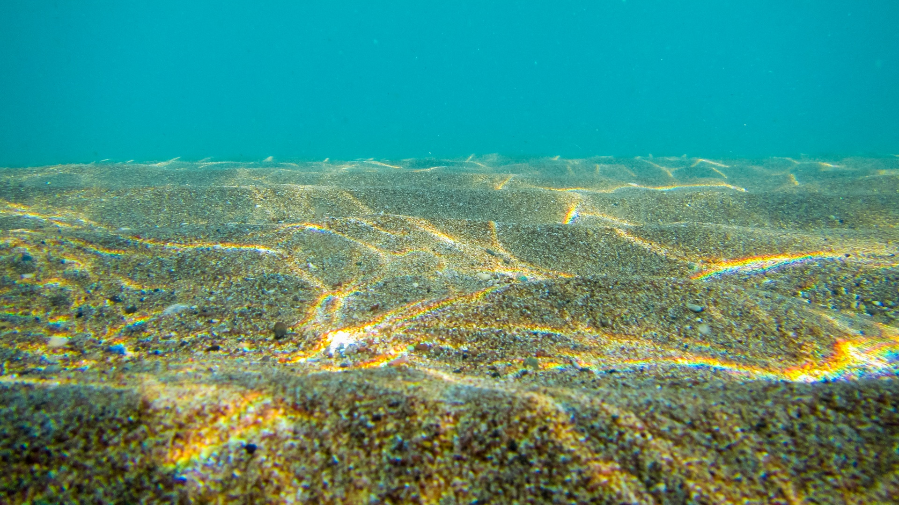
Where does microplastic come from?
- Microplastics come from a variety of sources
- primary microplastics (made to a small size): microbeads from facial crubs,
printer ink, artificial grass, raw material pellets and powder for the
plastics industry
- secondary microplastics (larger plastic pieces that have broken apart):
plastic bags, bottles and fishing nets, laundering of synthetic clothes,
abrasion of tyres
- Microplastic are found in growing quantities in the sea. The plastic
accumulates in marine animals (fish, shellfisk) and throug food chain
plastic ends in humans (microplastics has been found in placenta and
blood)

Slide 4
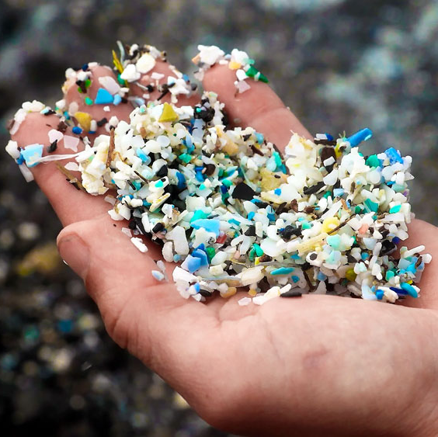
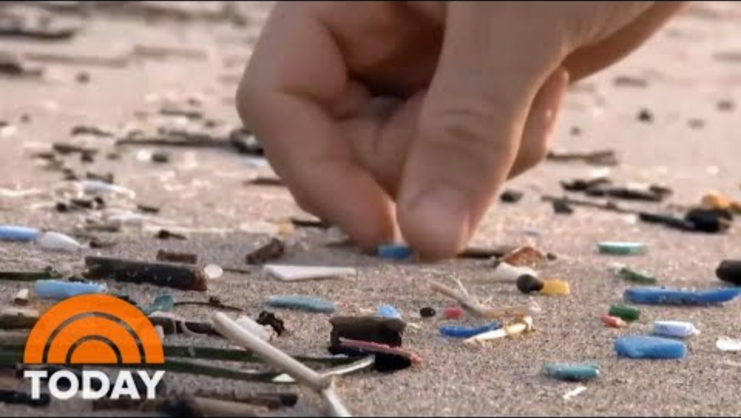
What are the effects of microplastics?
When eaten, they cause blockages and starvation.
Additives contaided in plastic may be harmful to animals or human ingesting them (disrupt hormone function).
Plastics absorb harmful substances (like PCB) from the environment and transport them to animals.

