Slide 1
Microplastic Research in Petäjävesi, Finland
(Autumn 2023)

Slide 2
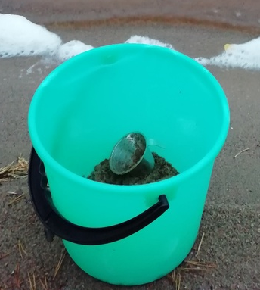
How we did this research
First we went to the lake and collected some sand in the bucket.
Then we put water in the bucket. We mixed the mixture and then we sift it. Next we collected tiny plastic parts from the strainer. We measured and counted the plastic parts and wrote the results and definition for the lakes microplastic status down on survey form.
We took pictures for every steps and put these in the research.
Eight students explored five lakes (next two slides, the explored lakes are marked on the map).

Slide 3
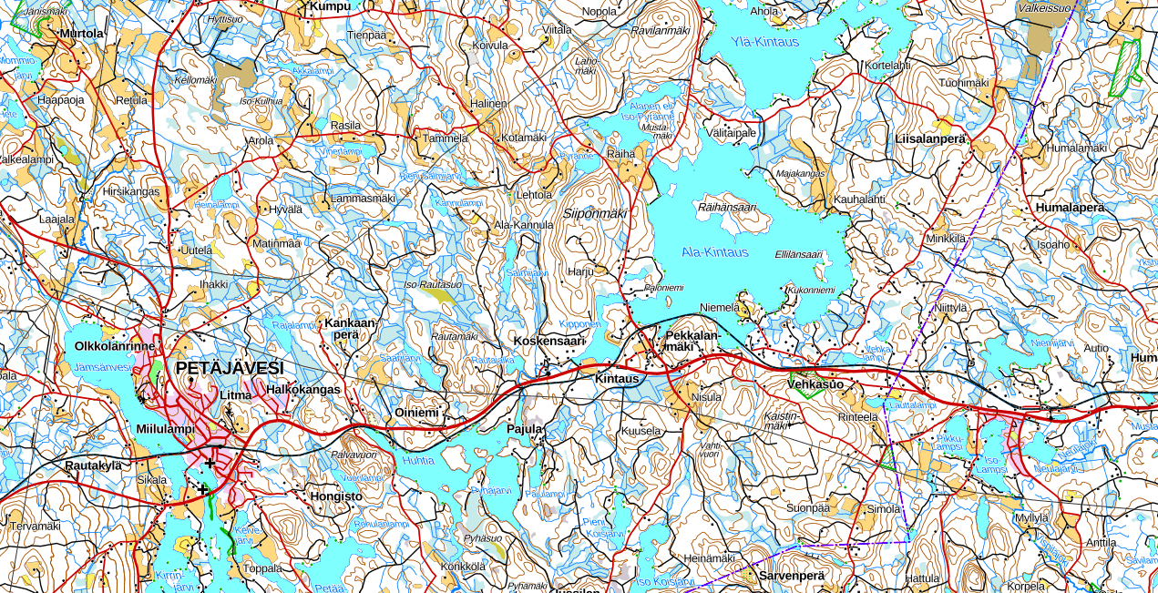
Ala kintaus
jämsävesi
Jämsävesi(2)
Ala kintaus (2)
kipponen
marjojärvi
Jämsävesi(3)

Slide 4
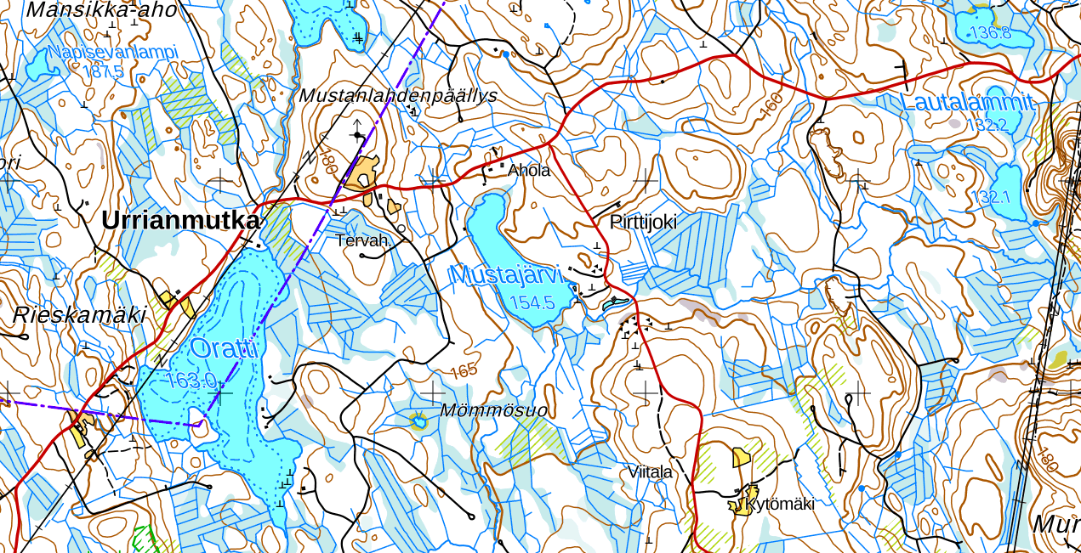
Mustiaisen järvi

Slide 5
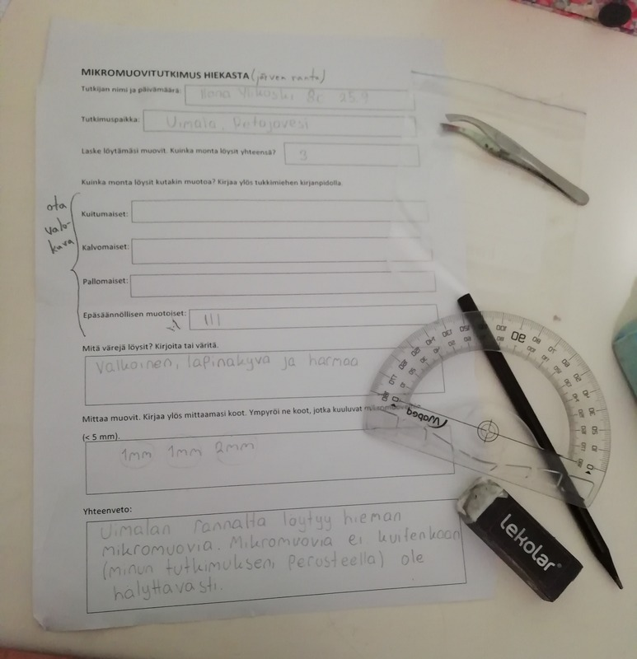
Instructional video and the survey form
https://mappa.fi/materiaalit/tutki-itse-roska-ja-mikromuovi/ (research by yourself: trash and microplastics)
(microplastic research – survey form)

Slide 6
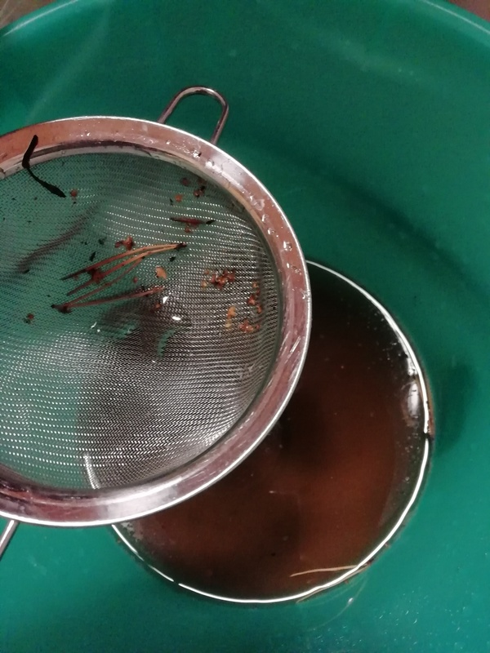
Results and review of results
Microplastics (white piaces in the colander) were found in the sand of swimming beeches from both Jämsänvesi and Ala-Kintausjärvi.
Microplastics can be found on beaches or lakes with a lot of human activity.

