Slide 1
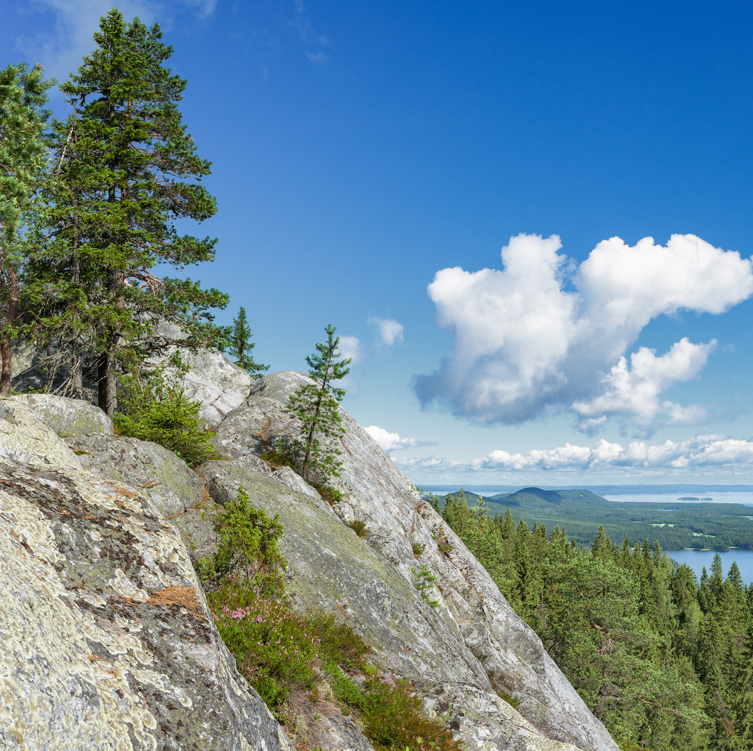
Finland
Population is 5,6 million (2024).
Capital city is Helsinki.

Slide 2
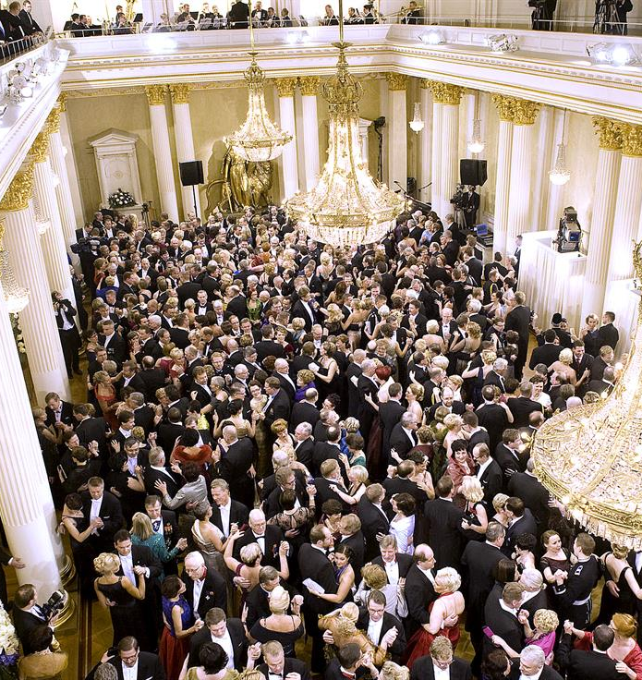
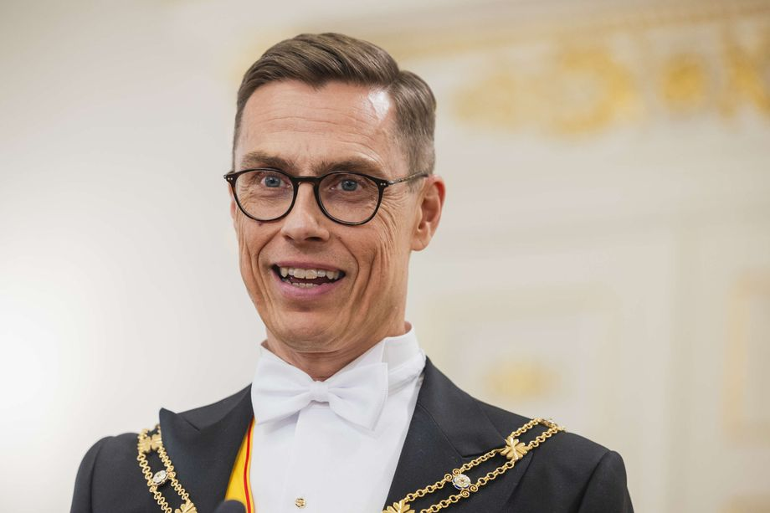
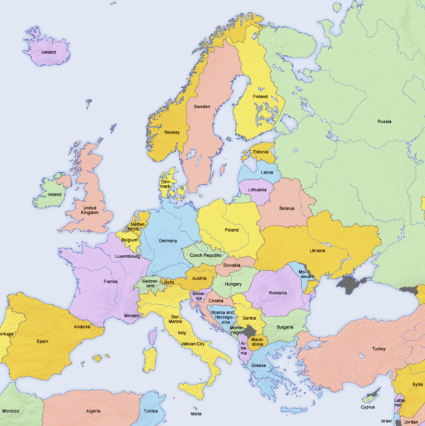
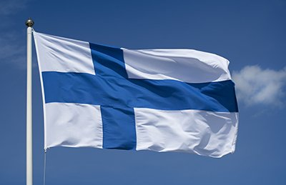
Finland in brief
Finland is located in Northern Europe.
Neighbouring countries are Russia, Norway and Sweden.
Independent since 1917 (6.12 is our Independence Day).
Independence Day Ball in Presidential Palace.
President Alexander Stubb.
The colors in the flag, blue and white, are the colors of freedom.
Belongs to the Nordic countries and to European Union.
Finland is a member of NATO.

Slide 3
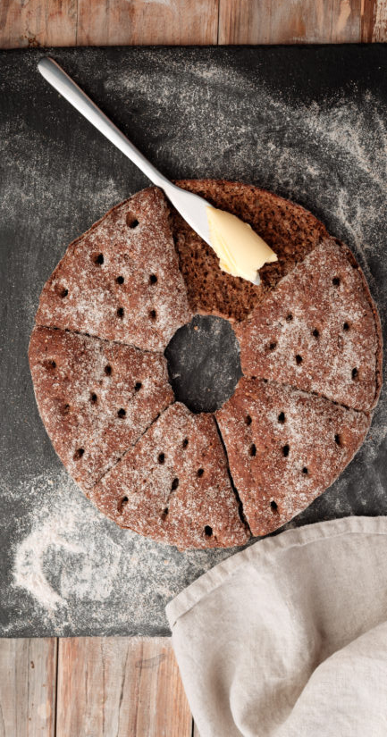
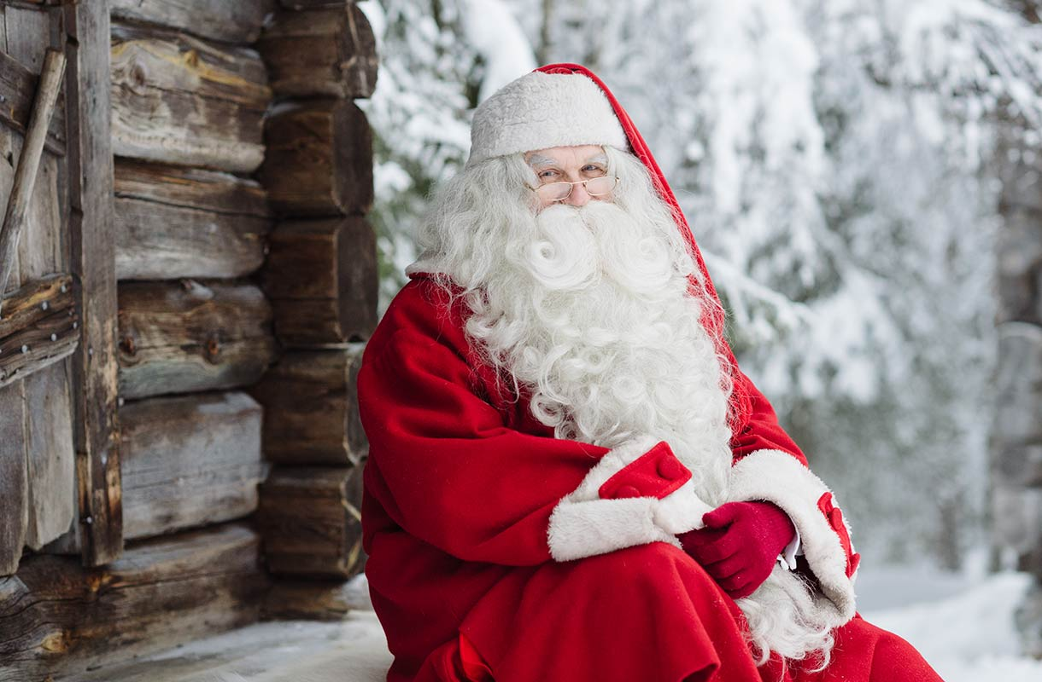
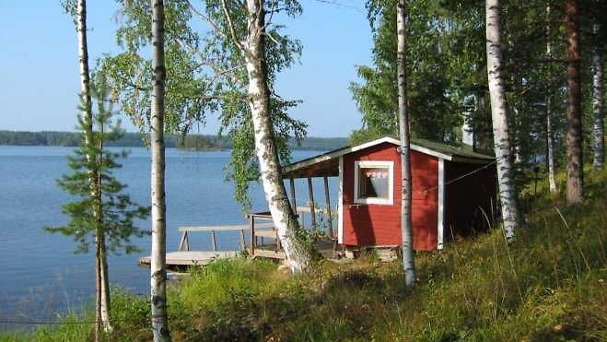
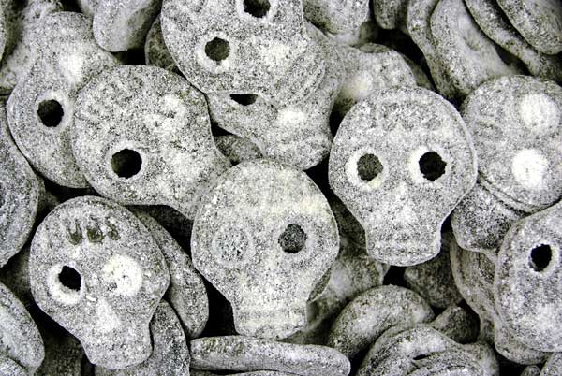
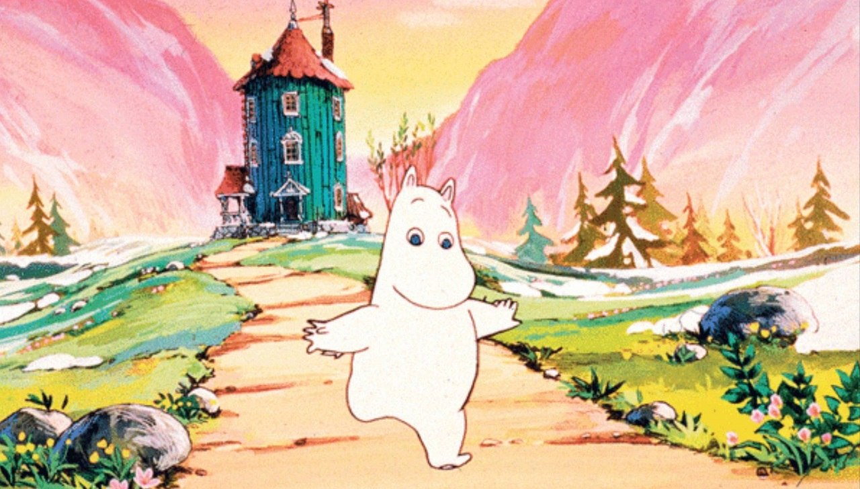
Important to us Finns
Rye bread
Ice hockey
Sauna
Salty liquorice
Moomin

Slide 4
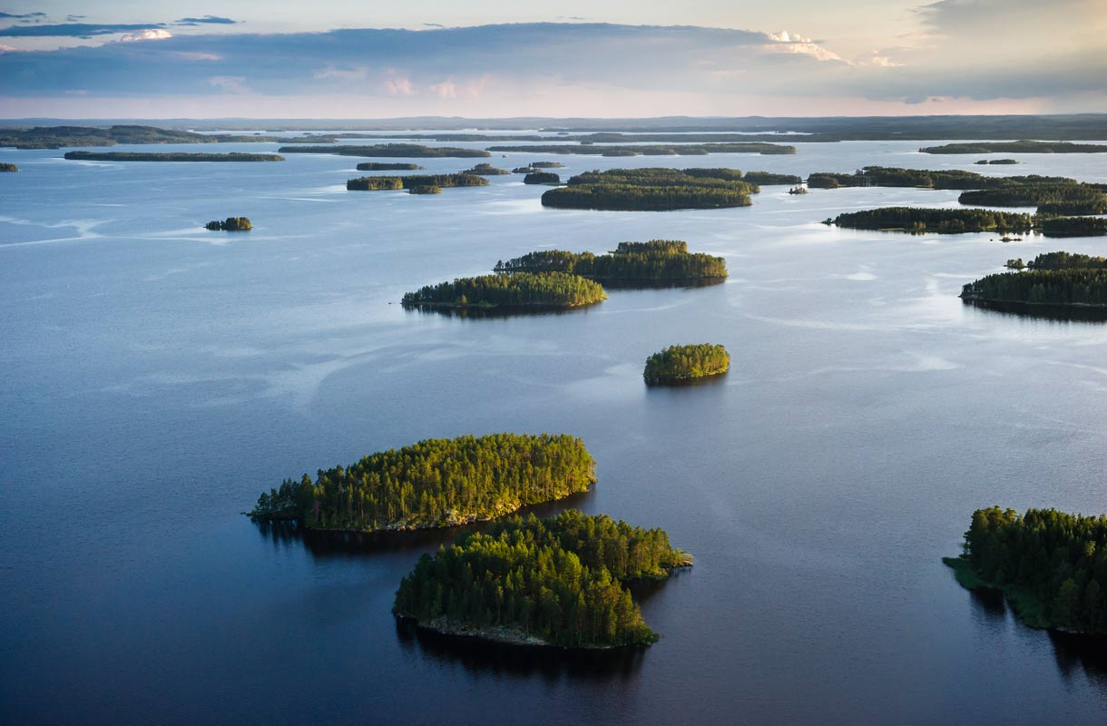
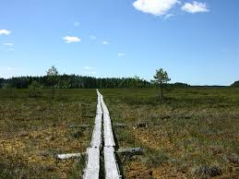
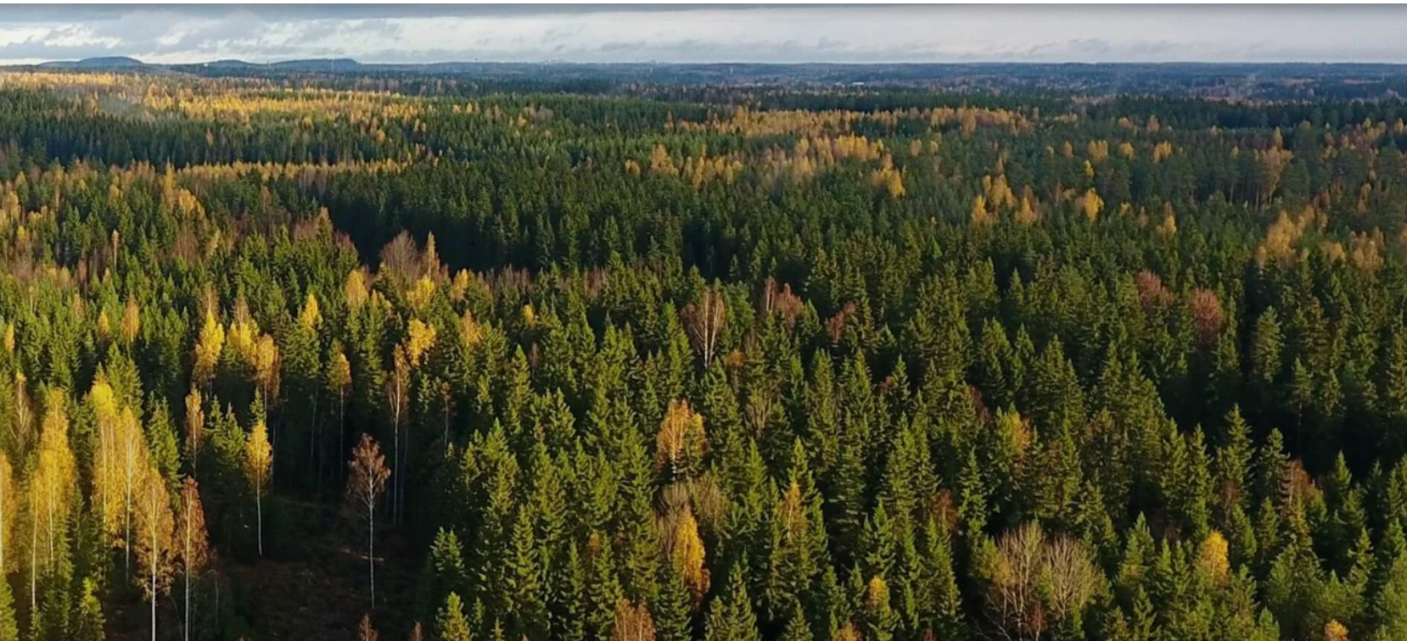
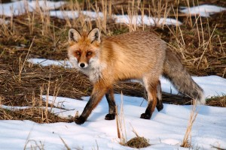
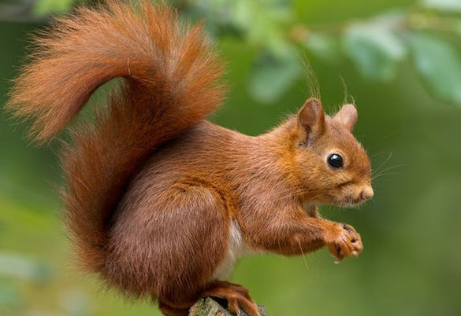
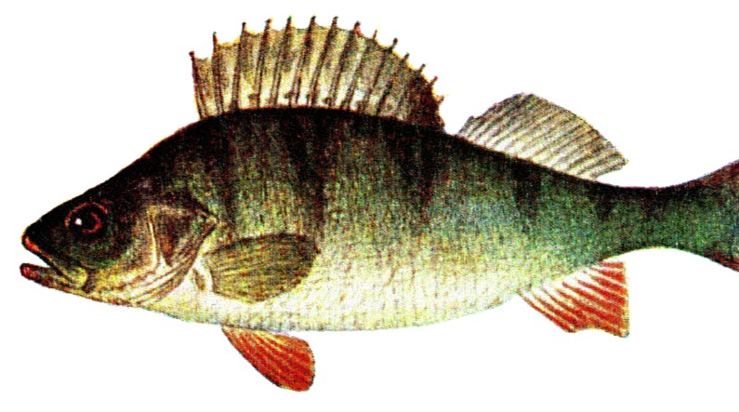
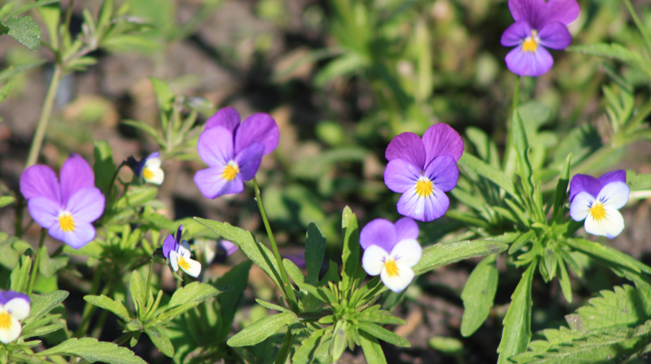
Finnish nature
Nature consist of lakes, forests and swamps. We have over 180 000 lakes.

Slide 5
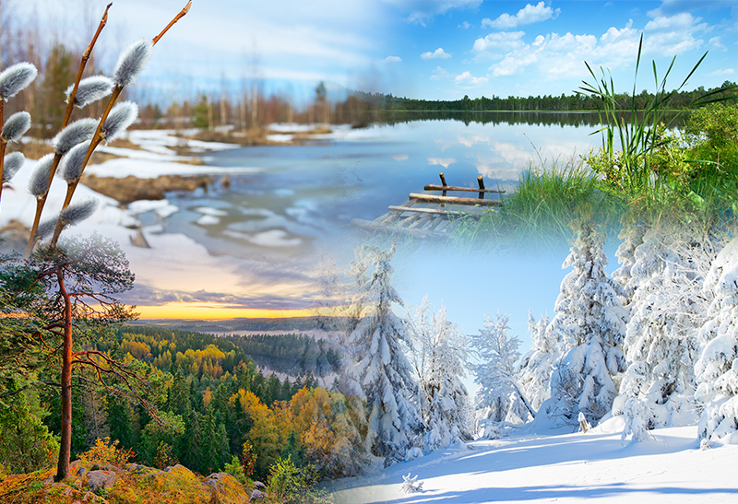
Four seasons:
  Winter
  Autumn
  Summer
  Spring.

Slide 6
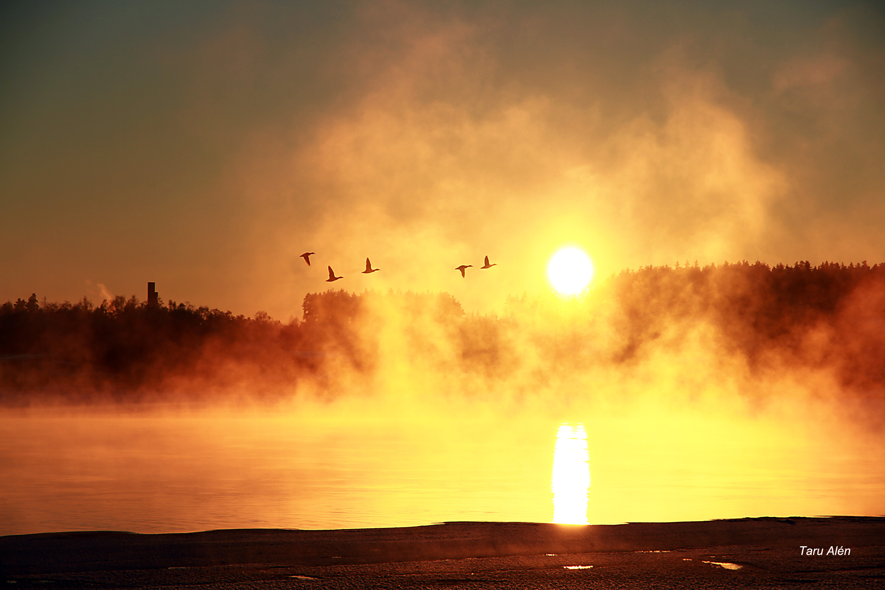
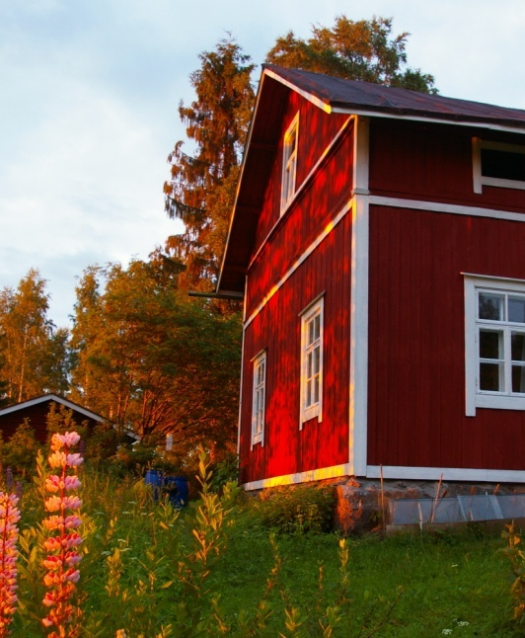
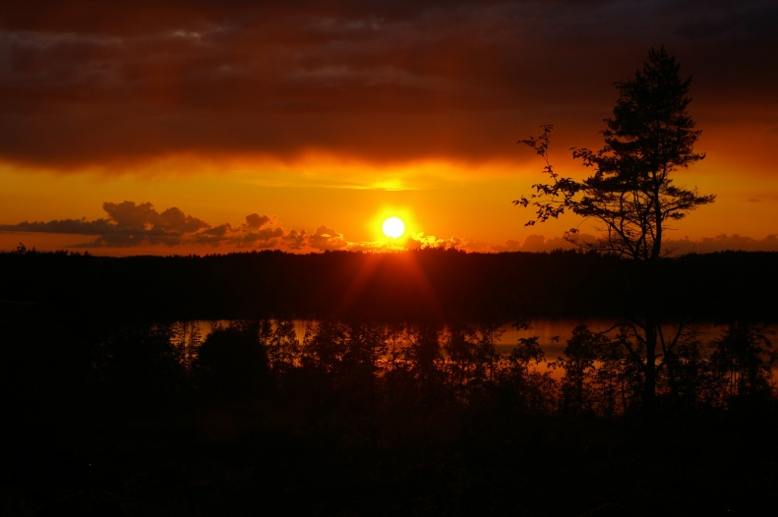
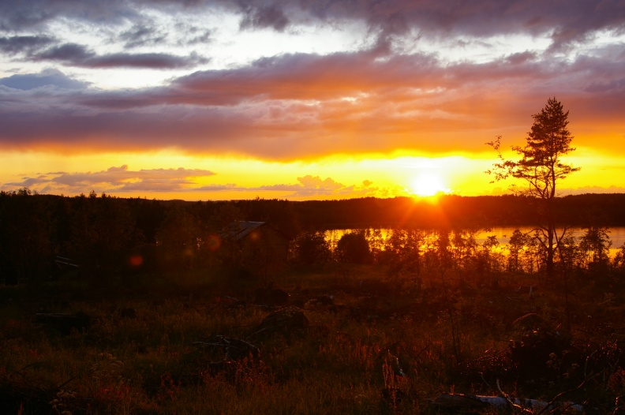
Midnight sun
This photo is taken at night (11.30 PM)
The sun remains visible troughout the night.
Only seen in polar circles.
It's because of the inclination of the Earth's axis.

Slide 7
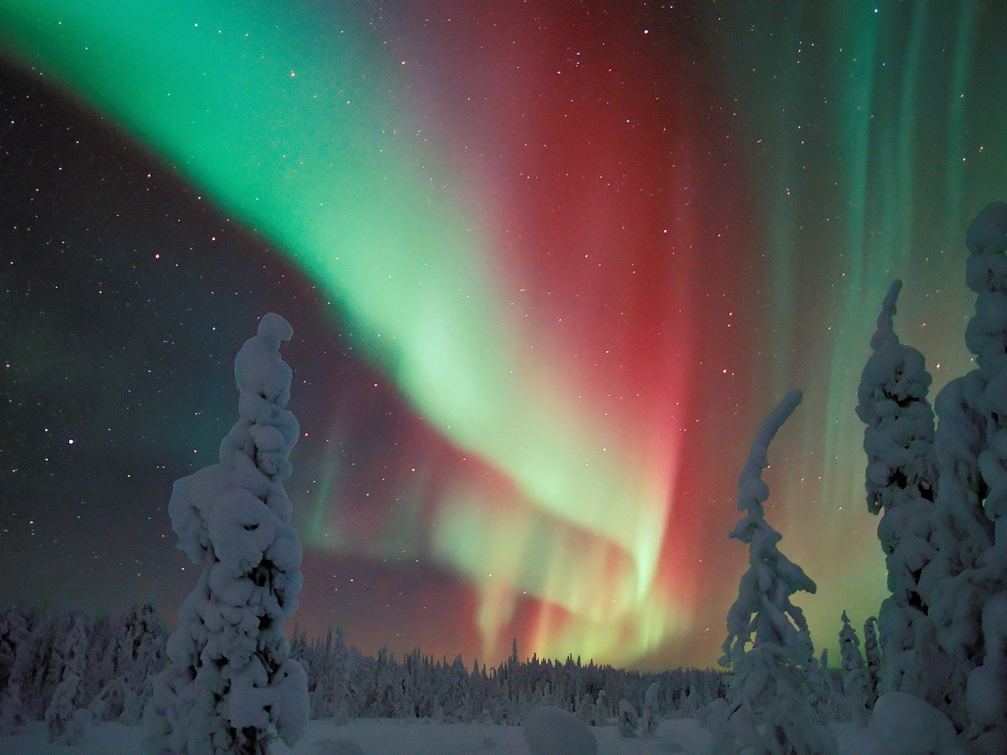
Northern Lights
A natural light display in the Earth's sky.
Mostly seen near the poles.
Happens when the solar winds touch Earth's atmosphere.

Slide 8








Finnish companies

Slide 9
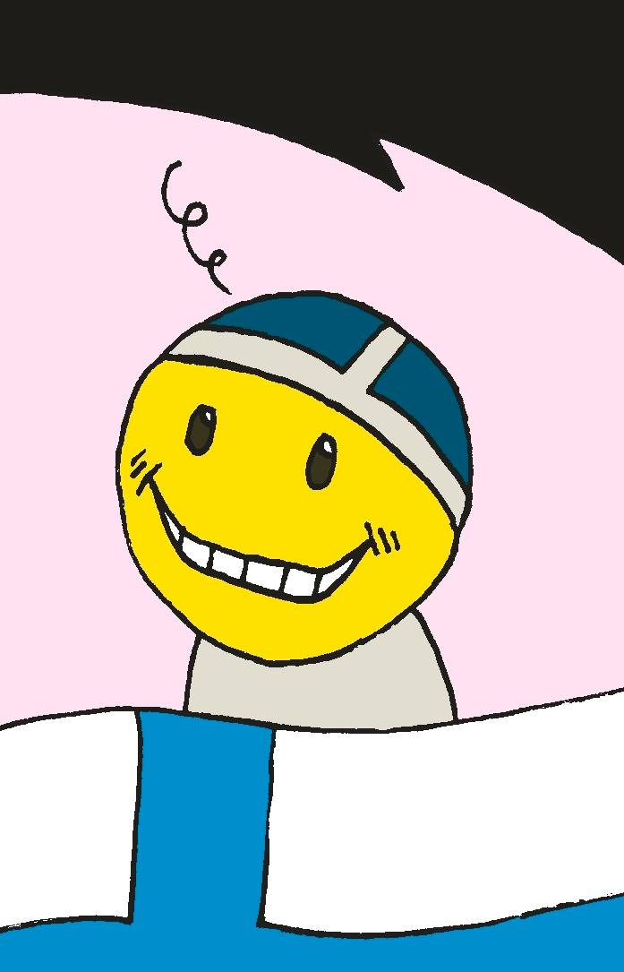
For the seventh year in a row, Finland was chosen as the happiest country in the world (year 2024)
https://www.youtube.com/watch?v=LXAI2hGVw7Y

Slide 10
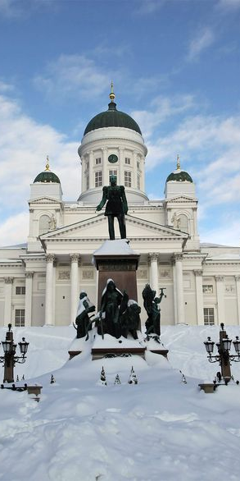
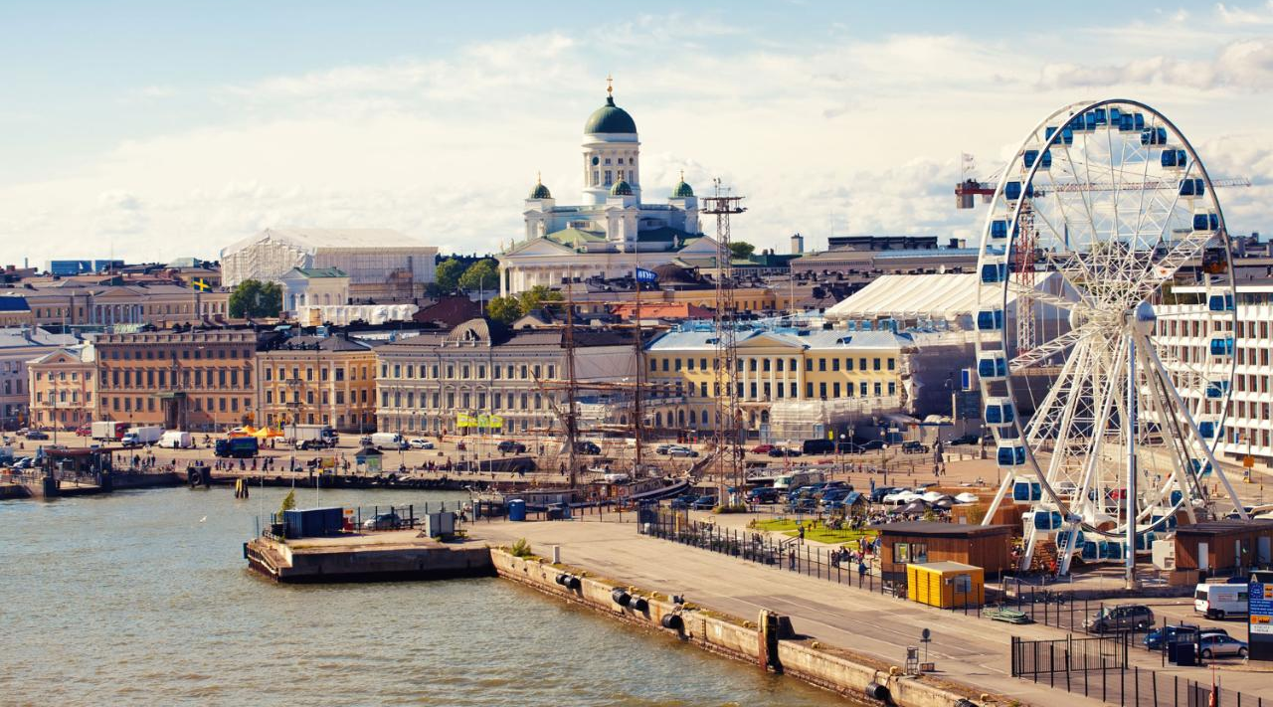
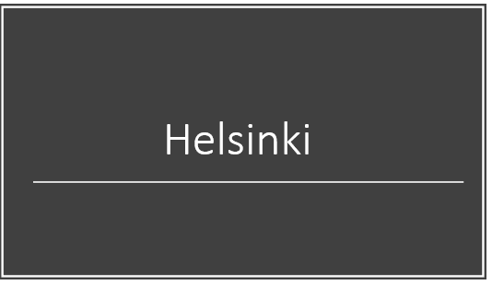
Helsinki
https://www.youtube.com/watch?v=mPs_lCNRNDU (8 min.)

Slide 11
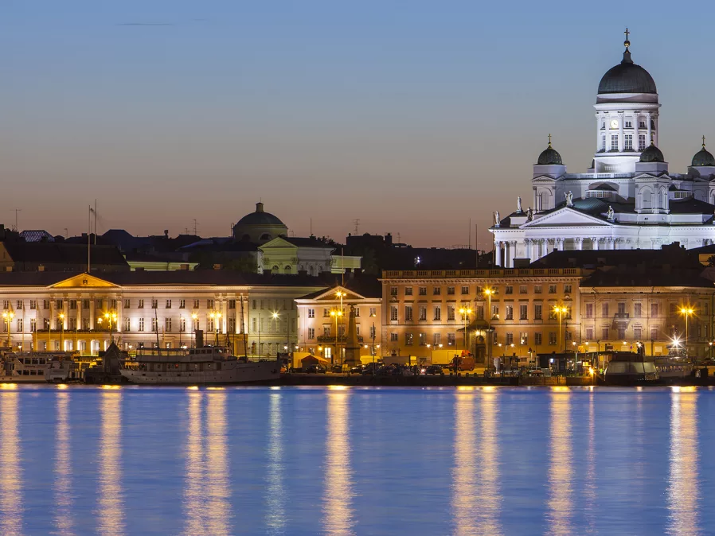
Helsinki
Helsinki is the capital city and the most popular city in Finland.
In Helsinki the population is
657 000 but in the wider
Helsinki region the population
is 1 200 000.
It's the country's most important center for politics, education, finance, culture and research.

Slide 12
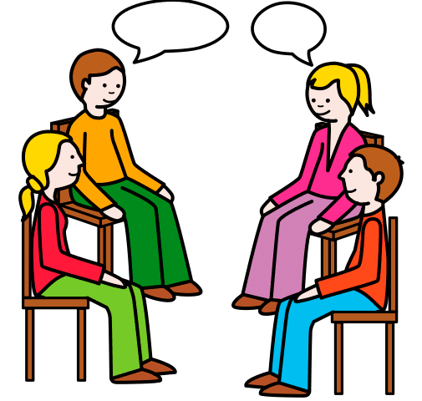
Finnish
Finnish compared to other languages - by Gurra - YouTube

