Slide 1
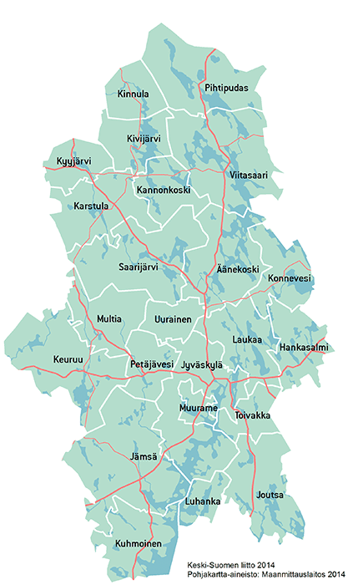
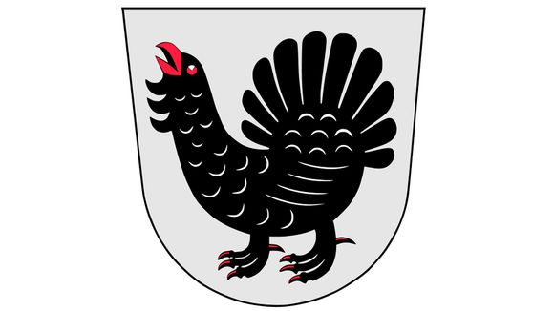
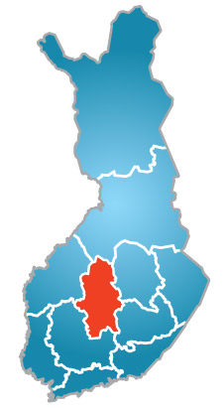
Central Finland
Central Finland has 23 localities.
Population: 276 000 (2019).
The nature here is
beautiful and there are
lots of
beautiful lakes,
swamps
and forests.

Slide 2
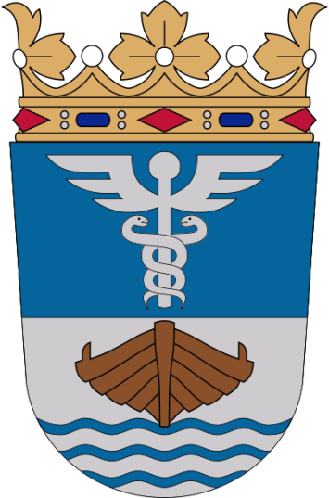
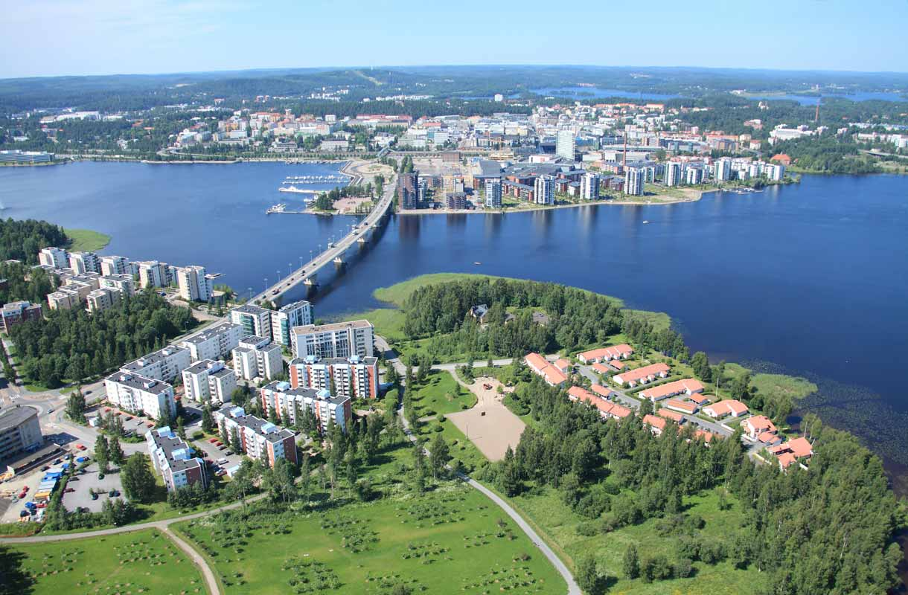
Jyväskylä - the largest
city in Central Finland
Jyväskylä is the 7th biggest city in Finland.
Population: about 148 000 (2023)
Founded at 1837
Lots of people go to work in Jyväskylä from other towns around it.
Alvar Aalto has designed
lots of buildings in
Jyväskylä, for example
a university.

Slide 3
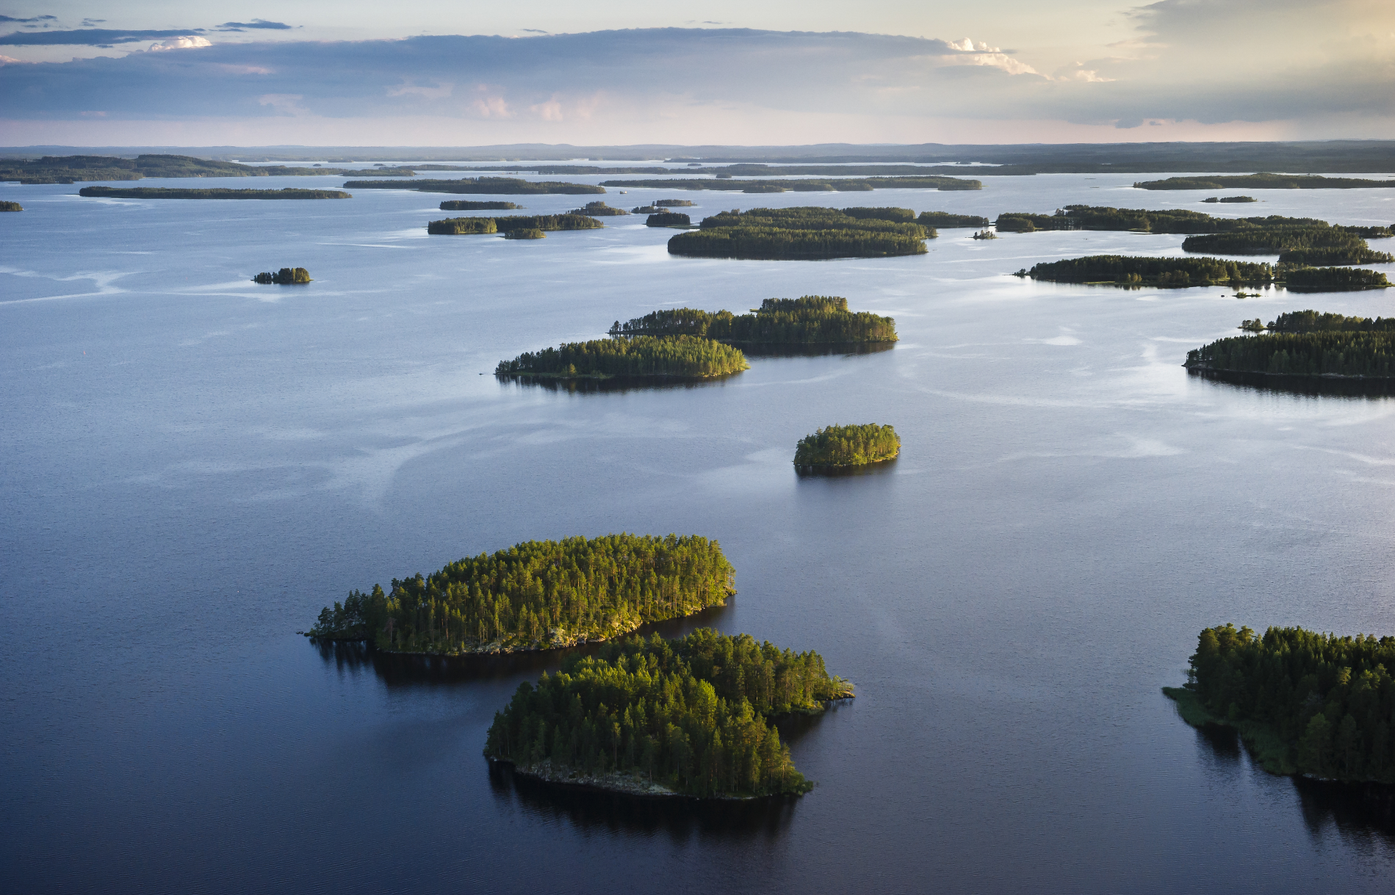
https://visitjyvaskyla.fi/?gad_source=1&gclid=EAIaIQobChMIwOmAgvf6hAMVhUd_AB1KvAEEEAAYASAAEgJJZvD_BwE (Jyväskylä region past 12 months)

Slide 4
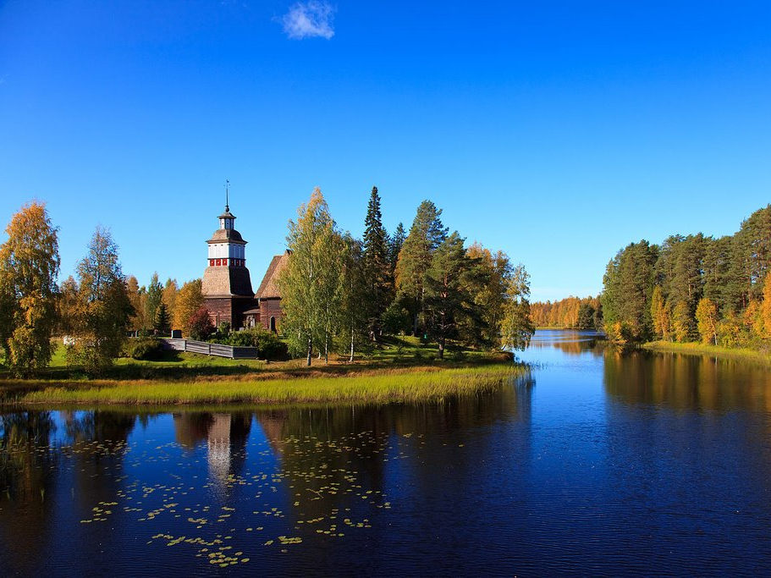
Petäjävesi

Slide 5
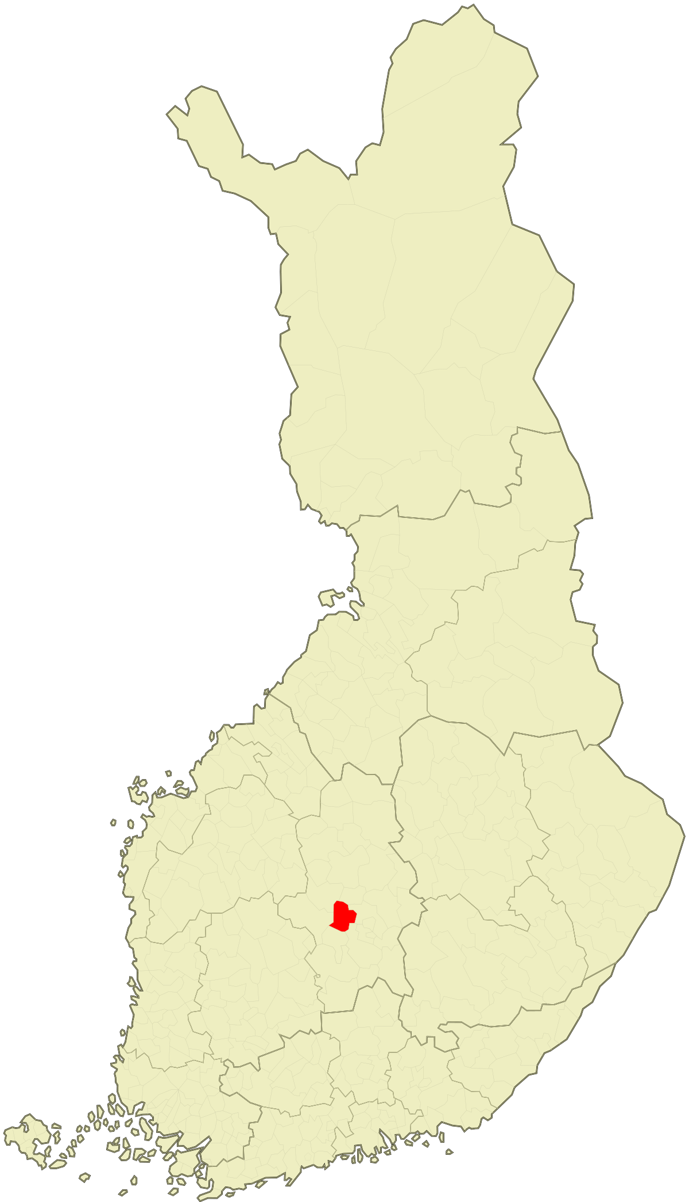
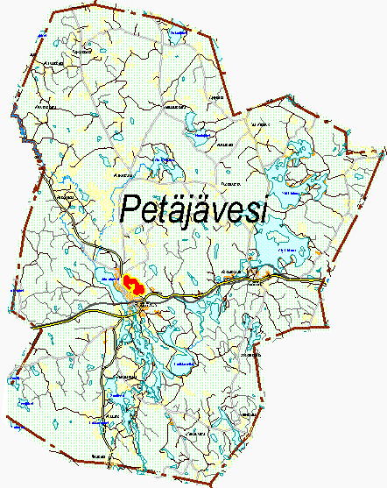
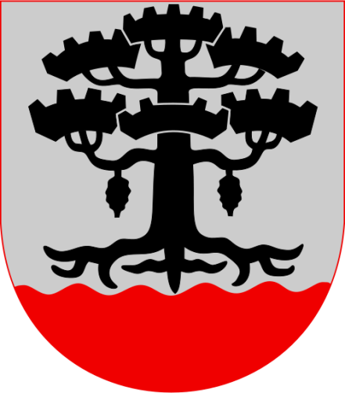
The location of Petäjävesi

Slide 6
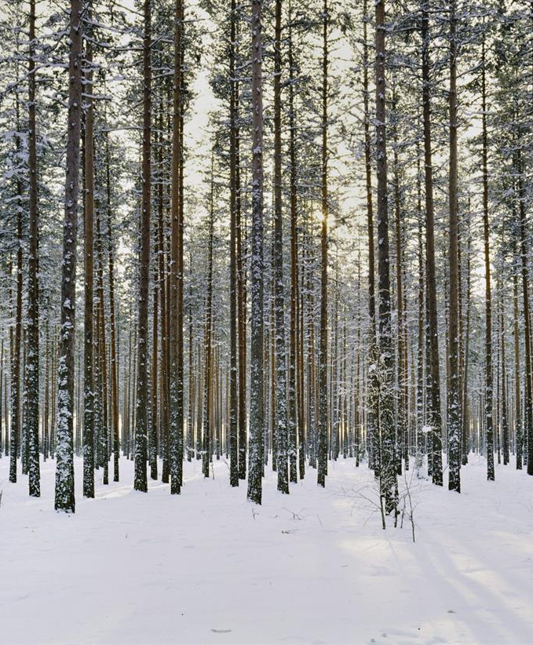
Petäjävesi
in brief
About 3 800 inhabitants (2020).
There are almost 100 lakes.
petäjä= old pine
vesi = water –> lake

Slide 7
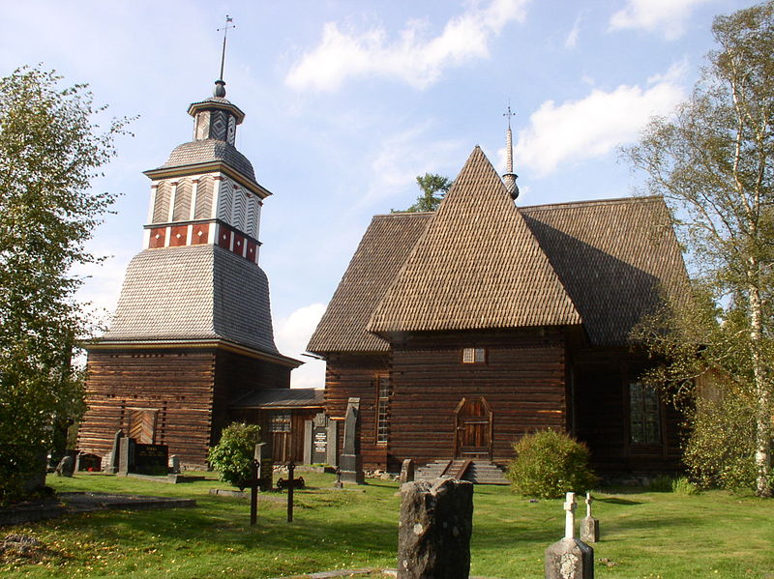
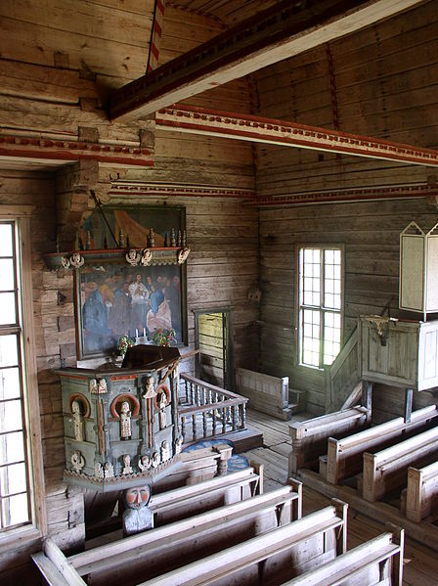
Old church
Jaakko Klementinpoika Leppänen builded wooden church in 1763-1765.
It has been chosen to be a UNESCO’s world heritage site in 1972.
It was chosen because it is a rare wooden church and representing it's own era.

Slide 8
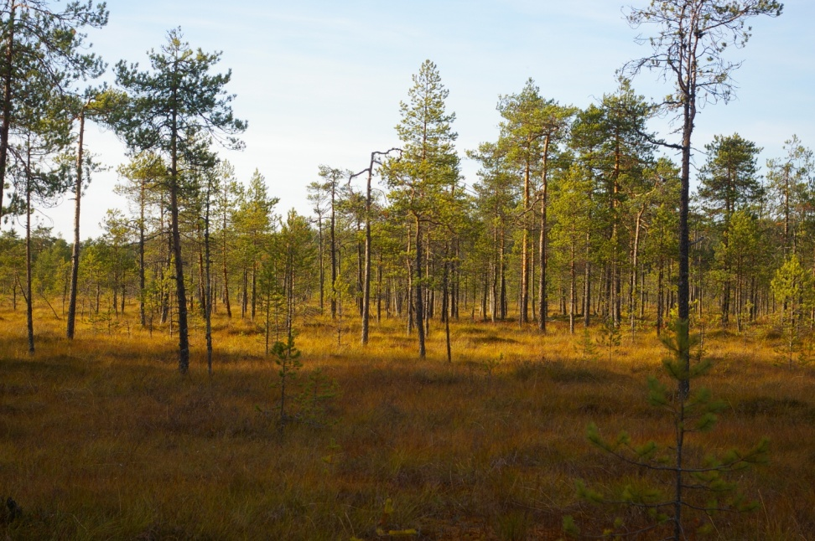
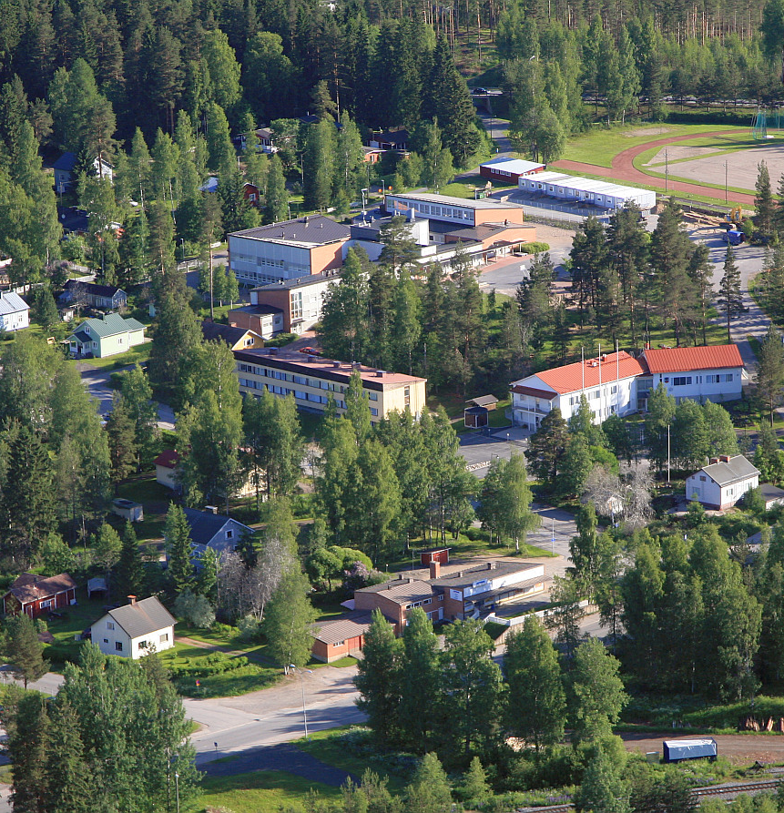
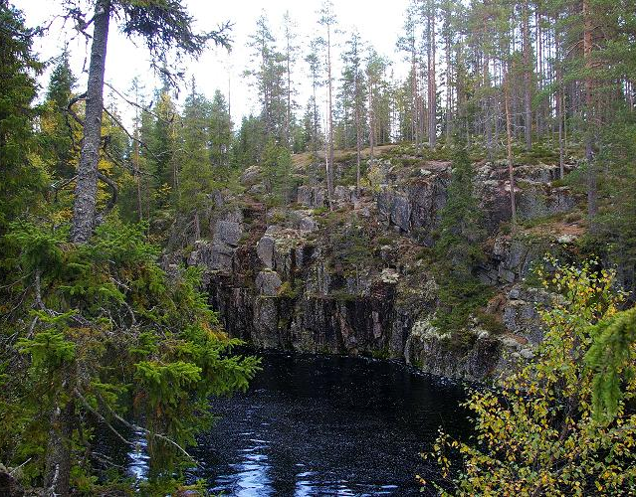
Some places in Petäjävesi
2.
1.
3.
1. Tampin kierros, a nature trail in a swamp.
2. An aerial photo from Petäjävesi.
3. Karhunahas, a lake in a ravine.

Slide 9
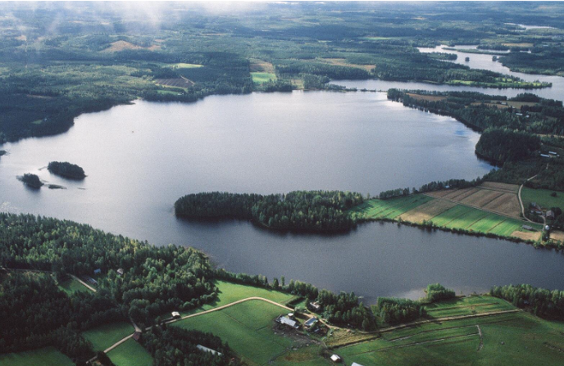
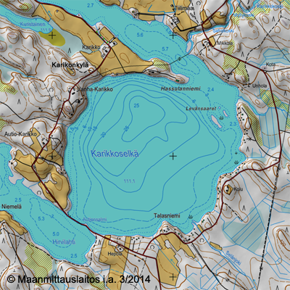
Petäjävesi Karikkoselkä is a pool made by a meteorite. ”The meteorite lake” was created approximately 70 million years ago.
1.

Slide 10

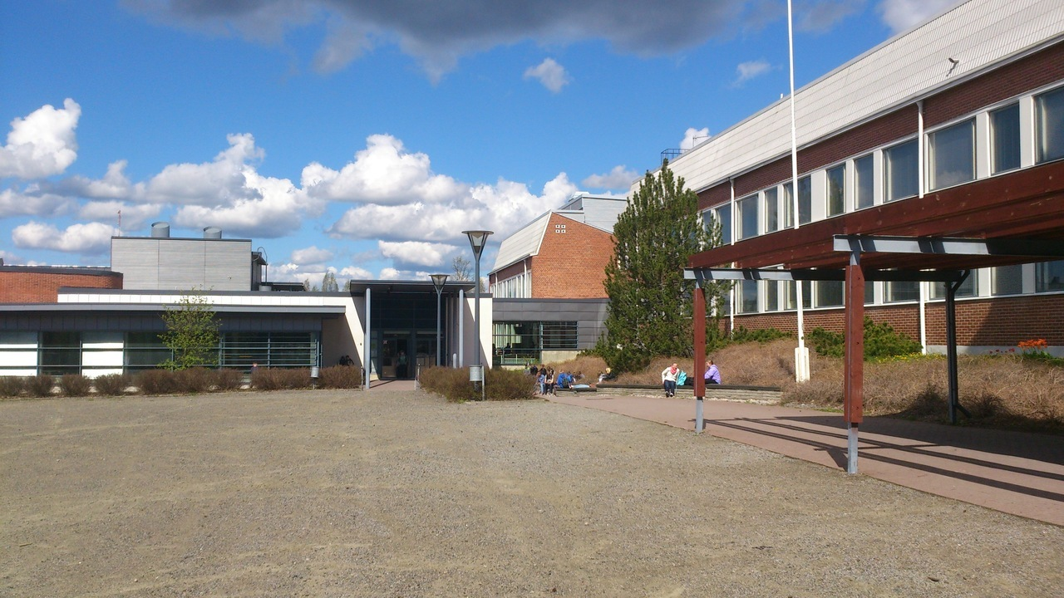
Our school, Petäjäveden yläaste
Our school has 160 students and there is a high school with 60 students in the same building.
Our school is quite small.
We have really good food here. Some of the best school foods in Finland.
There is always three classes of the same grade: a, b & c.

Slide 11
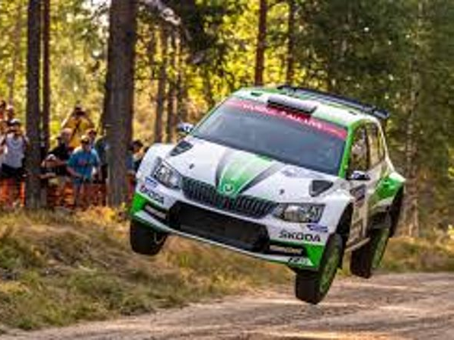
Secto Rally
Secto Rally is a tradition in Finland. The rally is being driven in Jyväskylä and also in Petäjävesi.
The name of the rally was earlier Neste Rally, and before it Thousand Lakes Rally.
It's always a very big event that has participants and spectators coming from all over the world to watch it.
Finns are rally people, most of us like to watch it.

Slide 12
The end

Slide 13
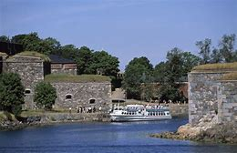
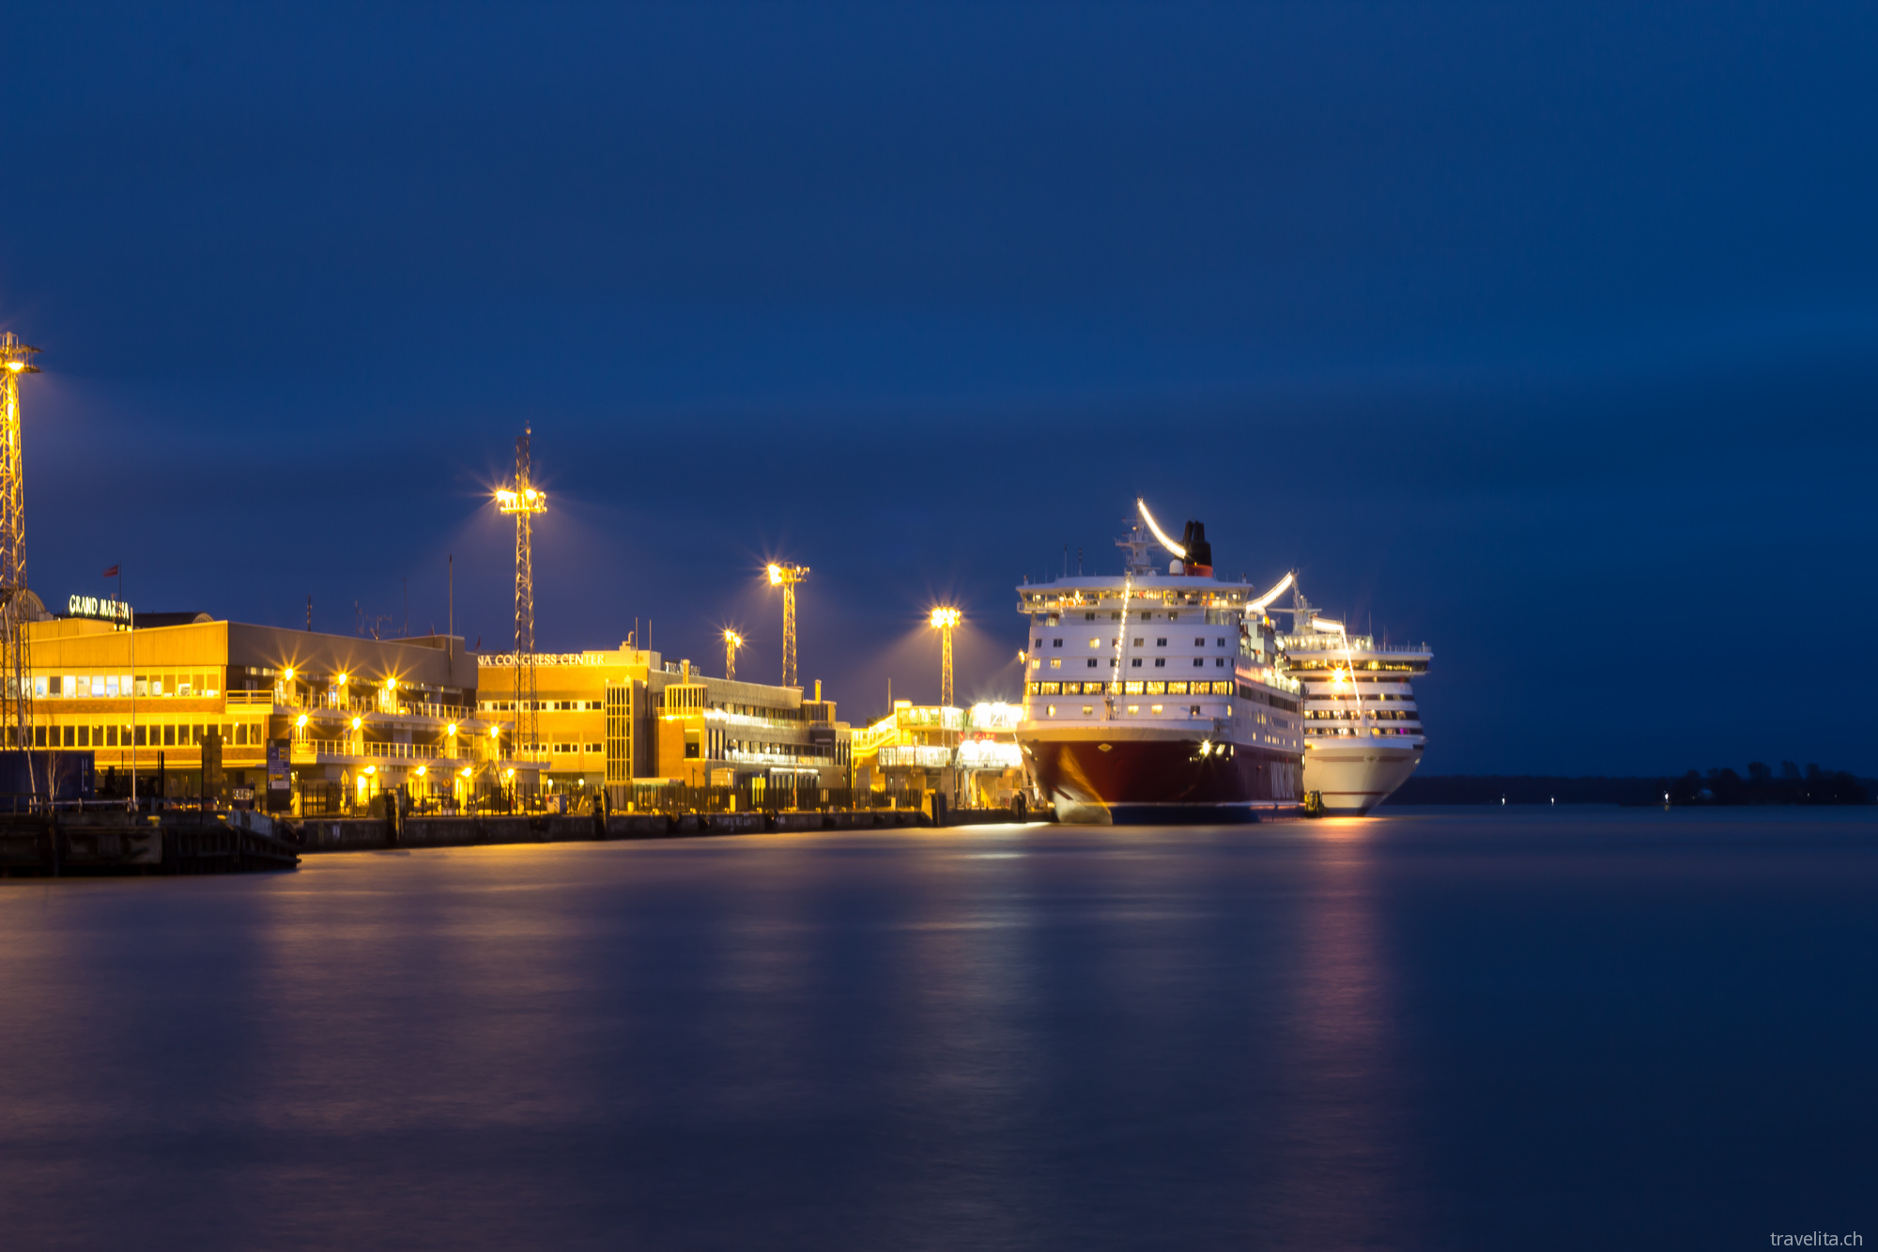
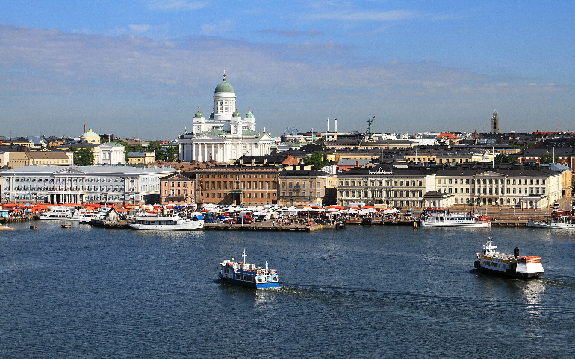
Suomenlinna world heritage site
Helsinki harbor

Slide 14
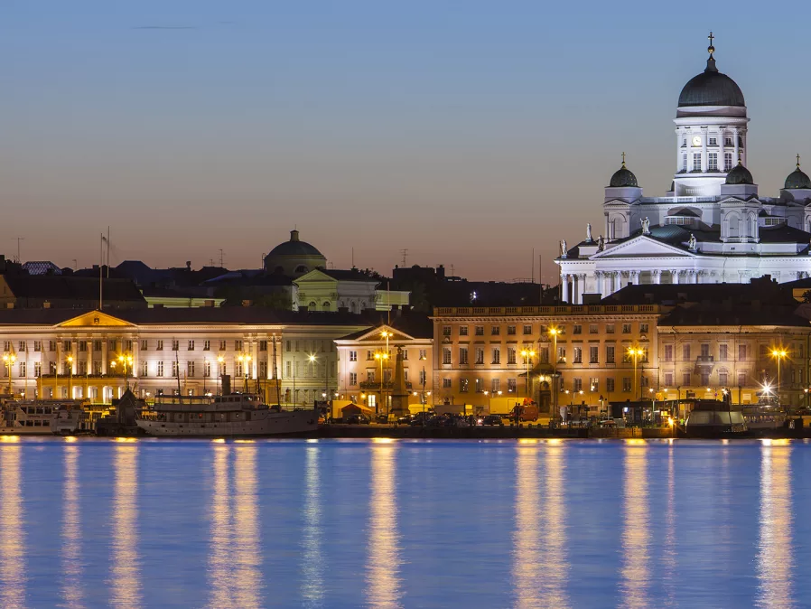
Helsinki
Helsinki is the capital city and most populous city of Finland.
Helsinki city centre's population is 645 482 but in the wider Helsinki region's population is 1 456 619.
It's the country's most important center for politics, education, finance, culture and research.
Helsinki's mayor is Jussi Pajunen

Slide 15
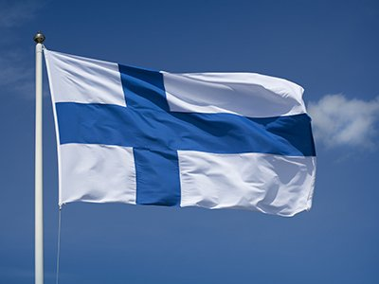
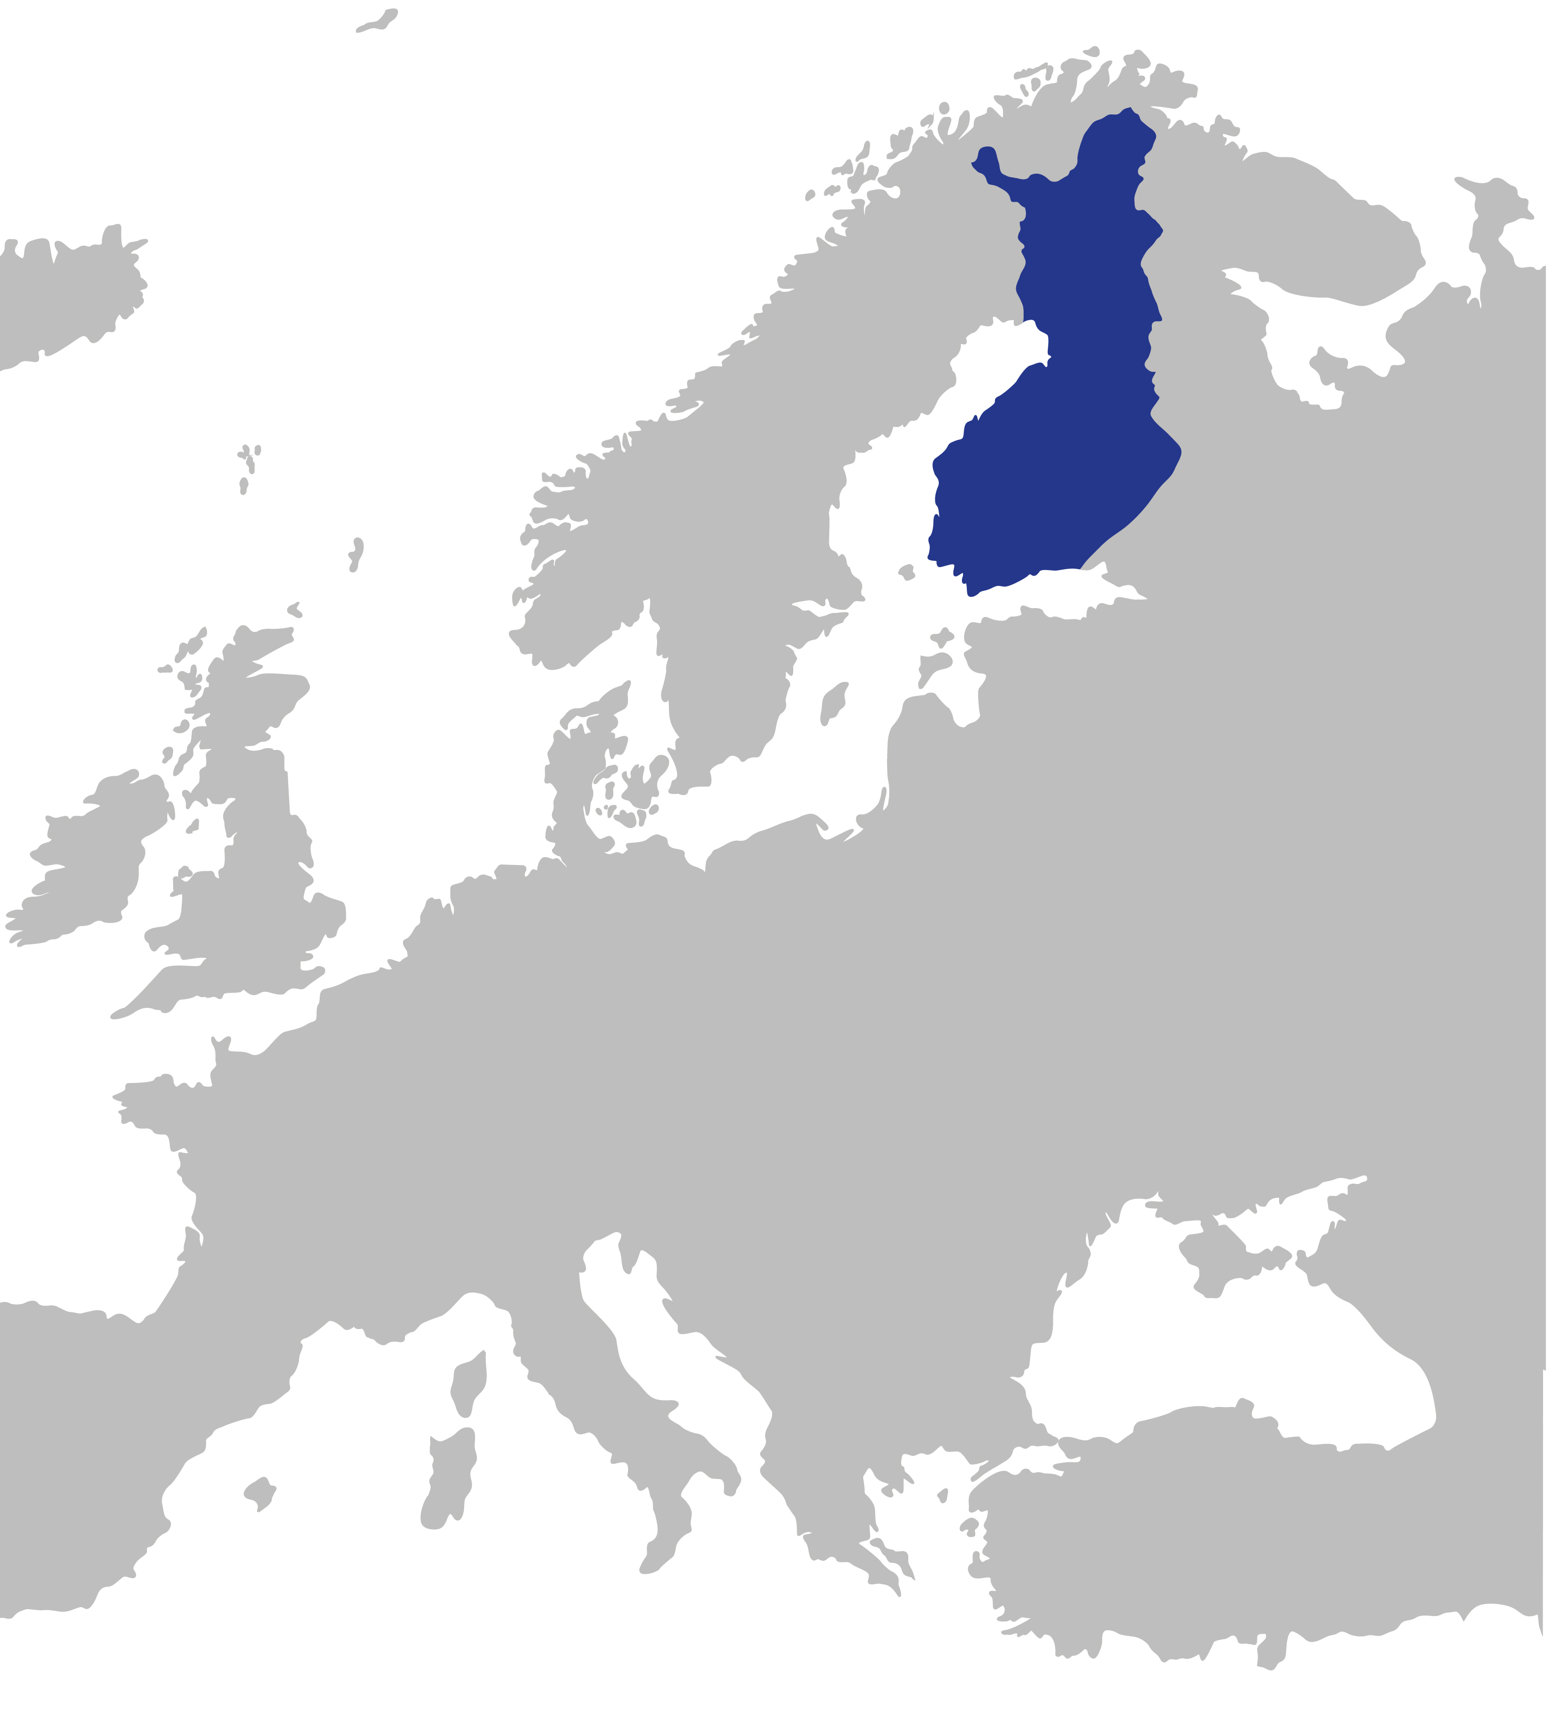
Information
Finland is located in northern Europe.
Neighbouring states: Russia, Norway and Sweden
Belongs to Nordic countries and to EU
Population: 5,5 million
Capital city: Helsinki

Slide 16
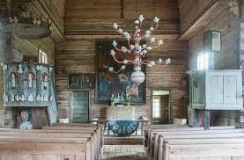
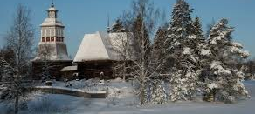
Old church
Jaakko Klementinpoika Leppänen builded Wooden church in 1763-1765.
It's been chosen to be a UNESCO'S world heritage site. It has been a UNESCO'S world heritage site since 1972
It was chosen because it is a rare wooden church and representing its own era.

Slide 17
Some places in Petäjävesi
1.
1. Tampin kierros, a nature trail in a swamp
2. An Aerial picture on Petäjävesi.
3. Karhunahas, a lake in a ravine.

